Slide 1
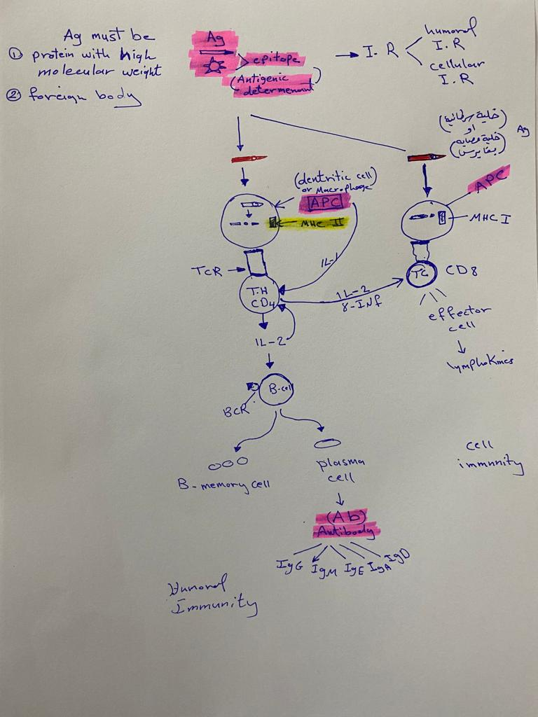

Slide 2
Stoppage of bleeding is called
a-hemostasis.
b-vascular spasm.
c-thrombosis.
d-coagulation.

Slide 3
Which of the following would lead to increased erythropoiesis?
A) increased environmental O2 levels
B) increased erythropoietin levels
C) increased blood pH
D) increased blood pressure
E) increased CO2 levels

Slide 4
Which of the following events is one of the three main stages of coagulation
A) conversion of fibrinogen to fibrin
B) platelet aggregation
E) calcium is released

Slide 5
WBCs which release heparin and histamine.
(a) Basophils
(b) Neutrophils
(c) Monocytes
(d) Eosinophils

Slide 6
WBCs which are the most active phagocytic cells
(a) lymphocytes and macrophages
(b) neutrophils and eosinophils
(c) neutrophils and monocytes
(d) eosinophils and lymphocytes

Slide 7
Which of the following cell types secrete interleukins to coordinate the immune system?
A. Cytotoxic T-lymphocytes
B. Memory B- lymphocytes
C. Basophils
D. Eosinophils
E. Helper T-lymphocytes

Slide 8
A person with type B blood
A) has antigen A.
B) has antibody a.
C) will have a transfusion reaction if given type B blood.
D) has antibody b.
E) can receive type A blood

Slide 9
Endocrinology

Slide 10
Endocrine system
All the physiological activities are regulated by two major systems in the body.
1. Nervous system
2. Endocrine system.
These two systems interact with one another and regulate the body functions. Endocrine system functions by secreting some chemical substances called hormones.

Slide 11
Endocrine glands
are the glands which synthesize and release the classical hormones into the blood. The endocrine glands are also called ductless glands because the hormones secreted by them are released directly into blood without any duct.
HORMONES
Hormones are chemical messengers, synthesized by endocrine glands.

Slide 12
Coordination of Body Functions by Chemical Messengers
The multiple activities of the cells, tissues, and organs of the body are coordinated by the interplay of several types of chemical messenger systems:
1. Neurotransmitters are released by axon terminals of neurons into the synaptic junctions and act locally to control nerve cell functions.
2. Endocrine hormones are released by glands or specialized cells into the circulating blood and influence the function of cells at another location in the body.
3. Neuroendocrine hormones are secreted by neurons into the circulating blood and influence the function of cells at another location in the body.

Slide 13
4. Paracrines are secreted by cells into the extracellular fluid and affect neighboring cells of a different type.
5. Autocrines are secreted by cells into the extracellular fluid and affect the function of the same cells that produced them by binding to cell surface receptors.
6. Cytokines are peptides secreted by cells into the extracellular fluid and can function as autocrines, paracrines, or endocrine hormones.

Slide 14
Based on chemical nature, hormones are classified into three types:
1-STEROID HORMONES
Steroid hormones are the hormones synthesized from cholesterol or its derivatives. Steroid hormones are secreted by adrenal cortex, gonads and placenta
2- PROTEIN HORMONES
Protein hormones are large or small peptides. Protein hormones are secreted by pituitary gland, parathyroid glands, pancreas and placenta
3- TYROSINE DERIVATIVES
Two types of hormones, namely thyroid hormones and adrenal medullary hormones are derived from the amino acid tyrosine.

Slide 15
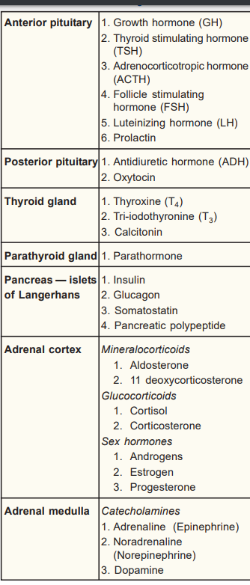
Hormones secreted by major endocrine glands

Slide 16
Polypeptide and Protein Hormones Are Stored in Secretory Vesicles Until Needed.
Most of the hormones in the body are polypeptides and proteins.
These hormones range in size from small peptides with as few as 3 amino acids (thyrotropin-releasing hormone) to proteins with almost 200 amino acids (growth hormone and prolactin).
In general, polypeptides with 100 or more amino acids are called proteins, and those with fewer than 100 amino acids are referred to as peptides.

Slide 17
Protein and peptide hormones are synthesized on the rough end of the endoplasmic reticulum of the different endocrine cells, in the same fashion as most other proteins.
They are usually synthesized first as larger proteins that are not biologically active (preprohormones) and are cleaved to form smaller prohormones in the endoplasmic reticulum.
These are then transferred to the Golgi apparatus for packaging into secretory vesicles.
In this process, enzymes in the vesicles cleave the prohormones to produce smaller, biologically active hormones and inactive fragments.

Slide 18
The vesicles are stored within the cytoplasm, and many are bound to the cell membrane until their secretion is needed.
Secretion of the hormones (as well as the inactive fragments) occurs when the secretory vesicles fuse with the cell membrane and the granular contents are extruded into the interstitial fluid or directly into the blood stream by exocytosis.

Slide 19
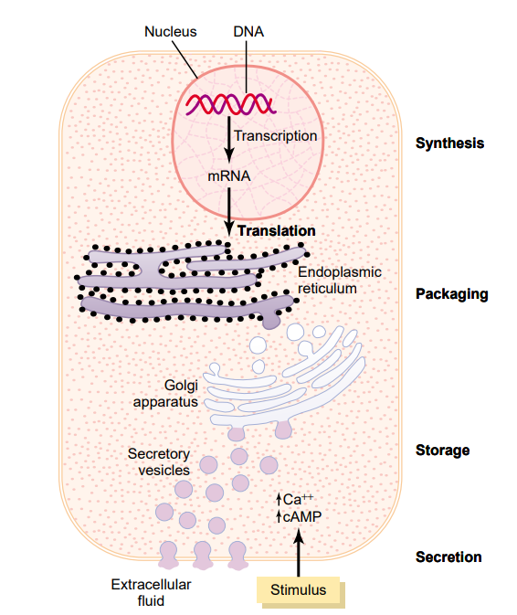
Synthesis and secretion of peptide hormones.

Slide 20

The answer is Hormones!

Slide 21
HORMONAL ACTION
Hormone does not act directly on target cells. First it combines with receptor present on the target cells and forms a hormone-receptor complex. This hormone receptor complex induces various changes or reactions in the target cells.

Slide 22
HORMONE RECEPTORS
Hormone receptors are the large proteins present in the target cells. Each cell has thousands of receptors. Important characteristic feature of the receptors is that, each receptor is specific for one single hormone, i.e. each receptor can combine with only one hormone. Thus, a hormone can act on a target cell, only if the target cell has the receptor for that particular hormone

Slide 23
Situation of the Hormone Receptors
Hormone receptors are situated either in cell membrane or cytoplasm or nucleus of the target cells as follows:
Cell membrane: Receptors of protein hormones and adrenal medullary hormones (catecholamines) are situated in the cell membrane .
2.Cytoplasm: Receptors of steroid hormones are situated in the cytoplasm of target cells.
3. Nucleus: Receptors of thyroid hormones are in the nucleus of the cell.

Slide 24
Situation of hormonal receptors

Slide 25
Regulation of Hormone Receptors
Receptor proteins are not static components of the cell. Their number increases or decreases in various conditions. Generally, when a hormone is secreted in excess, the number of receptors of that hormone decreases due to binding of hormone with receptors. This process is called down regulation. During the deficiency of the hormone, the number of receptor increases, which is called upregulation

Slide 26
MECHANISM OF HORMONAL ACTION
On the target cell, the hormone–receptor complex acts by any one of the following mechanisms:
1. By Altering the Permeability of Cell Membrane
The neurotransmitter substances in a synapse or neuromuscular junction act by changing the permeability of postsynaptic membrane. For example, in a neuromuscular junction, when an impulse (action potential) reaches the axon terminal of the motor nerve, acetylcholine is released from the vesicles. Acetylcholine increases permeability of postsynaptic membrane by opening the ligand gated sodium channels. So, sodium ions enter the neuromuscular junction from ECF through the channels. Sodium ions alter the resting membrane potential so that, endplate potential is developed.

Slide 27
2. By Activating the Intracellular Enzyme
The protein hormones and the catecholamines act by activating the intracellular enzymes. The hormone, which acts on a target cell, is called first messenger or chemical mediator. This hormone, in combination with the receptor forms hormone-receptor complex. This in turn activates the enzymes of the cell and causes the formation of another substance called the second messenger.

Slide 28
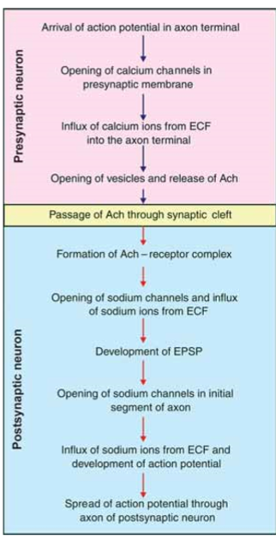
Sequence of events during synaptic transmission. Ach = Acetylcholine. ECF = Extracellular fluid. EPSP = Excitatory postsynaptic potential

Slide 29
Mode of action of steroid hormones. Thyroid hormones also act in the similar way. But their receptors are in the nucleus.HR= Hormone-receptor
complex
Mode of action of protein hormones and catecholamines. H = Hormone, R = Receptor

Slide 30
The second messenger produces the effects of the hormone inside the cells. The most common second messenger is adenosine monophosphate (cyclic AMP or cAMP).
Sequence of events in the activation of second messenger:
i. The hormone binds with the receptor in the cell membrane and forms the hormone-receptor complex which activates the enzyme adenyl cyclase
ii. Adenyl cyclase converts the ATP of the cytoplasm into cAMP. Cyclic AMP executes the actions of hormone inside the cell, by stimulating the enzymes like protein kinase A

Slide 31
3. By Acting on Genes
Thyroid and steroid hormones act by activating the genes of the target cells.
Sequence of events during activation of genes:
i. The hormone enters the interior of the cell and binds with receptor in cytoplasm (steroid hormone) or in nucleus (thyroid hormone) and forms hormone-receptor.
ii. This complex binds to DNA and increases transcription of mRNA
iii. The mRNA moves out of nucleus and reaches ribosomes and activates them.
iv. The activated ribosomes produce large quantities of proteins which produce the physiological responses in the target cells.

Slide 32
Onset of Hormone Secretion After a Stimulus, and Duration of Action of Different Hormones.
Some hormones, such as norepinephrine and epinephrine, are secreted within seconds after the gland is stimulated, and they may develop full action within another few seconds to minutes; the actions of other hormones, such as thyroxine or growth hormone, may require months for full effect.
Thus, each of the different hormones has its own characteristic onset and duration of action—each tailored to perform its specific control function.

Slide 33
Concentrations of Hormones in the Circulating Blood, and Hormonal Secretion Rates.
The concentrations of hormones required to control most metabolic and endocrine functions are incredibly small. Their concentrations in the blood range from as little as 1 picogram (which is one millionth of one millionth of a gram) in each milliliter of blood up to at most a few micrograms (a few millionths of a gram) per milliliter of blood. Similarly, the rates of secretion of the various hormones are extremely small, usually measured in micrograms or milligrams per day.

Slide 34
Measurement of Hormone Concentrations in the Blood
Most hormones are present in the blood in extremely minute quantities; some concentrations are as low as one billionth of a milligram (1 picogram) per milliliter. Therefore, it was very difficult to measure these concentrations by the usual chemical means. An extremely sensitive method, however, was developed about 40 years ago that revolutionized the measurement of hormones, their precursors, and their metabolic end products. This method is called radioimmunoassay.

Slide 35
Feedback Control of Hormone Secretion Negative Feedback Prevents Overactivity of Hormone Systems.
Although the plasma concentrations of many hormones fluctuate in response to various stimuli that occur throughout the day, all hormones studied thus far appear to be closely controlled.
In most instances, this control is exerted through negative feedback mechanisms that ensure a proper level of hormone activity at the target tissue. After a stimulus causes release of the hormone, conditions or products resulting from the action of the hormone tend to suppress its further release.

Slide 36
Surges of Hormones Can Occur with Positive Feedback.
In a few instances, positive feedback occurs when the biological action of the hormone causes additional secretion of the hormone. One example of this is the surge of luteinizing hormone (LH) that occurs as a result of the stimulatory effect of estrogen on the anterior pituitary before ovulation.
The secreted LH then acts on the ovaries to stimulate additional secretion of estrogen, which in turn causes more secretion of LH. Eventually, LH reaches an appropriate concentration, and typical negative feedback control of hormone secretion is then exerted. Cyclical Variations Occur in Hormone Release.

Slide 37
The pituitary gland
The pituitary gland is also known as hypophysis. It is a small gland that lies at the base of the brain. It is connected with the hypothalamus by the pituitary stalk or hypophyseal stalk.

Slide 38
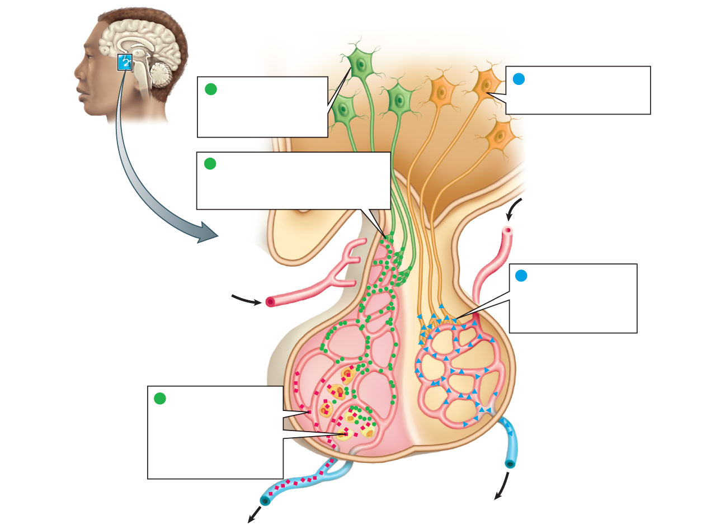
hypothalamus
Neurosecretory cells of
the hypothalamus produce
oxytocin and ADH
Neurosecretory cells
of the hypothalamus
produce releasing and
inhibiting hormones
1
1
Releasing or inhibiting hormones
(green circles) are secreted into
capillaries feeding the anterior lobe
of the pituitary
2
2
Oxytocin and ADH
(blue triangles) are
secreted into the blood
via capillaries in the
posterior pituitary
blood flow
pituitary
(anterior lobe)
endocrine
cell
capillary
bed
pituitary
(posterior lobe)
Endocrine cells of the
anterior pituitary secrete
hormones (red squares)
in response to releasing
hormones; the pituitary
hormones enter the
bloodstream
3
capillary
bed
blood
flow

Slide 39
HORMONES SECRETED BY ANTERIOR PITUITARY
Anterior pituitary is also known as the master gland because it regulates many other endocrine glands. Six hormones are secreted by the anterior pituitary:
1. Growth hormone (GH) or somatotropic hormone (STH)
2. Thyroid stimulating hormone (TSH) or thyrotropic hormone
3. Adrenocorticotropic hormone (ACTH)
4. Follicle stimulating hormone (FSH)
5. Luteinizing hormone (LH in females) or interstitial cell stimulating hormone (ICSH in males)
6. Prolactin.
FSH and LH are together called gonadotropic hormones or gonadotropins because of their action on the gonads. Recently, the hormone β-lipotropin is found to be secreted by anterior pituitary.

Slide 40
Releasing and Inhibitory Hormones Secreted by Hypothalamus
1. Growth hormone releasing hormone (GHRH)— stimulates the release of GH.
2.Growth hormone releasing polypeptide (GHRP) — stimulates the release of GHRH and GH.
3.Growth hormone inhibitory hormone (GHIH) or somatostatin — inhibits GH release.
4.Thyrotropic releasing hormone (TRH) —stimulates the release of TSH
5.Corticotropin releasing hormone (CRH) —stimulates the release of ACTH.
6.Gonadotropin releasing hormone (GnRH) —the release of the gonadotropins — FSH and LH.
7. Prolactin inhibitory hormone (PIH) — inhibits prolactin secretion.

Slide 41
GROTH HORMON
GH is responsible for the growth of almost all tissues of the body, which are capable of growing.
It actually increases the size and number of cells by increasing the mitotic division.
GH also causes specific differentiation of certain types of cells like bone cells and muscle cells.
GH also acts on the metabolism of all the three major types of foodstuffs in the body, viz. proteins, lipids and carbohydrates.

Slide 42
Regulation of GH Secretion
Secretion of GH is regulated by hypothalamus and feedback control. Role of hypothalamus in the secretion of GH Hypothalamus regulates GH secretion by releasing three hormones:
1.GHRH that increases the secretion of GH by stimulating the somatotropes of anterior pituitary.
2. GHRP that promotes the release of GHRH from hypothalamus and GH from pituitary
3. GHIH or somatostatin which inhibits the secretion of GH.
These three hormones are transported from hypothalamus to anterior pituitary by hypothalamo-hypophyseal portal blood vessels.
Hypothalamus is in turn influenced by many factors which cause increase or decrease in GH secretion

Slide 43
Feedback control
GH secretion is under negative feedback control Hypothalamus releases GHRH and GHRP, which in turn promote the release of GH from anterior pituitary. GH acts on various tissues. It also activates the liver cells to secrete somatomedin-C (IGF-I).
Now, the somatomedin-C increases the release of GHIH from hypothalamus. GHIH in turn inhibits release of GH from pituitary. Somatomedin also inhibits the release of GHRP from hypothalamus. It acts on pituitary directly and inhibits the secretion of GH.

Slide 44
Regulation of GH secretion

Slide 45
HORMONES OF POSTERIOR PITUITARY
Posterior pituitary hormones are:
1. Antidiuretic hormone (ADH) or vasopressin
2. Oxytocin.
Actually, the posterior pituitary does not secrete any hormone. ADH and oxytocin are synthesized in the hypothalamus. Hence, these two hormones are called neurohormones.

Slide 46
ANTIDIURETIC HORMONE
ADH is secreted mainly by supraoptic nucleus of hypothalamus and in small quantity by paraventricular nucleus. From here, this hormone is transported to the posterior pituitary through the nerve fibers of hypothalamo-hypophyseal tract by means of axonic flow Antidiuretic hormone is a polypeptide
The major function of ADH is retention of water by acting on kidneys. It increases the facultative reabsorption of water from distal convoluted tubule and collecting duct in the kidneys ADH increases water reabsorption in the tubular epithelial membrane by regulating the water channel proteins called aquaporins through V2 receptors.

Slide 47
In large amount, the ADH shows vasoconstrictor action in all parts of the body. Due to the vasoconstriction, the blood pressure increases. ADH acts on blood vessels through V1A receptors.
Regulation of Secretion
The secretion of ADH depends upon the volume of body fluid and the osmolarity of the body
fluids.
The potent stimulants for ADH secretion are:
1. Decrease in the ECF volume
2. Increase in osmolar concentration in the ECF

Slide 48
Role of osmoreceptors
The osmoreceptors are the receptors, which give response to change in the osmolar concentration of the blood. These receptors are situated in the hypothalamus near supraoptic and paraventricular nuclei. When osmolar concentration of blood increases, the osmoreceptors are activated.
In turn, the osmoreceptors stimulate the supraoptic and paraventricular nuclei which send motor impulses to posterior pituitary through the nerve fibers and cause release of ADH.
ADH causes reabsorption of water from the renal tubules. This increases the volume of the ECF and restores the normal osmolarity.

Slide 49
Oxytocin
Oxytocin is secreted mainly by the paraventricular nucleus and a small quantity is secreted by the supraoptic nucleus in the hypothalamus. And it is transported from hypothalamus to posterior pituitary through the nerve fibers of hypothalamo-hypophyseal tract.
In the posterior pituitary, the oxytocin is stored in the nerve endings of hypothalamohypo-physeal tract. When suitable stimuli reach the posterior pituitary from hypothalamus, oxytocin is released into the blood. Oxytocin is secreted in both males and females. Oxytocin is a polypeptide, having 9 amino acids.

Slide 50
Action of oxytocin on mammary glands
It causes ejection of milk from the mammary glands.
The ducts of the mammary glands are lined by myoepithelial cells. Oxytocin causes contraction of the myoepithelial cells and squeezes the milk from alveoli of the mammary glands to the exterior through the duct system and nipple.
The process by which the milk is ejected from the alveoli of mammary glands is called the milk ejection reflex or milk let down reflex. It is one of the neuroendocrine reflexes.

Slide 51
Milk ejection reflex Plenty of touch receptors are present on the mammary glands, particularly around the nipple. When the infant suckles mother’s nipple, the touch receptors are stimulated and impulses are discharged.
Impulses from here are carried by the somatic afferent nerve fibers and reach the paraventricular and supraoptic nuclei of hypothalamus.

Slide 52
Now, hypothalamus in turn, sends impulses to the posterior pituitary through hypothalamohypophyseal tract and cause release of oxytocin into the blood. When the hormone reaches the mammary gland, it causes contraction of myoepithelial cells resulting in ejection of milk from mammary glands. As this reflex is initiated by the nervous factors and completed by the hormonal action, it is called a neuroendocrine reflex. During this reflex, large amount of oxytocin is released by positive feedback mechanism.

Slide 53
Action oxytocin On pregnant uterus
Throughout the period of pregnancy, oxytocin secretion is inhibited by estrogen and progesterone. At the end of pregnancy, the secretion of these two hormones decreases suddenly and the secretion of oxytocin increases. Oxytocin causes contraction of uterus and helps in the expulsion of fetus.
During labor, large quantity of oxytocin is released by means of positive feedback mechanism, i.e. oxytocin induces contraction of uterus, which in turn causes release of more amount of oxytocin.
The contraction of uterus during labor is also a neuroendocrine reflex. Oxytocin also stimulates the release of prostaglandins in the placenta. The prostaglandins intensify the uterine contraction induced by oxytocin.

Slide 55
Dwarfism: Short stature can be due to GHRH deficiency, GH deficiency, IGF-I deficiency or other causes.
Gigantism and Acromegaly: Tumors of somatotropes of anterior pituitary secrete large amount of growth hormone leading in children to gigantism and in adults to acromegally.

