Slide 1
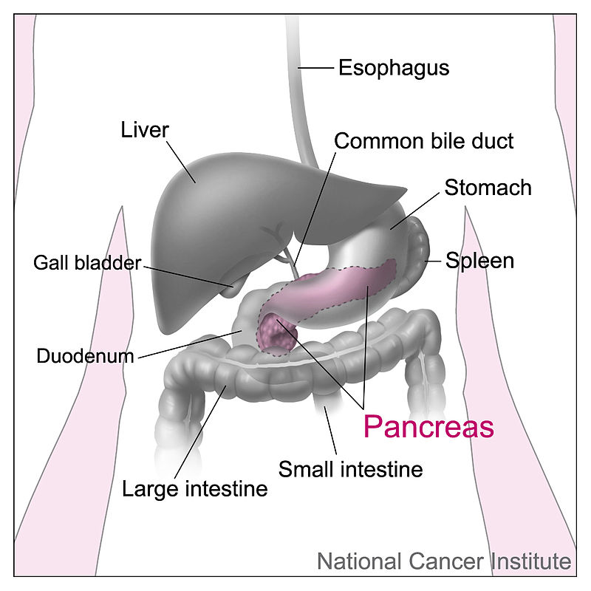
Endocrine Functions of Pancreas

Slide 2
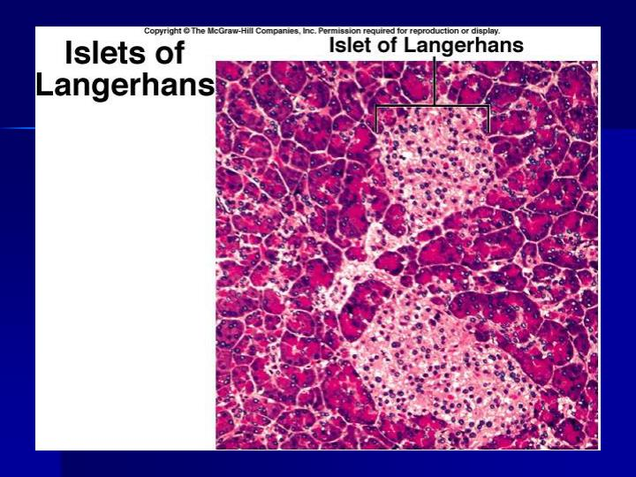
Islets of Langerhans consist of four types of Cells:
1. A cells or α cells which secrete glucagon
2. B cells or β cells which secrete insulin
3. D cells or δ cells which secrete somatostatin
4. F cells or PP cells which secrete pancreatic polypeptide

Slide 3
INSULIN
Insulin is secreted by B cells or the β cells in the islets of Langerhans of pancreas. Insulin is a polypeptide with 51 amino acids.
ACTIONS
Insulin is the important hormone that is concerned with regulation of carbohydrate metabolism and blood sugar level. It is also concerned with metabolism of proteins and fats.

Slide 4
1. On Carbohydrate Metabolism
Insulin is the only antidiabetic hormone secreted in the body, Insulin reduces the blood sugar level by its following actions on carbohydrate metabolism are:
i-Increases transport and uptake of glucose .
ii-Promotes peripheral utilization of glucose .
iii- Promotes storage of glucose — glycogenesis
iv-Inhibits glycogenolysis.
V-Inhibits gluconeogenesis

Slide 5
2. On Protein Metabolism
3. On Fat Metabolism
4. On Growth

Slide 6
MODE OF ACTION
On the target cells, insulin binds with the receptor protein and forms the insulin-receptor complex. This executes the action by activating the intracellular enzyme system.

Slide 7
REGULATION OF SECRETION
Insulin secretion is mainly regulated by blood glucose level.
In addition, other factors like
amino acids,
lipid derivatives,
gastrointestinal and
endocrine hormones
and autonomic nerve fibers
also stimulate insulin secretion.

Slide 8
GLUCAGON
Glucagon is secreted from A cells or α cells in the islets of Langerhans of pancreas. It is also secreted from A cells of stomach and L cells of intestine. Glucagon is a polypeptide with 29 amino acids.

Slide 9
ACTIONS
Actions of glucagon are antagonistic to those of insulin. It increases the blood sugar level and peripheral utilization of lipids and facilitates the
conversion of proteins into glucose.
1. On Carbohydrate Metabolism
2. On Protein Metabolism
3. On Fat Metabolis

Slide 10
MODE OF ACTION
On the target cells (mostly liver cells) glucagon causes formation of cyclic AMP which brings out the actions of glucagon.
REGULATION OF SECRETION
The secretion of glucagon is controlled mainly by blood glucose and amino acid levels in the blood.
Role of Blood Glucose Level
Role of Amino Acid Level in Blood

Slide 11
SOMATOSTATIN
ACTIONS
1.Somatostatin acts within islets of Langerhans and, inhibits α and β cells, i.e.
2.It decreases the motility of stomach, duodenum and gallbladder.
3.It reduces the secretion of gastrointestinal hormones.
4.Hypothalamic somatostatin inhibits secretion of GH and TSH from anterior pituitary. That is why, it is also called growth hormone inhibitory hormone (GHIH).

Slide 12
HYPOACTIVITY — DIABETES MELLITUS
Diabetes mellitus is a metabolic disorder characterized by high blood sugar (glucose) level associated with other manifestations. In most of the cases, the diabetes mellitus develops due to the deficiency of insulin.

Slide 13
Types of Diabetes Mellitus
Diabetes mellitus is of two types, Type I and Type II.
Type I Diabetes Mellitus
Type II Diabetes Mellitus

Slide 14
Causes of type I diabetes mellitus
1. Destruction of β cells during autoimmune
diseases.
2. Destruction of β cells by viral infection
3. Congenital disorder of β cells
1. Degeneration of β cells in the islets of
Langerhans of pancreas

Slide 15
Type II Diabetes Mellitus
Causes for type II diabetes mellitus
In this type of diabetes the structure and function of β cells and the blood level of insulin are normal. But the insulin receptors are reduced in number or absent in the body. The major causes for type II diabetes are:
1. Hereditary disorders
2. Other endocrine disorders.

Slide 16
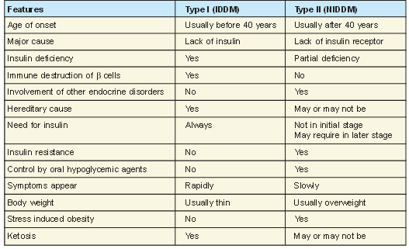
Differences between type I and type II diabetes mellitus

Slide 17
Following are the signs and symptoms of diabetes mellitus:
1. Glucosuria
2. Osmotic diuresis
3. Polyuria
4. Polydipsia
5. Polyphagia
6. Asthenia
7. Acidosis
8. Acetone breathing

Slide 18
9. Kussmaul breathing
10. Circulatory shock
11. Coma

Slide 19
Complications of Diabetes Mellitus
1.Cardiovascular complications like hypertension and myocardial infarction
2. Degenerative changes in retina called diabetic retinopathy
3. Degenerative changes in kidney known as diabetic nephropathy
4. Degeneration of autonomic and peripheral nerves called diabetic neuropathy.

Slide 20
Diagnostic Tests for Diabetes Mellitus
Diagnosis of diabetes mellitus includes the determination of:
1. Fasting blood sugar
2. Postprandial blood sugar
3. Glucose tolerance test (GTT)
4. Glycosylated (glycated) Hb.

Slide 21
HYPERACTIVITY — HYPERINSULINISM
Cause of Hyperinsulinism
Hyperinsulinism occurs due to the tumor of β cells in the islets of Langerhans.
Signs and Symptoms of Hyperinsulinism
1. Hypoglycemia
The blood sugar level falls below 50 mg/dL.
2. Manifestations of central nervous system

Slide 22
