Slide 1
Pharmaceutical chemistry Antibacterial Antibiotics Tetracyclines
Assist . Prof . Karima F. Ali
AL-Mustansiriyah university
College of pharmacy

Slide 2
Chemistry
Among the most important broad-spectrum antibiotics are members of the tetracycline family. Nine such compounds— tetracycline, rolitetracycline, oxytetracycline, chlortetracycline, demeclocycline, meclocycline, methacycline, doxycycline, and minocycline—have been introduced into medical use. Several others possess antibiotic activity.
The tetracyclines are obtained by fermentation procedures from Streptomyces spp. or by chemical transformations of the natural products

Slide 3
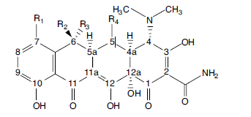
The stereochemistry of the tetracyclines is very complex. Carbon atoms 4, 4a, 5, 5a, 6, and 12a are potentially chiral, depending on substitution. Oxytetracycline and doxycycline, each with a 5α-hydroxyl substituent, have six asymmetric centers; the others, lacking chirality at C-5, have only five.

Slide 4
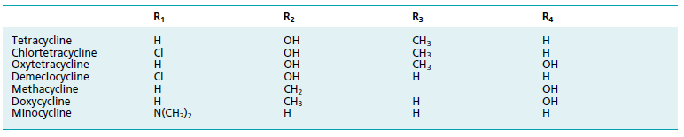
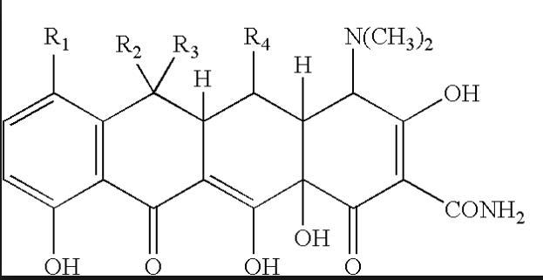
Structures of Tetracyclines

Slide 5
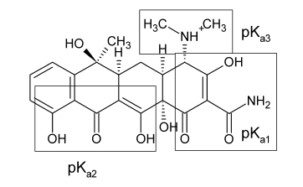
Structure of the Tetracyclines
The tetracyclines are amphoteric compounds, forming salts with either acids or bases.
In neutral solutions, these substances exist mainly as zwitterions.
The unusual structural groupings in the tetracyclines produce
three acidity constants in aqueous solutions of the acid
Salts (pKa1 pKa2 pKa3).

Slide 6
Strong acids and strong bases attack tetracyclines with a hydroxyl group on C-6, causing a loss in activity through modification of the C ring.
Strong acids produce dehydration through a reaction involving the 6-hydroxyl group and the 5a-hydrogen.
The double bond thus formed between positions 5a and 6 induces a shift in the position of the double bond between C-11a and C-12 to a position between C-11 and C-11a, forming the more energetically favored resonant system of the naphthalene group found in the inactive anhydrotetracyclines.

Slide 7
Bases promote a reaction between the 6- hydroxyl group and the ketone group at the 11-position, causing the bond between the 11 and 11a atoms to cleave, forming the lactone ring found in the inactive isotetracycline.
These two unfavorable reactions stimulated research
that led to the development of the more stable and longer acting compounds 6-deoxytetracycline, methacycline, doxycycline, and minocycline.

Slide 8
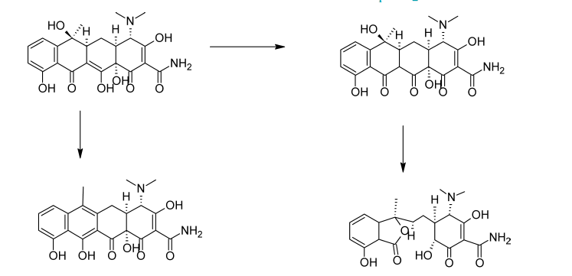
Base
Acid

Slide 9
Stable chelate complexes are formed by the tetracyclines with many metals, including calcium, magnesium, and iron.
Such chelates are usually very insoluble in water, accounting for the impaired absorption of most (if not all) tetracyclines in the presence of milk; calcium-, magnesium-, and aluminum-containing antacids; and iron salts. Soluble alkalinizers, such as sodium bicarbonate, also decrease the GI absorption of the tetracyclines.
The affinity of tetracyclines for calcium causes them to be incorporated into newly forming bones and teeth as tetracycline–calcium orthophosphate complexes

Slide 10
Mechanism of Action and Resistance
Tetracyclines are specific inhibitors of bacterial protein synthesis. They bind to the 30S ribosomal subunit and, thereby, prevent the binding of aminoacyl tRNA to the mRNA–ribosome complex.
Three biochemically distinct mechanisms of resistance to tetracyclines have been described in bacteria:
(a) efflux mediated by trans membrane-spanning, active-transport proteins that reduces the intracellular tetracycline concentration
(b) ribosomal protection, in which the bacterial protein
synthesis apparatus is rendered resistant to the action of
tetracyclines by an inducible cytoplasmic protein
(c)enzymatic oxidation.

Slide 11
Spectrum of Activity
The tetracyclines have the broadest spectrum of activity of any known antibacterial agents. They are active against a wide range of Gram-positive and Gram-negative bacteria, spirochetes, mycoplasma, rickettsiae, and chlamydiae.
Resistance to tetracyclines among both Gram-positive and Gram-negative bacteria is relatively common.

Slide 12
Structure–Activity Relationships
1. All derivatives containing fewer than four rings are inactive or nearly inactive.
2. The simplest tetracycline derivative that retains the characteristic broad-spectrum activity associated with this antibiotic class is 6-demethyl-6-deoxytetracycline.
3. The enolized tricarbonylmethane system at C-1 to C-3 must be intact for good activity.
4. Replacement of the amide at C-2 with other functions
(e.g., aldehyde or nitrile) reduces or abolishes activity.
5. Mono alkylation of the amide nitrogen reduces activity proportionately to the size of the alkyl group.

Slide 13
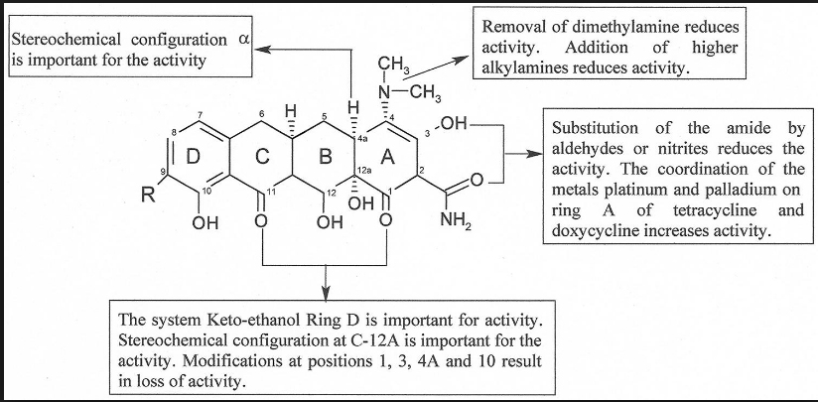

Slide 14
6. The dimethyl amino group at the 4-position must have the α- orientation: 4-epitetracyclines are very much less active than the natural isomers.
7. Removal of the 4-dimethylamino group reduces activity even further.
8. Activity is largely retained in the primary and N-methyl secondary amines but rapidly diminishes in the higher alkylamines.
9. A cis-A/B-ring fusion with a β -hydroxyl group at C-12a is apparently also essential.
10. Esters of the C-12a hydroxyl group are inactive, with the exception of the formyl ester, which readily hydrolyzes in aqueous solutions.
11. Alkylation at C-11a also leads to inactive compounds

Slide 15
12. Dehydrogenation to form a double bond between C-5a and C-11a markedly decreases activity, as does aromatization of ring C to form anhydrotetracyclines.
13. substituents at positions 5, 5a, 6, 7, 8, and 9, representing the largely hydrophobic “northern and western” faces of the molecule, can be modified with varying degrees of success, resulting in retention and, sometimes, improvement of antibiotic activity.
14. A 5-hydroxyl group, as in oxytetracycline and doxycycline, may influence pharmacokinetic properties but does not change antimicrobial activity.

Slide 16
15. Acid-stable 6-deoxytetracyclines and 6- demethyl-6-deoxytetracyclines have been used to prepare various mono substituted and di substituted derivatives by electrophilic substitution reactions at C-7 and C-9 of the D ring.
16. The more useful results have been achieved with the introduction of substituents at C-7.
17. Oddly, strongly electron withdrawing groups (e.g., chloro [lortetracycline] and nitro) and strongly electron-donating groups (e.g., dimethyl amino [minocycline]) enhance activity.

Slide 17
18. The most fruitful site for semisynthetic modification of the tetracyclines has been the 6-position. Neither the 6α-methyl nor the 6α-hydroxyl group is essential for antibacterial activity.
19. Polar substituents (i.e., hydroxyl groups) at C-5 and C-6 decrease lipid versus water solubility of the tetracyclines.
The 6-position is, however, considerably more sensitive than the 5-position to this effect. Nonpolar substituents have the opposite effect.

Slide 18
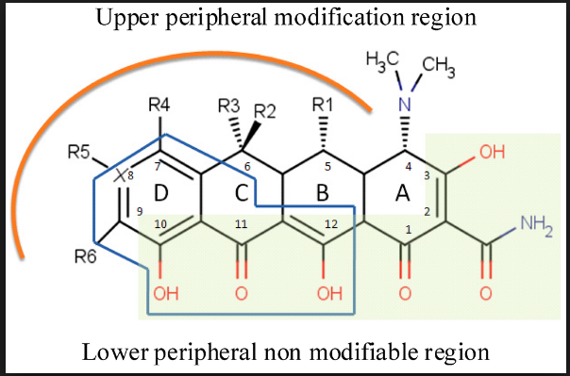

Slide 19
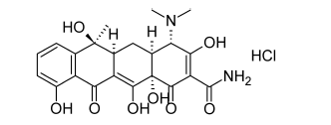
Products
Tetracycline
Tetracycline has become the most popular antibiotic of its group, largely because its plasma concentration appears to be higher and more enduring than that of either oxytetracycline or chlortetracycline.

Slide 20
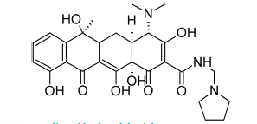
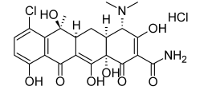
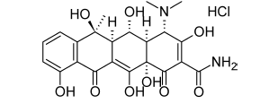
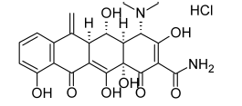
Rolitetracycline Chlortetracycline Hydrochloride
oxytetracycline
methacycline

Slide 21
The greater stability of methacycline, both in vivo and in vitro, results from modification at C-6. Removal of the 6-hydroxy group markedly increases the stability of ring C to both acids and bases, preventing the formation of isotetracyclines by bases.

Slide 22
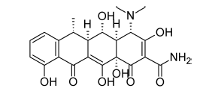
Doxycycline
Doxycycline,α-6-deoxy-5-oxytetracycline (Vibramycin).
The 6α-methyl epimer is more than 3 times as active as its β-epimer.
Apparently, the difference in orientation of the methyl groups, which slightly affects the shapes of the molecules, causes a substantial difference in biological effect.
6

Slide 23
absence of the 6-hydroxyl group produces a compound that is very stable in acids and bases and that has a long biological half-life.
In addition, it is absorbed very well from the GI tract, thus allowing a smaller dose to be administered

Slide 24
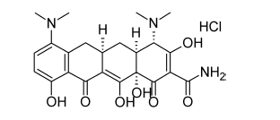
Minocycline Hydrochloride
Minocycline, 7-dimethylamino-6-demethyl-6-deoxytetracycline (Minocin, Vectrin), the most potent tetracycline currently used in therapy, is obtained by reductive methylation of 7-nitro-6-demethyl-6-deoxytetracycline. Because minocycline, like doxycycline, lacks the 6-hydroxyl group, it is stable in acids and does not dehydrate or rearrange to anhydro or lactone forms. It has a very long serum
half-life, resulting from slow urinary excretion and moderate
protein binding.

Slide 25
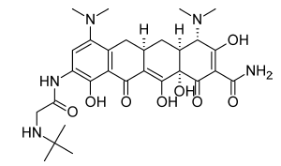
Newer tetracyclines
substituted in the aromatic (D) ring in an effort to discover analogs that might be effective against resistant strains. Glycylcyclines, a class of 9-dimethylglycylamino-(DMG)-substituted tetracyclines were discovered. The first of these to be marketed was tigecycline.

