Slide 1


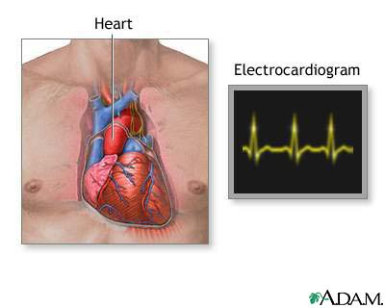
Diabetes Mellitus
Assist. Prof. Dr. Kadhim Ali Kadhim
PhD, in Clinical Pharmacy
Dept. of Clinical Pharmacy/ College of Pharmacy/University of AL-Mustansiriyah.
Pharm.drkaka75 @ uomustansiriyah.edu.iq
Kadhimali_2011@yahoo.com
Date : 8/ 3 /2018

Slide 2
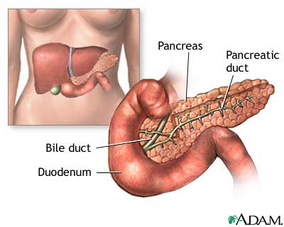
What is diabetes?
Diabetes mellitus (DM) is a chronic condition that is characterised by raised blood glucose levels (Hyperglycemia).

Slide 3
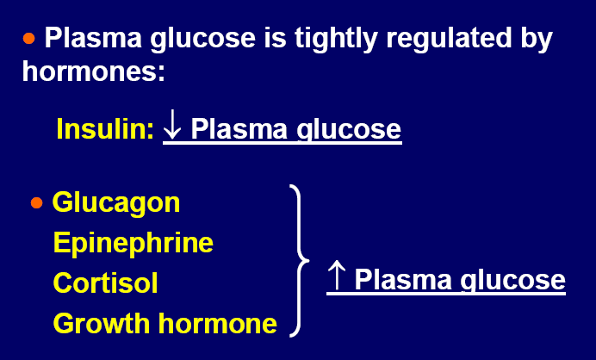
Regulation of Plasma Glucose Level

Slide 4
How Insuline Decrease Plasma Glucose Level?

Slide 5
Classification of DM
1. Type 1 DM
It is due to insulin deficiency and is formerly known as.
    Type I
    Insulin Dependent DM (IDDM)
    Juvenile onset DM
2. Type 2 DM
It is a combined insulin resistance and relative deficiency in insulin secretion and is frequently known as.
    Type II
    Noninsulin Dependent DM (NIDDM)
    Adult onset DM

Slide 6
3. Gestational Diabetes Mellitus (GDM):
Gestational Diabetes Mellitus (GDM) developing during some cases of pregnancy but usually disappears after pregnancy.
4. Other types:
Secondary DM

Slide 7
Etiology
1. Etiology of Type 1 Diabetes

Slide 9
2. Etiology of Type 2 Diabetes

Slide 10
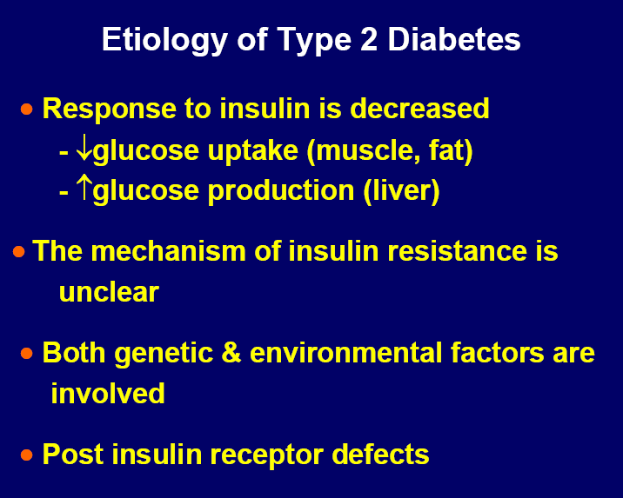
a

Slide 14
Characteristics
Type 1
Type 2
% of diabetic pop
5-10%
90%
Age of onset
Usually < 30 yr + some adults
Usually > 40 + some obese children
Pancreatic function
Usually none
Insulin is low, normal or high
Pathogenesis
Autoimmune process
Defect in insulin secretion, tissue resistance to insulin, increased HGO
Family history
Generally not strong
Strong
Obesity
Uncommon
Common
History of ketoacidosis
Often present
Rare except in stress
Clinical presentation
moderate to severe symptoms: 3Ps, fatigue, wt loss and ketoacidosis
Mild symptoms: Polyuria and fatigue. Diagnosed on routine physical examination
Treatment
Insulin, Diet
Exercise
Diet ,Exercise
Oral antidiabetics,Insulin
Notes:
Applied Therapeutics: Table 48-1
Oral antihyperglycemic

Slide 15
Epidemiology
Type 1 DM
  It is due to pancreatic islet β-cell destruction predominantly by an autoimmune process.
  Usually develops in childhood or early adulthood
  It accounts for upto 10% of all DM cases
  Develops as a result of the exposure of a genetically susceptible individual to an environmental agent
Notes:
Environmental factors such as infectious agents, chemical agents, and dietary agents are likely contributing factors to the expression of the disease.
HLA: Human Leukocyte Antigens

Slide 16
Type 2 DM
It results from insulin resistance with a defect in compensatory insulin secretion.
Insulin may be low, normal or high!
About 30% of the Type 2 DM patients are undiagnosed (they do not know that they have the disease) because symptoms are mild.
It accounts for up to 90% of all DM cases

Slide 17
Risk Factors
Type 1 DM
  Genetic predisposition
    In an individual with a genetic predisposition, an event such as virus or toxin triggers autoimmune destruction of β-cells probably over a period of several years.

Slide 18
Risk Factors
Type 2 DM
  Family History
  Obesity
  Habitual physical inactivity
  Previously identified impaired glucose tolerance
  (IGT) or impaired fasting glucose (IFG)
  Hypertension
  Hyperlipidemia
Notes:
IFG: > or = 110 and <126
IGT: > or = 140 and <200

Slide 20
Carbohydrate Metabolism
  Carbohydrates are metabolized in the body to glucose.
  CNS uses glucose as its primary energy source. This is independent of insulin.
  Glucose is taken by the muscle to produce energy (insulin required).
  Glucose is stored in the liver as glycogen and in adipose tissues as fat.
  Insulin is produced and stored by the β-cells of the pancreas
Notes:
If glucose is not available, muscle and fat can produce energy from amino acids and fatty acids

Slide 21
Carbohydrate Metabolism (Cont’d)
Postprandial glucose metabolism in normal individuals:
  After food is ingested, blood glucose concs rise and stimulate insulin release.
Insulin action:
    glucose uptake by the tissues
    liver glycogen formation and glycogen
    breakdown
    lipid synthesis and inhibits fatty acid
    breakdown to ketone bodies
    Promotes protein synthesis
Notes:
Insulin stimulates the uptake of amino acids and their conversion to protein
In adipose tissue glucose is converted to free fatty acids and stored as triglycerides
Liver does not require insulin for glucose transport

Slide 22
Carbohydrate Metabolism (Cont’d)
Fasting glucose metabolism in normal individuals:
  In the fasting state, insulin release is inhibited.
  Hormones that promote an increase in blood glucose are released:
    Glucagon, epinephrine, growth hormone, glucocorticoids, and thyroid hormones.
  Glycogenolysis
  Gluconeogenesis: AA are transported from muscle to liver and converted to glucose.
  TG are broken down into free FAs as an alternative fuel source.
Notes:
These processes maintain a minimum blood glucose conc for the CNS.

Slide 23
Pathophysiology
Type 1 DM
  Type 1 DM is characterized by an absolute deficiency of insulin due to immune- mediated destruction of the pancreatic β-cells
  In rare cases the β-cell destruction is not due to immune mediated reaction (idiopathic type 1 DM)

Slide 24
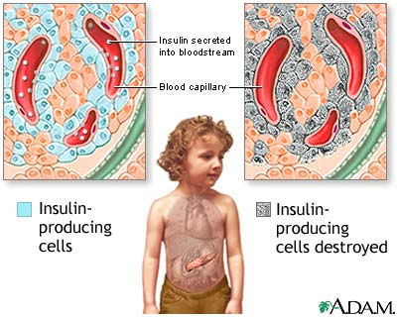
Notes:
Cells destroyed by the body’s immune system

Slide 25
Pathophysiology
Type 1 DM
  There are four stages in the development of Type 1 DM:
    Preclinical period with positive β-cell antibodies
    Hyperglycemia when 80-90% of the
    β- cells are destroyed.
    Transient remission (honeymoon phase).
    Establishment of the disease

Slide 26
Pathophysiology
Birth
Time (years)
Notes:
Figure 74-3, 72-4 (new book)

Slide 27
Pathophysiology
Type 2 DM
  Type 2 DM is characterized by the presence of both insulin resistance (tissue insensitivity) and some degree of insulin deficiency or β- cell dysfunction
  Type 2 DM occurs when a diabetogenic lifestyle (excessive calories, inadequate caloric expenditure and obesity) is superimposed upon a susceptible genotype

Slide 28
Pathophysiology
Type 2 DM
300
250
200
150
100
50
0
Glucose
mg/dL
Fasting blood glucose
Post-meal glucose
Relative
β- cell
Function
%
250
200
150
100
50
0
β-cell failure
Years of diabetes

Slide 29
Laboratory Tests
1. Glucosuria
  To detect glucose in urine by a paper strip
    Semi-quantitative
    Normal kidney threshold for glucose is essential
2. Ketonuria
  To detect ketonbodies in urine by a paper strip
    Semi-quantitative

Slide 30
Laboratory Tests (Cont’d)
3. Fasting blood glucose
  Glucose blood concentration in samples obtained after at least 8 hours of the last meal
4. Random Blood glucose
  Glucose blood concentration in samples obtained at any time regardless the time of the last meal

Slide 31
Laboratory Tests (Cont’d)
5. Glucose tolerance test
  75 gm of glucose are given to the patient with 300 ml of water after an overnight fast
  Blood samples are drawn 1, 2, and 3 hours after taking the glucose
  This is a more accurate test for glucose utilization if the fasting glucose is borderline

Slide 32
Laboratory Tests (Cont’d)
6. Glycosylated hemoglobin (HbA1C)
  HbA1C is formed by condensation of glucose with free amino groups of the globin component of hemoglobin
  Normally it comprises 4-6% of the total hemoglobin.
  Increase in the glucose blood concentration increases the glycated hemoglobin fraction.
  HbA1C reflects the glycemic state during the preceding 8-12 weeks.

Slide 33
Laboratory Findings (Cont’d)
7. Serum Fructosamine
  Formed by glycosylation of serum protein (mainly albumin)
  Since serum albumin has shorter half life than hemoglobin, serum fructosamine reflects the glycemic state in the preceding 2 weeks
  Normal is 1.5 - 2.4 mmole/L when serum albumin is 5 gm/dL.
Notes:
May be used in hemoglobinopathies that shorten red blood cell survival

Slide 34
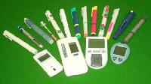
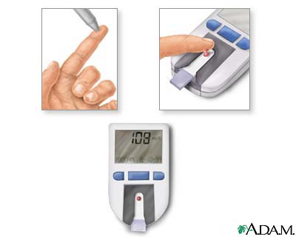
Self Monitoring Test
Self-monitoring of blood glucose
  Extremely useful for outpatient monitoring specially for patients who need tight control for their glycemic state.
  A portable battery operated device that measures the color intensity produced from adding a drop of blood to a glucose oxidase paper strip.
  e.g. One Touch, Accu-Chek, DEX, Prestige and Precision.

Slide 35
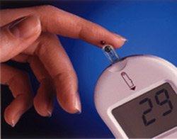
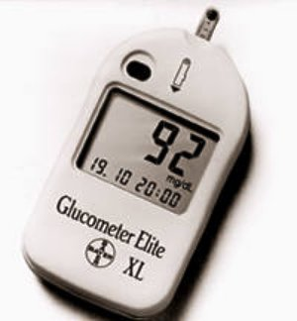
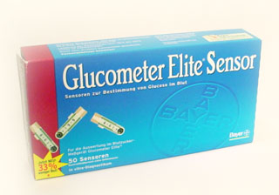

Slide 36
Diagnostic Criteria
  Any one test should be confirmed with a second test, most often fasting plasma glucose (FPG).
  This criteria for diagnosis should be confirmed by repeating the test on a different day.
Notes:
Table 74-3 OR 72-3 (new book)
HbA1c is not sensitive enough to detect DM but is the gold standard for the long term monitoring.

Slide 38
Clinical Presentation
Type 1 DM
Polyuria
Polydipsia
Polyphagia
Weight loss
Weakness
Dry skin
Ketoacidosis
Type 2 DM
Patients can be asymptomatic
Polyuria
Polydipsia
Polyphagia
Fatigue
Weight loss
Most patients are discovered while performing urine glucose screening

Slide 39
Treatment
Desired outcome
Relieve symptoms
Reduce mortality
Improve quality of life
Reduce the risk of microvascular and macrovascular disease complications
  Macrovascular complications:
  Coronary heart disease, stroke and peripheral vascular disease
  Microvascular Complications:
  Retinopathy, nephropathy and neuropathy

Slide 40
How to achieve the goals ?
Treatment
Near normal glycemic control reduce the risk of developing microvascular disease complications
Control of the traditional CV risk factors such as smoking, management of dyslipidemia, intensive BP control and antiplatelet therapy.

Slide 41
Treatment
General approaches
Medications
Dietary and exercise modification
Regular complication monitoring
Self monitoring of blood glucose
Control of BP and lipid level

Slide 42
Treatment
Glycemic goals
Notes:
Table 74-5 (72-7 New book): not the same numbers provided b different organizations

Slide 43
Treatment
Complication monitoring
Annual eye examination
Annual microalbuminuria
Feet examination
BP monitoring
Lipid profile

Slide 44
Treatment
Self-monitoring of blood glucose
Frequent self monitoring of blood glucose to achieve near normal level
More intense insulin regimen require more frequent monitoring
Notes:
SMBG needs to be 4 or more times daily in patients on multiple insulin injections per day.

Slide 45
Treatment
Nonpharmacological therapy
Diet
For type 1 the goal is to regulate insulin administration with a balanced diet
In most cases, high carbohydrate, low fat, and low cholesterol diet is appropriate
Type 2 DM patients need caloric restriction

Slide 46
Treatment
Nonpharmacological therapy
Diet (Cont’d)
Artificial sweeteners:
  e.g. Aspartame, saccharin, sucralose, and acesulfame
  Safe for use by all people with diabetes
Nutritive sweeteners:
  e.g. fructose and sorbitol
  Their use is increasing except for acute diarrhea in
some patients
Notes:
Excessive intake of sorbitol: can induce an osmotic diarrhea.
Excessive fructose can increase total and LDL cholesterol.

Slide 47

Treatment
Nonpharmacological therapy
Activity
Exercise improves insulin resistance and achieving glycemic control.
Exercise should start slowly for patients with limited activity.
Patients with CV diseases should be evaluated before starting any exercise

Slide 48


Slide 49
Treatment
Pharmacological therapy
Insulin (Type 1 and Type 2 DM)
Sulfonylurea (Type 2 DM)
Biguanides (Type 2 DM)
Meglitinides (Type 2 DM)
Thiazolidinediones Glitazones (Type 2 DM)
α-Glucosidase inhibitors (Type 2 DM)
Dipeptidyl pepidase-4 inhibitors (Type 2 DM)
Incretin mimetics (Type 2 DM)

Slide 50
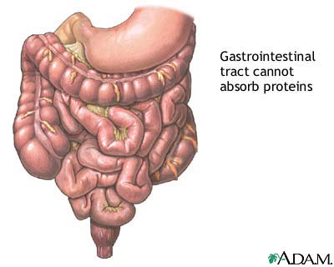

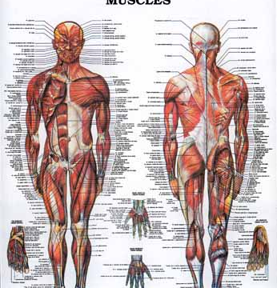
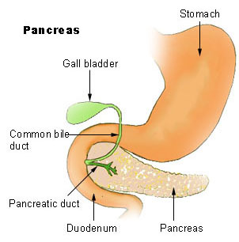
Pharmacological Treatment of Type 2 DM
Strategy for Controlling Hyperglycemia
Absorption from Diet
Biosynthesis in Liver
α-Glucosidase Inhibitors
Biguanides
Cellular Uptake
Serum Sugar
Biguanides;
thiazolidinediones
Pancreas
Insulin
Sulfonylureas
Meglitinide

Slide 51
1. Sulfonylureas
Pharmacological effect
Stimulate the pancreatic secretion of insulin

Slide 52
Sulfonylureas (Cont’d)
Classification
First generation
  e.g. tolbutamide, chlorpropamide, and acetohexamide
  Lower potency, more potential for drug interactions and side effects
Second generation
  e.g. glimepiride, glipizide, and glyburide
  higher potency, less potential for drug interactions and side effects
All sulfonylurea drugs are equally effective in reducing the blood glucose when given in equipotent doses.

Slide 53
Major Pharmacokinetic Properties of Sulfonyl Ureas
 | Eqv. Dose (mg) | Duration (h) | Active metabolites
First Generation
Tolbutamide | 1000-1500 | 12-24 | Yes (p-OH derivative)
Chlorpropamide | 250-375 | 24-60 | Yes (2’-OH and 3’OH groups)
Tolazamide | 250-375 | 12-24 | No (4-COOH derivative)
Second generation
Glipizide | 10 | 10-24 | No (cleavage of pyrazine ring)
Glyburide (glibenclamide) Third generation | 5 | 16-24 | Some (trans + cis 4’-OH groups)
Glimepiride | 1-2 | 24 | Yes (-OH on CH3 of R’ group)

Slide 54
Sulfonylureas (Cont’d)
Efficacy
  HbA1c: 1.5 – 1.7% reduction.
  FPG: 50 – 70 mg/dL reduction.
  PPG: 92 mg/dL reduction.
Adverse effects
Hypoglycemia
Hyponatremia (with tolbutamide and chlorpropamide)
Weight gain

Slide 55
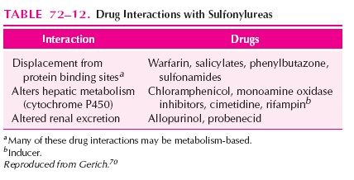
Sulfonylureas (Cont’d)
Drug interactions
Notes:
Table 74-12

Slide 56
2. Short-acting Secretogogues
Repaglinide
Nateglinide
Pharmacological effect
Stimulation of the pancreatic secretion of insulin
  The insulin release is glucose dependent and is decreased at low blood glucose
  With lower potential for hypoglycemia (incidence 0.3%)
  Should be given before meal or with the first bite of each meal. If you skip a meal don’t take the dose!

Slide 57
Secretogogues (Cont’d)
Adverse effect
Incidence of hypoglycemia is very low about 0.3 %
Drug Interactions
Inducers or inhibitors of CYP3A4 affect the action of repaglinide
Nateglinide is an inhibitor of CYP2C9
Notes:
Table 74-11

Slide 58
3. Biguanides
Metformin (Glucophage)
Pharmacological effect
Reduces hepatic glucose production
Increases peripheral glucose utilization
Adverse effects
Nausea, vomiting, diarrhea, and anorexia
Phenformin: another biguanide, was taken off the market because it causes lactic acidosis in almost 50% of patients
  As a precaution metformin should not be used in patients with renal insufficiency, CHF, conditions that lead to hypoxia

Slide 59
4. Glitazones (PPARγ Agonists)
PPARγ Agonists:
Peroxisome proliferator-activated receptor γ gonists
Rosiglitazone - Pioglitazone
Pharmacological effect
Reduces insulin resistance in the periphery (Sensitize muscle and fat to the action of insulin) and possibly in the liver
The onset of action is slow taking 2-3 months to see the full effect
Edema and weight gain are the most common side effects. (no hepatotoxicity)

Slide 60
5. α-Glucosidase Inhibitors
- Acarbose - Miglitol
Pharmacological effect
Prevent the breakdown of sucrose and complex carbohydrates
  The net effect is to reduce postprandial blood glucose rise
  The effect is limited to the luminal side of the intestine with limited systemic absorption. Majority eliminated in the feces.
  Postprandial glucose conc is reduced.
  FPG relatively unchanged.
  Average reduction in HbA1c: 0.3-1.0%
Notes:
CASE: If hypoglycemia, give oral or IV glucose NOT sucrose!

Slide 61
Pharmacotherapy :Type 2 DM
General considerations:
Consider therapeutic life style changes (TLC) for all patients with Type 2 DM
Initiation of therapy may depend on the level of HbA1C
  HbA1C < 7% may benefit from TLC
  HbA1C 8-9% may require one oral agent
  HbA1C > 9-10% my require more than one oral agent

Slide 62
Pharmacotherapy :Type 2 DM
Obese Patients >120% LBW:
Metformin or glitazone
Add SU or short-acting insulin secretagogue
Add Insulin or glitazone
Notes:
Figure 74-6
Metfromin is preferred if no contraindications

Slide 63
Pharmacotherapy :Type 2 DM
Non-obese Patients <120% LBW:
SU or short-acting insulin secretagogue
Add Metformin or glitazone
Add Insulin
Notes:
Nonobese patients tend to have a relatively greater degree of βeta -cell dysfunction relative to insulin resistance. Therefore they may respond better to secreatgogues. When insulin is added, secretagogues should be discontinued

Slide 64
Pharmacotherapy :Type 2 DM
Elderly Patients with newly diagnosed DM :
SU or short-acting insulin secretagogue or a-glucosidase inhibitor or insulin
Add or substitute insulin
Notes:
Risk of hypoglycemia is greater with SU
Risk of lactic acidosis increases with older age (metformin)
The easiest approach to glycemic control maybe a simple insulin regimen.

Slide 65
Pharmacotherapy :Type 2 DM
Early insulin resistance :
Metformin or glitazone
Add glitazone or metformin
Add SU or short-acting insulin secretagogue or insulin
Notes:
Recognizing the disease when bet-cell function is preserved

Slide 66
Clinical Trials: Diabetes Mellitus
1- Diabetes Prevention Program
Population: Over-weight patients with impaired glucose tolerance.
Intervention: Low-fat diet and 150 min of exercise per week.
Results: Decrease the risk of progression to Type 2 DM by 58%

Slide 67
Pharmacotherapy :Type 1 DM
The choice of therapy is simple
All patients need Insulin

Slide 68
Insulin
Pharmacological effect:
Anabolic
Glucose uptake
Glycogen synthesis
Lipogenesis
Protein synthesis
Triglyceride uptake
Anticatabolic
Inhibits gluconeogenesis
Inhibits glycogenolysis
Inhibits lipolysis
Inhibits proteolysis
Inhibits fatty acid oxidation
Notes:
Table 74-7

Slide 69
Insulin (Cont’d)
Strength
The number of units/ml
e.g. U-100 , U-20, U-10
Source
Pork: Differs by one a.a.
Beef-Pork
Human (recombinant DNA technology)

Slide 70
Insulin (Cont’d)
Onset and duration of effect
Changing the properties of insulin preparation can alter the onset and duration of action
Lispro: (Monomeric) absorbed to the circulation very rapidly
Aspart: (Mono- and dimeric) absorbed to the circulation very rapidly
Regular: (Hexameric) absorbed rapidly but slower than lispro and aspart
Notes:
Table 74-9

Slide 71
Insulin (Cont’d)
Onset and duration of effect
Lent insulin: Amorphous precipitate of insulin and zinc and insoluble crystals of insulin and zinc. Releases insulin slowly to the circulation
NPH: R-insulin + Protamine zinc insulin. Releases insulin slowly to the systemic circulation
Insulin glargine: Prepared by modification of the insulin structure. Precipitate after S.C. injection to form microcrystals that slowly release insulin to the systemic circulation (N.B. cannot be mixed with other insulins)

Slide 72
Insulin (Cont’d)
Onset and duration of effect
Rapid-acting insulin
    e.g. Insulin lispro and insulin aspart
Short-acting insulin
    e.g. Regular insulin
Intermediate-acting insulin
    e.g. NPH and Lente insulin
Long-acting insulin
    e.g. Insulin Glargine
Mixture of insulin can provide glycemic control over extended period of time
    e.g. Humalin 70/30 (NPH + regular)

Slide 73
Insulin (Cont’d)
Adverse effects
Hypoglycemia
  Treatment:
      Patients should be aware of symptoms of hypoglycemia
      Oral administration of 10-15 gm glucose
      IV dextrose in patients with lost consciousness
      1 gm glucagon IM if IV access is not available
Skin rash at injection site
  Treatment: Use more purified insulin preparation
Lipodystrophies (increase in fat mass) at injection site
  Treatment: rotate the site of injection
Notes:
Lypohypertrophy: Insulin absorption will be delayed and prolonged. This may contribute to changes in blood glucose control

Slide 74
Insulin (Cont’d)
Drugs interfering with glucose tolerance
The most significant interactions are with drugs that alter the blood glucose level:
Diazoxide
Thiazide diuretics
Corticosteroids
Oral contraceptives
Streptazocine
Phenytoin
All these drugs increase the blood glucoseconcentration.
Monitoring of BG is required
Notes:
Table 74-10

Slide 75
Insulin (Cont’d)
Methods of Insulin Administration
Insulin syringes and needles
Pen-sized injectors
Insulin Pumps

Slide 76
Pharmacotherapy :Type 1 DM
The goal is:
To balance the caloric intake with the glucose lowering processes (insulin and exercise), and allowing the patient to live as normal a life as possible

Slide 77
Pharmacotherapy :Type 1 DM
Breakfast
Lunch
Supper
Insulin
Concentration
Time of day
Normal insulin secretion during he day
- Constant background level (basal)
- Spikes of insulin secretion after eating
Notes:
Figure 74-5

Slide 78
Pharmacotherapy :Type 1 DM
-The insulin regimen has to mimic the physiological secretion of insulin
With the availability of the SMBG and HbA1C tests adequacy of the insulin regimen can be assessed
More intense insulin regimen require more intense monitoring

Slide 79
Pharmacotherapy :Type 1 DM
Example:
1- Morning dose (before breakfast):
Regular + NPH or Lente
2- Before evening meal:
Regular + NPH or Lente
Require strict adherence to the timing of meal and injections

Slide 80
Pharmacotherapy :Type 1 DM
Modification
NPH evening dose can be moved to bedtime
Three injections of regular or rapid acting insulin before each meal + long acting insulin at bedtime (4 injections)
The choice of the regimen will depend on the patient

Slide 81
Pharmacotherapy :Type 1 DM
How much insulin ?
A good starting dose is 0.6 U/kg/day
The total dose should be divided to:
  45% for basal insulin
  55% for prandial insulin
      The prandial dose is divided to
      - 25% pre-breakfast
      - 15% pre-lunch
      - 15% pre-supper

Slide 82
Pharmacotherapy :Type 1 DM
Example: For a 50 kg patient
The total dose = 0.6X50 = 30 U/day
  13.5 U for basal insulin (45% of dose)
    Administered in one or two doses
  16.5 U for prandial insulin (55% of dose)
      The 16.5 U are divided to:
      - 7.5 U pre-breakfast (25%)
      - 4.5 U pre-lunch (15%)
      - 4.5 U pre-supper (15%)

Slide 83
Pharmacotherapy :Type 1 DM
Monitoring
Most Type 1 patients require
0.5-1.0 U/kg/d
The initial regimen should be modified based on:
  Symptoms
  SMBG
  HbA1C

Slide 84
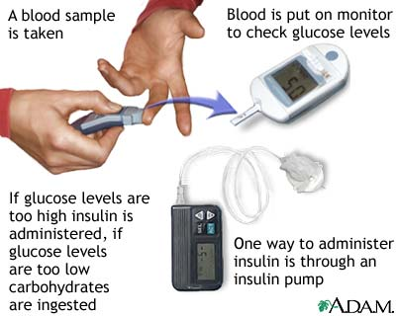
Pharmacotherapy :Type 1 DM
Monitoring

Slide 85
Pharmacotherapy :Type 1 DM
Insulin Pump Therapy
This involves continuous SC administration of short-acting insulin using a small pump
The pump can be programmed to deliver basal insulin and spikes of insulin at the time of the meals
Requires intense SMBG
Requires highly motivated patients because failure to deliver insulin will have serious consequences

Slide 86
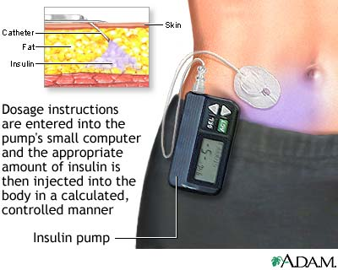
Pharmacotherapy :Type 1 DM
Insulin Pump

Slide 87
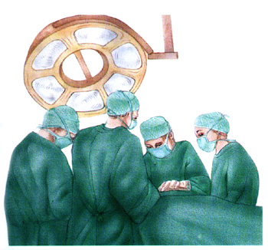
II. Surgery
Islet transplantation has been investigated as a treatment for type 1 diabetes mellitus in selected patients with inadequate glucose control despite insulin therapy.
Observations in patients with type 1 diabetes indicate that islet transplantation can result in insulin independence with excellent metabolic control

Slide 88
Diabetes Mellitus Complications
1. Hypoglycemia
Cause: Missing meals or excessive exercise or too much insulin
Symptoms: Tachycardia, palpitation, sweating, nausea, and vomiting. Progress to mental confusion, bizarre behavior and coma
Treatment: Candy or sugar
        IV glucose
        Glucagon 1 gm IM

Slide 89
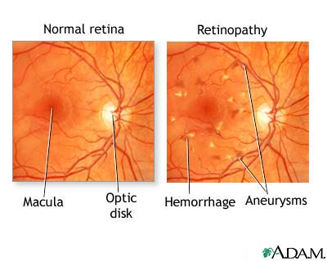
Diabetes Mellitus Complications
2. Diabetes retinopathy
Microaneurysm
Hemorrhage
Exudates
Retinal edema
other
Notes:
Early background retinopathy may reverse with glycemic control

Slide 90
Diabetes Mellitus Complications
3. Diabetes nephropathy
30-40 % of all type 1 DM patients develop nephropathy in 20 years
15-20 % of type 2 DM patients develop nephropathy
Manifested as:
  Microalbuminuria
  Progressive diabetic nephropathy leading to end-stage renal disease

Slide 91
Diabetes Mellitus Complications
Diabetes nephropathy (Cont’d)
All diabetic patients should be screened annually for microalbuminurea to detect patients at high risk of developing progressive diabetic nephropathy
Tight glycemic control and management of the blood pressure can significantly decrease the risk of developing diabetic nephropathy.
ACE-inhibitors are recommended to decrease the progression of nephropathy
Notes:
Recent studies have also shown a protective effect of angiotensin receptor blockers
Patients with greater than 1 gram proteinuria per day should have their blood pressure goal be less thant 125/75 mm Hg (difficult to achieve)

Slide 92
Diabetes Mellitus Complications
4. Diabetes neuropathy
Autonomic neuropathy:
Manifested by orthostatic hypotension, diabetic diarrhea, erectile dysfunction, and difficulty in urination.

Slide 93
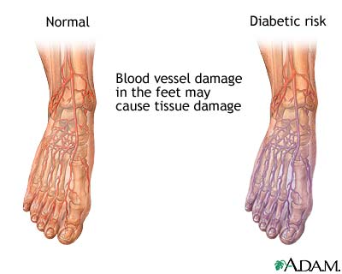
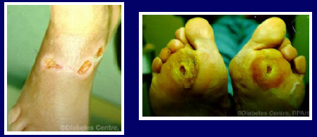
Diabetes Mellitus Complications
5. Peripheral vascular disease and foot ulcer
Incidence of gangrene
of the feet in DM is 20
fold higher than control
group due to:
- Ischemia
- Peripheral neuropathy
- Secondary infection

Slide 94
Special Patient Population
1. Adolescent Type 2 DM
Type 2 DM is increasing in adolescent
Lifestyle modification is essential in these patients
If lifestyle modification alone is not effective, metformin the only labeled oral agent for use in children (10-16 years)

Slide 95
Special Patient Population
2. Gestational DM
Dietary control
If blood glucose is not controlled by dietary control, insulin therapy is initiated
One dose of NPH or NPH + regular insulin (2:1) given before breakfast. Adjust regimen according to SMBG.
Sulfonylureas: Effective, but require further studies to demonstrate safety.

Slide 96
Special Situations
3. Diabetic ketoacidosis
It is a true emergency
Usually results from omitting insulin in type 1 DM or increase insulin requirements in other illness (e.g. infection, trauma) in type 1 DM and type 2 DM
Signs and symptoms:
  Fatigue, nausea, vomiting, evidence of dehydration, rapid deep breathing, fruity breath odor, hypotension and tachycardia
Notes:
Tachycardia, nausea, vomiting: Similar to hypoglycemia

Slide 97
Special Situations
Diabetic ketoacidosis (Cont’d)
Diagnosis
    Hyperglycemia, acidosis, low serum bicarbonate, and positive serum ketones
Abnormalities:
- Dehydration, acidosis, sodium and potassium deficit
Patient education is important

Slide 98
Special Situations
Diabetic ketoacidosis (Cont’d)
Management:
    Fluid administration: Rapid fluid administration to restore the vascular volume,
    IV infusion of insulin to restore the metabolic abnormalities. Titrate the dose according to the blood glucose level.
    Potassium and phosphate can be added to the fluid if needed.
Follow up:
    Metabolic improvement is manifested by an increase in serum bicarbonate or pH.
Notes:
Administration of iv glucose when glucose level decreases to <250 mg/dL is preferable to titration of insulin based on the glucose level. The latter strategy may delay clearance of ketosis and prolong treatment.

