Slide 1
Altering product strength , use of stock solution and problem solving
Dr. Methaq Hamad Sabar
CH 15

Slide 2
The strength of a pharmaceutical preparation may be increased or decreased by changing the proportion of active ingredient to the whole. A preparation may be strengthened or made more concentrated by the addition of active ingredient, by admixture with a like preparation of greater strength, or through the evaporation of its vehicle, if liquid. The strength of a preparation may be decreased or diluted by the addition of diluent or by admixture with a like preparation of lesser strength

Slide 3
Relationship between strength and total quantity
if a mixture of a given percentage or ratio strength is diluted to twice its original quantity, its active ingredient will be contained in twice as many parts of the whole, and its strength therefore will be reduced by one half.
By contrast, if a mixture is concentrated by evaporation to one-half its original quantity, the active ingredient (assuming that none was lost by evaporation) will be contained in one half as many parts of the whole, and the strength will be doubled.

Slide 4
c. If, then, the amount of active ingredient remains constant, any change in the quantity of a solution or mixture of solids is inversely proportional to the percentage or ratio strength; that is, the percentage or ratio strength decreases as the quantity increases, and conversely. This relationship is generally true for all mixtures except solutions containing components that contract when mixed together.

Slide 5
Problems in this section generally may be solved by any of the following methods:
Inverse proportion.
2. The equation:
(1stquantity)x(1stconcentration)=(2ndquantity)x(2nd concentration),
or Q1xC1=Q2 xC2.
3. By determining the quantity of active ingredient (solute) present or required and relating that quantity to the known or desired quantity of the preparation.

Slide 6
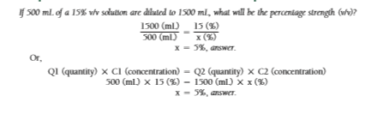
Example Calculations of the Dilution and Concentration of Liquids

Slide 7
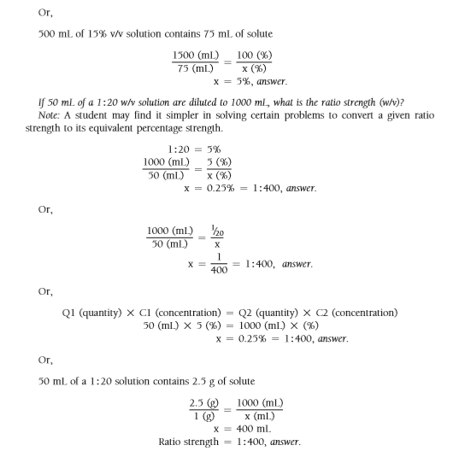

Slide 8
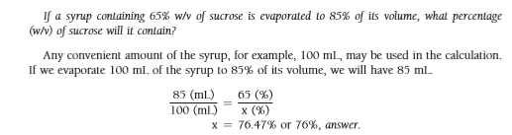

Slide 9
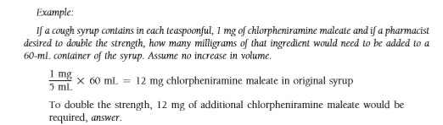
Strengthening of pharmaceutical product

Slide 10
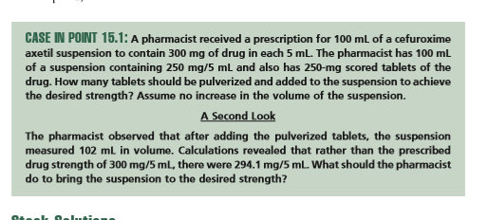


Slide 11
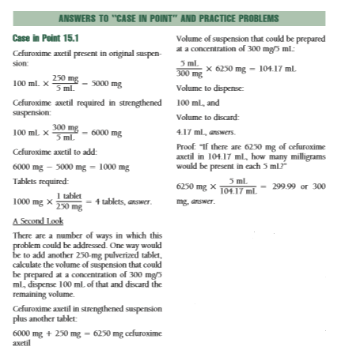

Slide 12
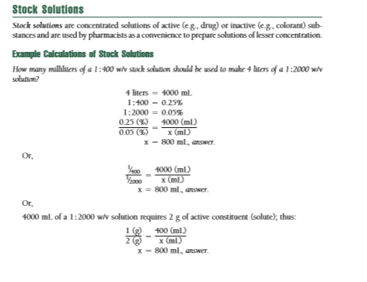

Slide 13
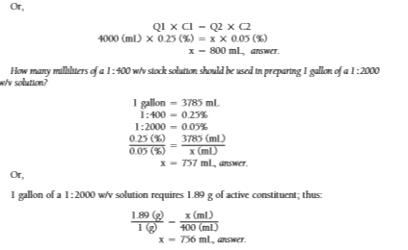

Slide 14
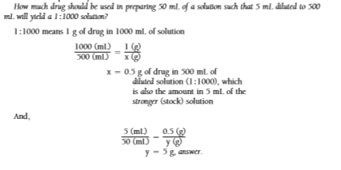

Slide 15
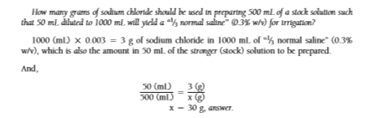
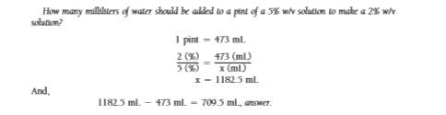

Slide 16


Slide 17
