Slide 2
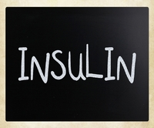
Management of T1DM

Slide 3
Route(S) | Appearance | Duration | peak | Onset (hours) | Type of insulin
S.C, I.V⁽⁵⁾ | Clear صافي | 3-6⁽²⁾ | 1-2⁽²⁾ | 15-30 minutes⁽²⁾ | Rapid-acting insulin Insulin Lispro,Insulin aspart, and insulin glulisine
S.C, I.V, And I.M⁽⁵⁾ | Clear صافي | 6-8⁽³⁾ | 2-4⁽¹⁾ | 0.5-1.0⁽¹⁾ | Short-acting insulin ويسمى ايضا (soluble, regular ,neutral)
S.C⁽⁵⁾ only | Cloudy خابط Cloudy خابط | 18-24⁽³⁾ 18-24⁽³⁾ | 6-14⁽¹⁾ 6-14⁽¹⁾ | 1-2⁽¹⁾ 1-3⁽¹⁾ | Intermediate-acting insulin Isophane* insulin also called NPH(neutral protamine hagedorn) Lente
S.C⁽⁵⁾ only | Cloudy خابط Clear صافي | 24-36⁽¹⁾ 24⁽¹⁾ | 18-24⁽¹⁾ No pronounced peak | 4-6⁽³⁾ 4-6⁽³⁾ | long-acting insulin Ultrlente(insulin zinc susp., protamine zinc sup.) Insulin Glargine

Slide 4
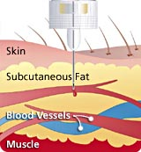
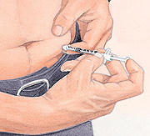
INJECTION SITE

Slide 5
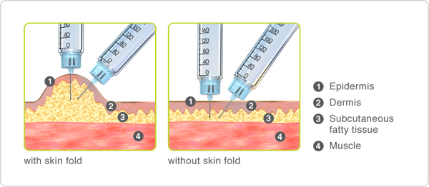

Slide 6
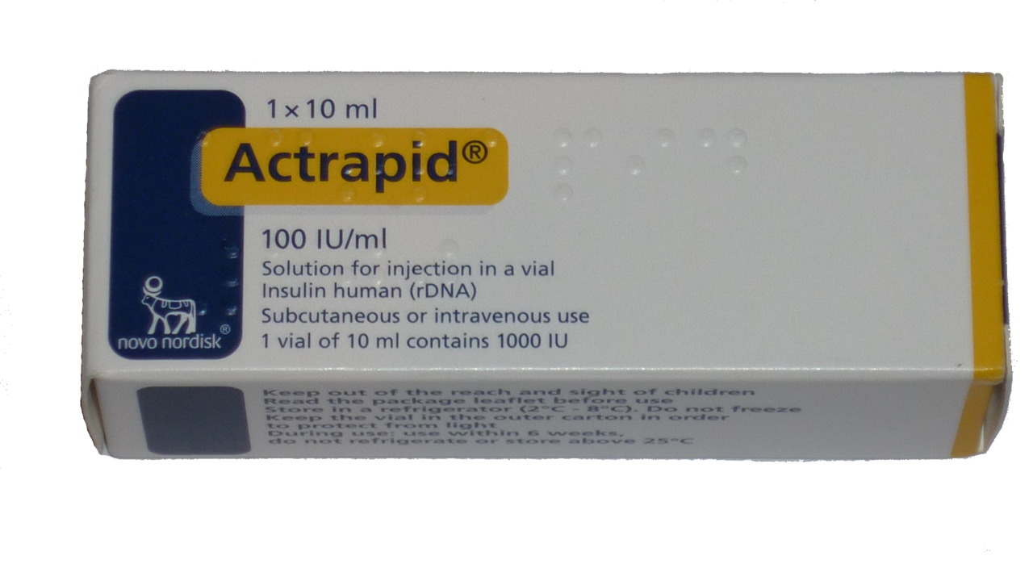
S.A.I

Slide 7
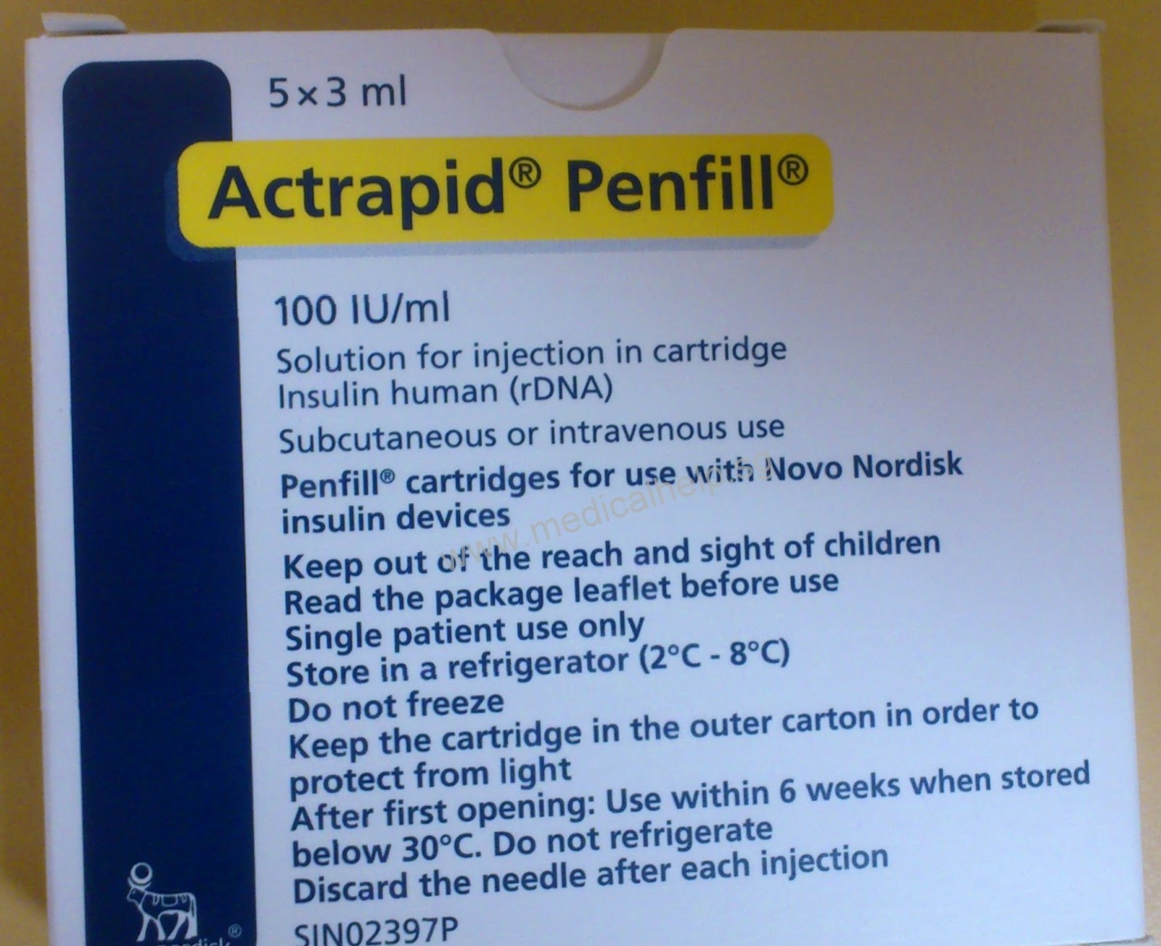

Slide 8
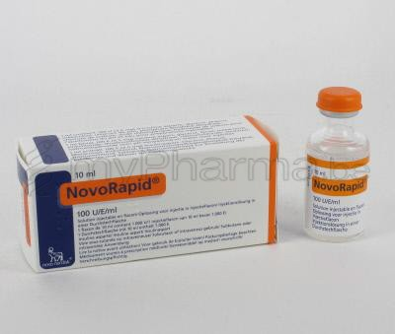
Insulin aspart

Slide 9
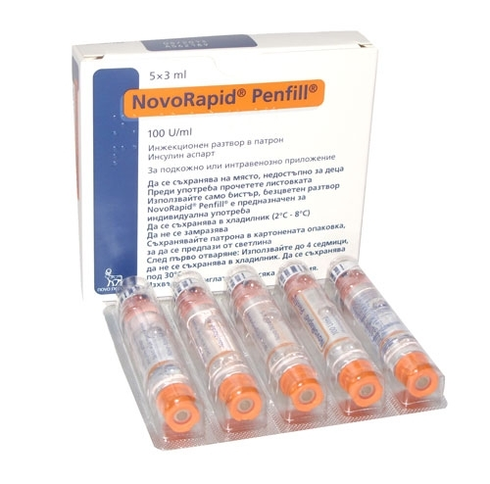

Slide 10
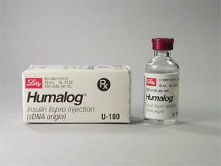
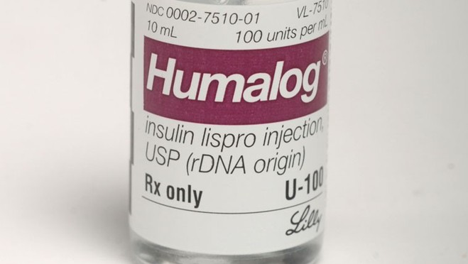
Insulin lispro

Slide 11
Insulin glulisine

Slide 12
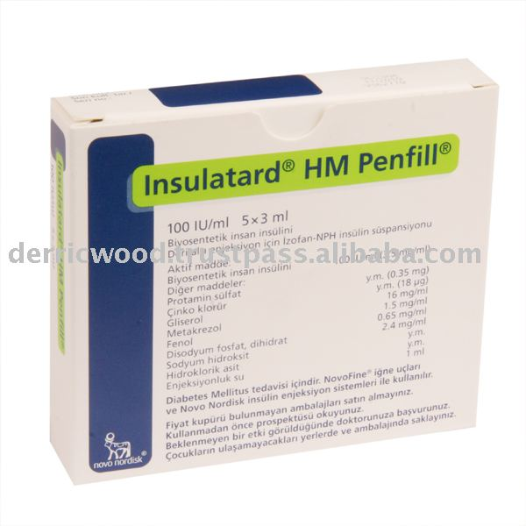
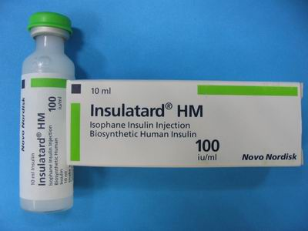
I.A.I

Slide 13
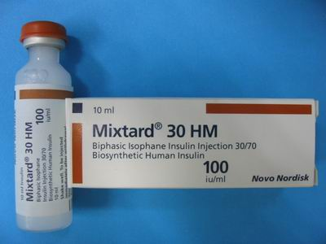

Slide 14
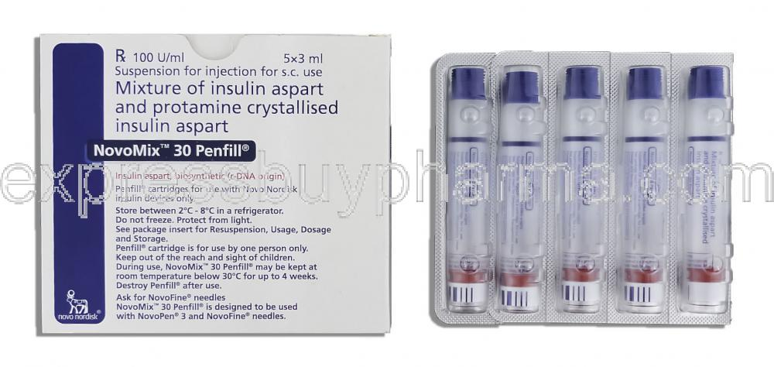

Slide 15
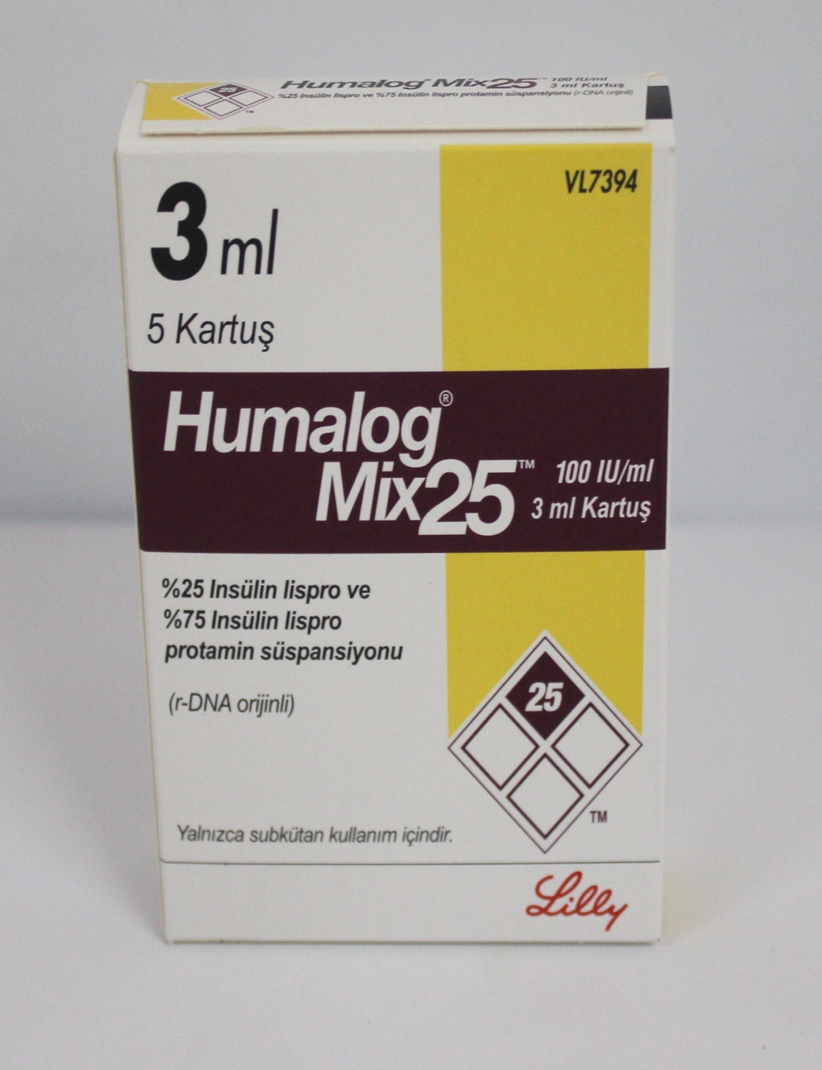
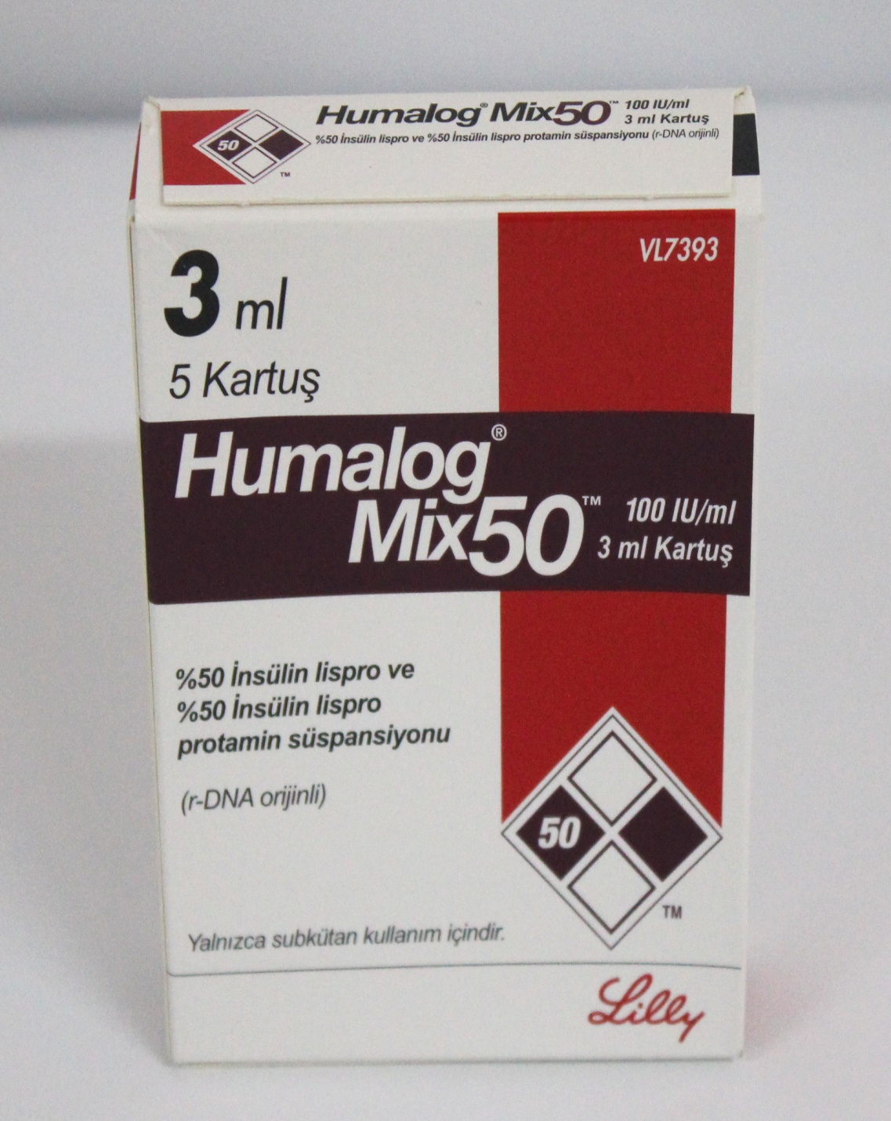

Slide 16
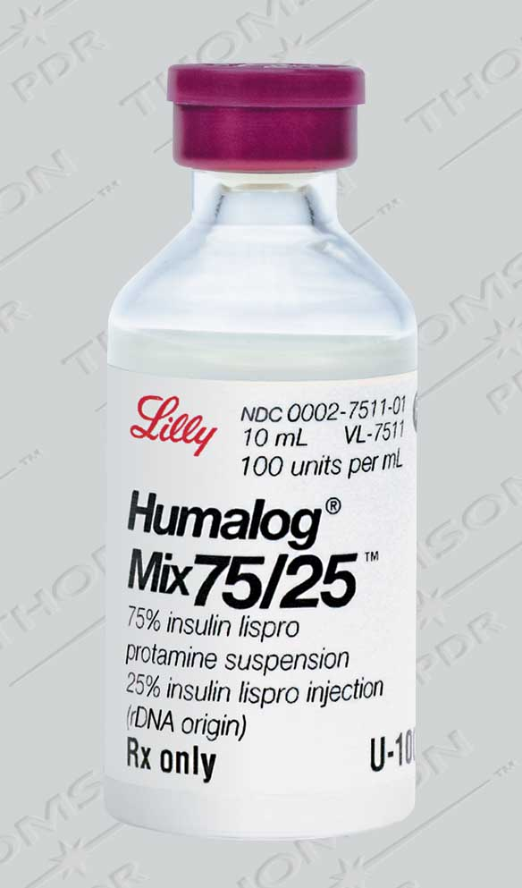

Slide 17
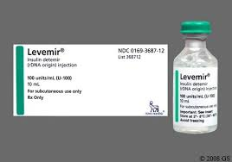
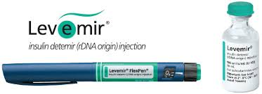
L.A.I

Slide 18
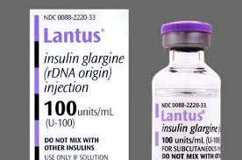

Slide 19
B ⁽¹⁾-Examples of insulin dosing regimen:
bedtime | Before** dinner | Before** lunch | Before** breakfast | Regimen
 | 1/3 of the total daily dose وهذه الجرعة بدورها تقسم بالشكل التالي 1/2 as I .A.I 1/2 as S.A.I (تخبط عادة في نفس السرنجة) |  | 2/3 of the total daily dose 2/3 as I .A.I 1/3 as S.A.I (تخبط عادة في نفس السرنجة) | 1
1/6 of the total daily dose given as I . A . I | 1/6 of the total daily dose given as S.A.I |  | 2/3 of the total daily dose وهذه الجرعة بدورها تقسم بالشكل التالي 2/3 as I .A.I 1/3 as S.A.I | 2
1/4 of the total daily dose as I .A.I | 1/4 of the total daily dose as S.A.I | 1/4 of the total daily dose as S.A.I | 1/4 of the total daily dose as S.A.I | 3
 | 1/5 of the total daily dose as S.A.I and 1/5 of the total daily dose as L .A.I | 1/5 of the total daily dose as S.A.I | 1/5 of the total daily dose as S.A.I and 1/5 of the total daily dose as L .A.I | 4

Slide 20
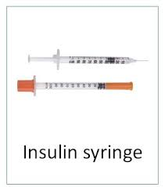

Slide 21
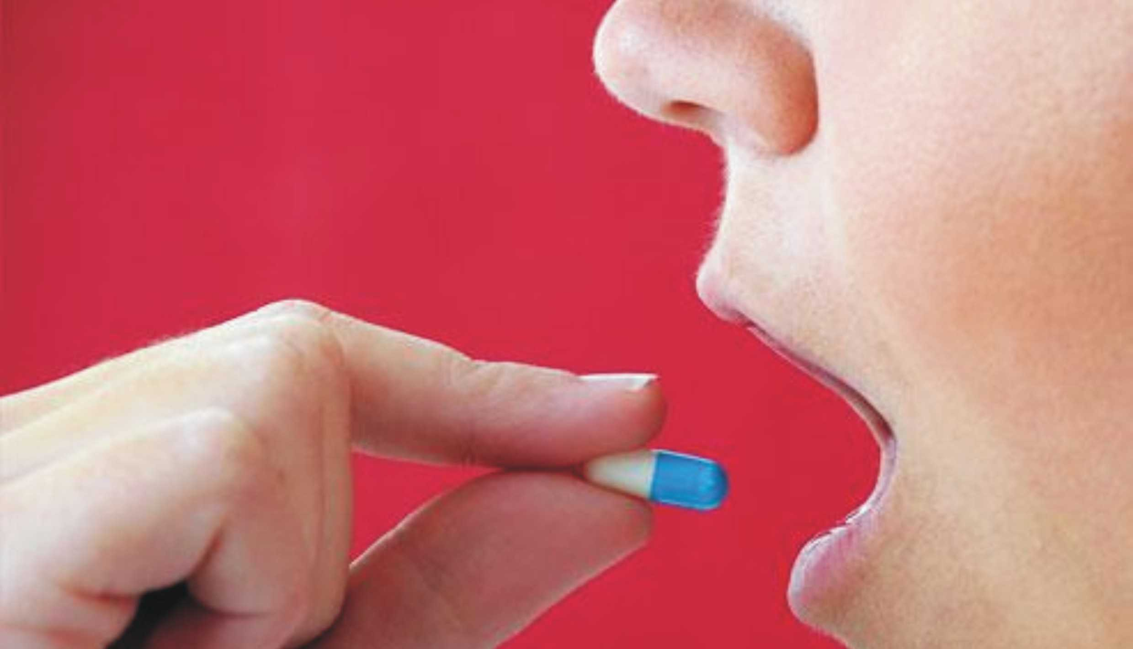
Management of T2DM

Slide 22
Sulfonylureas
Stimulate insulin release from the β-cells of the pancreas
Biguanides
Inhibit gluconeogenesis and increased insulin-stimulated glucose uptake
Thiazolidinedione
Bind to the PPARγ
and regulate the expression of multiple genes
Meglitinides
Stimulate insulin release from the β-cells of the pancreas
Incretin Mimetics
bind to GLP-1 receptors and stimulate glucose dependent insulin release.
Alpha-Glucosidase Inhibitors
Inhibit the digestion of complex carbohydrates

Slide 23
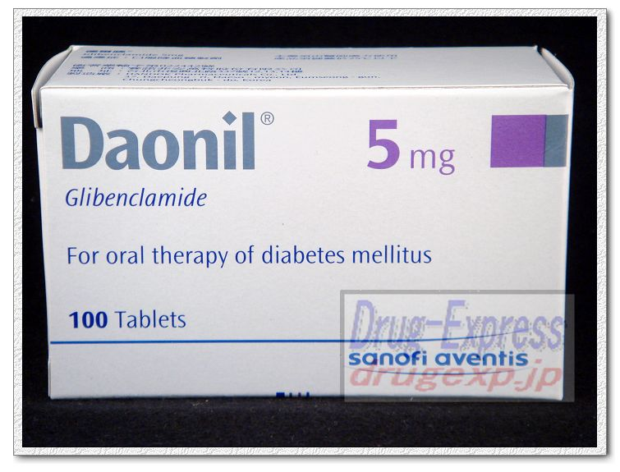

Slide 24
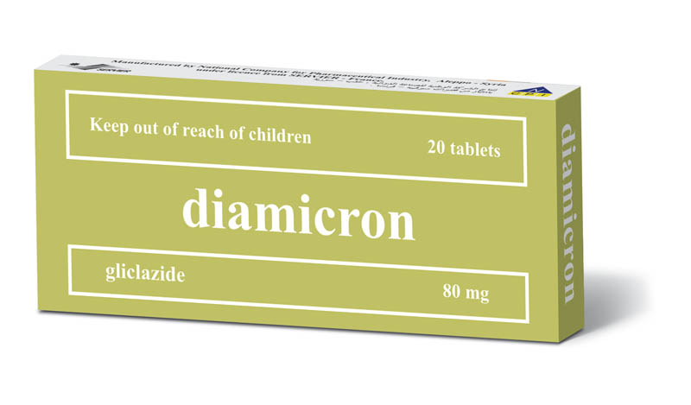
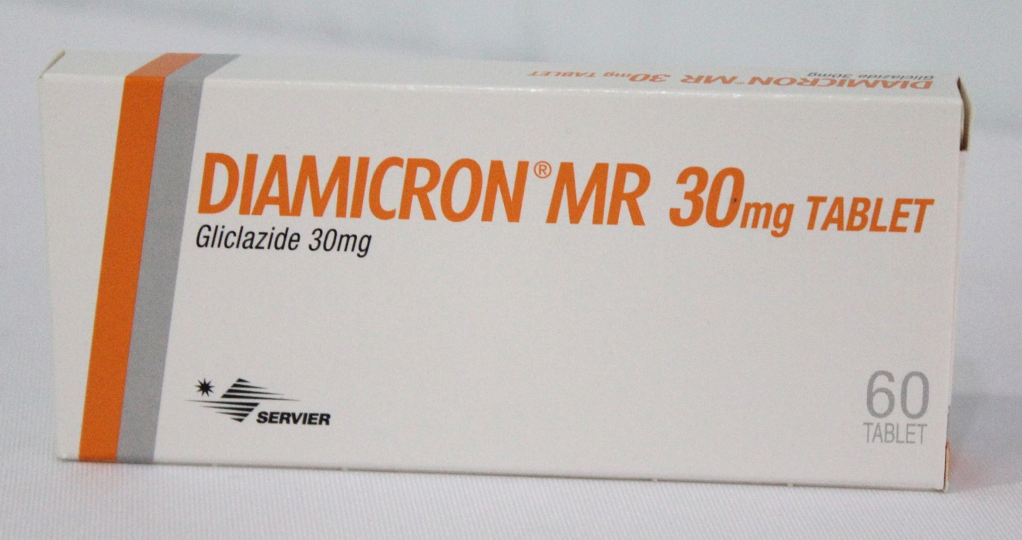

Slide 25
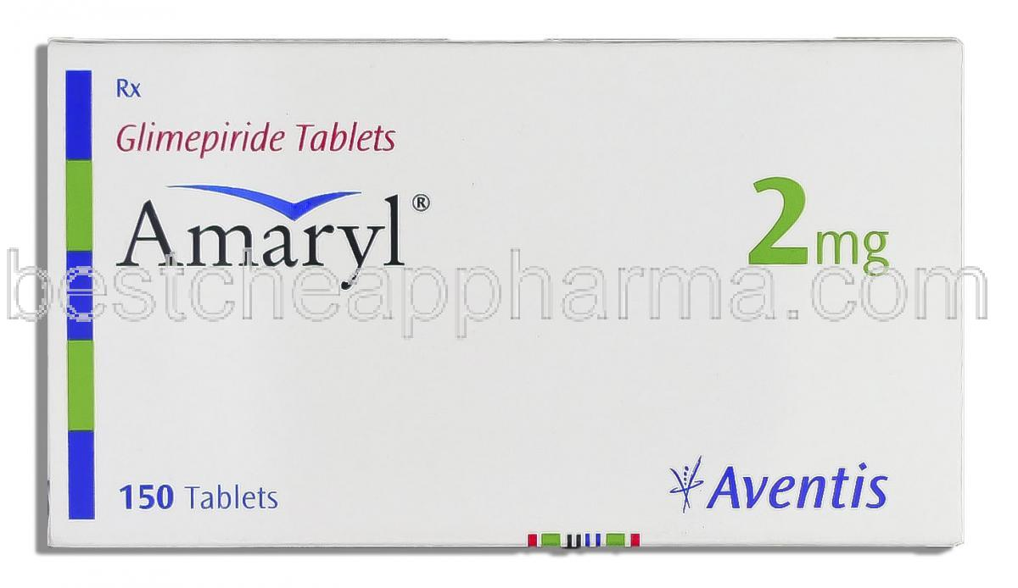
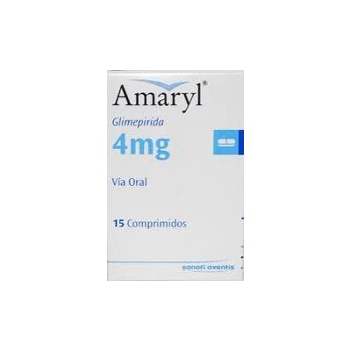
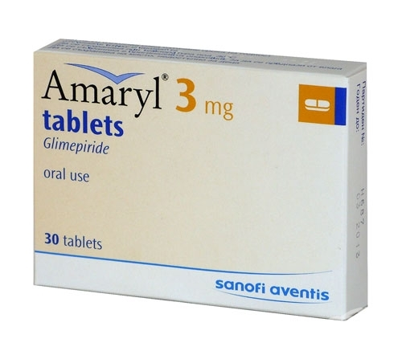

Slide 26
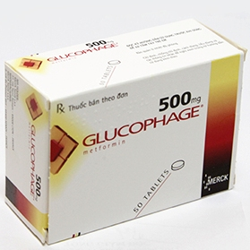
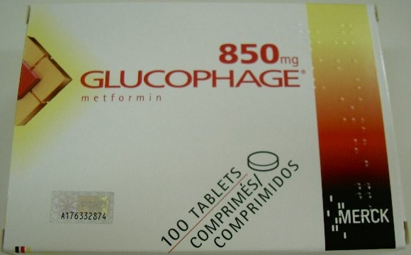

Slide 27
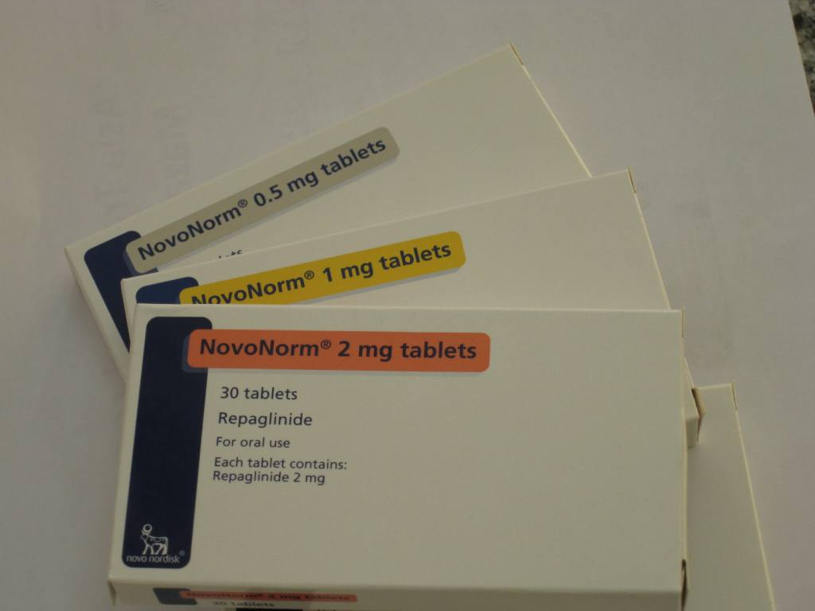

Slide 28
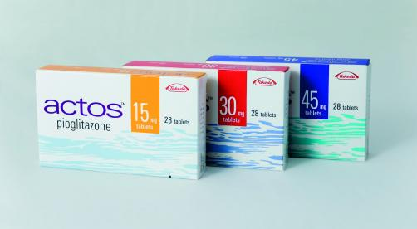

Slide 29
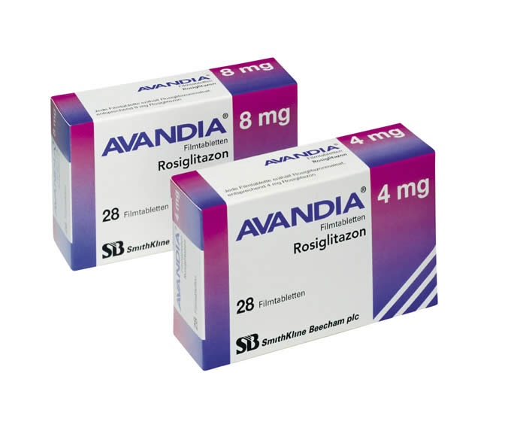

Slide 30
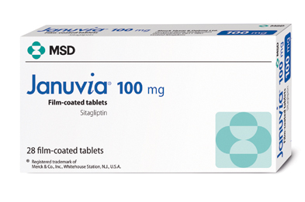

Slide 31
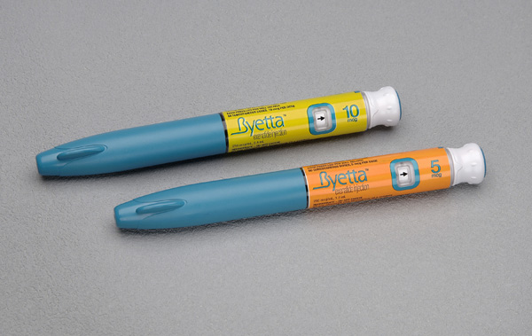

Slide 33
