Slide 1
Principles of pharmacy practice
Lec 1
Lecturer Dr Athmar Dhahir Habeeb Al-Shohani
PhD in industrial pharmacy and pharmaceutical formulations
athmar1978@uomustansiriyah.edu.iq
athmar1978@yahoo.com
athmar.habeeb.12@ucl.ac.uk

Slide 2
Interpretation of Prescriptions and
Medication Orders
Prescription
is an order for medication issued by a physician, dentist ,or other properly licensed medical practitioner.
A prescription designates a specific medication and dosage to be prepared by a pharmacist and administered to a particular patient.
A prescription is usually written on preprinted forms containing the traditional symbol (meaning ‘‘recipe,’’ ‘‘take thou,’’ or ‘‘you take’’), name, address, telephone number, and other pertinent information regarding the physician or other prescriber.
In addition, blank spaces are used by the prescriber to provide information about the patient, the medication desired, and the directions for use.

Slide 3
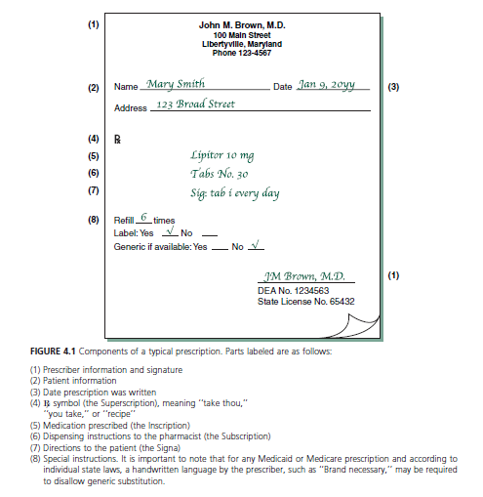

Slide 4
Components of a typical prescription
(1) Prescriber information and signature
(2) Patient information
(3) Date prescription was written
(4) symbol (the Superscription), meaning ‘‘take thou,’’
‘‘you take,’’ or ‘‘recipe’’
(5) Medication prescribed (the Inscription)
(6) Dispensing instructions to the pharmacist (the Subscription)
(7) Directions to the patient (the Signa)
(8) Special instructions.
It is important to note that for any Medicated or Medicare prescription and according to individual state laws, a handwritten language by the prescriber, such as ‘‘Brand necessary,’’ may be required to disallow generic substitution.

Slide 5
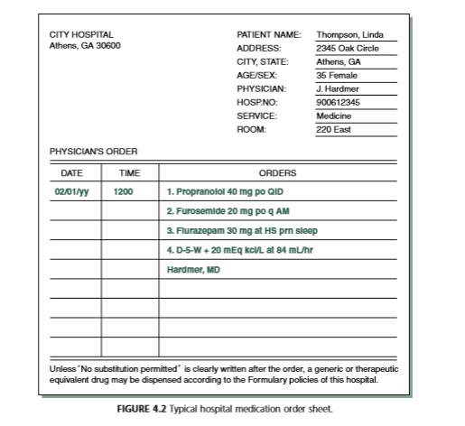
In hospitals and other institutions, the forms are somewhat different and are referred to as medication orders.
The orders shown in this example are typed; typically, these instructions are written by the physician in ink

Slide 6
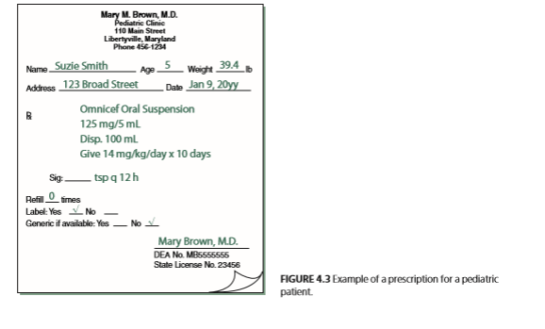
A prescription or medication order for an infant, child, or an elderly person may also include the age, weight, and/or body surface area (BSA) of the patient
This information is sometimes necessary in calculating the appropriate medication dosage.

Slide 7
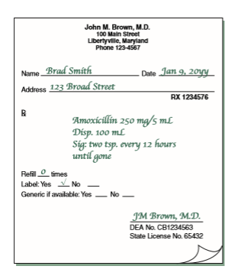
It is important to recognize two broad categories of prescriptions:
those not requiring compounding or admixture by the pharmacist
A prescription may include the chemical or non proprietary (generic) name of the substance or the manufacturer’s brand or trademark name

Slide 8
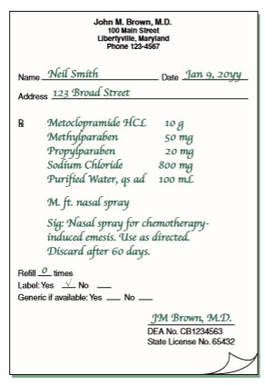
(2) those requiring compounding
Prescriptions requiring compounding contain the quantities of each ingredient required

Slide 9
The quantities of ingredients to be used almost always are expressed in SI metric units of weight and measurement.
In rare instances, units of the apothecaries’ system may be used.
In the use of the SI(metric system),the decimal point may be replaced by a vertical line that is imprinted on the prescription blank or hand drawn by the prescriber. In these instances, whole or subunits of grams of weight and milliliters of volume are separated by the vertical line.
Sometimes the abbreviations g (for gram) and mL (for milliliter) are absent and must be presumed.

Slide 10
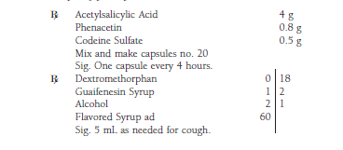
Examples of prescriptions written in SI metric units:

Slide 11
e-prescriptions
The use of electronic means for the generation and transmission of prescriptions is accepted throughout the United States.
In the inpatient or outpatient setting, a medication order, for a patient is entered into an automated data entry system (PC)or a handheld device loaded with e-prescribing software and sent to a pharmacy as an e-prescription. When received, a pharmacist immediately reduces the order to a hard copy and or stores it as a computer file.
Among the advantages cited fore e–prescriptions over traditional paper prescriptions are:
reduced errors due to prescription legibility;
concurrent software screens for drug interactions;
reduced incidence of altered or forged prescriptions;
efficiency for both prescriber and pharmacist;
convenience to the patient, whose prescription would likely be ready for pick-up upon arrival at the pharmacy

