Slide 1
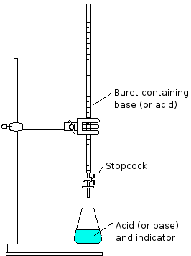
Standardization
The Titration

Slide 2
TYPES OF TITRATION
1-Acid base
2-Oxidation-reduction
3-Precipitation titration
4-Complex-formation titration

Slide 3
Applications of Neutralization Titration
When a solution of a strong acid is mixed with solution of a strong base, a chemical reaction
H⁺ (aq) + OH⁻ (aq) → H₂O

Slide 4
Experiment 4
Preparation and standardization (0.1 N ) HCL with (0.1 N) Na OH
1-Preparation of an (0.1N ) Na OH
N = $\frac{WT}{EQ .WT}X\frac{1000}{Vml}$ N = 0.1
V ml = 250
Eq. wt = 40
Wt = X = 1
Weigh (1gm ) of Na OH , Dissolve and dilute in volumetric flask with (250 ml ) by using distilled water .

Slide 5
2. Preparation of (0.1N) HCl from concentrated HCl
N_{(HCl)} = $\frac{SecificgravityX \% w/wX 1000 }{EQ .WTofHCl}$
Specific gravity = 1.18
Eq.wt of HCl = 36.5
%38 $\frac{w}{w}$ of HCl is obtained from the reagent bottle
... N concentrated HCL = 12
To calculate the volume of concentrated HCL that should be taken to prepare 250 ml of (0.1N) HCL
Conc.HCL diluted HCL
N₁ V₁ = N₂ V₂
12 X V₁ = 0.1 X 250
V₁ = 2.2 ml should be taken from the concentrated HCL and should be diluted with distilled water in the volumetric flask with (250 ml ) to obtain ( 0.1 N) HCL

Slide 6
Standardization of (0.1N ) NaOH solution
Procedure :
1.Transfer (10.0 ml) of standard HCl solution to conical flask .
2. Add 1-2 drops of phenolphthalein(ph- ph)indicator it will be colorless .
3. Place a white sheet of paper under the flask to aid in the detection of any color change .
4. Fill the burette with the prepared NaOH solution .
5. Start titration by adding NaOH solution dropwise into the conical flask until the color of the solution is faint pink

Slide 7
6. The exact normality of NaOH is obtained from the following equation :
HCl + NaOH → NaCl + H ₂O
N₁ V₁ = N₂V₂ (NaOH) ( HCl )

