Slide 1
Pharmaceutical chemistry
Adrenergic Agents
Assist . Prof . Karima F. Ali
AL-Mustansiriyah university
College of pharmacy

Slide 2
Adrenergic drugs exert their principal pharmacological and therapeutic effects by either enhancing or reducing the activity of the various components of the sympathetic division of the autonomic nervous system.
In general, substances that produce effects similar to stimulation of sympathetic nervous activity are known as sympathomimetics or adrenergic stimulants. Those that decrease sympathetic activity are referred to as sympatholytics, antiadrenergics, or adrenergic-blocking agents.
Adrenergic agents act on adrenergic receptors (adrenoceptors, ARs) or affect the life cycle of adrenergic neurotransmitters (NTs), including norepinephrine (NE, noradrenaline), epinephrine (E, adrenaline), and dopamine (DA). These NTs modulate many vital functions, such as the rate and force of cardiac contraction, constriction, and dilation of blood vessels and bronchioles, the release of insulin, and the breakdown of fat.

Slide 3
Structure and Physicochemical Properties
NE,E, and DA are chemically catecholamines (CAs) ,which refer generally to all organic compounds that contain a catechol nucleus (orthodihydroxybenzene) and an ethylamine group.
In a physiological context, the term usually means DA and its metabolites NE and E.
E contains one secondary amino group and three hydroxyl groups. E and NE each possess a chiral carbon atom; thus, each can exist as an enantiomeric pair of isomers. The enantiomer with the (R) configuration is biosynthesized by the body and possesses the biological activity. This (R) configuration of many other adrenergic agents also contributes to their high affinity to the corresponding adrenoceptors

Slide 4
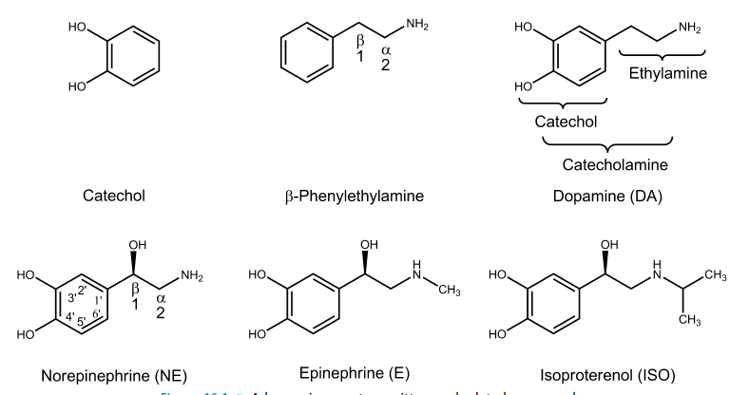
Adrenergic neurotransmitters and related compounds.

Slide 5
E is a weak base (pKa 9.9) because of its aliphatic amino group. It is also a weak acid (pKa 8.7) because of its phenolic hydroxyl group. It can be predicted that ionized species (the cation form) of E at physiological pH is predominant (log D at pH 7 2.75). This largely accounts for the high water solubility of this compound as well as other CAs.
Because log P with a value of 0 to 3 is an optimal window for absorption, we can predict that E has poor absorption and poor central nervous system (CNS) penetration.

Slide 6
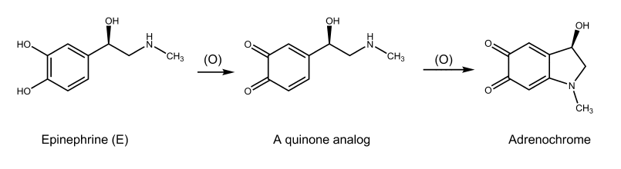
Like most phenols, the catechol functional groups in CAs are highly susceptible to facile oxidation.
E and NE undergo oxidation in the presence of oxygen (air) or other oxidizing agents to produce a quinone analog, which undergoes further reactions to give mixtures of colored products, one of which is adrenochrome .Hence, solutions of these drugs often are stabilized by the addition of an antioxidant (reducing agent) such as ascorbic acid or sodium bisulfite.

Slide 7
Biosynthesis
The first step in CA biosynthesis is the 3-hydroxylation of the amino acid L-tyrosine to form L- dihydroxyphenyl alanine (L-DOPA) by tyrosine hydroxylase (TH, tyrosine-3-monooxygenase).
As usual for the first enzyme in a biosynthetic pathway, TH hydroxylation is the rate-limiting step in the biosynthesis of NE. Further inhibitors of TH markedly reduce endogenous NE and DA in the brain and NE in the heart, spleen, and other sympathetically innervated tissues. This enzyme plays a key role in the regulation of CA biosynthesis and is, therefore, the logical biological target of some drugs.

Slide 8
The second step is the decarboxylation of L-DOPA to give DA. The enzyme involved is DOPA decarboxylase.
The third step is side-chain hydroxylation of DA to give NE.
The last step is the N-methylation of NE to give E in the adrenal medulla. The reaction is catalyzed by the enzyme phenylethanolamine-N-methyl transferase (PNMT).

Slide 9
Biosynthesis of the catecholamines dopamine, norepinephrine, and epinephrine.

Slide 10
Storage, Release, Uptake, and Metabolism
Storage and Release.
A large percentage of the NE present is located within highly specialized subcellular particles (later shown to be synaptic vesicles but colloquially referred to as granules) in sympathetic nerve endings and chromaffin cells. Much of the NE in CNS is also located within similar vesicles. The concentration in the vesicles is maintained also by the VMAT (Vesicular monoamine transporter). Indirectly acting and mixed sympatho-mimetics (e.g. Tyramine, amphetamines, and ephedrine) are capable of releasing stored transmitter from noradrenergic nerve endings by a calcium-independent process.
These drugs are poor agonists (some are inactive) at adrenoceptors, but they are excellent substrates for VMAT

Slide 11
Uptake.
Two uptake mechanisms exist for terminating the action of adrenergic catecholamines - uptake 1 and uptake 2. Uptake 1 occurs at the presynaptic nerve terminal to remove the neurotransmitter from the synapse. Uptake 2 occurs at postsynaptic and peripheral cells to prevent the neurotransmitter from diffusing laterally. Once NE has exerted its effect at adrenergic receptors, there must be mechanisms for removing the NE from the synapse and terminating its action at the receptors. These mechanisms include (a) reuptake of NE into the presynaptic neuron (recycling, major mechanism) by NET (NE reuptake transporter) and into extraneuronal tissues, (b) conversion of NE to an inactive metabolite, and (c) diffusion of the NE away from the synapse. The first two of these mechanisms require specific transport proteins or enzymes, and therefore are targets for pharmacologic intervention.

Slide 12
Model of life cycle of NE.

Slide 13
Metabolism
The major mammalian enzymes of importance in the CA metabolism are monoamine oxidase (MAO) and catechol-O-methyl transferase (COMT).
MAOs oxidatively deaminate CAs to their corresponding aldehydes, which are rapidly oxidized to the corresponding acid by the enzyme aldehyde dehydrogenase (AD).

Slide 14
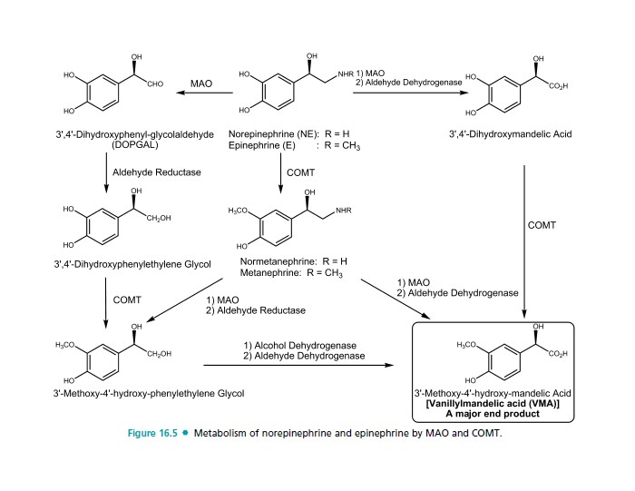

Slide 15
Adrenergic Receptors Adrenergic Receptor Subtypes
most signaling molecules such as CAs are too polar to pass through the membrane, and no appropriate transport systems are available. Thus, the information that they present must be transmitted across the cell membrane without the molecules themselves entering the cell.
An important factor in the response of any cell or organ to adrenergic drugs is the density and proportion of α- and β-adrenoceptors. For example, NE has relatively little capacity to increase bronchial airflow, because the receptors in bronchial smooth muscle are largely of the β2-subtype.
In contrast, isoproterenol (ISO) and E are potent bronchodilators.

Slide 16
The various adrenoceptor types and subtypes are not uniformly distributed with certain tissues containing more of one type than another.
The clinical use of receptors-selective drugs becomes obvious when one considers the adrenoceptor subtypes and their locations.
α1-Agonists as Vasoconstrictors and Nasal Decongestants.
α1-Antagonists for Treatment of Hypertension.
α2-Agonists for Treatment of Hypertension.
β1-Blockers for Treatment of Hypertension, Angina, and Certain Cardiac Arrhythmias.
β 2-Agonists for Treatment of Asthma and Premature Labor.

Slide 17
α-Adrenergic Receptors
A functional classification of the α–receptors was proposed wherein α1-receptors were designated as those that were excitatory, while α2-receptors purportedly mediated inhibitory responses.
The α1- and α2-receptors each have been divided into at least three subtypes.
The interaction of adrenergic drugs and the receptors alters the tertiary or quaternary structure of the receptor, including the intracellular domain. α-receptors are involved in control of the Cardio-vascular system.
The α2-receptors not only play a role in the regulation of NE release but also regulate the release of other NTs, such as acetylcholine and serotonin. Both α1- and α2-receptors also play an important role in the regulation of several metabolic processes, such as insulin secretion and glycogenolysis.

Slide 18
β-Adrenergic Receptors
Three β-receptor subtypes have been cloned, including β1,β2, and β3.
The use of β2-agonists as bronchodilators and β1- or
β1/β2-blockers as antihypertensives is well established.
The β2-receptors are located on smooth muscle throughout the body, where they are involved in relaxation of the smooth muscle, producing such effects as bronchodilation and vasodilatation
The β3-receptor is located on brown adipose tissue and is involved in the stimulation of lipolysis.

Slide 19
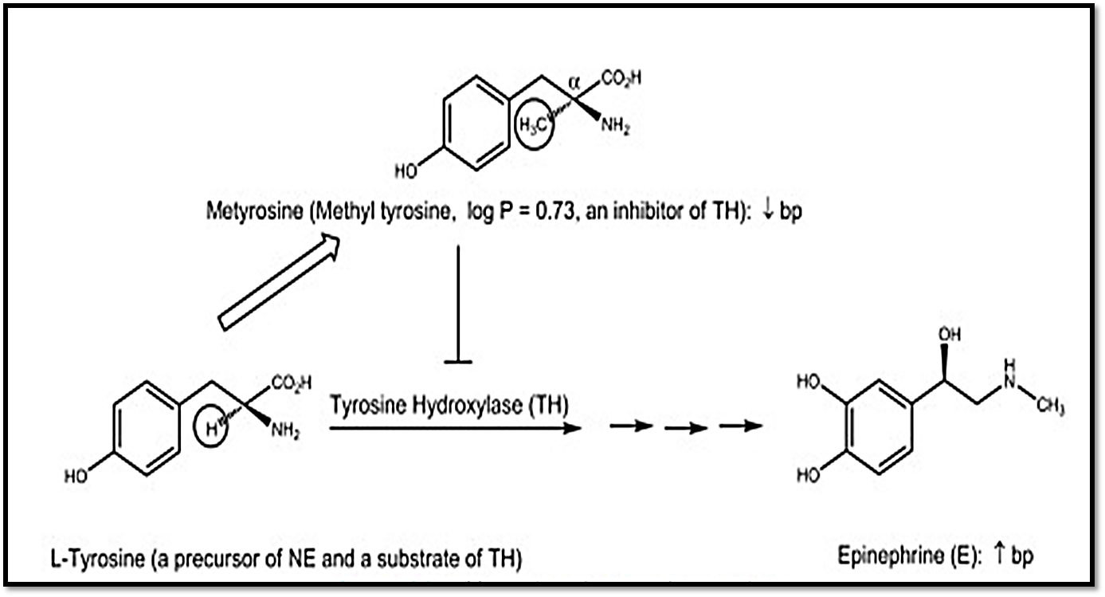
Drugs affecting adrenergic neurotransmission
Drugs Affecting Catecholamine Biosynthesis
Metyrosine (-Methyl-L-tyrosine, Demser).
Metyrosine is a much more effective competitive inhibitor of E and NE production than agents that inhibit any of the other enzymes involved in CA biosynthesis. Metyrosine differs structurally from tyrosine only in the presence of an -methyl group.

Slide 20
Drugs Affecting Catecholamine Storage and Release
1.Reserpine (an NT Depleter).
Reserpine, a prototypical and historically important drug, is an indole alkaloid obtained from the root of Rauwolfia serpentina found in India.
It not only depletes the vesicle storage of NE in sympathetic neurons in PNS, neurons of the CNS, and E in the adrenal medulla, but also depletes the storage of serotonin and DA in their respective neurons in the brain.
Reserpine binds extremely tightly with and blocks VMAT that transports NE and other biogenic amines from the cytoplasm into the storage vesicles.

Slide 22
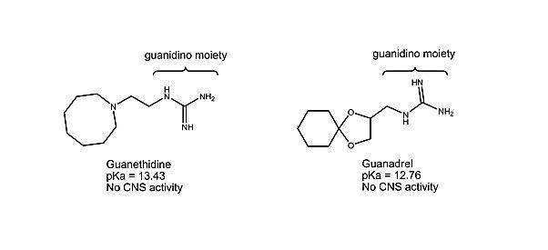
2.Guanethidine (Ismelin) and guanadrel (Hylorel)
Are seldom used orally active antihypertensives. Drugs of this type enter the adrenergic neuron by way of the uptake-1 process and accumulate within the neuronal storage vesicles.
They bind to the storage vesicles and stabilize the neuronal storage vesicle membranes, making them less responsive to nerve impulses.

Slide 23
The ability of the vesicles to fuse with the neuronal membrane is also diminished, resulting in inhibition of NE release into the synaptic cleft in response to a neuronal impulse and generalized decrease in sympathetic tone. Long-term administration of some of these agents also can produce a depletion of NE stores in sympathetic neurons. Both neuronal blocking drugs possess a guanidino moiety which is attached to either hexahydroazocinyl ring linked by an ethyl group as in guanethidine, or a dioxaspirodecyl ring linked by a methyl group as in guanadrel.
The presence of the more basic guanidino group (pKa 12) than the ordinary amino group in these drugs means that at physiological pH, they are essentially completely protonated.

Slide 24
Sympathomimetic agents
Sympathomimetic agents produce effects resembling those produced by stimulation of the sympathetic nervous system. They may be classified as agents that produce effects by a direct, indirect, or mixed mechanism of action.
Direct-acting agents elicit a sympathomimetic response by interacting directly with adrenergic receptors. These drugs act directly on one or more adrenergic receptors. According to receptor selectivity they are two types:
Non-selective: drugs act on one or more receptors; these are:
Adrenaline (almost all adrenergic receptors).
Noradrenaline (acts on α1, α2, β1).
Isoprenaline (acts on β1, β2, β3).
Dopamine (acts on α1, α2, β1, D1, D2).

Slide 25
Selective: drugs which act on a single receptor only; these are further classified into α selective & β selective.
α1 selective: Phenylephrine, Methoxamine, Midodrine, Oxymetazoline.
α2 selective: α-Methyl dopa, clonidine, brimonidine.
β1 selective: Dobutamine.
β2 selective: Salbutamol/Albuterol, Terbutaline, Salmeterol, Formoterol, Pirbuterol.

Slide 26
Indirect-acting agents produce effects primarily by causing the release of NE from adrenergic nerve terminals; the NE that is released by the indirect- acting agent activates the receptors to produce the response. (agents that increase neurotransmission in endogenous chemicals in this case Epinephrine and Norepinephrine)
Amphetamines, Cocaine, Methylenedioxy methamphetamine (MDMA), Tyramine, Nicotine, Caffeine, Methylphenidate
Compounds with a mixed mechanism of action interact directly with adrenergic receptors and indirectly cause the release of NE.
Ephedrine, Pseudoephedrine

Slide 27
Direct Acting Sympathomimetics
The parent structure with the features in common for many of the adrenergic drugs is: β-phenyl ethyl-amine.
The substitution on the meta-,and Para-positions of the aromatic ring, on the amino, and on α - (R2) and β-positions (R1) of the ethylamine side chain influences not only their mechanism of action, the receptor selectivity, but also their absorption, oral activity, metabolism, degradation, and thus duration 0f action (DOA). For the direct acting Sympathomimetic amines, maximal activity is seen in β-phenylethylamine derivatives containing (a) a catechol and (b) a (1R)-OH group on the ethylamine portion of the molecule.

Slide 28
Such structural features are seen in the prototypical direct-acting compounds NE, E, and ISO. A critical factor in the interaction of adrenergic agonists with their receptors is stereo selectivity.
Substitution on either carbon-1 or carbon-2 yields optical isomers. (1R,2S) isomers seem correct configuration for direct-acting activity. For CAs, the more potent enantiomer has the (1R) configuration. This enantiomer is typically several 100-fold more potent than the enantiomer with the (1S) configuration.
All direct-acting, phenylethylamine-derived agonists that are structurally similar to NE, the more potent enantiomer is capable of assuming a conformation that results in the arrangement in space of the catechol group, the amino group, and the (1R)-OH group in a fashion resembling that of (1R)-NE.

Slide 29
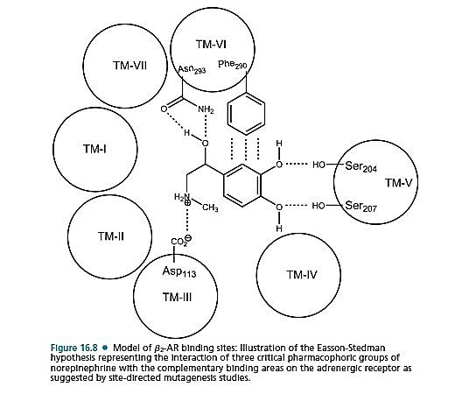
This explanation of stereo selectivity is based on the presumed interaction of these three critical pharmacophoric groups with three complementary binding areas on the receptor.

Slide 30
Structure–activity relationships
1.Separation of Aromatic Ring and Amino Group.
The greatest adrenergic activity occurs when two carbon atoms separate the aromatic ring from the amino group. This rule applies with few exceptions to all types of activities.
2.R1, Substitution on the Amino Nitrogen Determines α – or β -Receptor Selectivity
Replacing nitrogen with carbon results in a large decline in activity. The activity is also affected by the number of substituents on the nitrogen. Primary and secondary amines have good adrenergic activity, whereas tertiary amines and quaternary ammonium salts do not.

Slide 31
*As the size of the nitrogen substituent increases, α-receptor agonist activity generally decreases and β–receptor agonist activity increases.
3. R2, Substitution on the -Carbon (Carbon-2).
Substitution by small alkyl group (e.g., CH3- or C2H5-) slows metabolism by MAO but has little overall effect on DOA of catechols because they remain substrates for COMT.
4. OH substitution on the -carbon (carbon-1). generally decreases CNS activity largely because it lowers lipid solubility. However, such substitution greatly enhances agonist activity at both α – and β -receptors.

Slide 32
5. Substitution on the Aromatic Ring.
Maximal α – and β -activity also depends on the presence of 3′ and 4′ OH groups.
Tyramine, which lacks two OH groups, has no affinity for adrenoceptors, indicating the importance of the OH groups. Studies of adrenoceptor structure suggest that the OH groups on serine residues 204 and 207 probably form H bonds with the catechol OH groups at positions 3 and 4, respectively.
Replacement of the catechol function of ISO with the resorcinol structure gives a selective β2- agonist , (metaproterenol). Furthermore, because the resorcinol ring is not a substrate for COMT, β-agonists that contain this ring structure tend to have better absorption characteristics and a longer DOA than their catechol-containing counterparts.

Slide 33
In another approach, replacement of the meta-OH of the catechol structure with a hydroxymethyl group gives agents, such as albuterol, which show selectivity to the β2-receptor. Because they are not catechols, these agents are not metabolized by COMT and thus show improved oral bioavailability and longer DOA.
The catechol moiety is more important for α2-activity than for α1-activity.
For example, removal of the p-OH group from E gives phenylephrine, which, in contrast to E, is selective for the α1-receptor.

Slide 34
6. CAs without OH Groups.
Phenylethylamines that lack OH groups on the ring and the β-OH group on the side chain act almost exclusively by causing the release of NE from sympathetic nerve terminals and thus results in a loss of direct Sympathomimetic activity.
Because substitution of OH groups on the phenylethylamine structure makes the resultant compounds less lipophilic, unsubstituted or alkyl substituted compounds cross the BBB more readily and have more central activity.

Slide 39
Imidazolines and α -Adrenergic Agonists.
A second chemical class of α-agonists, the imidazolines, which give rise to α -agonists and are thus vasoconstrictors.
These imidazolines can be nonselective, or they can be selective for either α1-or α2-receptors. Structurally, most imidazolines have their heterocyclic imidazoline nucleus linked to a substituted aromatic moiety via some type of bridging unit .The optimum bridging unit (X) is usually a single methylene group or amino group.

Slide 40
Although modification of the imidazoline ring generally results in compounds with significantly reduced agonist activity, there are examples of so-called open-ring imidazolines that are highly active.
The nature of the aromatic moiety, as well as how it is substituted, is quite flexible.
Agonist activity is enhanced when the aromatic ring is substituted with halogen substituents like chlorine (Cl) or small alkyl groups like methyl group, particularly when they are placed in the two ortho positions. Because the SARs of the imidazolines are quite different from those of the β-phenyl ethylamines, it has been postulated that the imidazolines interact with receptors differently from the way the β-phenyl ethylamines do, particularly with regard to the aromatic moiety.

Slide 41
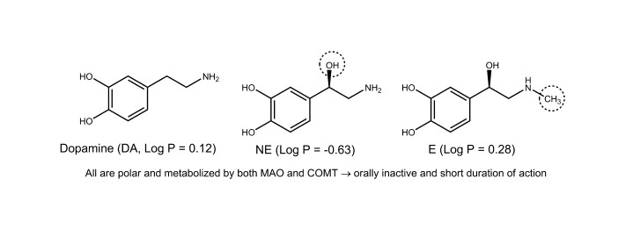
Endogenous catecholamines
The three naturally occurring catecholamines DA, NE, and E are used as therapeutic agents.

Slide 42
-DA stimulates the β1-receptors of the heart to increase cardiac output.
-NE is a stimulant of α1-,α 2-, and β1-adrenoceptors (notice that lacking the N-methyl group results
in lacking β2- and β3-activity). It has limited clinical application caused by the nonselective nature of its
activities.
-E is a potent stimulant of all α1-, α2-, β1-, β2-, and β3-
adrenoceptors,). It is much more widely used clinically than NE.
-CAs are light sensitive and easily oxidized on exposure to air because of the catechol ring system.
-All are polar and rapidly metabolized by both COMT and MAO, resulting in poor oral bioavailability and short DOA.

Slide 43
Dipivefrin (Propine, Dipivalyl Epinephrine).
Dipivefrin is a prodrug of Epinephrine that is formed by the esterification of the catechol OH groups of Epinephrine with pivalic acid. Most of the advantages of this prodrug over stem Epinephrine from improved bioavailability.

Slide 44
To overcome several of the pharmacokinetic and pharmaceutical shortcomings of E as an ophthalmic agent, the prodrug approach has been successfully applied. The greatly increased lipophilicity allows much greater penetrability in to the eye through the corneal epithelial and endothelial layer. Dipivefrin has the β1-OH group and cationic Nitrogen. This dual solubility permits much greater penetrability into the eye than the very hydrophilic E hydrochloride.
Increased DOA is also achieved because the drug is resistant to the metabolism by COMT.
After its absorption, it is converted to E by esterases slowly in the cornea and anterior chamber.
Dipivefrin also offers the advantage of being less irritating to the eye than E.

Slide 45
α -adrenergic receptor agonists
All selective α1-agonists have therapeutic activity as vasoconstrictors. Structurally, they include:
(a)Phenylethanolamine derivatives:
such as phenylephrine, Metaraminol, and methoxamine.
(b) 2-arylimidazolines derivatives:
such as xylometazoline,oxymetazoline,tetrahydrozoline, and naphazoline.

Slide 46
Phenylephrine.
(Neo- Synephrine), a prototypical selective direct-acting α1-agonist differs from E only in lacking a p-OH group. It is orally active, and its DOA is about twice that of E because it lacks the catechol moiety and thus is not metabolized by COMT. However, its oral bioavailability is less than 10% because of its hydrophilic properties (log P 0.3), intestinal 3-O-glucuronidation/ sulfation and metabolism by MAO. Lacking the p-OH group, it is less potent than E and NE but it is a selective α1-agonist and thus a potent vasoconstrictor. It is used for hypotension.
Metaraminol is just another example.

Slide 47
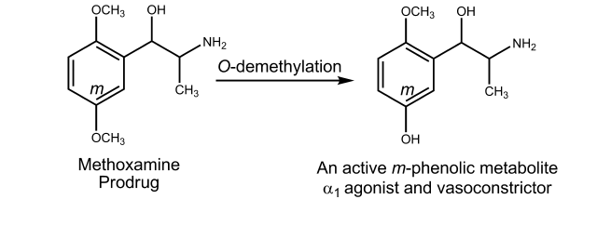
Methoxamine (Vasoxyl)
is another α1-agonist and parenteral vasopressor used therapeutically and so have few cardiac stimulatory properties.
It is bioactivated by O-demethylation to an active m-phenolic metabolite.

Slide 48
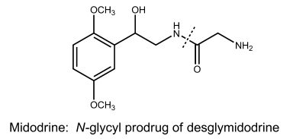
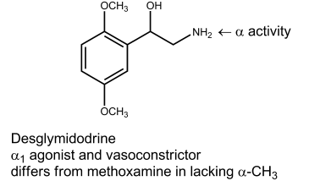
Midodrine (ProAmatine)
The N- glycyl prodrug of the selective α1-agonist desglymidodrine. Removal of the N-glycyl moiety from midodrine occurs readily in the liver as well as throughout the body, presumably by amidases.
Midodrine is orally active and represents another example of a dimethoxy-β-phenylethylamine derivative that is used therapeutically for its vasoconstrictor properties.

Slide 49
Naphazoline (Privine), tetrahydrozoline (Tyzine,
Visine), xylometazoline (Otrivin), and oxymetazoline (Afrin)
These agents are used for their vasoconstrictive effects as nasal and ophthalmic decongestants.
All α2-aralkylimidazoline α1-agonists contain a one-carbon bridge between C-2 of the imidazoline ring and a phenyl ring, and thus a phenylethylamine structure feature is there.
Ortho-lipophilic groups on the phenyl ring are important for -activity.
meta or Para-bulky lipophilic substituents on the phenyl ring may be important for the α1-selectivity.
They have limited access to the CNS, because they essentially exist in an ionized form at physiological pH caused by the very basic nature of the imidazoline ring (pKa 10–11).
Xylometazoline and oxymetazoline have been used as topical nasal decongestants because of their ability to promote constriction of the nasal mucosa

Slide 52
Clonidine (Catapres)
Differs from 2-arylimidazoline α1-agonists mainly by the presence of o-chlorine groups and a NH bridge.
The o-chlorine groups afford better activity than o-methyl groups at α2 sites. Importantly, clonidine contains a NH bridge (aminoimidazolines) instead of CH2 bridge in α2-arylimidazoline.
The ability of clonidine and its analogs to exert an antihypertensive effect depends on the ability of these compounds not only to interact with the α2-receptor in the brain but also to gain entry into the CNS.

Slide 53
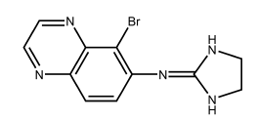
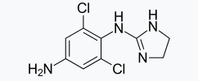
Apraclonidine (Iopidine) and Brimonidine (Alphagan)
Apraclonidine does not cross the BBB. However, brimonidine can cross the BBB and hence can produce hypotension and sedation, although these CNS effects are slight compared with those of clonidine. Brimonidine is a much more selective α2-agonist than clonidine or apraclonidine and is a firstline agent for treating glaucoma.
Apraclonidine Brimonidine

Slide 54
Guanabenz (Wytensin) and Guanfacine ((Tenex) (Open-Ring Imidazolidine
Studies on SAR of central α2-agonists showed that the imidazoline ring was not necessary for α2-activity. the 2,6-dichlorophenyl moiety found in clonidine is connected to aguanidino group by a two-atom bridge. guanabenz, this bridge is a -CH=N- group, whereas for guanfacine, it is a —CH2CO— moiety. For both compounds, conjugation of the guanidino moiety with the bridging moiety helps to decrease the pKa of the basic group, so that at physiological pH a significant portion of each drug exists in its nonionized form. This accounts for their CNS penetration and high oral bioavailability (70%–80% for guanabenz and 80% for guanfacine). Guanfacine is more selective for α2-receptors than is clonidine.

Slide 56
Methyldopa (L-methyldopa, Aldomet)
Differs structurally from L-DOPA only in the presence of a α - methyl group. Methyldopa ultimately decreases the concentration of DA, NE, E, and serotonin in the CNS and periphery. However, its mechanism of action is not caused by its inhibition of AADC(L-Aromatic Amino acid Decarboxylase) but, rather, by its metabolism in the CNS to its active metabolite (α-methylnorepinephrine). This active metabolite is a selective α2-agonist because it has correct (1R,2S) configuration.

Slide 57
α- methyl norepinephrine acts on α2-receptors in the CNS in the same manner as clonidine, to decrease sympathetic outflow and lower blood pressure. Methyldopa is used only by oral administration because its zwitter ionic character limits its solubility. The ester hydrochloride salt of methyldopa, methyldopate (Aldomet ester), was developed as a highly water-soluble derivative that could be used to make parenteral preparations. It is converted to methyldopa in the body through the action of esterases

Slide 58
Metabolic conversion of methyl dopate and methyldopa to -methylnorepinephrine

Slide 59
β-Adrenergic receptor agonists Isoproterenol
Isoproterenol (Isuprel) is a nonselective and prototypical β -agonist (β2/β1 = 1).
The principal reason for its poor absorption characteristics and relatively short DOA is its facile metabolism by sulfate and glucuronide conjugation of the phenolic OH groups and o-methylation by COMT.

Slide 60
Unlike E and NE, ISO does not appear to undergo oxidative deamination by MAO. Because of an isopropyl substitution on the nitrogen atom, isoproterenol has virtually no α -activity. However, it does act on both β1- and β2-receptors. It thus can produce an increase in cardiac output by stimulating cardiac β1-receptors and can bring about bronchodilation through stimulation of β2-receptors in the respiratory tract.

Slide 61
Metaproterenol (Alupent), terbutaline (Bricanyl, Brethine), and fenoterol (an investigational drugs)

Slide 62
They belong to the structural class of resorcinol, bronchodilators that have 3,5-diOH groups of the phenyl ring (rather than 3,4-diOH groups as in catechols).they are β2-selective agonists. They relax the bronchial musculature in patients with asthma but cause less direct cardiac stimulation than do the nonselective -agonists. Metaproterenol is less β2 selective than either terbutaline or albuterol (both have 2-directing t-butyl groups), Although these agents are more selective for β2-receptors, they have a lower affinity for β2-receptors than ISO. However, they are much more effective when given orally, and they have a longer DOA.
This is because they are resistant to the metabolism by either COMT or MAO.

Slide 63
Albuterol (Proventil, Ventolin), pirbuterol (Maxair),and salmeterol (Serevent)

Slide 64
These drugs are selective β2-agonists whose selectivity results from replacement of the meta-OH group of the aromatic ring with a hydroxymethyl moiety.
Pirbuterol is closely related structurally to albuterol (β2/β1 60); the only difference between the two is that pirbuterol contains a pyridine ring instead of a benzene ring. As in the case of metaproterenol and terbutaline, these drugs are not metabolized by either COMT or MAO. Instead, they are conjugated with sulfate. They are thus orally active, and exhibit a longer DOA than ISO.

Slide 65
Salmeterol has an N-phenylbutoxyhexyl substituent in combination with a β-OH group and a salicyl phenyl ring for optimal direct-acting β2-receptor selectivity and potency. This drug associates with the β2 -receptor slowly resulting in slow onset of action and dissociates from the receptor at an even slower rate.
It is resistant to both MAO and COMT and highly lipophilic (log P 3.88). It is thus very long acting (12 hours), an effect also attributed to the highly lipophilic phenyl alkyl substituent on the nitrogen atom, which is believed to interact with a site outside but adjacent to the active site.

Slide 66
β3-Adrenergic Receptor Agonists
The β3-receptor has been shown to mediate various pharmacological effects such as lipolysis, thermogenesis, and relaxation of the urinary bladder.
Activation of the β3-receptor is thought to be a possible approach for the treatment of obesity, type 2 diabetes mellitus, and frequent urination.

Slide 67
Indirect-Acting Sympathomimetics
Indirect-acting sympathomimetics act by releasing endogenous NE. They also enter the nerve ending by way of the active-uptake process and displace NE from its storage granules.
As with the direct-acting agents, the presence of the catechol OH groups enhances the potency of indirect-acting phenylethylamines. However, the indirect-acting drugs that are used therapeutically are not catechol derivatives and, in most cases, do not even contain an OH moiety. In contrast with the direct-acting agents, the presence of a β –hydroxyl group decreases, and an α-methyl group increases, the effectiveness of indirect-acting agents.
.

Slide 68
The presence of nitrogen substituents decreases indirect activity, with substituents larger than methyl groups rendering the compound virtually inactive.
Phenylethylamines that contain a tertiary amino group are also ineffective as NE-releasing agents.
Amphetamine and p-tyramine are often cited as prototypical indirect-acting sympathomimetics. Because amphetamine- type drugs exert their primary effects on the CNS.

Slide 69
Hydroxy amphetamine (Paredrine)
Is an effective, Indirect-acting sympathomimetic drug. It differs from amphetamine in the presence of p-OH group and so it has little or no CNS-stimulating action. It is used to dilate the pupil for diagnostic eye examinations and for surgical procedures on the eye.

Slide 70
Propylhexedrine (Benzedrex)
Another analog of amphetamine in which the aromatic ring has been replaced with a cyclohexane ring. This drug produces vasoconstriction and a decongestant effect on the nasal membranes, but it has only about one half the pressor effect of amphetamine and produces.

Slide 71
Sympathomimetics with a Mixed Mechanism of Action
Those phenylethylamines considered to have a mixed mechanism of action usually have no hydroxyls on the aromatic ring but do have a β -hydroxyl group.
D-(-)-Ephedrine. The pharmacological activity of (1R,2S)-D-(-)-They are thus orally active resembles that of E. The drug acts on both α – and β -receptors. Its ability to activate α–receptors probably accounted for its earlier use in asthma. It is the classic example of a sympathomimetic with a mixed mechanism of action. Lacking H-bonding phenolic OH groups, ephedrine is less polar (log P 1.05, pKa 9.6) and, thus, crosses the BBB far better than do other CAs. Therefore, ephedrine has been used as a CNS stimulant and exhibits side effects related to its action in the brain. The drug is not metabolized by either MAO or COMT and therefore has more oral activity and longer DOA than E.

Slide 73
Phenylpropanolamine (Propadrine)
Is the N-desmethyl analog of ephedrine and thus has many similar properties. Lacking the N-methyl group, phenylpropanolamine is slightly more polar, and therefore does not enter the CNS as well as ephedrine. This modification gives an agent that has slightly higher vasopressive action and lower central stimulatory action than ephedrine. Its action as a nasal decongestant is more prolonged than that of ephedrine. It is orally active.

Slide 74
Adrenergic receptor antagonists (blockers)
Nonselective α –blockers:
Because α-agonists cause vasoconstriction and raise blood pressure, α -blockers should be therapeutically used as antihypertensive agents. The α-blockers consist of several compounds of diverse chemical structure that bear little obvious resemblance to the α-agonists. Unlike theβ-blockers, which bear clear structural similarities to the adrenergic agonists.

Slide 75
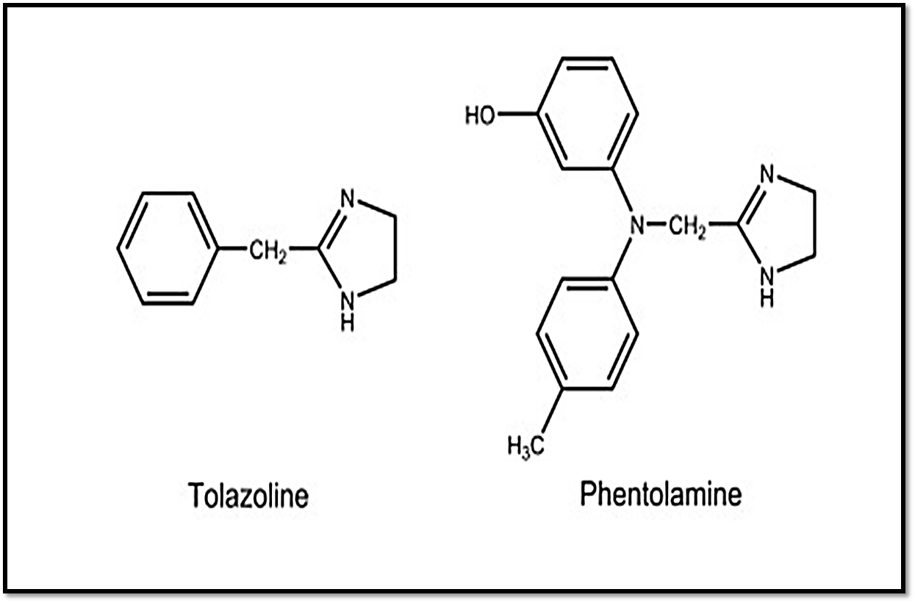
Tolazoline (Priscoline) and phentolamine (Regitine)
Are imidazoline competitive α -blockers, and primarily of historical interest. The structure of tolazoline are similar to the imidazoline α1-agonists, but does not have the lipophilic substituents required for agonist activity.
The type of group attached to the imidazoline ring thus dictates whether an imidazoline is an agonist or a blocker.

Slide 76
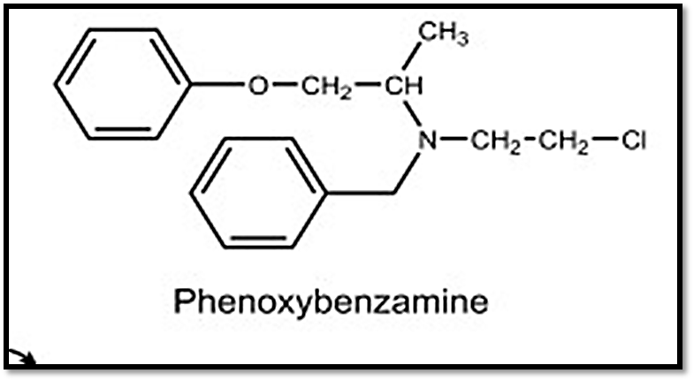
Irreversible α-blockers
Agents in this class, when given in adequate doses, produce a slowly developing, prolonged adrenergic blockade that is not overcome by E.
They are irreversible α-blockers, because β-haloalkyamines in the molecules alkylate α-receptors (recall that β -haloalkylamines are present in nitrogen mustard anticancer agents and are highly reactive alkylating agents). Phenoxybenzamine (Dibenzyline) :
An old but powerful α-blocker, is a haloalkylamine that blocks α1- and α2- receptors irreversibly.

Slide 77
Selective α1-blockers
Prazosin (Minipress), terazosin (Hytrin), and doxazosin
(Cardura):
They are quinazoline α1-blockers. As a result, in part, of its greater α1-receptor selectivity, the quinazoline class of α1 -blockers exhibits greater clinical utility and has largely replaced the nonselective haloalkylamine and imidazoline α1-blockers. Structurally, these agents consist of three components: the quinazoline ring, the piperazine ring, and the acyl moiety. The 4-amino group on the quinazoline ring is very important for α1-receptor affinity. These drugs dilate both arterioles and veins and are thus used in the treatment of hypertension.

Slide 79
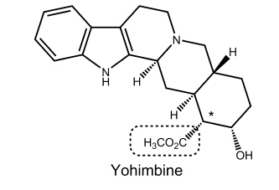
Selective α2-blockers
Yohimbine and Corynanthine. Yohimbine (Yocon)
Is a competitive and selective α2-blocker. The compound is an indolealkylamine alkaloid and is found in the bark of the tree Pausinystalia yohimbe and in Rauwolfia root; its structure resembles that of reserpine.

Slide 80
β-Blockers structure–activity relationships
β-Blockers are among the most widely employed antihypertensives and are also considered the first-line treatment for glaucoma. Most of β -blockers are in the chemical class of aryloxypropanolamines.
The first β -blocker, dichloroisoproterenol (DCI).
Pronethalol was the next important β-blocker developed. it was withdrawn from clinical testing because of reports that it caused thymic tumors in mice.
Propranolol has become one of the most thoroughly studied and widely used drugs in the therapeutic armamentarium. It is the standard against which all other β-blockers are compared.
Practolol is the prototypical example of a β1-blocker of this structural type. It was the first cardio selective β1-blocker to be used extensively in humans. Because it produced several toxic effects, however, it is no longer in general use in most countries.

Slide 81
For aryl ethanolamine adrenergic agonists, the β–OH-substituted carbon must be in the R absolute configuration for maximal direct activity.
However, for β-blockers, the-OH-substituted carbon must be in the S absolute configuration for maximal β-blocking activity.
Propranolol (Inderal, others) is the prototypical and nonselective β-blocker. It blocks the β1- and β2-receptors with equal affinity. Propranolol belongs to the group of β-blockers known as aryloxypropanolamines. This term reflects the fact that An O-CH2- group has been incorporated into the molecule between the aromatic ring and the ethylamino side chain. The nature of the aromatic ring and its substituents that is the primary determinant of β –antagonistic activity. The aryl group also affects the absorption, excretion, and metabolism of the β –blockers.

Slide 84
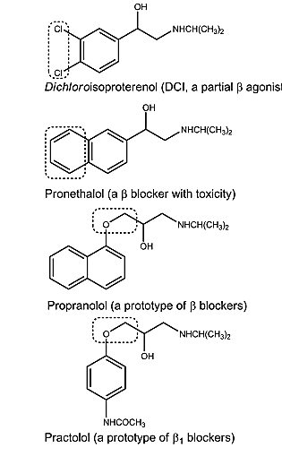

Slide 85
Other Nonselective -Blockers.

Slide 86
β1-selective blockers (second generation)

Slide 87
β1-blockers are drugs that have a greater affinity for the β1-receptors of the heart than for β2-receptors in other tissues.
Such cardio selective agents should provide two important therapeutic advantages. The first advantage should be the lack of a blocking effect on the β2-receptors in the bronchi.
Theoretically, this would make β1-blockers safe for use in patients who have bronchitis or bronchial asthma. The second advantage should be the absence of blockade of the vascular β2-receptors, which mediate vasodilation.

Slide 88
β-Blockers with α1-antagonist (activity (third generation
Several drugs have been developed that possess both β – and α-receptor–blocking activities within the same molecule.
Two examples of such molecules are labetalol (Normodyne) and carvedilol (Coreg).
As in the case of dobutamine, the arylalkyl group with nearby methyl group in these molecules is responsible for its α1-blocking activity. The bulky N-substituents and another substituted aromatic ring are responsible for its β -blocking activity.

Slide 89
Labetalol:
A phenylethanolamine derivative, is representative of a class of drugs that act as competitive blockers at α1-, β1-, and β2-receptors. It is a more potent β -blocker than α-blocker. Because it has two asymmetric carbon atoms (1 and 1′), it exists as a mixture of four isomers

Slide 90
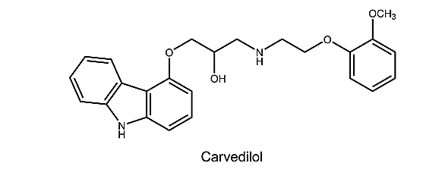
Carvedilol.
Carvedilol (Coreg) is a β-blocker that has a unique pharmacological profile. Like labetalol, it is a β-blocker that possesses α1-blocking activity.
Only the (S) enantiomer possesses the β-blocking activity, although both enantiomers are blockers of the α1-receptor.
Overall, its β -blocking activity is 10- to 100-fold of its α- blocking activity.
It is used in treating hypertension and congestive heart failure.

Slide 91
Thank for your listening

