Slide 1
Acidimetric Titration
Lecturer Luma Amer
Department of Pharmaceutical Chemistry/Collage of pharmacy
3 ^{rd} stage: ^{1st}lab.

Slide 2
Acidimetric Titration
Theory of acidimetry:
Acidimetry, essentially involves the direct or residual titrimetric analysis of alkaline substances (bases) employing an aliquot of acid and is provided usually in the analytical control of a large number of substances. Examples:
(a) Organic substances: urea, sodium salicylate, diphenhydramine.
(b) Inorganic substances : sodium bicarbonate, milk of magnesia, ammonium chloride, calcium hydroxide, lithium carbonate, zinc oxide etc.
Direct titration method
Residual titration method

Slide 3
Assay of Sodium Carbonate
Introduction:
Sodium carbonate, Na₂CO₃, is a sodium salt of carbonic acid.
Formula: Na₂CO₃ , Molar mass: 105.9885 g/mol
a crystalline heptahydrate, which readily effloresces to form a white powder.
Soluble in water and very slightly soluble in alcohol,
odorless powder that absorbs moisture from the air, has an alkaline taste, and forms a strongly alkaline water solution.
Uses:
for dermatitis’s, mouthwash, vaginal douche; veterinary use as emergency emetic.
In solution to cleanse skin, in eczema,to soften scabs of ringworm.

Slide 4

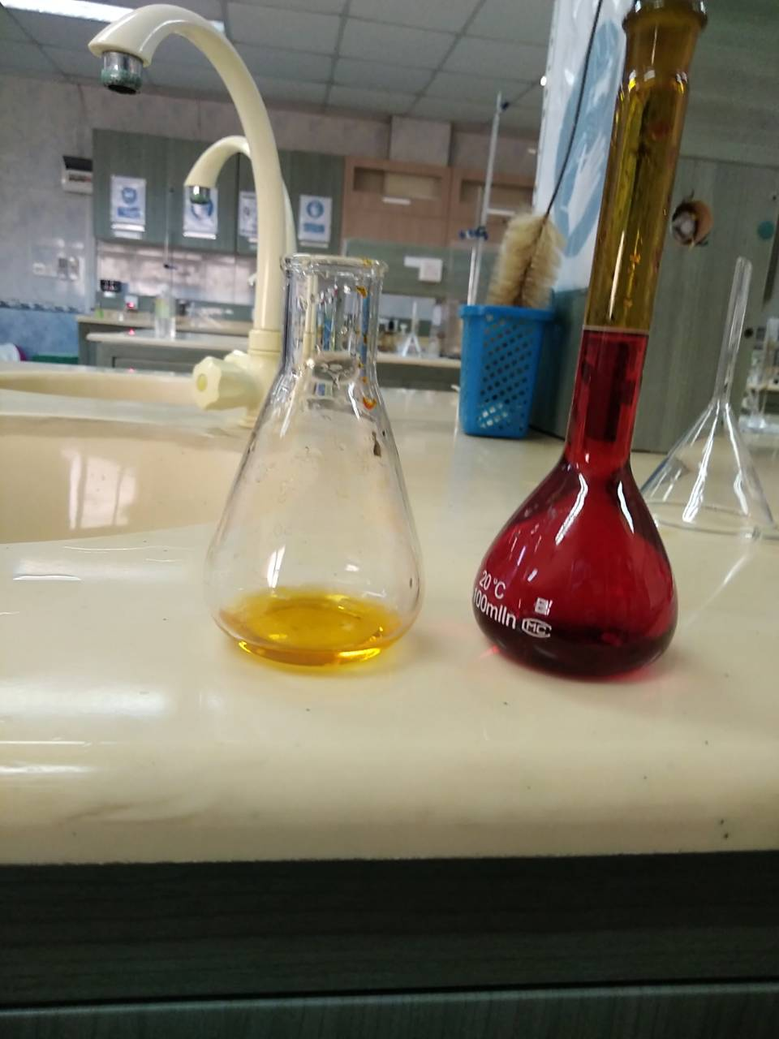
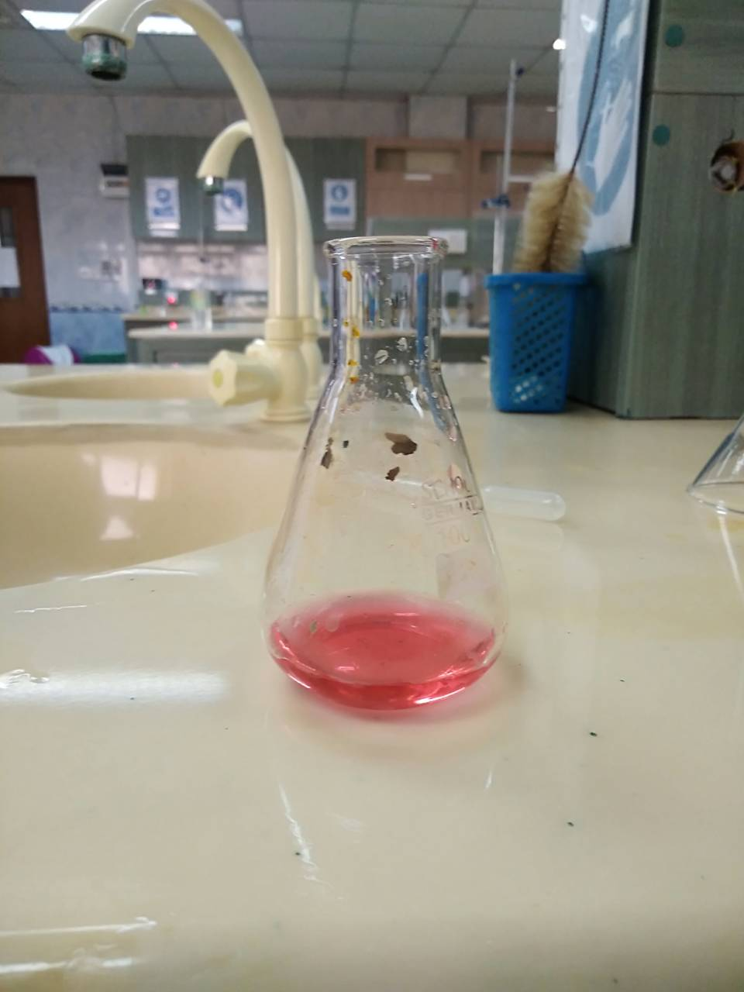
Principle:
Assay of Na₂CO₃ with what?
Type of titration ?
Direct acid base titration method .
Against 1.5N sulphuric acid and by using methyl orange solution as indicator.
. The equation of reaction is:
Na₂CO₃ + H₂SO₄ Na₂SO₄ + H₂O + CO2
Yellow (orange) pink
ph= 4.6 ph= 3.2
Before titration at the end point

Slide 5
Procedure:
1- Weigh accurately about 1.00 g, of sodium carbonate in a suitable beaker.
2- Dissolve it in 20 ml of water (DW).
Notice: you will get turbid (cloudy) solution, Wait until it becomes clear.
3- Transfer 10 ml from previous solution to a conical flask.
4-Add two drop of methyl orange solution as indicator.
5- Fill the burette with 1.00 N sulphuric acids.
6- Titrate with 1.00 N sulphuric acids.
7- Repeat the titration method and take the mean for the end point Values.

Slide 6
Calculation:
% Na₂CO₃ = V x N x meq. wt. x 100 / wt of sample
Each ml of 1 N sulphuric acid is equivalent to 0.053g of Na₂CO₃
Each ml of 1.5 N sulphuric acid is equivalent to 0.0795 gm of Na₂CO₃.
Cognate Assays: Sodium bicarbonate; sodium salicylate tablets.

Slide 8


