Slide 1
Digestive System Buthaina Ibrahem Al-ezzi
Zahraa Ahmed

Slide 2
INTRODUCTION
The digestive system consists of oral cavity and a hollow tubular gastrointestinal tract (GIT) plus digestive glands associated with it. The main function of the digestive system is to digest the ingested food and absorb the nutrients.
GENERAL FEATURES OF GASTROINTESTINAL TRACT
The general structure of gastrointestinal tract (GIT) starting from esophagus to anal canal is more or less same except for regional variations in the mucosal coat.
The GIT shows four distinct Layers, from inner to outer ,They are:
1. Mucosa :
It is composed of the following three layers:
(a) Epithelium.
(b) Lamina propria – made of connective tissue containing glands and
lymphoid accumulations.
(c) Muscularis mucosa – made of smooth muscle fibers; arranged in two
layers, the inner circular and the outer longitudinal. This layer is
responsible for movement and folding of mucosa.

Slide 3
2. Submucosa
- Consists of fibroblastic connective tissue.
- Contains Meissner’s nerve plexus.
- May contain glands (esophagus and duodenum).
3. Muscularis externa
Composed of two layers of smooth muscle, the inner circular and the outer longitudinal. Muscularis externa is responsible for peristaltic contractions. In the esophagus skeletal muscle is present in the upper part. Contains ‘Auerbach’s’ nerve plexus (myenteric) and parasympathetic ganglia between the two layers of muscle.
4. Adventitia/Serosa
- Adventitia consists of only loose connective tissue without peritoneum.
- Serosa consists of peritoneum (mesothelial lining) over a layer of loose connective tissue.

Slide 4
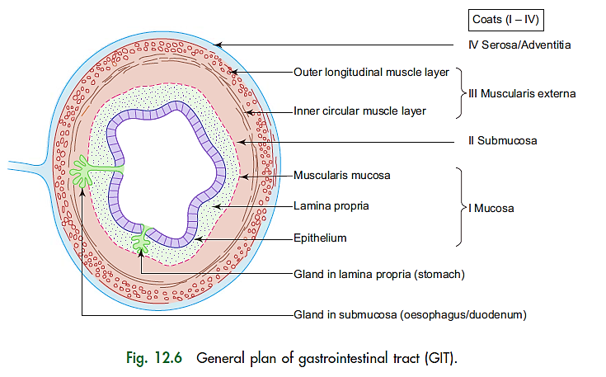

Slide 5
ESOPHAGUS
Esophagus is composed of four basic Layers, From inner to outer they are:
1. Mucosa
It is composed of the following three layers:
(a) Epithelium – stratified squamous Nonkeratinized epithelium.
(b) Lamina propria – contains esophageal cardiac glands in the lower part of esophagus.
(c) Muscularis mucosa – is made of single longitudinal layer of smooth muscle. (No circular layer.)
2. Submucosa
It contains esophageal glands (mucous).
3. Muscularis externa
It is made of muscles of following types; arranged into inner circular and outer longitudinal layers:
– Upper one-third of esophagus – only skeletal muscle.
– Middle one-third of esophagus – both skeletal and smooth muscle.
– Lower one-third of esophagus – only smooth muscle.
4. Adventitia
It is same as the general structure of GIT.

Slide 6
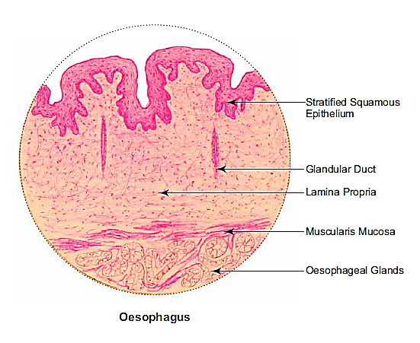

Slide 7
STOMACH
GENERAL FEATURES
Stomach mucosa shows longitudinal folds called rugae which disappear when stomach is expanded, its mucosa also shows tiny grooves which appear as invaginations called gastric pits.
All the glands of the stomach open into the bottom of the gastric pits.
Anatomically, stomach is divided into four parts, namely : cardia, fundus, body and pylorus . However, histologically
it is divided into three parts only because the fundus and body share common histological features.

Slide 8
HISTOLOGICAL STRUCTURE
Stomach has from inner to outer, the following four layers:
1. Mucosa It is made of the following three layers:
(a) Epithelium – simple tall columnar epithelium, which secretes mucus that lubricates and protects the epithelial surface from the acid content of chyme. The epithelium shows invaginations called gastric pits. The epithelial cells are renewed about every three days.
(b) Lamina propria – contains gastric glands .
(c) Muscularis mucosa – made of two layers of smooth muscle as in the general plan of GIT. Smooth muscle fibers extend into lamina propria between gastric glands.
2. Submucosa
It is same as the general plan of GIT.
3. Muscularis externa
It is composed of three layers of smooth muscle :
– Inner oblique
– Middle circular
– Outer longitudinal
4. Serosa
It is same as general structure of GIT.

Slide 9
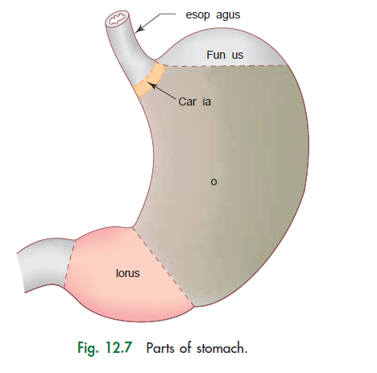
Esophagus
Fundus
Cardia
Body
Pylorus

Slide 10
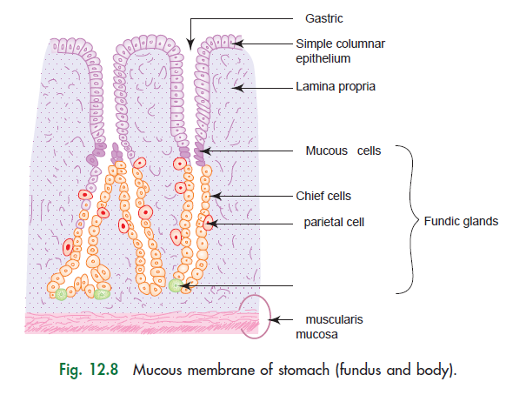
pits

Slide 11
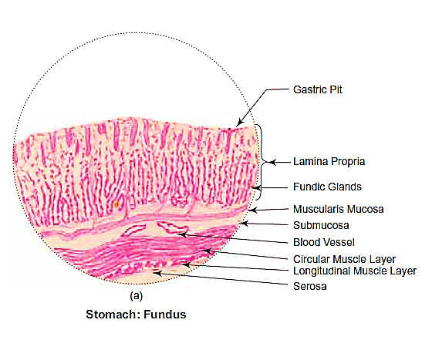
Fundus:
Presence of :
(i) shallow gastric pits lined by simple columnar epithelium;
(ii) long tubular fundic glands in the lamina propria;
(iii) chief and parietal cells in the fundic
gland;
(iv) Muscularis externa showing 3 layers of smooth muscle (inner oblique, middle circular, outer longitudinal).

Slide 12
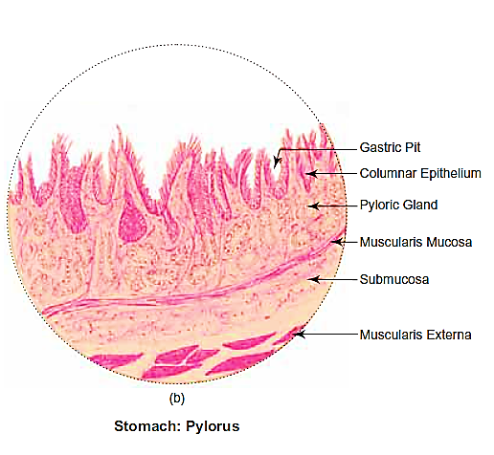
(b) Pylorus:
Presence of
deep gastric pits lined by simple columnar epithelium;
(ii) pyloric glands (mucous) in the lamina propria;
(iii) pyloric sphincter (thickened middle circular layer of smooth muscle).

Slide 13
SMALL INTESTINE
GENERAL FEATURES
- It is about 6 m long.
- Is divided into 3 parts : duodenum, jejunum and ileum.
- Is the principal site for absorption of products of digestion. It also secretes some hormones through enteroendocrine cells.
- Digestion is completed in small intestine.
To facilitate absorption, the luminal surface area is increased 400–600-fold by the presence of the following structures:
1. Plicae circulares (valves of Kerckring)
Permanent circular folds of mucosa and submucosa which increase the surface area 2–3-fold.
2. Intestinal villi (Fig. 12.9)
Minute finger-like projections of mucosa containing a central core of
lamina propria with a single lacteal (blind ended lymphatic vessel),
capillary loops and smooth muscle cells derived from Muscularis
mucosa. These increase the surface area 10-fold.

Slide 14
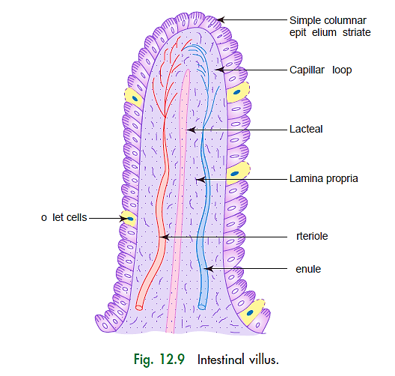
epithelium
Goblet cells
Arteriole
Venule

Slide 15
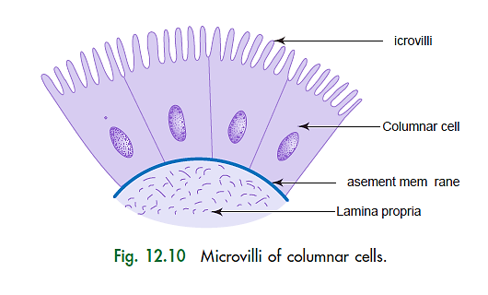
3. Microvilli (Fig. 12.10)
- Very minute finger-like projections of plasma membrane of
absorptive columnar epithelial cells.
- These give a striated border to the epithelium.
- Increase the surface area by 20-fold.
Microvilli
Basement membrane

Slide 16
STRUCTURE OF SMALL INTESTINE
Small intestine is composed of the following four layers:
1. Mucosa (Fig. 12.11)
(a) Epithelium
It is made of simple columnar absorptive epithelium with goblet cells.
The epithelium and the underlying lamina propria shows finger-like evaginations called intestinal villi.
Epithelium also shows tubular invagination from the base of the villi into the lamina propria known as crypts of Lieberkuhn (intestinal glands). These crypts are lined by columnar and goblet cells. Apart from these cells
Paneth cells are found at the base, which secrete lysozyme, an antibacterial enzyme controlling the intestinal flora. The crypts open at the base of the villus in the intervillous space. Epithelium is renewed every 3–5 days.

Slide 17
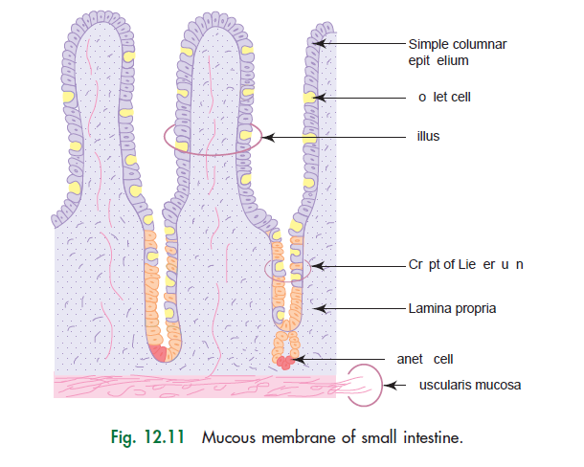
epithelium
Goblet cell
Villus
crypts of Lieberkuhn
Paneth Cell
Muscularis mucosa

Slide 18
Goblet cell
A goblet cell is a glandular simple columnar epithelial cell whose function is to secrete gel-forming mucins, the major components of mucus.
Goblet cells are found scattered among the epithelial lining of organs, such as the intestinal and respiratory tracts. They are found inside the trachea, bronchi, and larger bronchioles in the respiratory tract, small intestines, the large intestine, and conjunctiva in the upper eyelid.
Goblet cells are modified simple columnar epithelial cells, having a height of four times that of their width. The cytoplasm of goblet cells tends to be displaced toward the basal end of the cell body by the large mucin granules, which accumulate near the apical surface of the cell along the Golgi apparatus, which lies between the granules and the nucleus.

Slide 19
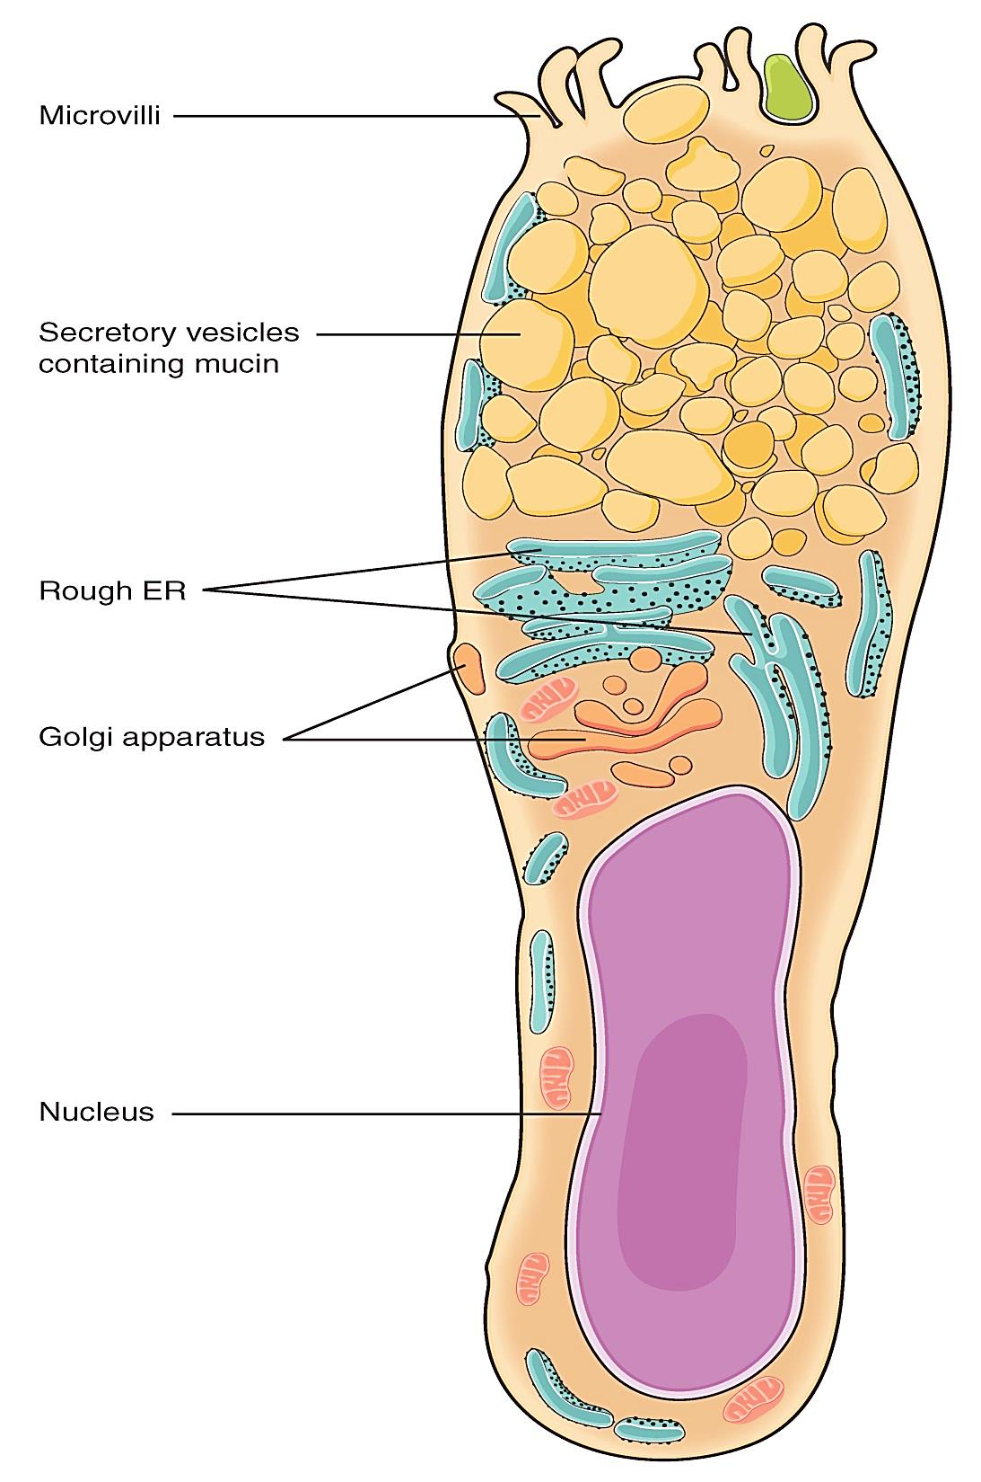
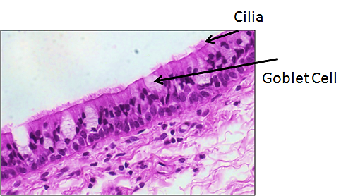

Slide 20
(b) Lamina propria
It is the connective tissue that contains : fibroblasts, mast
cells, plasma cells, lymphocytes + crypts of Lieberkuhn
+ lacteals + capillary loops.
(c) Muscularis mucosa
Same as the general structure of GIT.
2. Submucosa
It shows regional variations, e.g.
– Presence of Brunner’s gland in duodenum
– Peyer’s patches in ileum
– None of the above in jejunum
3. Muscularis externa
Same as the general structure of GIT.
4. Serosa
Same as the general structure of GIT.

Slide 21
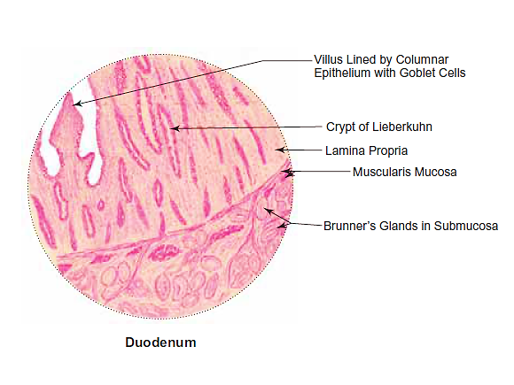
General Histological Features of Duodenum :
Presence of
(i) short leaf-like
intestinal villi lined by
simple columnar
epithelium with goblet
cells;
(ii) Brunner’s glands
(mucous) in the
submucosa;
(iii) crypts of Lieberkuhn.

Slide 22
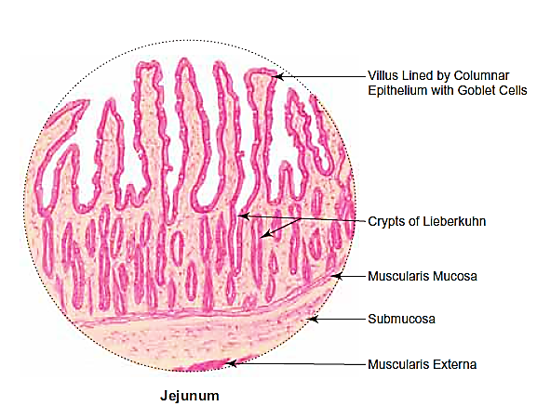
General Histological Features of Jejunum :
Presence of
(i) long club-shaped
intestinal villi
lined by simple
columnar epithelium
with goblet cells;
(ii) absence of Brunner’s
glands;
(iii) absence of Peyer’s
patches.

Slide 23
LARGE INTESTINE
- GENERAL FEATURES
It consists of the caecum, appendix, colon, rectum and anal canal. It lacks intestinal villi.
- STRUCTURE
The structure of large intestine follows the general structure of small intestine, except for certain specific features in each part of the large intestine.
Vermiform Appendix
- Small angular lumen.
- No villi.
- Few short crypts.
- Ring of lymphoid follicles with germinal centers in the
lamina propria around the lumen.
- Disrupted Muscularis mucosa.

Slide 24
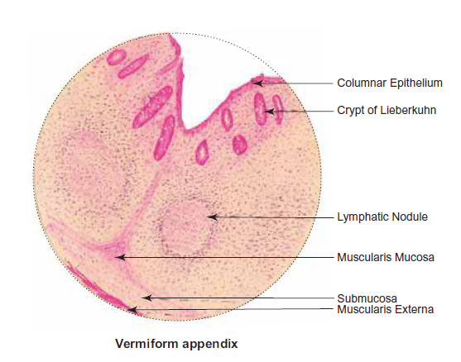
General Histological Features of Vermiform Appendix :
Presence of
(i) few crypts of Lieberkuhn
lined by simple columnar
epithelium with goblet cells;
(ii) lymphatic nodules in the
lamina propria;
(iii) small angular lumen
compared to the thick wall of
Large intestine.
(iv) Absence of intestinal villi.

Slide 25
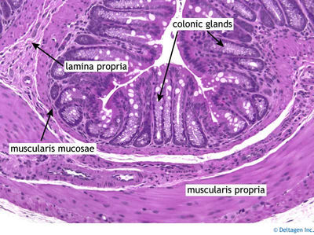
Rectum
- Long crypts of Lieberkuhn (intestinal glands).
- Lymphoid tissue is less abundant in the lamina propria.
- The muscle coat lacks ‘tenia coli’ (three separate longitudinal ribbons of
smooth muscle).
- Serosa is replaced by adventitia in the lower part.

Slide 26
References :
1- Textbook of Histology A Practical guide - Gunasegaran, J.P. 2nd ed 2010
2- DiFiore’s Atlas of Histology with Functional Correlations, 11th ed 2008

Slide 27
Thanks for your attention

