Slide 1
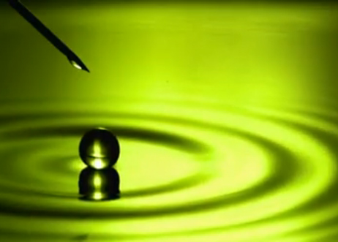
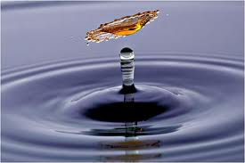
Interfacial Phenomena

Slide 2
Micelle formation
The surface tension of a surfactant solution decreases progressively with increase of concentration as more surfactant molecules enter the surface or interfacial layer. However, at a certain concentration this layer becomes saturated and an alternative means of shielding the hydrophobic group of the surfactant from the aqueous environment occurs through the formation of aggregates (usually spherical) of colloidal dimensions, called micelles.

Slide 3
The concentration at which micelles first form in solution is termed the critical micelle concentration or CMC.

Slide 4
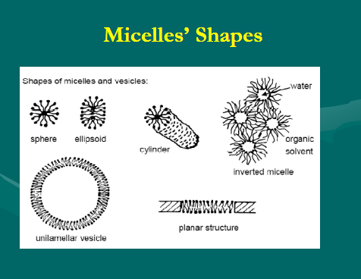

Slide 5
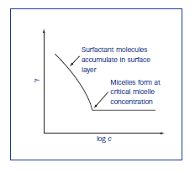
Surface tension decrease with increasing conc. Of surfactant until CMC is reached , then become constant

Slide 6
The CMC decreases with an increase in the length of the hydrophobic chain.
The addition of electrolytes to ionic surfactants
decreases the CMC and increases the micellar
size.The effect is simply explained in terms of a
reduction in the magnitude of the forces of
repulsion between the charged head groups in
the micelle, allowing the micelles to grow and
also reducing the work required for their formation.

Slide 7
Adsorption at solid interfaces
Adsorption of materials at solid interfaces can take place from either an adjacent liquid or gas phase .
The study of adsorption at gases arises in applications as removal of objectionable odors from rooms or food.
The principle of solid –liquid adsorption are used in decolorizing solutions , adsorption chromatography , detergency and wetting .

Slide 8
Wetting
Adsorption at solid surfaces is involved in the phenomena of wetting and detergency.
When a liquid comes into contact with the solid , the forces of attraction between the liquid and the solid phases begin to play a significant role .
In case of water and glass , attractive forces between the solid and liquid molecules are greater than the forces between molecules of liquid themselves. And so the liquid is able to wet the surface of the glass.

Slide 9
The most important action of wetting agent is to lower the contact angle between the surface of and the wetting liquid
The contact angle is the angle between a liquid droplet and the surface over which it spreads.
The contact angle may be 0°, signifying complete wetting , or may be 180 ° at which wetting is insignificant.
Or any value between these limits.

Slide 10
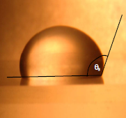

Slide 11
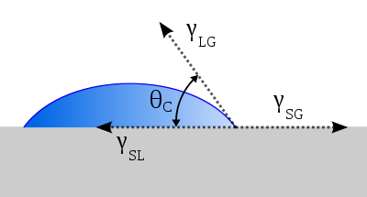

Slide 12
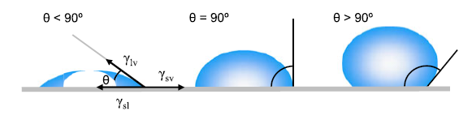

Slide 13
At equilibrium :
Y s = Ys L+ y L Cos Ø
Which is known as young ´ s equation
The work of adhesion between the solid and the liquid is given :
Wa = WsL = YL (1+CosØ )
Spreading coefficient :
S= YL(CosØ-1)

Slide 14
A contact angle is lower than 90°, the solid is called wettable
A contact angle is wider than 90°, the solid is named non-wettable.
A contact angle equal to zero indicates complete wettability.

Slide 15
Wetting agent is a surfactant that when dissolved in water, lower the contact angle and aids in displacing the air phase at the surface and replacing it with a liquid phase.
Examples on application of wetting in pharmacy and medicine include the displacement of air from the surface of the sulfur , charcoal and other powders for the purpose of dispersing these drugs in liquid vehicle ;displacement of dirt and debris by use of detergents in washing the wounds; and application of sprays and lotions to the surface of skin and mucous membranes.

Slide 16
Example 15-14
Calculate spreading coefficient and work of adhesion of water on tablet surface to compare the influence of three tablet binders on wettability:
Binder | Y ( N/m) | Cos Ø
Povidone | 71.23 | 0.7455
Gelatin | 71.23 | 0.7230
tapioca | 71.23 | 0.7570

Slide 17
Detergents
are surfactants that are used for the removal of dirt . Detergency is a complex process involving the removal of foreign matter form surfaces.
The process includes :
Initial wetting of dirt and of the surface to be cleaned .
Deflocculation and suspension Emulsification or solubilization of the dirt particles .
And sometimes foaming for washing away the particles.

Slide 18
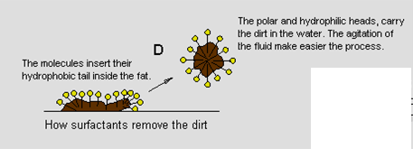
Detergents
Detergents are surfactants used for removal of dirt.
Detergency involves:
Initial wetting of the dirt and the surface to be
cleaned.
Deflocculation and suspension, emulsification or
solubilisation of the dirt particles
Finally washing away the dirt.

Slide 19
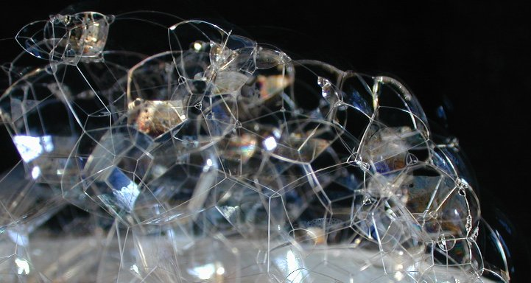
Foaming and Anti Foaming agents
Foams are dispersion of a gas in a liquid
(liquid foams as that formed by soaps and
detergents ) or in a solid (solid foams as
sponges ).
Foaming agents
Many Surfactants solutions promote the formation of foams and stabilize them, in pharmacy they are useful in toothpastes compositions.
Anti Foaming agents
They break foams and reduce frothing that may cause problems as in foaming of solubilized liquid preparations.

Slide 20
Micellar Solubilization
Surfactant molecules accumulate in the interfaces between
water and water insoluble compound. Their hydrocarbon
chains penetrate the outermost layer of insoluble compound
which combine with the water­ insoluble molecules. Micelles
form around the molecules of the water ­insoluble compound
inside the micelles’ cores and bring them into solution in an
aqueous medium. This phenomenon is called micellar
solubilization.
The inverted micelles formed by oil­ soluble surfactant which
dissolves in a hydrocarbon solvent can solubilize water-soluble
compound which is located in the center of the micelle, out of
contact with the solvent.

Slide 21
Classification of Surface Active Agents
Functional Classification
According to their pharmaceutical use, surfactants can be divided into the following groups:
Wetting agents
Solubilizing agents
Emulsifying agents
Dispersing, Suspending and Defloculating agents
Foaming and antifoaming agents
Detergents

