Slide 1
Drugs used in Parkinson’s Disease
Asst Prof Dr Inam S. Arif
isamalhaj@yahoo.com
Pharm.dr.isamalhaj@uomustansiriyah.edu.iq

Slide 2
Schematic representation of the sequence of neurons involved in parkinsonism Top: DAergic N (red) originating in the substantia nigra normally inhibit the GABAergic output from the striatum, whereas cholinergic N (green) exert an excitatory effect Bottom: In parkinsonism, there is a selective loss of dopaminergic neurons (dashed, red).

Slide 3
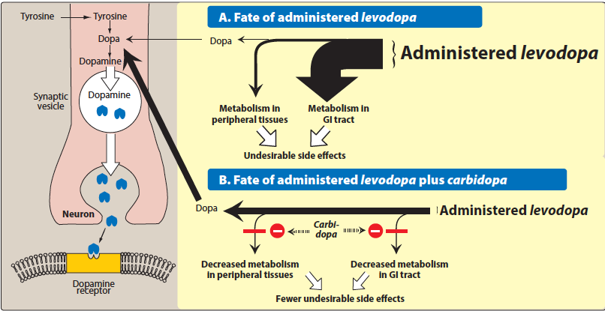
Drugs used in Parkinson’s Disease
1- Levodopa and Carbidopa

Slide 4
Fate of orally l-dopa & the effect of carbidopa.

Slide 5
Levodopa and Carbidopa, cont.
decrease rigidity, tremor & other symptoms
clear beneficial respond 1st few yrs of treatment
decline response during 3rd - 5th yr of therapy
stop treatment gradually
well abs. on empty stomach (high ptn diet?????, 30 min before meal)
t1/2 of l-dopa is 1- 2 hrs ——— troublesome “on-off”

Slide 6
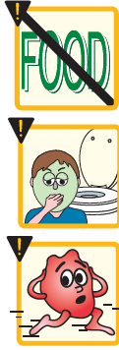
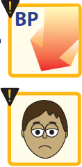
Levodopa and Carbidopa, cont.
Adverse effects:
Peripheral effects
N, V, anorexia ????
tachycardia, vent. Extrasystole????
hypotension, mydriasis
blood dycrasias & +ve Coomb’s test
brownish urine & saliva????
CNS effects
visual & auditory hallucination
dyskinesia (abnormal involuntary movement)????
mood changes & depression, psychosis & anxiety

Slide 7
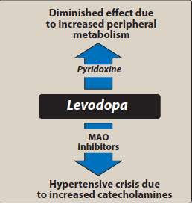
Drug-Drug Interactions
vit B6
MAOIs/phenelzine
Cardiac patients
Antipsychotic agents

Slide 8
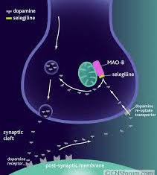
2-Selegiline (Deprenyl)& Rasagiline
Selective irrev. MAOI type B???
Given with l-dopa???
Low potential for hypertensive crisis
Metabolized to amphetamine + methamphetamine???
Rasagiline, selective irrev. MAOI type B in brain, x5
Not metabolised to amphetamine
used for early treatment in patients with mild symptoms.

Slide 9
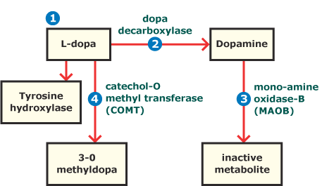
3- Catechol-O-methyltransferse inhibitors
Entacapone & Tolcapone
Selective & reversible inhibitors of COMT
Readily abs, not affected with food
Extensive pl ptn binding
Tolcapone has long duration of action
Extensively metabolized by liver
Diarrhea, postural hypos., nausea, anorexia, dyskainesea, hallucination, sleep disorders, liver necrosis (tolcapone)
Entacapone doesn’t have this toxicity

Slide 10
4- Dopamine Receptor Agonist
Ergot derive. (Bomocriptine)
Non-ergot derive.
Ropinirole
Pramipexole
Rotigotine
Apomorhhine
Bromocriptine
Pramipexole
Ropinirole

Slide 11
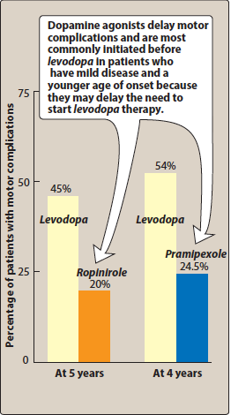

Slide 12
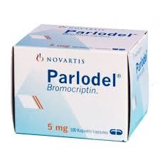
Bromocriptine
D2 agonist
similar to l-dopa (widely used in the past)
hallucination, confusion, delirium, nausea & orthstatic hypotension more common
less dyskinesia
caution with patients with psychiatric problems, MI, peripheral vascular disease

Slide 13
Apomorhhine, Pramipexole, Ropinirole & Rotigotine
Non-ergot
Pramipexole & Ropinirole / oral
Apomorphine / injectable
Rotigotine / transdermal/ once daily
Apomorphine used in hypomobility “off” phenomenon
Alleviate motor problems, delay need to l-dopa & reduce dose
No effect on CVS problems
Nausea, hallucinate,insomnia, constipation & orthostatic hypos.
Cimetidine ???
Fluoroquinolone antibiotic???

Slide 14
Pergolide
Ergot derivative, directly stimulates both D1 and D2receptors
It has been widely used for parkinsonism
its use has been associated with the development of valvular heart disease
Pramipexole
is not an ergot derivative
has preferential affinity for the D3 family of receptors
effective as mono therapy in mild cases & also helpful in patients with advanced cases, permitting the dose of levodopa to be reduced and smoothing out response fluctuations
may ameliorate affective symptoms
A possible neuroprotective effect has been suggested by its ability to scavenge hydrogen peroxide

Slide 15
Ropinirole
nonergoline derivative,
relatively pure D2 receptor agonist
effective as monotherapy in patients with mild disease and as a means of smoothing the response to levodopa and response fluctuations
metabolized by CYP1A2; (possible D- D interaction)
Rotigotine
delivered daily through a skin patch, is approved for treatment of early Parkinson’s disease
It provides more continuous dopaminergic stimulation than oral medication in early parkinsonism ( less efficacy in more advanced cases)
Benefits and side effects are similar to those of other DA agonists

Slide 16
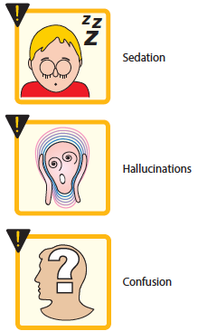
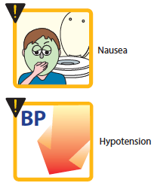
Side Effects of DA Agonists

Slide 17
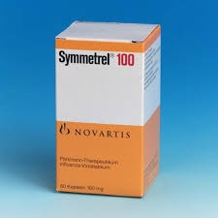
5- Amantadine
Antiviral Increase DA release ( antagonize the effects of adenosine at adenosine A2
receptors, which may inhibit D2 receptor function)
Block cholinergic receptors
Amantadine is an antagonist of the NMDA-type
glutamate receptor, suggesting an antidyskinetic effect.

Slide 18
Amantidine (cont.)
Amantadine is less efficacious than levodopa
its benefits may be short-lived, often disappearing after only a few weeks of treatment
Nevertheless, during that time it may favorably influence the bradykinesia, rigidity, and tremor of parkinsonism
Side Effects:
Low doses: restlessness, agitation, confusion & hallucination
high doses:Acute toxic psychoses Orthostatic hypotension, urinary retention, dry mouth

Slide 19
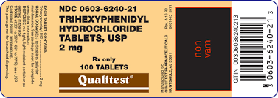
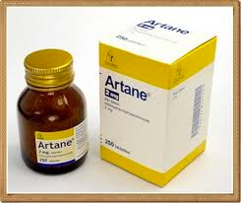
6- Antimuscarinic Agents
Trihexyphenidyl, Benztropine, Procyclidine, Biperidine
low efficacy
adjuvant therapy
induces mood changes, xerostomia, constipation, visual disturbances
Interfere with GIT peristalsis
CI: glaucoma, prostate hyperplasia, pyloric
stenosis

Slide 20
Antimuscarinic Agents (cont.)
Treatment is started with a low dose of one of the drugs in this
category, the dosage gradually being increased until benefit occurs
or until adverse effects limit further increments
If patients do not respond to one drug, a trial with another member of the drug class is warranted and may be successful

Slide 21
Some drugs with antimuscarinic properties used in parkinsonism

Slide 22
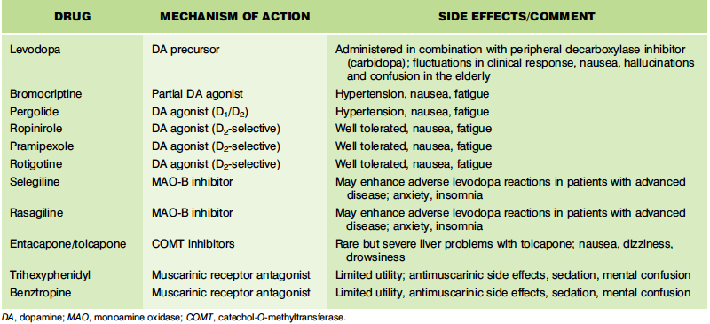

Slide 24
Drugs used in Alzheimer’s disease
a neurodegenerative disorder characterized by progressive impairment of short-term memory, language, and thought processes.
Functions are typically lost in the reverse order in which they were attained.
In advanced stages, patients cannot perform simple activities of daily life.
Diagnosis is usually made 3 years or more after symptom onset, and life expectancy is approximately 7 to 10 years after diagnosis.
Dementia in Alzheimer involves
accumulation of B-amyloid
formation of neurofibrillary tangles aggregates hyperphosphorylated tau protein
loss of cortical neurones,mainly cholinergic

Slide 25
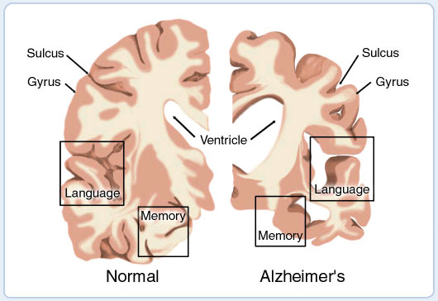

Slide 26
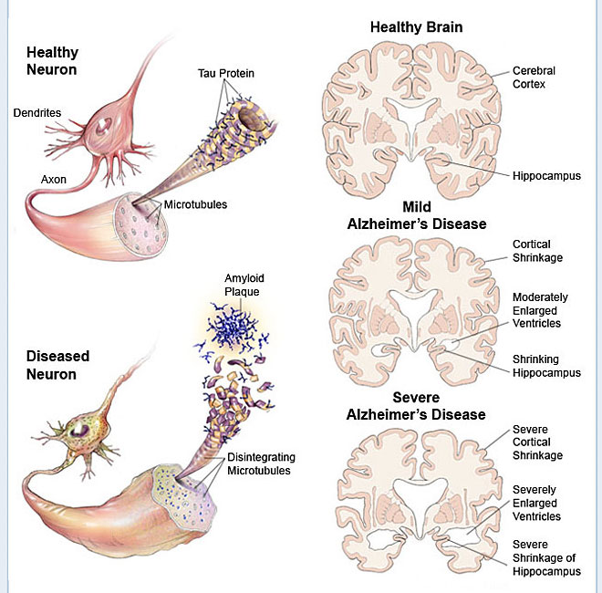
How the Brain and Nerve Cells Change During Alzheimer's Disease

Slide 27
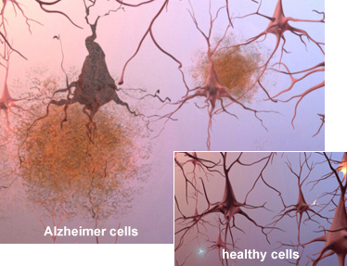
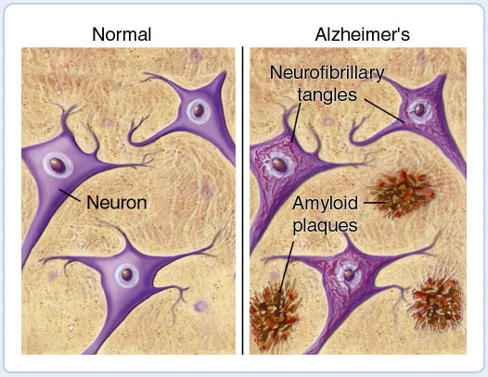

Slide 28
Drugs used in Alzheimer’s disease
Therapy:
cholinergic enhancement
prevent excitotoxic action of NMDA glutamate
1- Acetylcholinesterase inhibitors:
Donepezil, Galantamine, rivastigmine
SE: NVD, anorexia, tremor, bradycardia, muscle cramps
2- NMDA R antagonist:
Glutamate stimulation—————disturbed memories
Excessive stimulation————-N degeneration or apoptosis (Ca⁺²)
Memantine / NMDA antag. / well tolerated
SE: confusion, agitation, restlessness
Given in combination with AChEIs

Slide 29
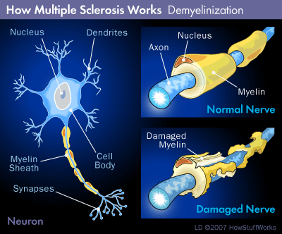
Drugs Used in Multiple sclerosis
Autoimmune inflammatory demyelinated disease

Slide 30
A-Disease-modifying therapies
(decrease relapse, prevent accumulation of disability)
Modify immune response by inhibiting WBC mediated inflammatory processes which result in myelin damage
1-Interferone β1a, interferone β1b
reduce inflammatory response to demyelination of nerves
SE: depression, local injection site reactions, increases in hepatic enzymes,
and flu-like symptoms.
2- Glatiramer:
synthetic polypeptide & act as decoy to T-cell attack
SE: post injection reaction that includes flushing, chest pain, anxiety, and itching
It is usually self-limiting

Slide 31
Disease-modifying therapies (cont.)
3- Fingolimod
oral D, alter lymphocyte migration,------low level of lymphocyte in CNS
SE: 1st- dose bradycardia, increase risk of infection
4- Dimethylfumarate
oral D, alter cellular response to oxidative stress to reduce progression
SE: flushing & abdominal pain
5- Teriflunomide: oral pyrimidine synthesis inhibitor that leads to a lower concentration of active lymphocytes in the CNS
SE: elevated liver enzymes. It should be avoided in pregnancy
6- Mitoxantrone: cytotoxic agent

Slide 32
7-Monoclonal antibodies
Alemtuzumab, daclizumab, natalizumab, & ocrelizumab
monoclonal antibodies indicated for the treatment of MS
Ocrelizumab is the first agent to be approved for primary progressive forms of the disease
These agents can be associated with significant toxicities, such as
natalizumab ------progressive multifocal leukoencephalopathy
daclizumab and alemtuzumab--------- serious infections with
with alemtuzumab------------ and autoimmune disorders
these agents may be reserved for patients who have failed other therapies.
B-Symptomatic treatment:
Dalfampridine, oral K+ chan. blocker, reduce spasticity

Slide 33
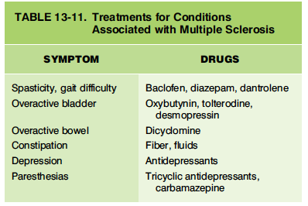

Slide 34
Quiz
1- Strategies for Controlling/ reducing fluctuation in response of L-dopa.
2- Is it possible to use metoclopramide to treat nausea & vomiting produced by l-dopa?
3- Which type of receptors are involved in controlling motor effects of l-dopa?
4- Which would you prefer in the treatment of the drug-induced form of parkinsonism:
-Levodopa -Bromocriptine -Benztropine -Dopamine

