Slide 1
Prepartion of Coumarin
Assistant lecturer
Noor Waleed

Slide 2
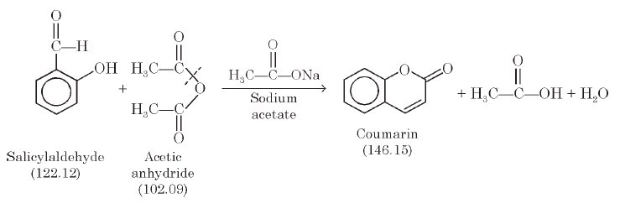
Coumarin
The interaction between salicyldehyde and acetic anhydride in the presence of sodium acetate results into the formation of the heterocyclic pyran ring to give coumarin in addition to a mole of each acetic acid and water as products of the reaction.

Slide 3
Chemicals Required:
Salicylaldehyde : 8 g
Acetic Anhydride : 20 ml
Fused and finely powdered Sodium Acetate: 10 g Sodium Carbonate : q.s.
Activated Animal Charcoal : 2 g

Slide 4
Procedure:
(1) Transfer 8 g salicylaldehyde, 10 g fused sodium accetate and 20 ml acetic anhydride in a 250 ml round-bottomed flask duly installed with an air reflux condenser the top-end of which should be provided with a CaCl2-guard tube.
(2) Heat the mixture in an oil-bath for a duration of 6 hours between 180-190°C.
(3) Cool the contents of the flask and subject it to steam distillation, so as to get rid of the unreacted salicylaldehyde completely, and discard the distillate.

Slide 5
(4) Add to the resulting residue in the flask solid Na₂CO₃ slowly and carefully until
the solution is rendered alkaline to litmus paper.
(5) Chill the contents of the flask in an ice-bath when the desired product coumarin gets separated. Filter it in a Büchner funnel, wash with a little spray of cold water, drain well and dry it in filter paper folds.
The yield of the crude product is 4.3 g mp 68–69°C

Slide 6
Precautions:
(1) Always use freshly fused and finely powdered sodium acetate in the Perkin Reaction.
(2) The heating of the reaction mixture in an oil-bath should be steady and gentle for a period of 6 hours at a stretch preferably.
(3) After removal of the unreacted salicylaldehyde by steam distillation the residual product must be made alkaline carefully by adding solid Na2CO3 and check with litmus paper.
(4) A small amount of activated decolourizing carbon powder may be used while recrystallizing.

Slide 7
Recrystallization:
Dissolve the crude coumarin in 250-300 ml of boiling water and add to it 1-1.5 g of decolourizing carbon. Filter at the pump and concentrate the filtrate over a water bath till its volume becomes almost 1/3 rd its original volume. Keep it in the refrigerator overnight when beautiful crystals of pure coumarin shall separate out.
The yield of the pure coumarin is 4.0 g mp. 68.5-70°C.

Slide 8
Theoretical Yield/Practical Yield:
The theoretical yield is calculated from the equation under as given below :
Salicylaldehyde + Acetic Anhydride = Coumarin
122.12 g 102.09 g 146.15 g
∴ 8 g = X
146. 15 x 8 /122. 12 = 9.57 g
Hence, Theoretical yield of Coumarin = 9.57 g
Reported Pactical yield = 4.3 g
Therefore, Percentage Practical yield =Practical yield /Theoretical yield x100
= 4.3 /9.57 x100 = 44.93%

Slide 9
Uses:
It is used mostly as a flavouring agent in pharmaceutical & food preparations (in general it is banned as a flavorant food additive, due to concerns regarding its hepatotoxicity in animal models.
It has been used as an edema modifier. Like other benzopyrones, it is known to stimulate macrophages to degrade extracellular albumin, allowing faster resorption of edematous fluids.
(3) Many structural analogues of ‘coumarin’ may be employed as anticoagulants.
(4) Coumarin has been used as an aroma enhancer in pipe tobaccos and certain alcoholic drinks.

Slide 10
Perkin Reaction:
The formation of α, β-unsaturated carboxylic acid by Aldol Condensation of
aromatic aldehydes and acid anhydrides in the presence of an alkali salt of the acid is
known as the Perkin Reaction.

Slide 11
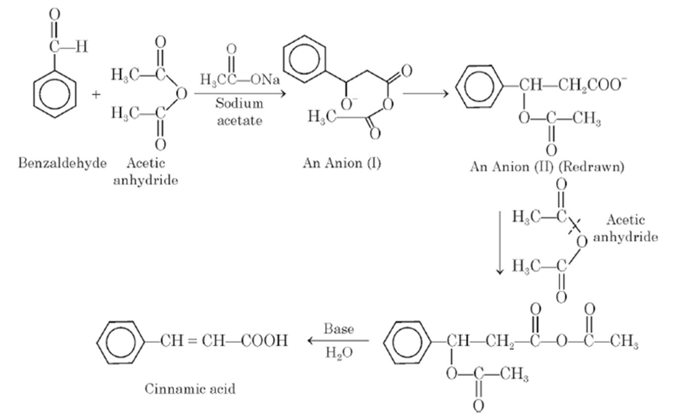

Slide 12
The above discourse of the Perkin Reaction is self-explanatory in which benzaldehyde and acetic anhydride interacts to form an anion (I) that undergoes molecular rearrangement to give another anion (II). The resulting restructured anion (II) reacts with acetic anhydride to form an intermediate which subsequently undergoes hydrolysis in the presence of a base to give rise to the formation of an α, β-unsaturated carboxylic acid

Slide 13
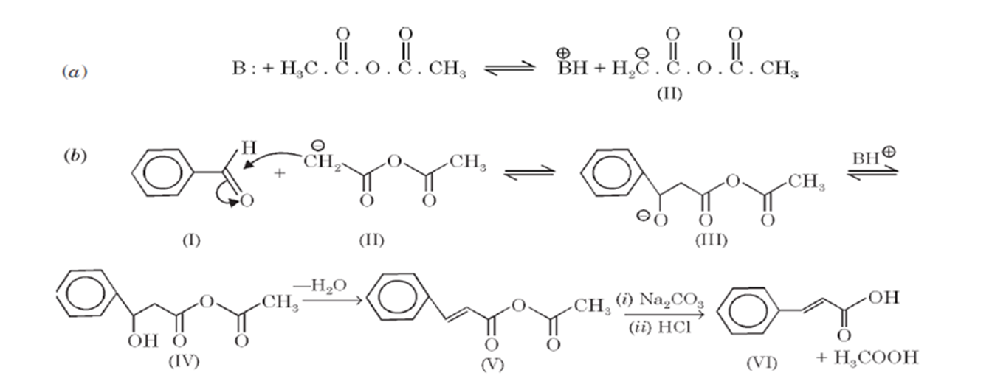
Mechanism of Perkin reaction:
The mechanism of the reaction, which is of the aldol-type may be expatiated with the help of the following equations (a) and (b) respectively.

