Slide 1
Infra-red spectroscopy

Slide 2
IR regions
The infrared portion of the electromagnetic spectrum is usually divided into three regions:
1.The near-infrared; The higher-energy near-IR, approximately 14000–4000 cm⁻¹ (0.8–2.5 μm wavelength) can excite overtone or harmonic vibrations.
2. The mid-infrared; approximately 4000–400 cm⁻¹(2.5–25 μm) may be used to study the fundamental vibrations and associated rotational-vibrational structure.
3. The far-infrared, approximately 400–10 cm⁻¹ (25–1000 μm), lying adjacent to the microwave region, has low energy and may be used for rotational spectroscopy.

Slide 3
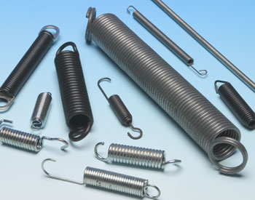
Hooke’s law
Bonds can be thought like a spring, and wavenumbers can be approximated by Hooke’s law
This study of vibrations of bonds between different atoms and varied multiplicities which depending on:
The electronegativity (force constant of the bond)
The relative masses of the atoms
Their geometry vibrate at different
c = speed of light (3 x 10¹⁰ cm/s)
k = force constant
μ = reduced mass of the atoms
M_{x} = mass of atom x in kg
M_{y} = mass of atom y in kg

Slide 4
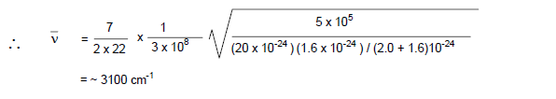
Hooke’s law-Example
Calculate the predicted vibrational frequency (in cm⁻¹) for C- H bond, knowing that: The force constant for single bond is 5x 10⁵ dyne/ cm, the velocity of light is 3 X 10⁸ cm/s, the mass of carbon atom is 20 x10⁻²⁴g, the mass of hydrogen is 1.6 x 10⁻²⁴ g, and what are the relationship between wave number (v), bond strength and mass?

Slide 5


The relationship between wave number (v), bond strength and mass
The vibrational frequency of a bond would increase with the increase in bond strength. Consequently, we can expect that
C=C and C=O > C-C and C-O, respectively
The vibrational frequency of a bond would increase with the decrease in reduced mass of the system.
Similarly,
C-H and O-H > C-C and C-O, respectively
O-H > O-D

Slide 6
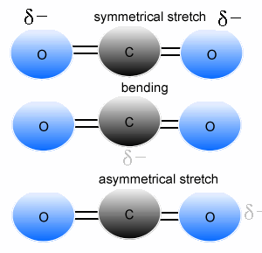
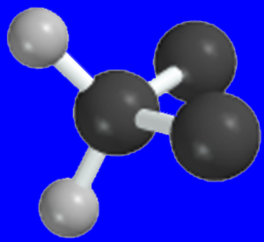
Types of molecular vibrations
The two atoms joined together by a chemical bond (may be single, double or triple bond), macroscopically can be composed as two balls joined by a spring.
Stretching of one or both the atoms is a rhythmical movement along the band axis such that interatomic distance is increasing or decreasing its either
Symmetric
Antisymmetric

Slide 7
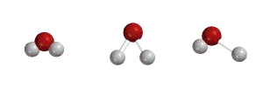
Number of vibrational modes
A molecule can vibrate in many ways, and each way is called a vibrational mode.
In order for a vibrational mode in a sample to be "IR active", it must be associated with changes in the dipole moment. A permanent dipole is not necessary, as the rule requires only a change in dipole moment.
For molecules with N number of atoms,
Linear molecules have 3N – 5 degrees of vibrational modes,
Nonlinear molecules have 3N – 6 degrees of vibrational modes (also called vibrational degrees of freedom).
Symmetric Bending Asymmetric
Example H₂O, will have (3 × 3 – 6 = 3) degrees of vibrational freedom, or modes.

Slide 8
Bending of one of the atoms either vertically or horizontally and then release of the force results in the vibrations on the two balls (atoms).
Changing of in bond angles between bonds with common atom of the movement of group of atom with respect to the reminder of the molecule without movement of the atoms in the group with respect to another
These vibrations depend on the strength of the spring and also the mode (stretching or bending) in which the force is being applied.

Slide 9
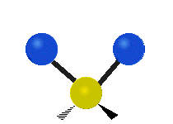

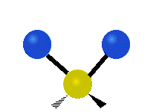


Symmetric
stretching
Asymmetric
stretching
Scissoring
Wagging
Twisting
Rocking

Slide 10
Bending Vibrations of a CH₂ Group
In plane
In plane
Notes:
2

Slide 11
Bending Vibrations of a CH₂ Group
Out of plane
Out of plane
Notes:
2

Slide 12
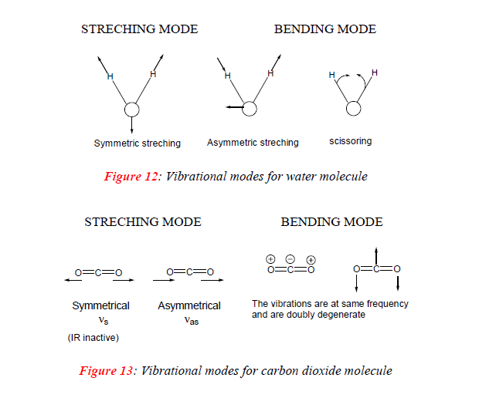

Slide 13
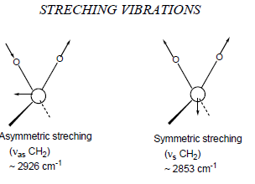
Stretching CH₂
The stretching and bending modes for an AX2 group appearing as a portion of molecule, for example, the CH2 group in a hydrocarbon molecule.
Any atom joined to two other atoms will undergo comparable vibrations for example NH2 or NO2. Each of different vibration modes may give rise to a different absorption band so that CH2 groups give rise to two C-H stretching bands i.e. υ_{sym} and υ_{asym}.
Some of the vibrations may have the same frequency i.e. they are degenerate and their absorption bands will appear at same position .

Slide 14
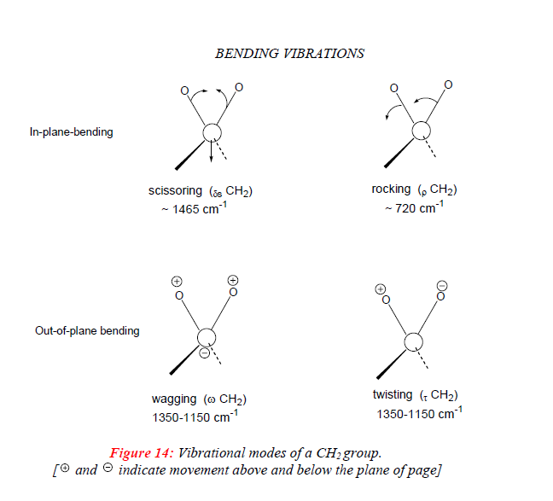

Slide 15
The atoms in a CH₂X₂ group, commonly found in organic compounds and where X can represent any other atom, can vibrate in nine different ways. Six of these vibrations involve only the CH₂ portion:
symmetric and asymmetric stretching, scissoring, rocking, wagging and twisting.
Structures that do not have the two additional X groups attached have fewer modes because some modes are defined by specific relationships to those other attached groups.
For example, in water, the rocking, wagging, and twisting modes do not exist because these types of motions of the H represent simple rotation of the whole molecule rather than vibrations within it.

Slide 16
Effects of hydrogen bonding IR spectroscopy
Intermolecular hydrogen bonding involves association of two or more molecules of the same different compounds.
Intermolecular hydrogen bonding may result in dimer molecules (as observed for carboxylic acid) or in polymeric molecular chains.
Intramolecular hydrogen bonds are formed when the proton donor and acceptor are present in a single molecule under spatial conditions that allow the of a five or six membered ring the extent of both inter and intra molecular bonding is temperature dependent.
Hydrogen bonding to a C=O group withdraws electrons from oxygen and lowers the C=O double bond character. This results in lowering of C=O absorption frequency. More effective is the hydrogen bonding, higher will be the lowering in C=O absorption frequencies
The monomeric carboxylic acids (in very dilute solutions) absorb at ~1760 cm⁻¹. The dimerization of carboxylic acids in their concentrated solutions or in solid state lowers the carboxyl carbonyl frequency to 1710 cm⁻¹.

Slide 17
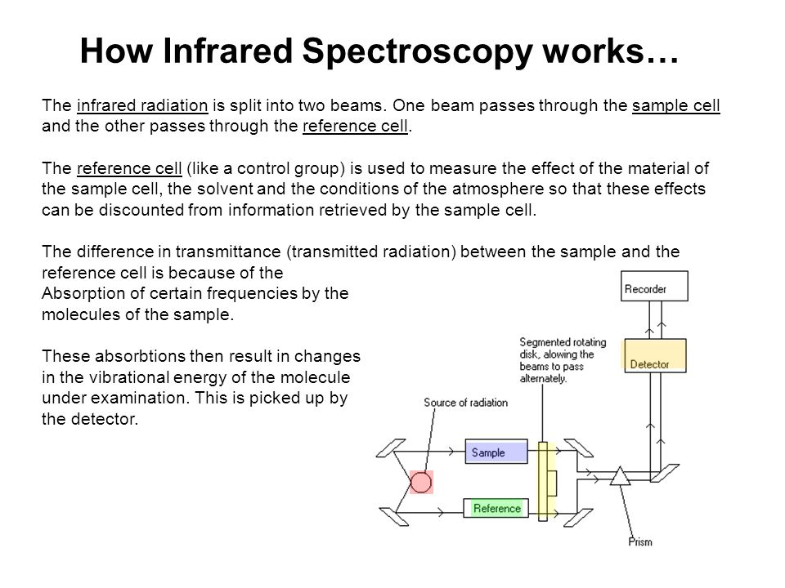
Instrumentation IR spectroscopy
source of energy
Sampling area
Photometer
Grating (monochromator )
Detector

Slide 18
Sample Preparation
For recording an IR spectrum, the sample may be gas, a liquid, a solid or a solution of any of these. The samples should be perfectly free of moisture, since cell materials (NaCl, KBr, CsBr etc.) are usually spoiled by the moisture.
Liquids are studied neat or in solution. In case of neat liquid, a thin film of < 0.01 mm thickness is obtained by pressing the liquid between two sodium chloride plates and plates are subjected to IR beam. Spectra of solutions are obtained by taking 1-10 % solution of the sample in an appropriate solvent in cells of 0.1-1 mm thickness.
A compensating cell, containing pure solvent is placed in the reference beam of the instrument. The choice of solvent depends on the solubility of the sample and its own minimal absorption in IR region. Carbon tetrachloride, chloroform and carbon disulfide are preferred solvents.

