Slide 1
CHEMICAL TESTS OF ANTHRAQUNIONE
Pharmacognosy
3rd Class, 1st Semester
Lab.5

Slide 2
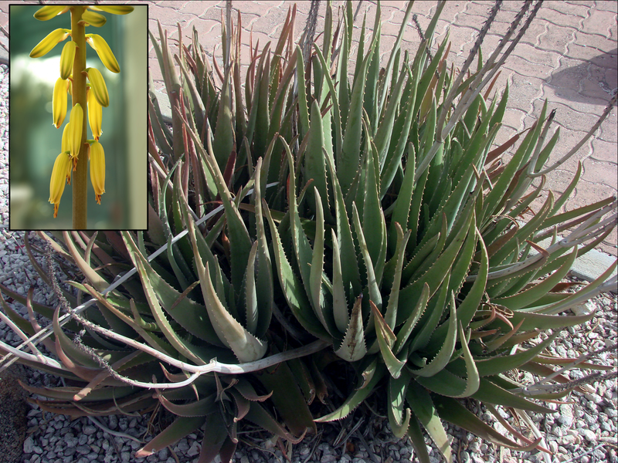
Binomial name:- Aloe vera
Family: - Xanthorrhoeaceae

Slide 3
A- GENERAL REACTION
Boil 1gm of the crude drugs (aloe) with 100ml of water.
Filter the solution and use this solution for the following tests:
1) SCHONTETENS REACTION (BORAX TEST)
2) BROMINE TEST FOR ALOIN

Slide 4
1) SCHONTETENS REACTION (BORAX TEST)
AIM
To identify the Anthraquinone glycosides in general
Equipment and reagents
Test tube
Small beaker
Water bath
Borax
Procedure
Take 5 ml of the extract.
Add 0.2 gm of the borax and heat until dissolved.
Pour a few drops of the liquid into a test tube nearly full in water.
Results
A green fluorescence is produced.
Discussion
This green fluorescence is due to barbaloin which is obtained from hydrolysis of aloe emodin anthranol with borax giving this reaction.

Slide 5
2) BROMINE TEST FOR ALOIN
AIM
To identify the Anthraquinone glycosides in general
Equipment and reagents
Test tube
Bromine solution
Procedure
Take 2ml of the extract
Add an equal volume or an excess of freshly prepared solution of the bromine.
Record the color
Results
Pale Yellow precipitates.

Slide 6
B- SPECAL REAGENTS
1) Nitric acid test
Aim
Specific identification of the Anthraquinone glycosides.
Equipment and reagents
Test tube
Concentrated nitric acid
Procedure
Take 5ml of solution.
Add 2ml of concentrated nitric acid.
Record the results pale brown.

Slide 7
2-Nitrous acid test (specific for isobarbaloin)
Aim
Specific identification of the Anthraquinone glycosides(isobarbaloin )
Equipment and reagents
Test tube
Sodium nitrite
Glacial acetic acid
Procedure
Take a few mills from an aqueous solution
Add a few crystals of sodium nitric acid and a drop of glacial acetic acid , shake well.
Record the results brown.

Slide 8
3) CUPRALOIN TEST FOR ISOBARBALOIN (KLUNG’S REACTION)
AIM
To identity test for Curacao aloe.
Equipment and reagents
Small beaker
Water bath
10%coppersulphate solution
Sodium chloride
Procedure
1) Mix 5ml of the filtrate with 5ml of the water
2) Add:
A drop of 10% copper sulphate solution
0.5gm of sodium chloride
1ml of alcohol, warm gently.
3) Record the results dark brown .

Slide 9
4 )Borntragers test
Aim
To identity test for Anthraquinone.
Equipment and reagents
Separatory funnel
Test tube
Dilute acid
Benzene
Dilute ammonia 10%
Procedure
Take 10 ml of the solution extract (fraction A)
Add few drops of dilute acid
Place the mixture in a separatory funnel and extract with 10 ml of benzene for 1 minute.
Separate the upper layer and place in a test tube (aqueous glycoside layer fraction B).
Take the lower benzene layer (fraction C) and shake it with dilute ammonia (10%).
Results
Pink color will be produced which is very clear with fraction C
Discussion
The benzene extracts the aglycone, and with ammonia, forms Anthraquinone salts, which have, pink color.

Slide 10
RHUBARB
TEST FOR IDENTITY
The Anthraquinone may readily be separated from powdered rhubarb by micro-sublimation.
Borntragers test (is carried out as above procedure)
TEST FOR PURITY:-
Test A)
Extract a small amount of the powdered rhubarb with ether
Add a few drops of this extract on a piece of filter paper.
When dry, add a few drops of boric acid solution and one drop of dilute HCL, a red color develops which after treating with ammonia becomes blue to bluish- black.
Test B)
Moisten a small amount of the powdered drug with a cooled mixture of equal parts of concentrated H₂SO₄ and alcohol. A reddish-violet color should develop.

Slide 11
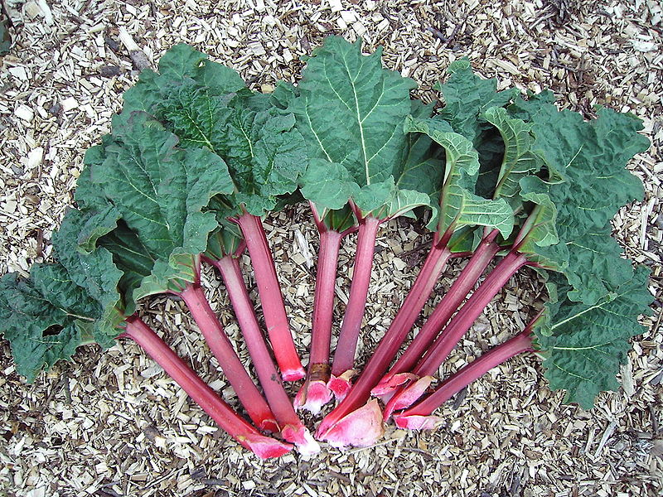
Binomial name:- Rheum rhabarbarum Family :- Polygonaceae

Slide 12
THANK YOU

