Slide 1
Spectrochemical analysis
UV-VIS spectroscopy

Slide 2
outline
Electromagnetic radiation (EMR)
Wave Characteristics
The particle nature of light
Spectroscopy
Absorption and Emission
Beer-lambert’s law
Terms describing UV absorptions
Molecular transitions
Factors affecting UV absorptions
Instrumentation
Woodward –Fieser’s rules

Slide 3
VISIBLE SPECTROSCOPY
When a sample only absorbs light of a single wavelength the eye sees COMPLEMENTARY colours.
Wavelength Range Absorbed | Colour Absorbed | Colour Seen By Eye
380 - 430 | Violet | Yellow - Green
430 - 480 | Blue | Yellow
480 - 490 | Green - Blue | Orange
490 – 500 | Blue - Green | Red
500 - 560 | Green | Purple
560 - 580 | Yellow - Green | Violet
580 - 590 | Yellow | Blue
590 - 610 | Orange | Green - Blue
610 - 750 | Red | Blue - Green

Slide 4
Terms describing UV absorptions
Chromophores: Unsaturated organic functional groups that absorb in the ultraviolet or visible regions.
Group | Structure | λ_{max}
Carbonyl | > C = O | 280
Azo | -N = N- | 262
Nitro | -N=O | 270
Thioketone | -C =S | 330
Nitrite | -NO2 | 230
Conjugated Diene | -C=C-C=C- | 233
Conjugated Triene | -C=C-C=C-C=C- | 268
Conjugated Tetraene | -C=C-C=C-C=C-C=C- | 315
Benzene |  | 261

Slide 5
Auxochromes: substituents with unshared pairs like OH, NH, SH ..., when attached to π chromophore they generally move the absorption max. to longer λ.
Increase in absorption intensity.
Hyperchromic
ε
shorter λ
blue shift.
Hypsochromic
Bathochromic
longer λ
red shift.
Hypochromic
200 nm
700 nm
Decrease in absorption intensity.

Slide 6
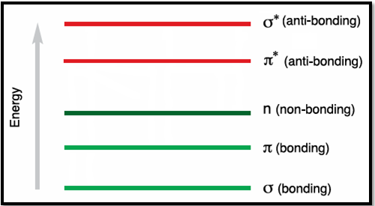
Uv-visible spectroscopy
Why we use UV-Visible spectroscopy?
Detection of functional groups
Detection of impurities
Qualitative and quantitative analysis
Its helpful to show the relationship between different groups, and detect the conjugation of compounds.
Types of electrons
σ electrons: in saturated compounds
π electrons: in unsaturated compounds
n electrons: in non bonded electrons

Slide 7
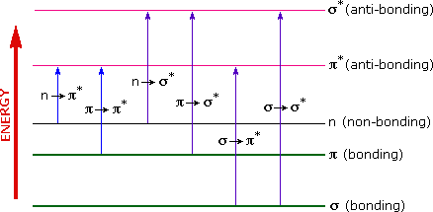

Molecular transitions
σ → σ* transition
n → π* transition
π → σ* transition
n → σ* transition
σ → π* transition
π → π* transition
3
6
1
4
2
5
n → π* | n → σ* | π → π* | σ → σ*
High energy (E)
Low wavelength (𝝀)

Slide 8
σ → σ* transition
An electron in a bonding σ orbital is excited to the corresponding antibonding orbital. The energy required is large.
For example, methane (CH₄) (which has only C-H bonds, and can only undergo σ → σ* transitions) shows an absorbance maximum at 125 nm.
Absorption maxima due to σ → σ* transitions are not seen in typical UV-VIS spectra (200 - 700 nm)

Slide 9
n → σ* transition
Saturated compounds containing atoms with lone pairs (non-bonding electrons) are capable of n→σ∗ transitions.
These transitions usually need less energy than σ→ σ ∗ transitions. They can be initiated by light whose wavelength is in the range 150 - 250 nm.
The number of organic functional groups with n → σ∗ peaks in the UV region is small.

Slide 10
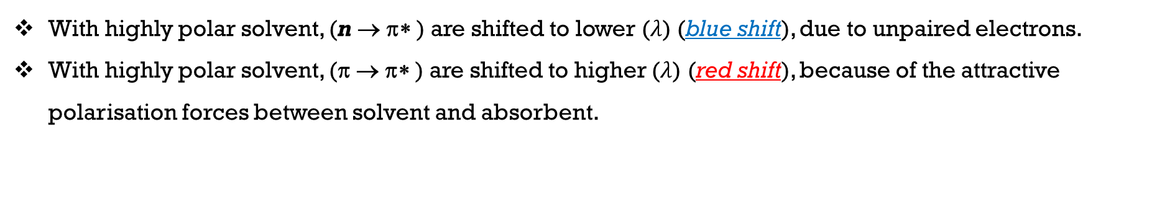
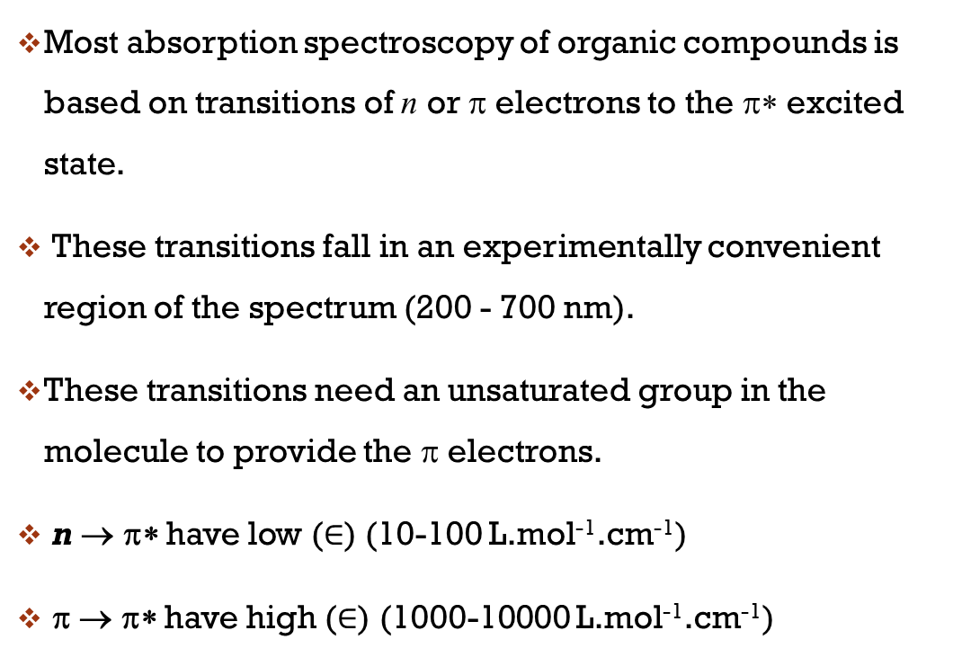
n → π* transition
π → π* transition
Most absorption spectroscopy of organic compounds is based on transitions of n or π electrons to the π∗ excited state.
These transitions fall in an experimentally convenient region of the spectrum (200 - 700 nm).
These transitions need an unsaturated group in the molecule to provide the π electrons.
n → π∗ have low ($∈$) (10-100 L.mol⁻¹.cm⁻¹)
π → π∗ have high ($∈$) (1000-10000 L.mol⁻¹.cm⁻¹)
UV/VIS
With highly polar solvent, (n → π∗ ) are shifted to lower ($λ$) (blue shift), due to unpaired electrons.
With highly polar solvent, (π → π∗ ) are shifted to higher ($λ$) (red shift), because of the attractive polarisation forces between solvent and absorbent.

Slide 11
(π → π∗)Transition is the most convenient and useful transition in UV-Vis Spectroscopy. Why?
π−π* transition is the most frequently used transition for the following reasons:
The Є for the π−π* transition is high allowing sensitive determinations.
The energy required is moderate, far less than dissociation energy.
In presence of the most convenient solvent (water), the energy required for a π−π* transition is usually smaller.
Chromophore | Excitation | λ_{max}, nm | Solvent
C=C | π→π* | 171 | hexane
C=O | n→π* π→π* | 290 180 | hexane hexane
N=O | n→π* π→π* | 275 200 | ethanol ethanol
C-X X=Br, I | n→σ* n→σ* | 205 255 | hexane hexane

Slide 12
Factors influencing uv-vis absorption
This depends on the nature of the interaction of the particular solvent with the environment of the chromophore in the molecule under study.
It is usually observed that ethanol solutions give absorption maxima at longer 𝝀 than hexane solutions.
Changes in the polarity of the solvent can influence shifts to longer or shorter 𝝀, by changing in the energy gap between these electronic states.
Non-polar solvents (saturated hydrocarbons) do not interact with solute molecules either in the ground or excited state.
Type of solvent
Concentration
Temperature
Conjugation
pH of the solution

Slide 13
Factors influencing uv-vis absorption
The buffer though needs to be transparent over the wavelength range of the measurements. If the buffer absorbs radiation, absorbance readings attributed to the analyte may be higher than they should because the buffer and analyte absorptions will add together at each wavelength.
If the optimum pH buffer solution is suitable with analyte, The absorbance spectra will show clear peak of the analyte, and vice versa.
Type of solvent
Concentration
Temperature
Conjugation
pH of the solution

Slide 14
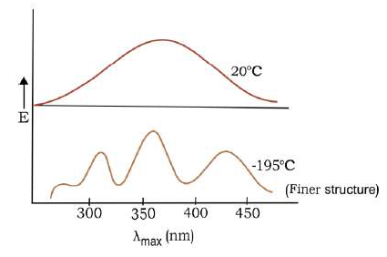
Factors influencing uv-vis absorption
To get more accurate results, the spectrum needs to taken at a specified or constant temperature.
Band sharpness increases with decreasing temperature.
Position of absorption maximum does not move or moves very little towards the longer wavelength side, with decreasing temperature.
The total absorption intensity is approximately independent of the temperature.
Type of solvent
Concentration
Temperature
Conjugation
pH of the solution

Slide 15
Factors influencing uv-vis absorption
Sample concentration is proportional to the intensity of the absorption.
At high concentrations however, molecular interactions can take place causing changes to the position and shape of absorption bands.
Such an outcome can affect the linearity of the relationship between sample concentration and absorbance.
Higher the concentration of the analyte show higher absorbance they probably don’t follow Beer-Lambert’s law.
Optimum concentration of analyte will be use , the absorbance will below then (0.8) .
Type of solvent
Concentration
Temperature
Conjugation
pH of the solution

Slide 16
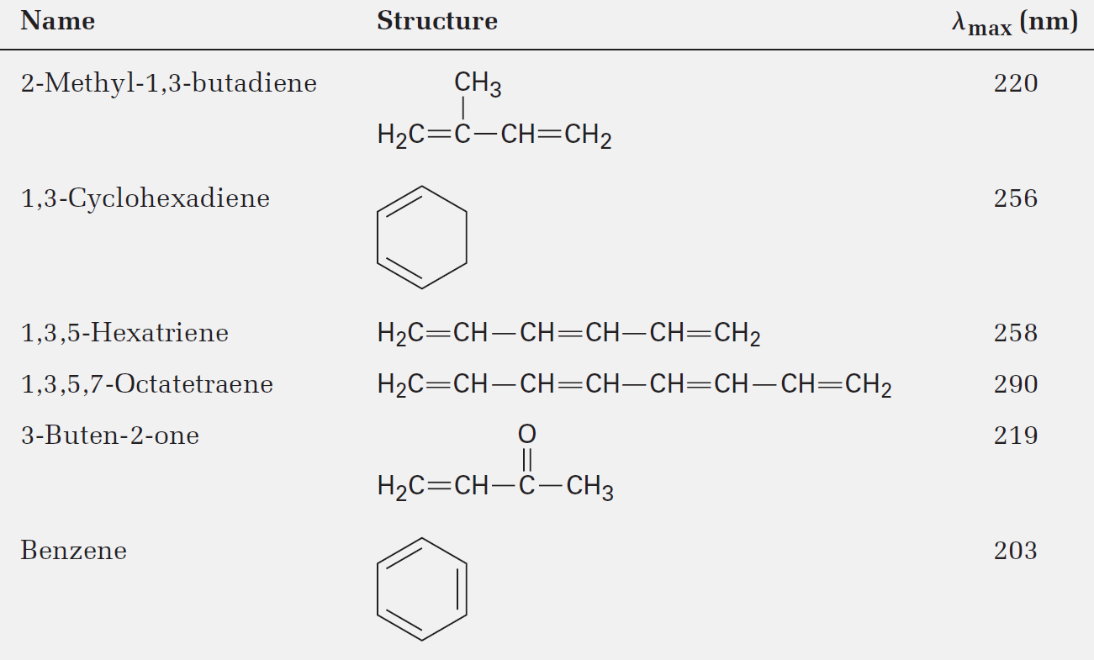
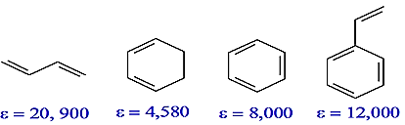
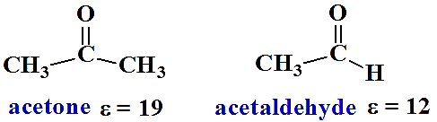
Factors influencing uv-vis absorption
Wavelength of UV radiation that causes π → π∗ excitation in a conjugated molecule ultimately depends on the nature of the conjugated system
Degree of conjugation has a significant influence on the wavelength and molar absorptivity.
Type of solvent
Concentration
Temperature
Conjugation
pH of the solution

Slide 17
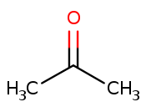
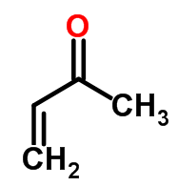
𝝀_{max}= 178 nm
𝝀_{max}= 227 nm
n → π* | 𝝀_{max}= 274 nm (Є_{max}= 13.6) | 𝝀_{max}= 331 nm (Є_{max}= 25)
π → π* | 𝝀_{max}= 195 nm (Є_{max}= 9000) | 𝝀_{max}= 203 nm (Є_{max}= 9600)
MORE conjugated double bonds MEANS LESS (E )is required for the electronic transition, and therefore LONGER 𝝀 at which the electronic transition occurs.

Slide 18
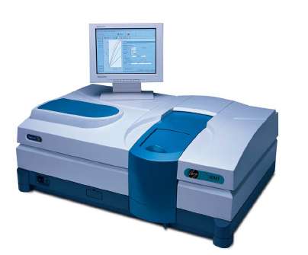
UV/Visible Spectroscopy: Instrumentation
Spectrometer is an instrument which can measure the absorbance of a sample at any wavelength
Most spectroscopic instruments in the UV/visible and IR regions are made up of five components:
A stable source of radiant energy
A wavelength selector to isolate a limited region of the spectrum for measurement
One or more sample containers
A radiation detector, to convert radiant energy to a measurable electrical signal
A signal-processing and readout unit consisting of electronic hardware and in modern instruments a computer.

Slide 19
Optical materials
The cells, windows, lenses, mirrors, and wavelength-selecting elements in an optical spectroscopic instrument must transmit radiation in the wavelength region being investigated.
Sample containers:
Quartz or fused silica is required for the UV region (wavelengths less than 350 nm) and may be used in the visible region.
Silicate glass is usually used for the 375–2000 nm region because of its low cost compared to quartz. Plastic cells are also used in the visible.
The best cells have windows that are perpendicular to the direction of the beam in order to minimize reflection losses.
The most common cell path length for studies in the UV and visible regions is 1 cm

Slide 20
Sample containers:
Fingerprints, grease, or other deposits on the walls may alter significantly the transmission characteristics of a cell. Thus, it is important to clean cells both before and after use, and the windows must not be touched after cleaning is complete.
Matched cells should never be dried by heating in an oven or over a flame because this may cause physical damage or may change the path length. Matched cells should be calibrated against each other regularly with an absorbing solution.

