Slide 1
States of Matter
Lecture 4 Assistant Prof.Dr Fouad Al-saady Physical pharmacy

Slide 2
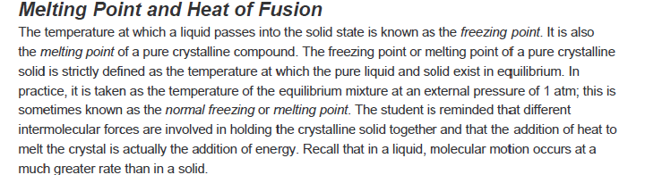

Slide 3
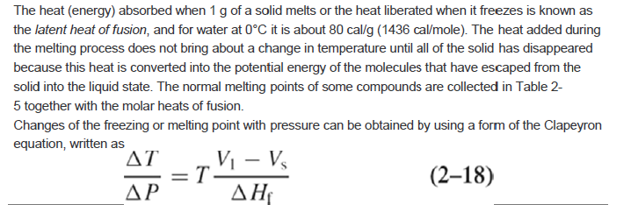

Slide 4
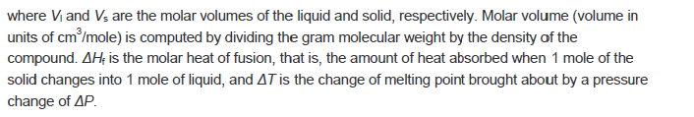

Slide 5
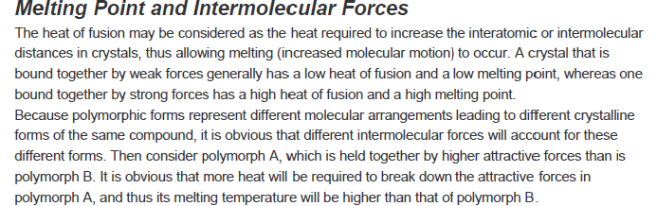

Slide 6
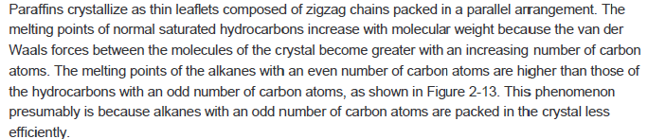

Slide 7
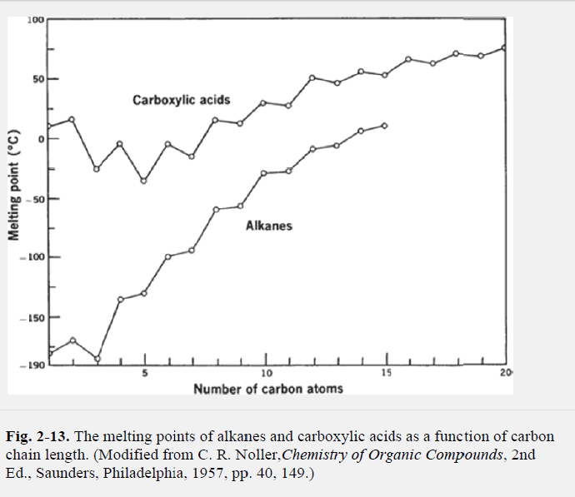

Slide 8
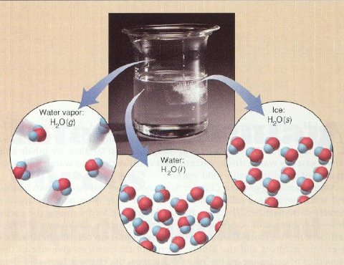
Phase Equilibria & The Phase Rule

Slide 9
Phase Equilibria & The Phase Rule: Definitions
Phase Equilibrium: A stable phase structure with lowest free-energy (internal energy) of a system, and also randomness or disorder of the atoms or molecules (entropy).
Any change in Temperature, Composition, and Pressure causes an increase in free energy and away from Equilibrium thus forcing a move to another ‘state’

Slide 10
Phase Definition
A phase is defined as any homogeneous and physically distinct part of a system which is separated from other parts of the system by interfaces.
A phase may be gas, liquid or solid.
A gas or a gaseous mixture is a single phase.
Totally miscible liquids constitute a single phase.

Slide 11
In an immiscible liquid system, each layer is counted as a separate phase.
Every solid constitutes a single phase except when a solid solution is formed.
A solid solution is considered as a single phase.
Each polymorphic form constitutes a separate phase.

Slide 12
Liquid water, pieces of ice and water vapour are present together.
The number of phases is 3 as each form is a separate phase. Ice in the system is a single phase even if it is present as a number of pieces.
Calcium carbonate undergoes thermal decomposition.
The chemical reaction is: CaCO₃(s) → CaO(s) + CO₂ (g)
Number of phases = 3 : This system consists of 2 solid phases, CaCO3 and CaO and one gaseous phase, that of CO₂.
3. A solution of NaCl in water Number of phases = 1

Slide 13
Components
The number of components of a system at equilibrium is the smallest number of independently varying chemical constituents using which the composition of each and every phase in the system can be expressed.

Slide 14
Examples
Counting the number of components
The sulphur system is a one component system. All the phases, monoclinic, rhombic, liquid and vapour – can be expressed in terms of the single constituent – sulphur.
A mixture of ethanol and water is an example of a two component system. We need both ethanol and water to express its composition.

Slide 15
Degrees of freedom (or variance)
The degrees of freedom or variance of a system is defined as the minimum number of variables such as:
temperature
pressure
concentration
which must be fixed in order to define the system completely.
F = C − P + 2

Slide 16
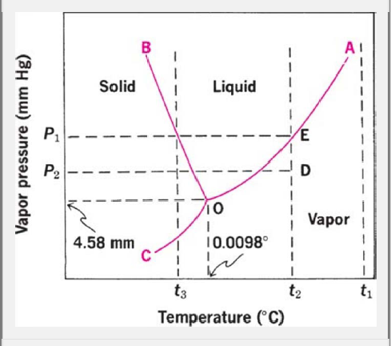
One-component systems
Phase diagram of water
Curve O-A
Vaporization
Condensation
Critical point
218
Curve O -B
Melting
Freezing
1
P (atm)
Curve O -C
Sublimation
Deposition
0.006
=0
=100
O--Triple point
374
F = C − P + 2

Slide 17
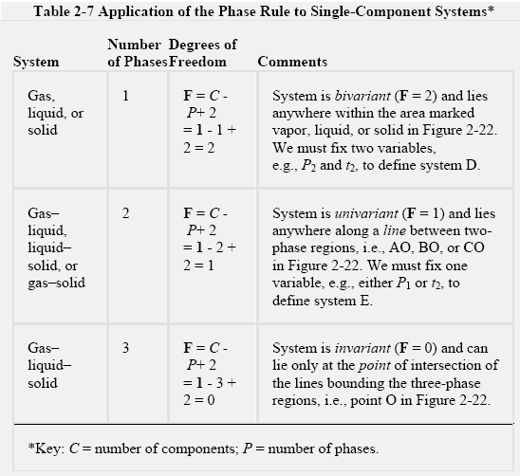
F = C − P + 2

Slide 18
Condensed system: System in which the vapor phase is ignored and only the solid and/or liquid phases are considered.
Two component system
For two component system F can be 3, (3D model is needed), e.g. T, p and concentration , usually we fix p = 1atm , the vapor phase is neglected, and F is reduced to 2
For three component system the pressure and temperature are fixed

Slide 19
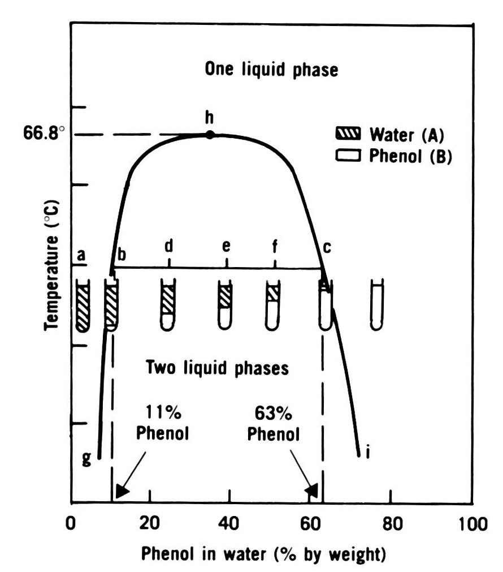

Slide 20
The Critical Solution Temperature: CST
Is the maximum temperature at which the 2-phase region exists (or upper consolute temperature).
In the case of the phenol-water system, this is 66.8ºC (point h)
All combinations of phenol and water > CST are completely miscible and yield 1-phase liquid systems.

Slide 21
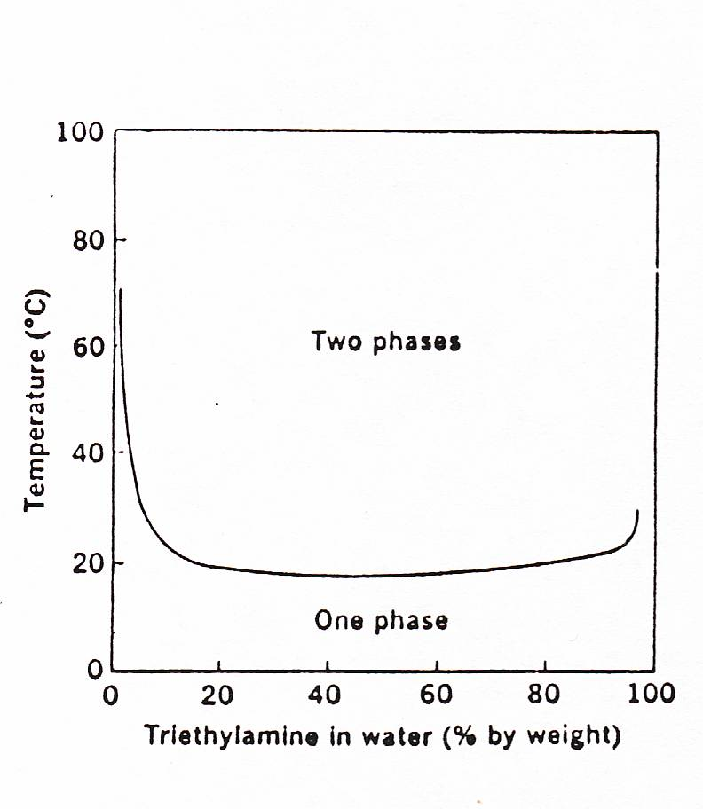
Systems Showing a Decrease in Miscibility with Rise in Temperature
A few mixtures, exhibit a lower critical solution temperature (low CST), e.g. triethylamine plus water. The increased miscibility with reduced in temperature.

Slide 22
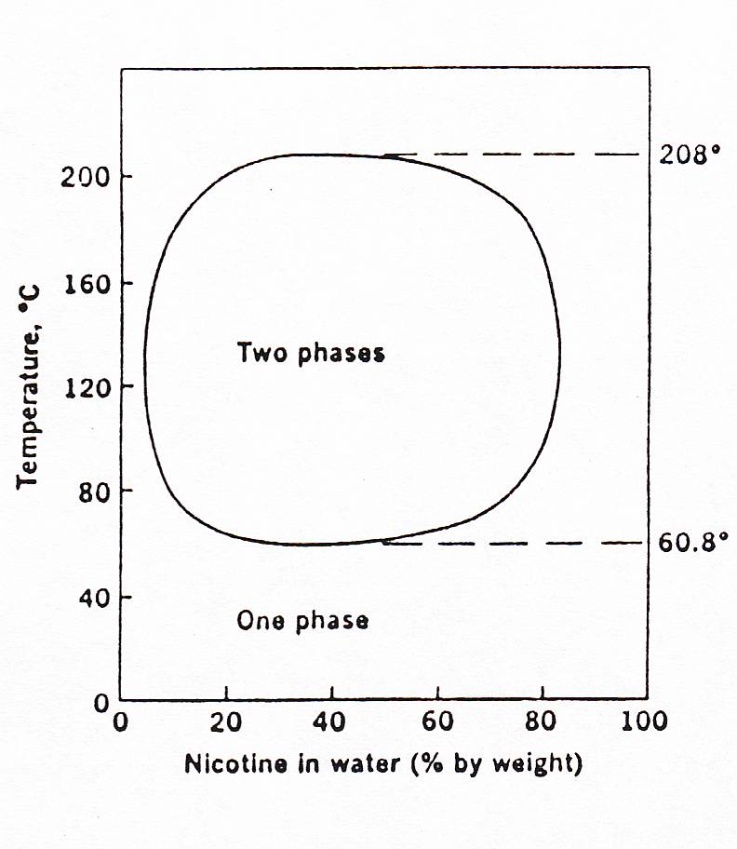
Systems Showing Upper and Lower CSTs
nicotine-water system has both lower and upper consolute temperature

