Slide 1
Principles of pharmacy practice
Percentage, ratio strength and other expressions of concentration
Chapter -6-
Lec.8 (part 2)
Lecturer Anas Tarik nafei

Slide 2
Ratio strength
The concentrations of weak solutions are frequently expressed in terms of ratio strength.
Because all percentages are a ratio of parts per hundred, ratio strength is merely another way of expressing the percentage strength of solutions or liquid preparations (and, less frequently, of mixtures of solids).
For example: (5% = 5 parts per 100 or 5:100). Although 5 parts per 100 designates a ratio strength, it is customary to translate this designation into a ratio, the first figure of which is 1; thus, (5:100 = 1:20).

Slide 3
Example 2: a ratio strength (1:1000), is used to designate a concentration, it is to be interpreted as follows:
For solids in liquids 1g of solute or constituent in 1000 mL of solution or liquid preparation.
For liquids in liquids 1 mL of constituent in 1000 mL of solution or liquid preparation.
For solids in solids 1g of constituent in 1000 g of mixture.
The ratio and percentage strengths of any solution or mixture of solids are proportional, and either is easily converted to the other by the use of proportion.

Slide 4
Example 3:
Easy way: convert last 00 to percent and then divide 1 by 40 so convert to 0.025%

Slide 5
Example 4:
Example 5:

Slide 6
Example 6:
Example 7:

Slide 7
Example 8:

Slide 8
Simple Conversions of Concentration to “mg/mL”
Conversions needed by pharmacists in patient care convert rapidly product concentrations expressed as percentage strength, ratio strength, or as g/L to mg/mL (as in IV infusions)
To convert product percentage strengths to mg/mL, multiply the percentage strength, expressed as a whole number, by 10.
Example 9:
To convert product ratio strengths to mg/mL, divide the ratio strength by 1000.
Example 10:

Slide 9
Parts per Million (PPM) and Parts per Billion (PPB)
The strengths of very dilute solutions are commonly expressed in terms of parts per million (ppm) or parts per billion (ppb), i.e., the number of parts of the agent per 1 million or 1 billion parts of the whole
Example 1:

Slide 10
Example 2:
Example 3:

Slide 11
Additional Examples
1 ppm written as 1 g:1000000 mL
1/X=1000000/10
X=0.00001 g
1g=1000000 mcg
X= 10 mcg
g= 1000 mg so 10 mg= 0.01 g
kg= 1000 g
0.01 g/1 = 1000 g/X
X= 100000
So the ratio is 1:100000 w/w

Slide 12
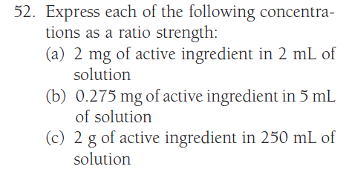
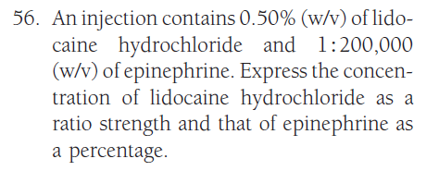
H.W.

Slide 13
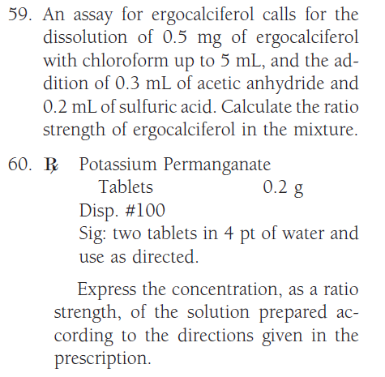

Slide 15
