Slide 1

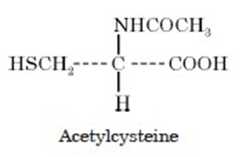
Synthesis of Acetylcystiene

Slide 2
Theory:
L-Cysteine is directly acetylated with acetic anhydride in the presence of a few drops of concentrated sulphuric acid to produce acetylcysteine and a mole of acetic acid.
The H₂SO₄ present helps in the abstraction of one H-atom from the amino function of L-cysteine to form one mole of acetic acid.

Slide 3

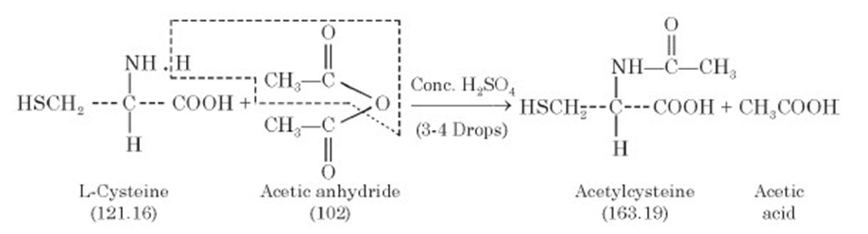
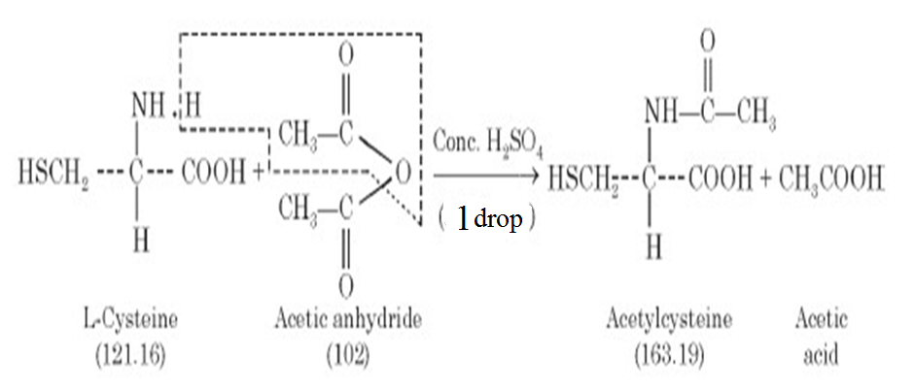
Equation:

Slide 4
Uses :
(1) It reduces the viscosity of pulmonary secretions and facilitate their removal.
(2) It is most effective in 10% to 20% solutions with a pH of 7 to 9 ; and is mostly employed either by direct instillation* or by aerosol nebulization.
(3) Administration of N-Acetylcysteine (NAC) appears to reduce symptomatology associated with influenza and influenza-like episodes.

Slide 5

(4) Oral supplementation with NAC might be a prudent recommendation for smokers or individuals constantly exposed to second-hand smoke.
(5) NAC is the antidote of choice for acetaminophen
(paracetamol) overdose or poisoning.
(6) NAC seems to have some clinical usefulness as a chelating agent in the therapy of heavy-metal poisoning. (NAC effectively chelates Au, Ag and Hg.)

Slide 6
(7) NAC may have a beneficial therapeutic effect on ocular symptoms of Sjogren’s Syndrome.

Slide 7
Procedure:
1. Weigh 1 g of L-cysteine and transfer to conical flask.
2. Add to the flask 6 mL of acetic anhydride and 6 drop of concentrated sulphuric
acid carefully.
3. Mix the contents of the flask intimately, and warm the mixture over a water-bath
maintained at 60°C for about 20 minutes with intermittent stirring.
4. Allow the contents of the flask to attain room temperature, and pour the contents in
a thin stream right into 10 ml of cold water in a beaker with frequent stirring
with a glass rod.
5. Filter the crude and wash it generously with cold water.

Slide 8
Precautions :
(1) All glass apparatus used in the above synthesis should be perfectly dry.
(2) Addition of the drop of concentrated sulphuric acid must be done very carefully.
(3) The reaction mixture is to be warmed at 60°C for a duration of 20 minutes only.

Slide 9
Recrystallization:
The crude product may be recrystallized from a mixture of rectified spirit and water (1 : 1). The yield of pure white, crystalline powder (mp 106–109.5°C).

Slide 10
Calculations:Theoretical yield/Practical yield:
The theoretical yield is calculated from the equation as given below :
121 g of L-Cysteine on reacting with 102 g of acetic anhydride yields acetylcysteine = 163 g L-Cysteine acetylcysteine
121 g 163 g
0.5 g X
∴ 0.5g of L-cysteine shall yield acetylcysteine =163 × 0.5 / 121 = 1.34 g
Hence, Theoretical yield of Acetylcysteine = 0.67g
Actual Practical yield =Y g
Therefore, Percentage Practical yield = Practical yield / Theoretical yield × 100
=Y/ 0.67 × 100 = Z %

Slide 11
Q1/ During the preparation of acetylcysteine we use H2SO4 acid explain it’s role with the equation?
Q2/ What are the acetylcysteine uses?

Slide 12
What are the oxidation , reduction and hydrolysis reactions explain with example ?
What are donating groups, withdrawing groups and how it’s effect on the reaction explain with example?
What are atom ,molecule, material, compound with example ?

Slide 13
Q1/How we can classify L-cysteine and acetylcysteine according to their amine group with the general equation?
Q2/ What is the antidote of choice for acetaminophen poisioning and why?

Slide 14
Q1/ If the percentage of the practical yield is 65% and the chemical structure of L-cysteine is C3H7 N O2 S and for acetylcysteine is C5H9NO3S find the practical weight?
If you know the atomic weight for:
H=1 S=32
C=12 O=16
N=14

Slide 15
Q2/ Write 3 therapeutic use for acetylcysteine with their cause?

Slide 16
Q1/ Numerate 5 uses for acetylcysteine?
Q2/ If your practical weight is 4.5 g of acetylcysteine C5H9NO3S and we start with 5 g of L-cysteine C3H7 N O2 S find the percentage of the practical weight?
H=1 S=32
C=12 O=16
N=14

Slide 17
L-Cysteine acetylcysteine
121 g 163 g
5 X
X=163x5/121=6.73g
Percentage Practical yield = Practical yield / Theoretical yield × 100
P=4.5/6.73 x100=66.86

Slide 18
Q1/ Why we use H2SO4 IN THE PREPARATION of acetylcysteine and how we classify the amine group of the reactant and product with the equation?

Slide 19
Q2/ If the percentage of the practical yield is 75% and the chemical structure of L-cysteine is C3H7 N O2 S and for acetylcysteine is C5H9NO3S find the practical weight if you start with 3 g of L-cysteine?
If you know the atomic weight for:
H=1 S=32
C=12 O=16 N=14

Slide 20
L-Cysteine acetylcysteine
121 g 163 g
3 X
X=163x3/121= 4.04g
Percentage Practical yield = Practical yield / Theoretical yield × 100
0.75=X/4.04= 3.03 g

