Slide 1
INTRODUCTION TO INDUSTRIAL PHARMACY

Slide 2
Definition of Industrial Pharmacy
The conversion of raw materials into certain dosage forms.
Or it is manufacturing, development, marketing and distribution of drug products including quality assurance of these activities .
E.g.: Tablets, capsules, suspensions and ampoules.

Slide 3
Properties of Dosage Form
Safe
Effective
Stable
Bioavialable

Slide 4
Requirements to Formulate Dosage Form
Physicochemical properties of active ingredient and additives
Physical properties
Appearance, Texture,
Color, Odor, Taste, Melting point, Boiling point, Density, Solubility.
Chemical properties
Oxidation, Decomposition, Crystal structure, Toxicity, Thermodynamic properties

Slide 5
Department of Drug Industry
Research and development department
A- Small Scale department (pilot plant)
B- Responsible for formulation of a new dosage forms.
C- Need Wikipedia pharmacist
E.g.: Discover new drug like Evotaz (atazanavir and cobicistat) tablets for HIV and check its pharmacological properties then transfer to development department to develop the new drug

Slide 6
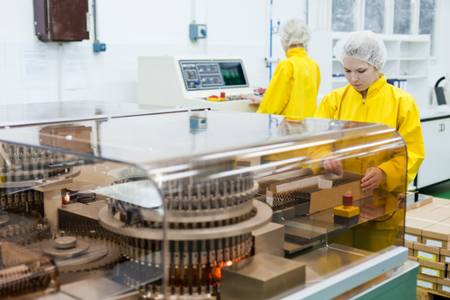
2- Production department
(A) Large scale department (full-scale plant).
(B) Responsible for production of dosage form in large scale department.
(C) Need skilled workers.
E.g. Area for production of tablets, capsules, ampoules and solutions.

Slide 7
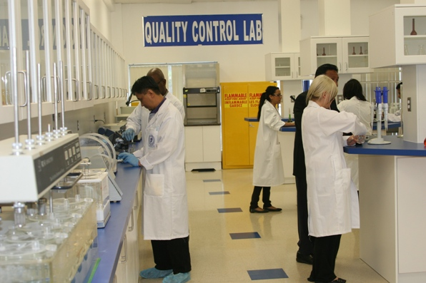
3- Quality control department:
Evaluation department.
Responsible for evaluation of dosage form before going to the market and following up the product from the market to ensure the stability.
To ensure that products meets the requirements specified by the official monographs and to ensure that there is no differences between batches for the same company within accepted evaluations.

Slide 8
4- Marketing department:
Responsible for marketing of drugs to pharmacies and hospitals.
5- Non-laboratory department:
Responsible for finding markets for dispense, management, accounting and personnel.

Slide 9
Drug Factories Requirements
1- Compatible with the GMP specifications like clean, sterilization, and all personnel should wear certain protective work outfits.
2- Departments separation
E.g.: Antibiotics department should be separated from other departments.

Slide 10
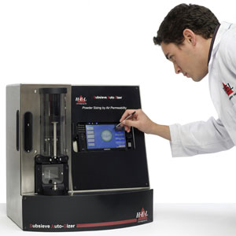
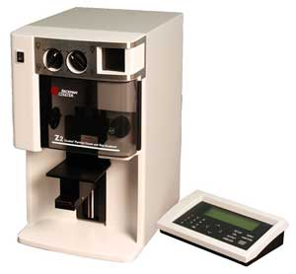
Equipments used in laboratory 1st: tablet Equipments
(1) Sieves
Get uniform particle size
Sub-sieve sizer
Separate particles according to their size (0.2 to 50µm range).
Coulter counter
Measure number of particles and size (< 1µm).

Slide 11
2- Mixers
(2) Mixers
Cubic mixer
Double cone mixer
V-Shaped mixer
Z-Shaped mixer
Suppository mixer
Ribbon mixer
Powder and granules
Wet granulation
Dense powder and granules
Dry and free flowing powders
Non viscous granules or powder

Slide 12
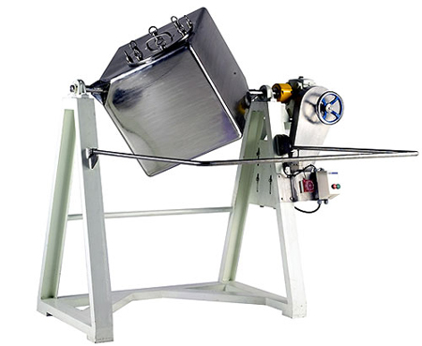
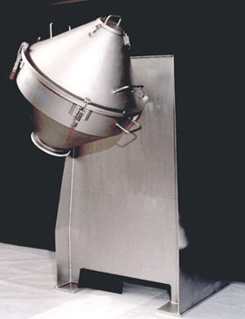
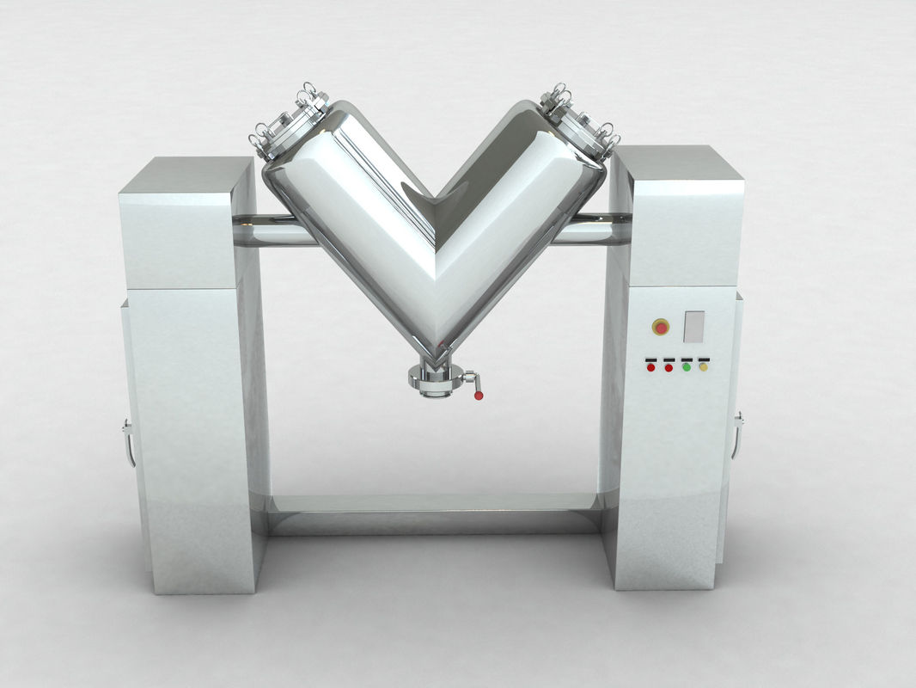
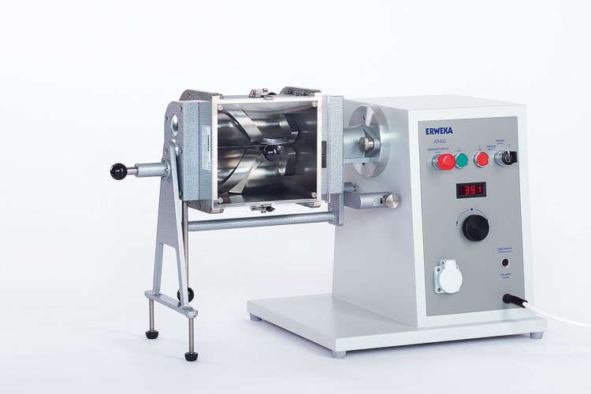
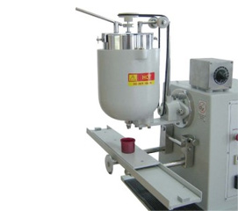
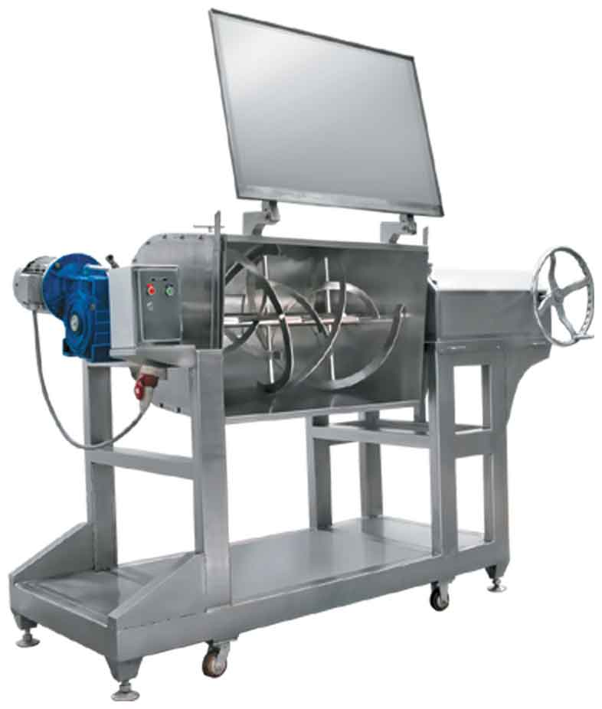

Slide 13
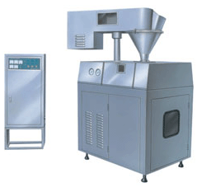
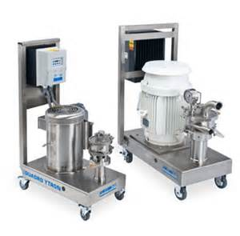
(3) Homogenizer [Granulator]
Dry granulator
granulate slugs, ribbons and pellets.
Wet granulator granulate suspensions, emulsions and dispersions.

Slide 14
(4) Tablet machine
a- Hooper (for storing the materials).
b- Feeder.
c- Die.
d- Upper punch (determine the thickness and hardness of the tablet) and the lower punch (determine the weight of the tablet).

Slide 16
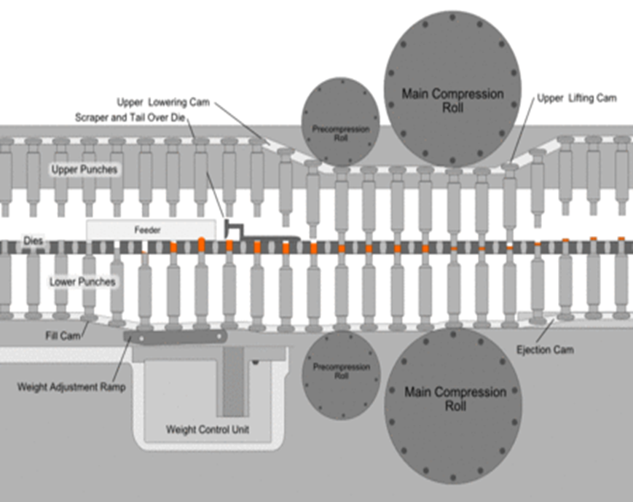
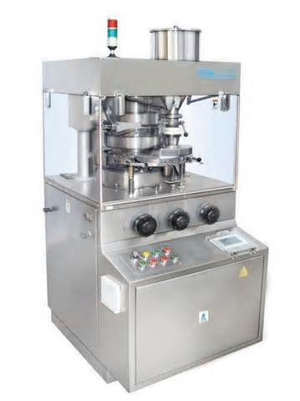

Slide 17
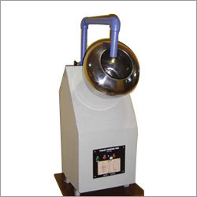
(5) Coating pan:
produce uniform coating on tablet by either sugar or thin film.
(6) Polishing drum:
add polishing materials during operating the drum.

Slide 18
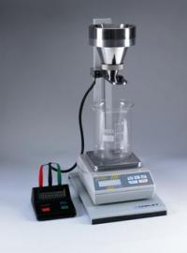
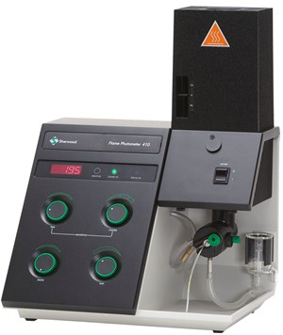
(7) Evaluation equipment
Quality control department to determine the manufactured tablet fall within required standards.
(A) Flow meter: measure the flowability of the tablets powder mixture.
(B)Flame photometer: measure the concentration or amount of ions such as K+ and Na+.
(C) Hardness tester: measure the hardness of the tablet

Slide 19
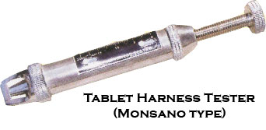
Hardness tester:
Electrical hardness tester
such as Erweka hardness tester.
Manual hardness tester
such as Monsato hardness tester.

Slide 20
(D)
Tablet friabilator:
measures the tablet friability that means
1- very friable tablet
crack rapidly.
2- very solid tablet
will not crack easily.

Slide 21
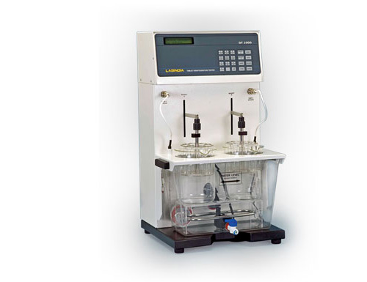
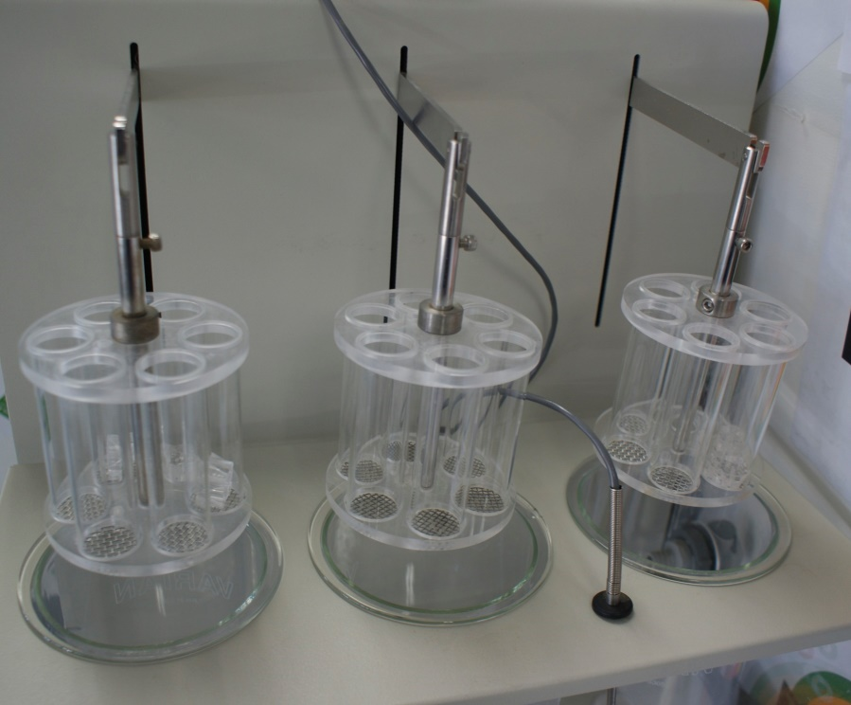
(E)Disintegration apparatus:
measure the time required for tablet break down.
consist of 2-4 baskets each has 6 cylinders, the dosage form placed in the cylinder, which will be immersed in buffer and placed in water bath operating at 37° C.
The disintegration time for ordinary tablets is usually between 15-30 minutes.
Note: (Hard tablet) with higher quantity of binder will require > 30 min. to disintegrate.

Slide 22
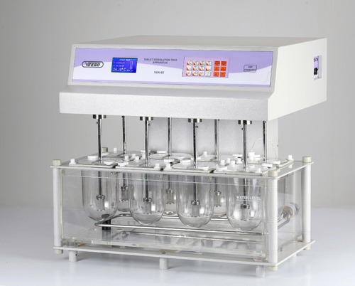
(f) Dissolution rate apparatus
In vitro method to measure the release of drugs inside the body.
Consist of 2-6 jars filled with buffer (0.1N HCl, phosphate) and the (Tablet, film or In-situ gel) is placed in the jar and a sample is taken every 10 min.

Slide 23
Questions
An equipment that is used to
evaluate the tablet breakdown is:
A- Dissolution apparatus
B- Hardness tester
C- Disintegration apparatus
E- Flow meter

Slide 24
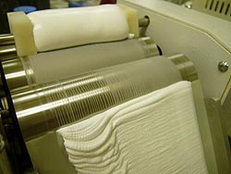
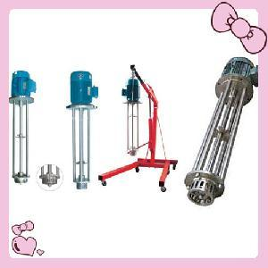
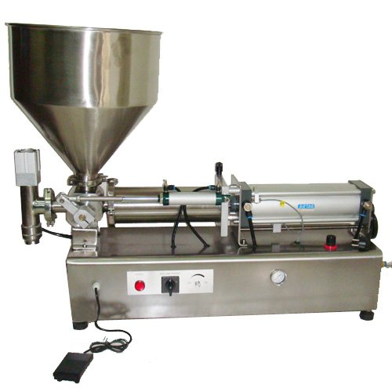
2nd: Semi solid dosage form equipment:
Three roller mill.
Ointment agitator (Filler).
Collapsible closer (to close the tubes).

Slide 25
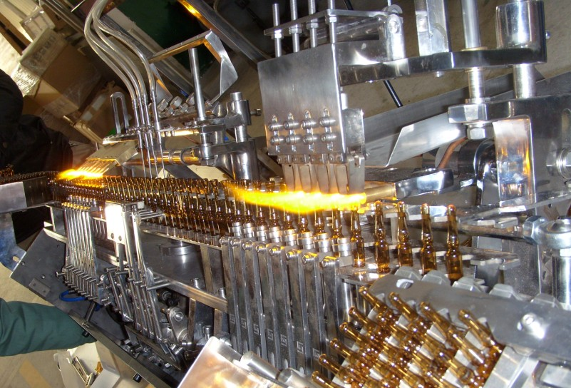
3rd: Ampoules equipment:
(A) Ampoule filling machine (consist of manual tool fills the ampoule in every push is 1 ml).
(B) Ampoule filling and sealing machine (connected with other device that control it’s operation).
(C) Ampoule sealing machine
(utilize high temperature heat to seal the tip of the ampoule).
(D) Millipore filter
(sterilization of liquid because of small pores (0.3 – 0.5 µ)).

Slide 26
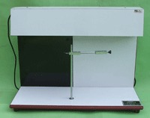
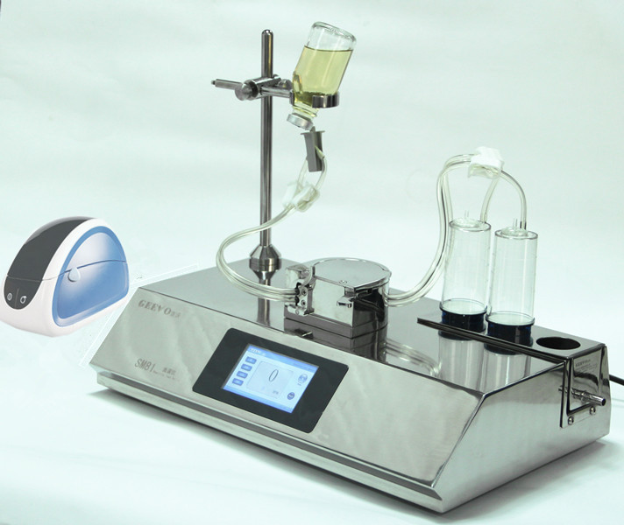
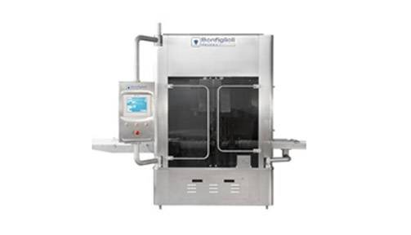
Devices for evaluation of ampoules:
(3) Leaker test apparatus.
(1) Clarity test device.
(2) Sterility test.

Slide 27
4th: Drying equipment:
Dry oven
for dry heat or heat sterilization that require long time.
Tray dryer
which operates by passing hot streams of air.
Freeze dryer
for substances affected by heat or moisture especially hormones.

Slide 28
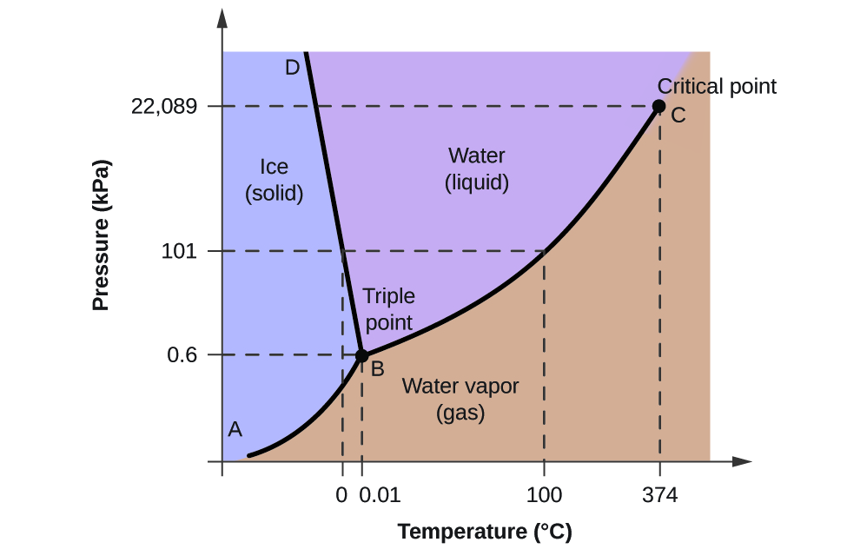

Slide 29
