Slide 1
Medical Microbiology
Lab. 4
By
Assistant lecturer
Zainab farooq shafeeq
Spore stain & Acid fast stain

Slide 2
Spore staining
(Schaeffer-Fulton method)
Principle
Bacteria in genera such as Bacillus and Clostridium produce a quite resistant structure capable of surviving for long periods in an unfavorable environment and then giving rise to new bacterial cell.
This structure is called an endospore since it develops within the bacterial cell.
The location and size of endospore vary with the species

Slide 3
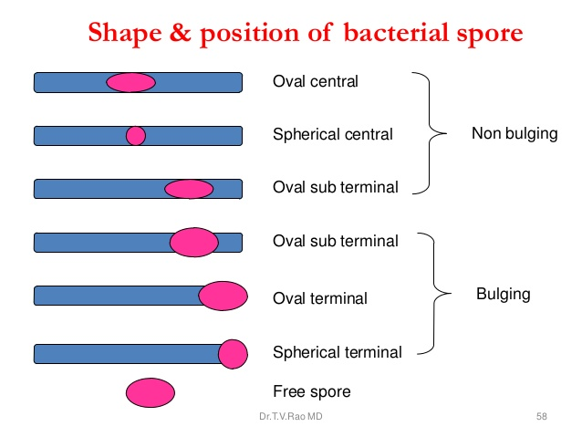

Slide 4
Endospore do not stain easily but , once stained they strongly resist decolorization .
The endospore are stained with malachite green , heat is used to provide stain penetration .
The rest of the cell is then decolorized and counter stained a light red safranin.

Slide 5

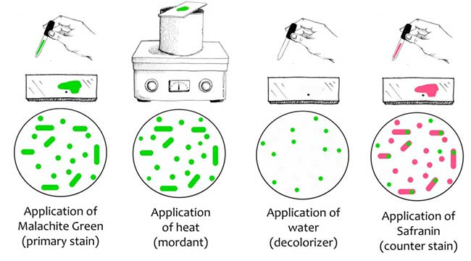

Slide 6
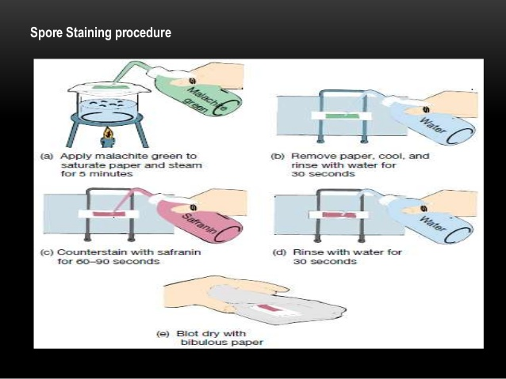

Slide 7
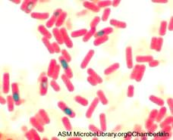
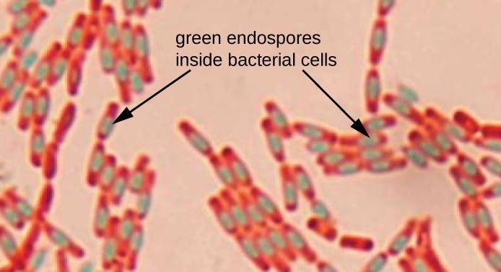
Bacillus subtilus

Slide 8
Acid fast staining
(Ziehl-Neelson stain)
Principle
A few species of bacteria in the genera Mycobacteria and Nocardia do not readily stain with simple stain ,however these microorganisms can be stained by heating them with carbolfuchsin .
The heat drives the stain in to the cell once the microorganisms have taken up the carbolfuchsin , they are not easily decolorized by acid-alcohol and hence are termed acid fast .
This acid fasten is due to the high lipid content (mycolic acid) in the cell wall these microorganisms.

Slide 9
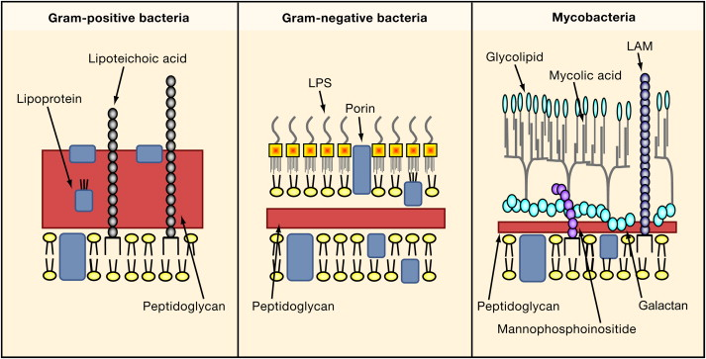

Slide 10
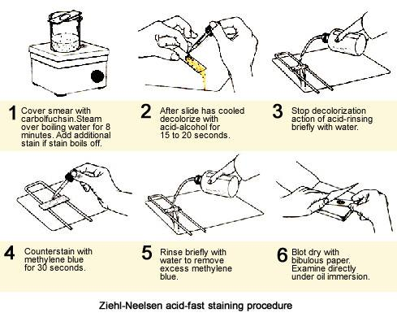

Slide 11
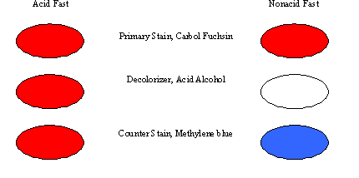
Microorganisms that are not acid fast , termed non acid fast appear (Blue due) staining with methylene blue after they have been decolorized by the acid alcohol.

Slide 12
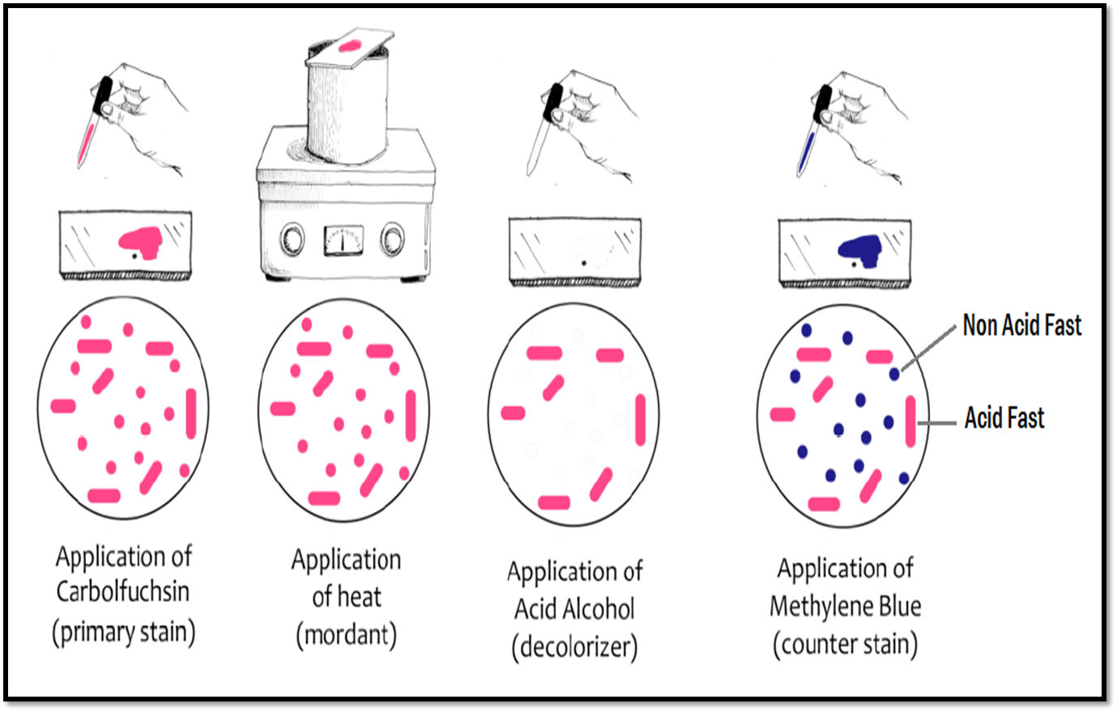

Slide 13
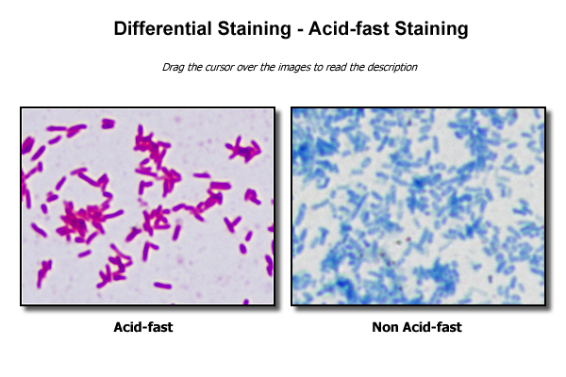
Mycobacterium tuberculosis
Escherichia coli

