Slide 1
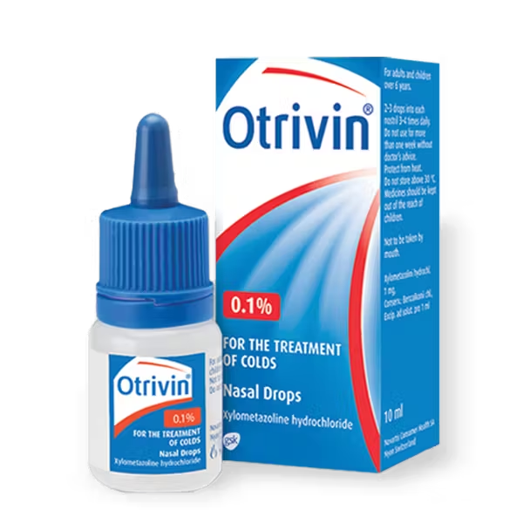
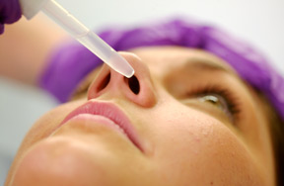
Nasal Drops
Pharmaceutical Technology Lab.
Third stage
Lab. 2

Slide 2
Nasal drops
Nasal drops are aqueous or oily sol. Which are designed to be administered to the nasal passages in drop or spray form . They are commonly used for their antiseptic ,local analgesic or vasoconstrictor properties
Nasal drops must be isotonic with nasal secretion and have the same pH of nasal secretion.

Slide 3
Ephedrine nasal drop
Rx
Ephedrine HCL 500 mg
NaCl 500 mg
Chlorobutol 500 mg
D.W Q.S 100 ml
Mitt.50 ml
Sig. two drops to be placed into each nostril as directed
Procedure
Dissolve 250 mg of chlorobutol in 37.5 ml of hot water
Add 250 mg of ephedrine HCl and 250 mg of NaCl to the solution
Complete the volume up to 50 ml by water

Slide 4
Notes:-
Ephedrine HCl used as vasoconstrictor (decongestant)
Chlorbutol has low solubility in water but it is more soluble in hot water.
Chlorbutol used as preservative, antiseptic ,mild sedative , local analgesic .
Sod.chloride used to maintain osmotic pressure.

Slide 5
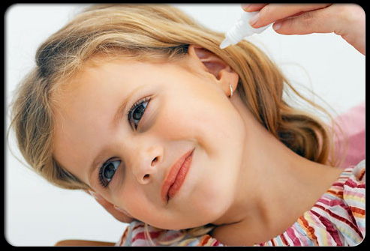
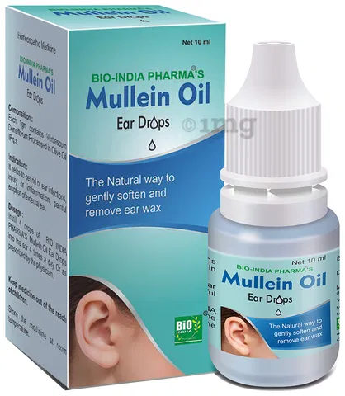
Ear drops

Slide 6
Ear drops
These are mostly simple solution of drugs dissolved in suitable solvent(s) applied into ear by dropper.
Example on solvent: glycerin , propylene glycol , alcohol , water or alcohol – water mixture )
Ear drops used as antibiotic ,wax softener ,cleansing solution.

Slide 7
Sodium bicarbonate ear drop
Rx
Sod.Bicarb. 5g
Glycerin 30 ml
D.W Q.S 100 ml
Ft. mist
Mitt 50 ml
Sig. as directed
Calculation:
Factor = 50/100 = 0.5
Sod. bicarb.= 5 x 0.5= 2.5 g
Glycerin 30 x 0.5 = 15 ml
D.W 100 x 0.5= 50 ml
50 x ¾ = 37.5 ml
37.5 - 15 ml= 22.5 ml of DW used to dissolve sodium .bicarb.

Slide 8
Procedure
Dissolve 2.5 gm of Sod. Bicarb in 22.5 ml of D.W.
Add 15 ml of glycerin.
Complete the volume up to 50 ml by D.W.
Notes:-
nasal drops used internally while ear drops used externally because the outer ear is a skin covered structure and susceptible to the same dermatologic condition as other parts of the body’s surface
Sod. Bicarb. Used for softening the wax
Glycerin used as preservative and lubricant , it increase the viscosity so it give suitable time for drug to be effective
Sod.Bicarb.ear drop should be freshly prepared

Slide 9
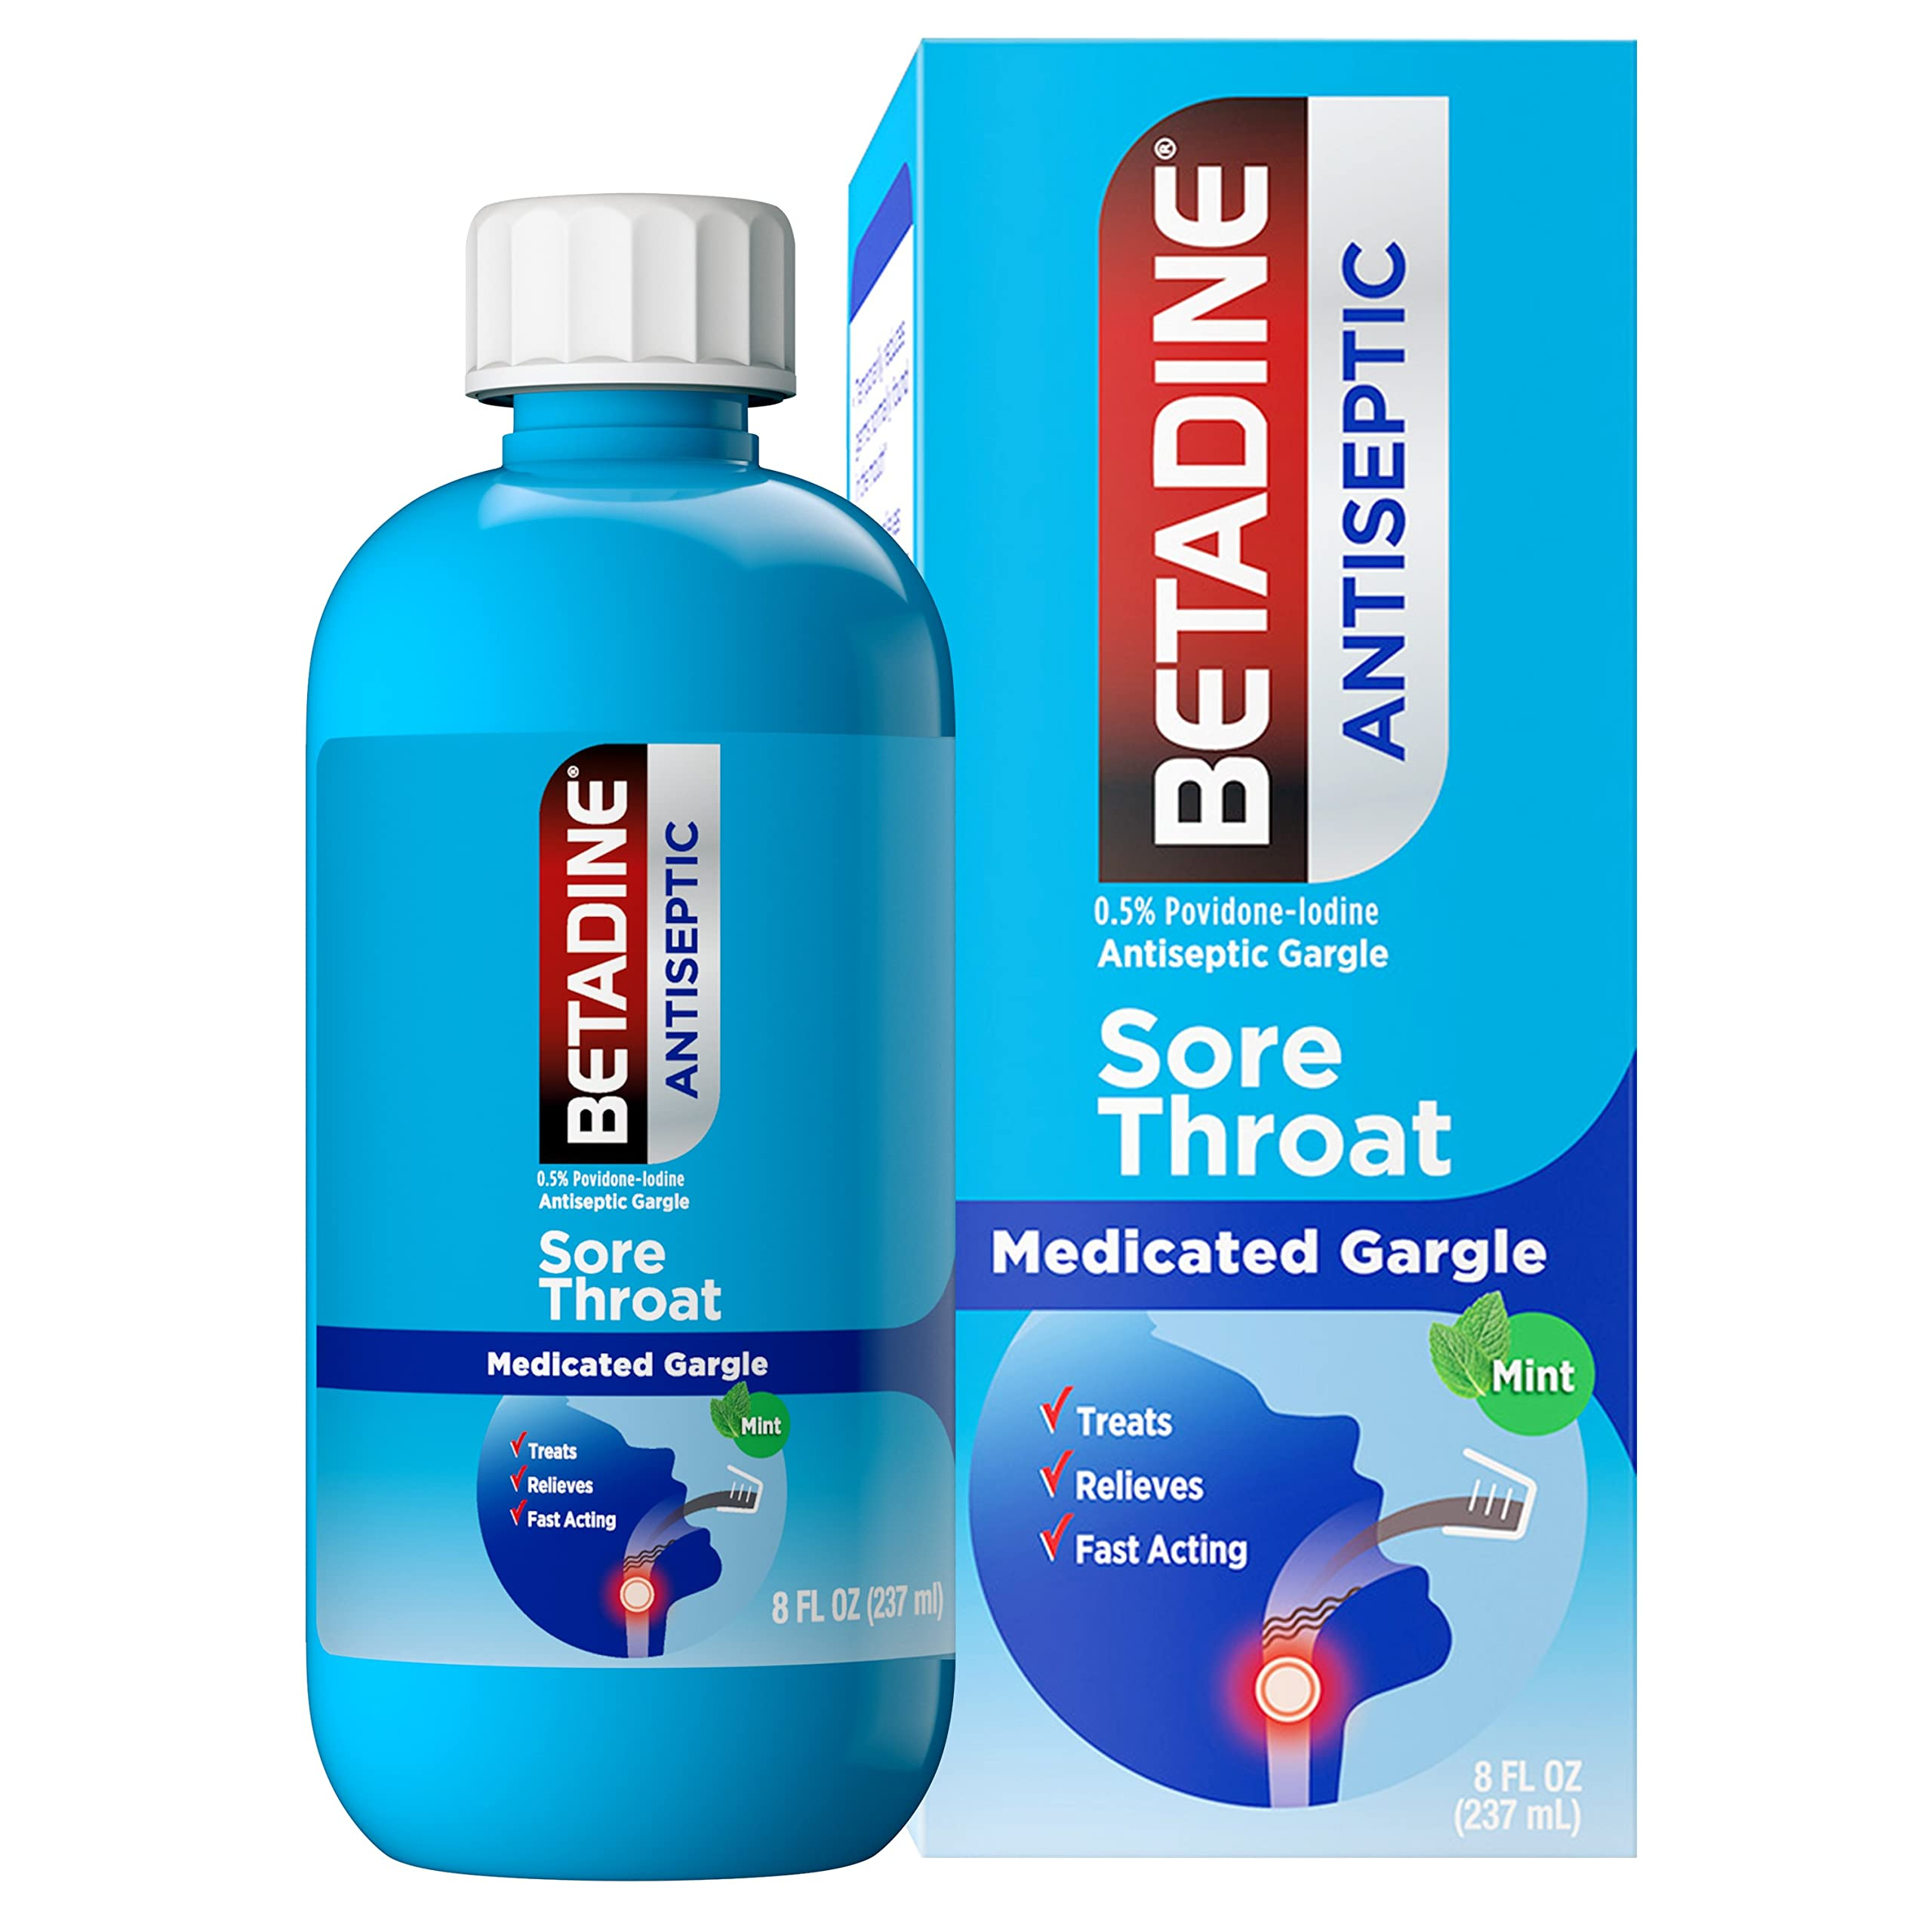
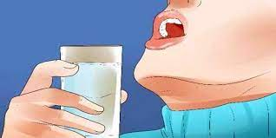
Gargles

Slide 10
Gargles
Gargles are aqueous solution used for treatment of pharynx and nasopharynx by forcing air from lung , it is held in throat for few moments then thrown out of the mouth. They are usually diluted with water before use such as phenol gargle .
Potassium chlorate and phenol gargle B.P.
Rx
Potassium Chlorate 3 g
Patent blue v 2 ml
Liquid phenol 1.5 ml
D.W Q.S 100 ml
Sig. 1table spoonful in half glass of warm water

Slide 11
procedure
Dissolve the potassium Chlorate in about 15 ml of warm water.
Cool before adding the liquefied phenol (very caustic).
Add the dye solution, filter if necessary.
Complete the volume by D.W.
Note:-
Stock solution of patent blue V contain 60 mg /100 ml
60 mg 100 ml
X 2 ml
X= 1.2 mg
Pot. Chl. used as anti-inflammatory.
Patent blue used as coloring agent.
Liquid phenol used as antiseptic.

Slide 12
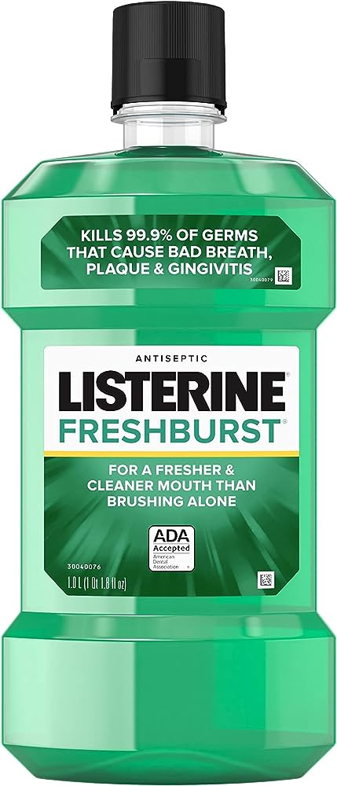
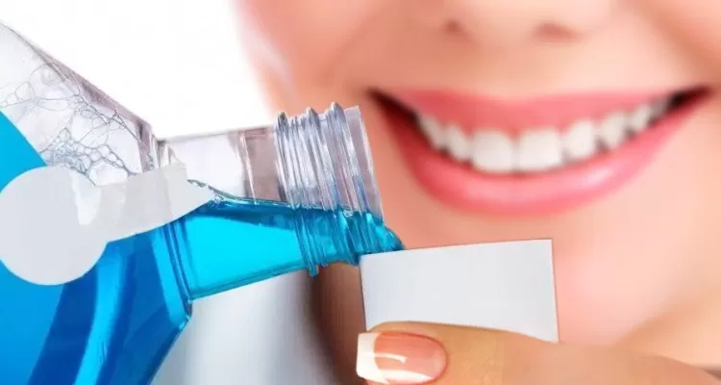
Mouth wash

Slide 13
Mouth Wash
Mouth wash:- are aqueous solutions, most often used for their deodorant ,refreshing or antiseptic effect. They may contain alcohol, glycerin, sweetener and flavoring agent.
Compound sodium chloride wash. B.P.
Rx
NaCl 1.5 mg
Na.bicarb 1 mg
Pepp. water Q.S 100 ml
Sig. to be used with equal volume of warm water
Procedure:-
By simple sol. Method
Note:-
Mouth washes are usually less medicated and more flavored than gargles.

