Slide 1
Hydrolysis of Acetyl Salicylic Acid Solution in Sorenson Phosphate Buffer at pH 8
BIOPHARMACEUTICS

Slide 2
What is in?
Why to study ?
How to study ?
How to link to previous Lab!

Slide 3
Introduction
Aspirin is a weak acid .it is soluble at 20 C° in 300 parts of water .
It is unstable in aqueous solutions degrading to salicylic acid and acetic acid
Aspirin also degrades in solid dosage forms when exposed to moisture and therefore , should be stored in tightly closed containers and kept in a dry environment .

Slide 4
Aim of Experiment
To study the effect of temperature on the hydrolysis of aspirin, and to calculate the shelf life of aspirin .
Shelf life of any drug :it is the time required for the drug to LOSE 10% of its effectiveness

Slide 5
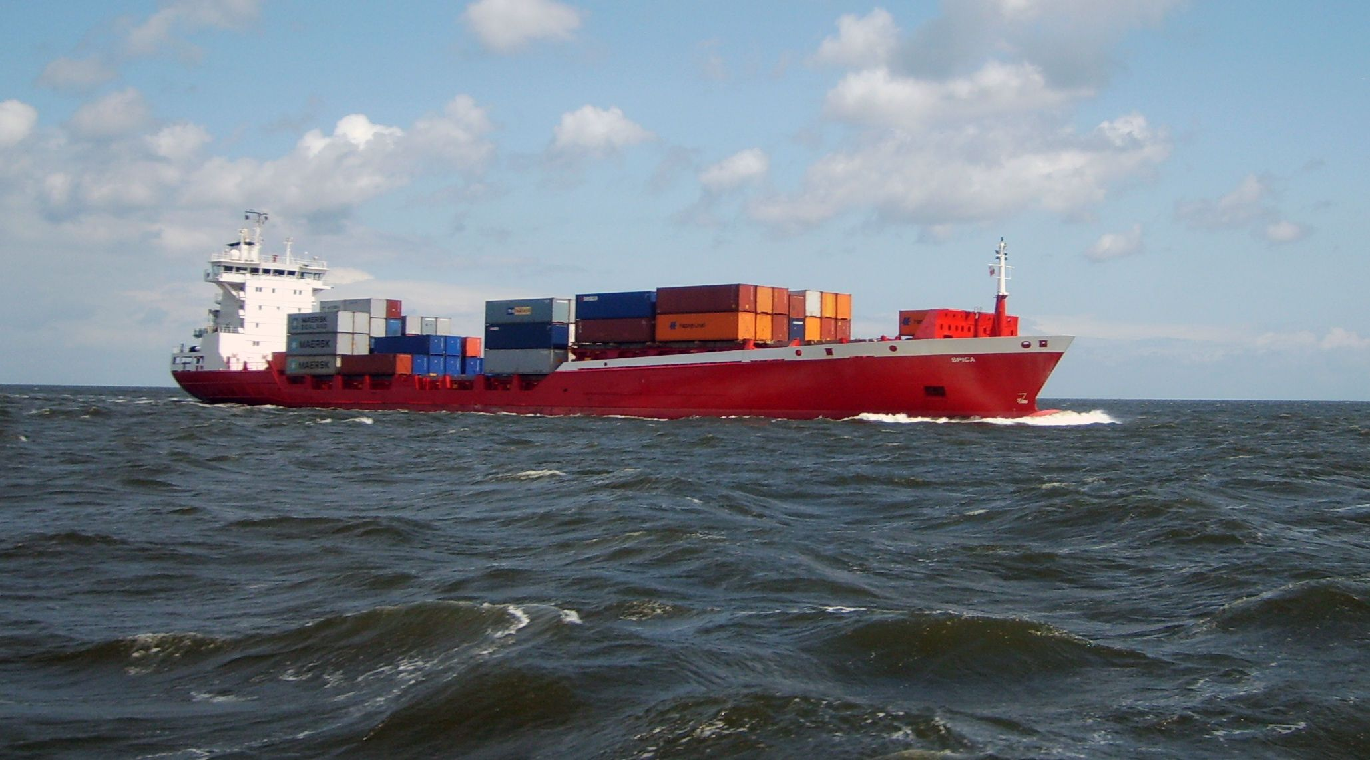

Slide 6
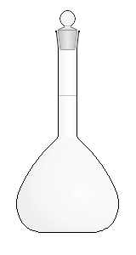
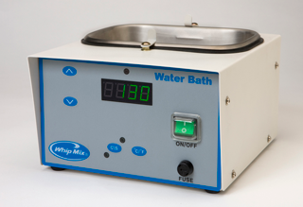
How to work
ASA
Buffer
250 ml
200 ml

Slide 7
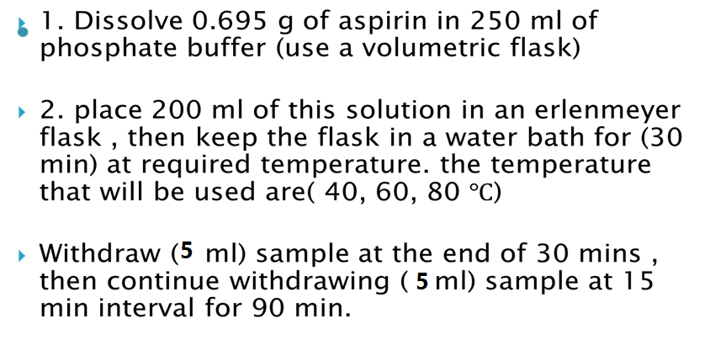
Procedure :

Slide 8
What to do with the sample ???

Slide 9
What is the sample ?
Sample contains Aspirin

Slide 10
Hydrolyzed ASA
SA
AA
Buffer
ASA

Slide 11
Notes:
absorbance increases with time
Concentration of S.A at zero time is ZERO since ASA is not hydrolyzed yet , however , the initial concentration of ASA is 2.78 mg/ml ??
The rate of ASA hydrolysis follows First Order reaction

Slide 12
ASA initial conc. Is 2.78 mg/ml?

Slide 13
Concept
ASA
SA

Slide 14
Sorenson phosphate buffer (pH 8)
Consist of two solutions
A-1/15 M Monopotasium phosphate KH2PO4
B- 1/15 M Disodium phosphate Na2HPO4.2H2O

Slide 15
How to calculate ?
Use the calibration curve of S.A to find the conc. Of SA
Y= C + b*X

Slide 16
Example :
Y = 0.65
intercept = 0.016
Slope = 1.83
So X will be calculated form the eq.
Y= C + b* X X = 0.35 mg / ml
conc,. Of SA.

Slide 17
We are seeking ASA not SA

Slide 18
Calculate remaining ASA from
Initial conc. Of ASA – conc. Of ASA degraded
2.78 – 0.46 = 2.38

Slide 19
Time | Absorbance | Conc. Of S.A | Conc. Of aspirin hydrolyzed ( Ct) | Conc.of aspirin remained
0 |  | Y= c + bx | X *180/138 | 2.78 - Ct
30
45
60

Slide 20
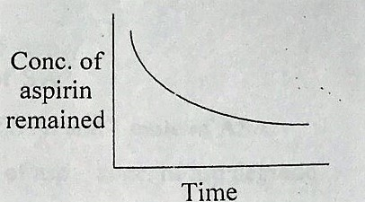
First order Kinetics

Slide 21
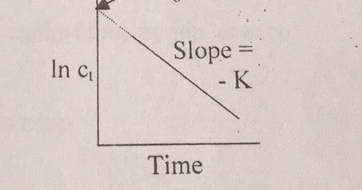
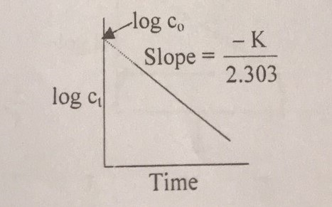

Slide 22
What to do with data ?
1
take the Log, or Ln for each calculated conc.
2
Plot the log/ ln of conc. against time in min for each temp.
You will have 3 plots
3
calculate K for each temp , from the equation
4
take log K and plot 1/𝑇
(draw Arrhenius plot ) to find K at 25 ℃.

Slide 23
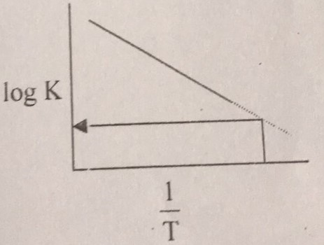
Arrhenious equation :
Log K= log A - (𝐸𝑎 )/(2.303 𝑅) *1/𝑇
Where A= frequency factor ,Ea = energy of activation ,T= absolute temp.
R= gas constant .
t10%= 0.105/ K25℃

