Slide 1
Lab. 2 Weight Measurement
Done by:
Lec. Sura Zuhair
Assistant lec. Marwa malik

Slide 2
Weight is measurement by means of a balance.
There are different types of balance, types for rough weights and others for sensitive weights.

Slide 3
Rules for the use and care of the balance
1- The balance should be located in a well –lightened place ,as far as possible from vibration ,dust, moisture and corrosive vapor.
2- The balance should be kept clean at all times.
3- Watch glass should be used for weighing of solids, stoppered bottles used for corrosive substances and liquids
4- Check to see if the balance is adjusted including zeroing of it ,also check the adjustment before each weighing.

Slide 4
Failure to adjust the scale
Currents of air
Source of errors in weighing

Slide 5
Systems of measuring weights
Systems of measuring weights
Imperial system which is mainly used in UK and USA
Grain
Drachm
Ounce
Pound
Metric system
Example:
Gram, Kilogram, Milligram and Microgram

Slide 6
1 grain= 0.065 gram
1 gram= 15.432 grain
1 drachm= 4 gram
1 ounce= 30 gram
1 kg= 2.2 pound

Slide 7
▰ A clean spatula may be put into a bottle to remove solids for weighing . ▰ Do not contaminate reagents by using dirty equipment's or improper techniques. ▰ Bottle should be kept clean and stoppered each reagent bottle with it's own stopper .
Notes

Slide 8
▰ Never place materials to be weighed directly on the pans . ▰ Accuracy requires both understanding and care . ▰ Most countries are following the metric system of weight and measure.
Notes

Slide 9
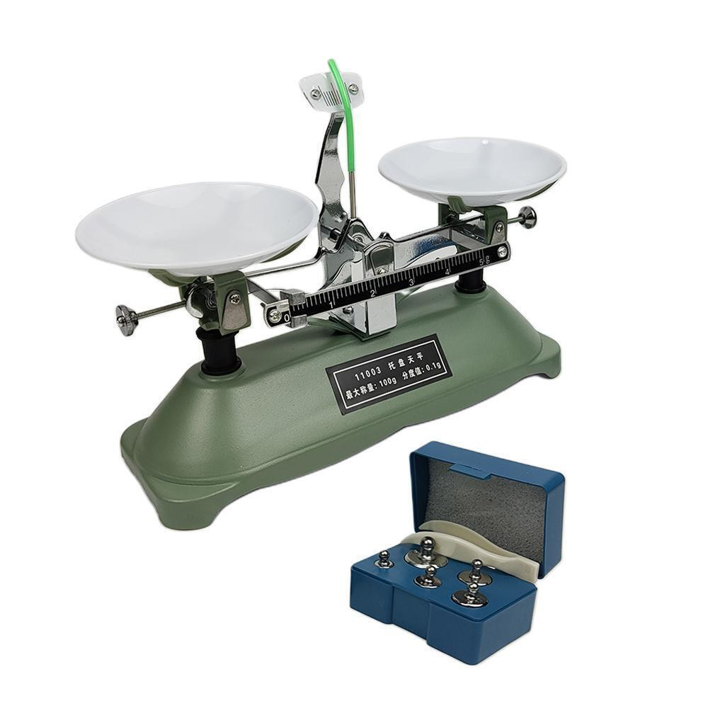
Balancing
indicator
Pan
Screw
Scale

Slide 10
Thank you

