Slide 1
Lecture-2
Downstream and Formulation of Biotech Products
Presented by
Lecturer Zahraa Amer Al-Juboori

Slide 2
biomanufacturing is conventionally divided into two phases, the first involving the synthesis of a given target molecule by a biological host (usually a microbial or mammalian cell line, but also in some cases, insect cells, plant cells, or whole animals and plants) and the second involving the extraction and purification of the target product from this host material

Slide 3
the first (upstream) phase is therefore governed by the biological parameters of the production host, for example, cell density, cell division rate, and the intrinsic yield of target product per cell or unit biomass.
the second (downstream) phase begins when the biological host is no longer required and can be considered as waste material. downstream processing (dsp)
from this point onward, the fate of the target product is governed wholly by chemical and physical parameters, so dsp can be defined as the series of operations that takes the complex output material from upstream production and yields a stable, pure product ( no more bioreactor)

Slide 4
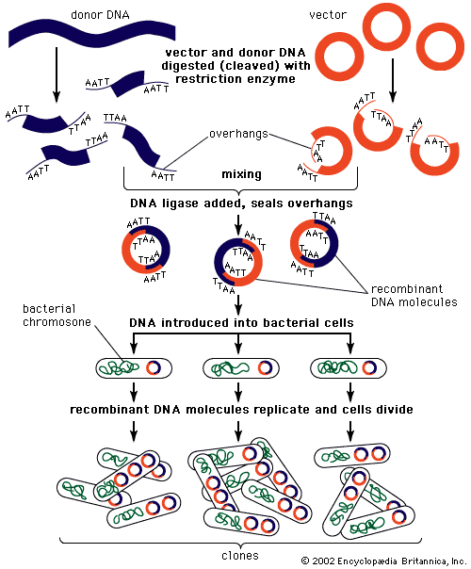

Slide 5
Upstream process
1- selection of host
2- selection of Gene target ( by reverse transcription ?)
3- transfer of gene into host !
4- replication of host in bioreactor

Slide 7
Downstream processing
1
solid-liquid separation
2
release of intracellular products
3
concentration
purification
formulation.

Slide 8
methods for purification the products
1- centrifugation
centrifugation is a mechanical process that utilizes an applied centrifugal force in place of gravity to separate the components of a mixture according to density and/or particle size. it is a well-established unit operation in dsp
2- Microfiltration
filtration refers to any process in which a liquid feedstock is forced through a selectively permeable medium so that only certain components of the feed pass through (into the permeate or filtrate), while other components are retained (the retentate)
3- chromatography

Slide 11
Pre-formulation preparation
Most proteins are administered parenterally and it should be sterile
(E.g.: Recombinant/purified protein vaccines consist of protein antigens like Hepatitis B vaccine I.M.)
(But are sensitive to heat and other sterilization treatments) so cannot withstand [autoclaving, gas sterilization, or sterilization by ionizing radiation].
Thus new methods required for sterilization
Sterilization required for products , equipment and the working place too

Slide 12
equipment and excipients (autoclaved, or sterilization by dry heat (>160ºc), chemical treatment or gamma radiation) to minimize bioburden since microorganism living on the surface of the equipment
filtration techniques used for the removal of micro-bacterial contaminants in the product .
pre-filters (remove the bulk of the bio-burden and other particulate materials).
the final 'sterilizing' step is filtration through 0.2 or 0.22 um membrane filters.

Slide 13
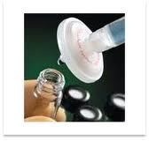
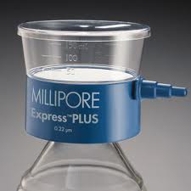
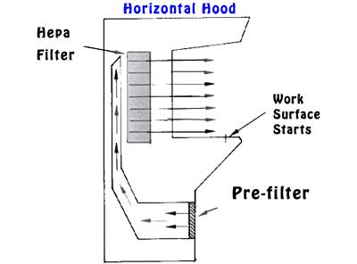

Slide 14
Specification of filters used for filtration during preparation of proteins
Product is done in class 100 (maximum 100 particles per cubic foot [> 0.5 um]) rooms with laminar air flow that is filtered through HEPA (high efficiency particulate air) filters.

Slide 15
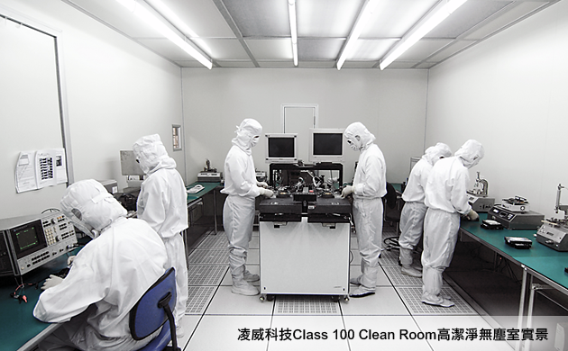
Cleanroom classifications
Cleanrooms classified according to the number and size of particles permitted per volume of air. Large numbers like "class 100" or "class 1000" denote the number of particles of size 0.5 um or larger permitted per cubic foot of air.

Slide 16
Notes
Cleanrooms maintain particulate-free air through the use of either HEPA or ULPA filters employing laminar or turbulent air flow principles.
The air entering a cleanroom from outside is filtered to exclude dust, and then the air inside is constantly recirculated through high-efficiency particulate air (HEPA) and/or ultra-low penetration air (ULPA) filters to remove internally generated contaminants.

Slide 17
Air flow principles
Air flow pattern for
“Laminar Flow Cleanroom"
Laminar air flow clean rooms utilizes HEPA filters to filter and clean all air entering the environment.
Laminar filters are often composed of stainless steel or other non-shed materials to ensure the amount of particles that enter the facility remains low.
These filters usually compose roughly 80 percent of the ceiling space.
Cleanrooms employing laminar air flow are typically referred to as Unidirectional Airflow Cleanrooms.

Slide 18
Air flow principles
Air flow pattern for
"Turbulent Cleanroom"
Non-unindirectional airflow cleanrooms utilize turbulent airflow systems to clean particulate air and maintain a clean environment.
Turbulent airflow filters designed to use laminar flow and random, non-specific velocity to keep the air particle-free.
Turbulent airflow can cause particles movement that are difficult to separate from the rest of the air, thus non-unidirectional airflow systems count on this random movement to move particles from the air through the filter.

Slide 19
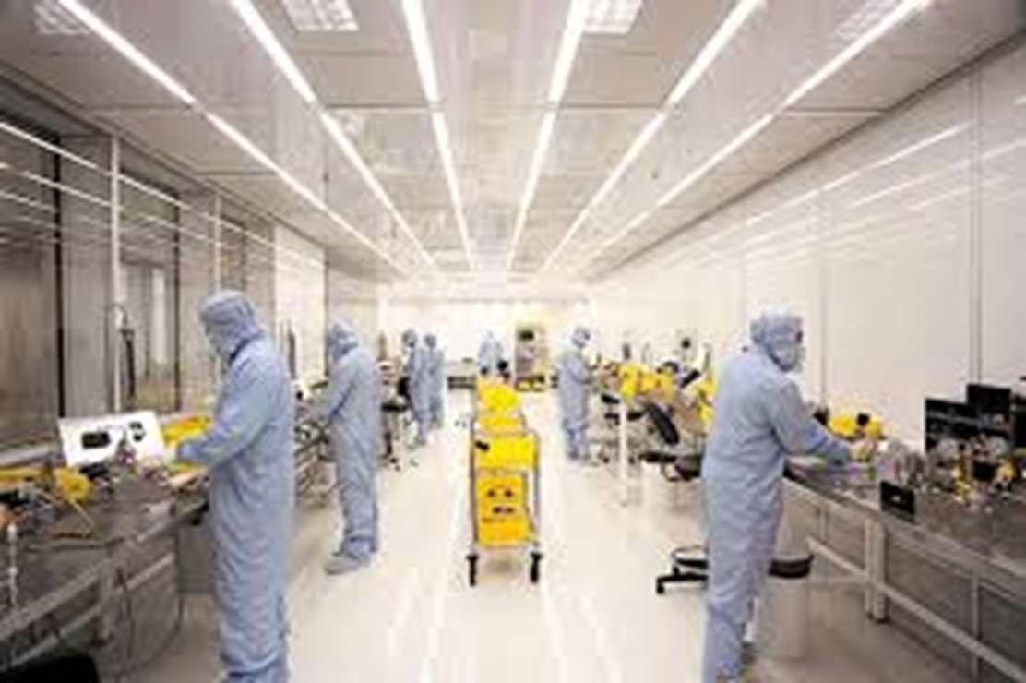
Additionally, the 'human factor' is a major source of contamination, and well-trained operators wearing protective cloths (face masks, hats, gowns, gloves, or head-to-toe overall garments) should operate the facility.
The regular exchange of filters, regular validation of HEPA equipment and the thorough cleaning of the room and equipment are critical factors for success.

Slide 20
Pyrogen removal
Pyrogens are compounds that induce fever, that are of two types endogenous pyrogens and exogenous pyrogens.
Exogenous pyrogens (pyrogens introduced into the body, not generated by the body itself) can be derived from bacterial, viral or fungal sources.
Bacterial pyrogens are mainly endotoxins shed from gram negative bacteria (They are lipopolysaccharides [cell wall from bacteria]).

Slide 21
Fever inducing mechanism
Endotoxin pyrogen enters blood stream and binds to lipopolysaccharide binding PTNs
Then bind to reticuloendothelial system (receptor cells of circulate Mononuclear and Polynuclear cells: CD-14 0f macrophages)
Production and release of proinflammatory cytokines (IL-1 and IL-6) of endogenous pyrogen
Inflammation and Fever (due to activation of arachidonic acid pathway).

Slide 22
A general structure is shown in the following Figure
Responsible for harmful and useful activities of endotoxin

Slide 23
General Structure of Endotoxins
Lipopolysaccharides

Slide 24
General notes on endotoxins
They aggregate and form large units with M.wt. of over 10⁶ in water and sharing a general property of high negative electrical charge.
In addition to their tendency to adsorb to surfaces, thus indicating that these compounds are amphipathic (hydrophilic and lipophilic) in nature as they are lipopolysaccharides.
Stable under autoclaving conditions, but break down when heated in the dry state (thus equipment and containers are treated at temperature above 160ºC for prolonged periods (e.g. 30 minutes dry heat at 250ºC)).

Slide 25
Continuous with Pyrogen removal
Pyrogen removal of recombinant products derived from bacterial sources should be an integral part of preparation process:
Ion exchange chromatographic procedures (utilizing its negative charge) can effectively reduce endotoxins levels in solution.
Excipients used in the protein formulation should be essentially endotoxins-free.
For solutions, water for injection (compendia standards) is (freshly) distilled or produced by reverse osmosis.

Slide 26
Ion exchange chromatography

Slide 27
Ion exchange chromatography

Slide 28
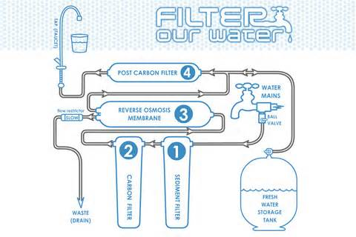

Slide 29
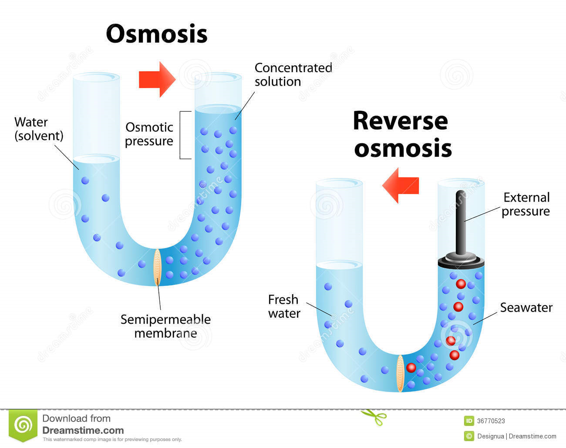
The aggregated endotoxins cannot pass through the reverse osmosis membrane.
Removal of endotoxins immediately prior to the filling of the final container can be accomplished by using activated charcoal or other materials with large surfaces offering hydrophobic interactions.
Endotoxins can also be inactivated on utensil surfaces by oxidation (e.g. peroxide) or dry heating (e.g. 30 minutes dry heat at 250ºC).

