Slide 1
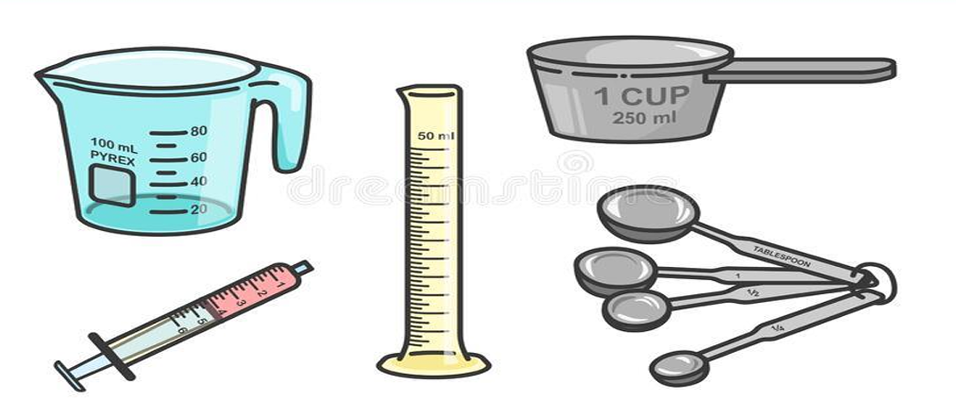
Lab.3 : Volume measurements
م.سرى زهير
م.مروة مالك

Slide 2
Volume: means space that is occupied by a given amount of matter.
Systems of measuring volume:
1- Imperial system example (fluid ounce, gallon, minims, fluid drachm)
2- Metric system example (litter, millilitre)

Slide 3
The relation between metric and imperial system
1 ml =16.23 Minims
1 gallon =3785 ml
1 fluid ounce =29.57 =30 ml=480 minim
1 fluid drachmae = 3.69 ≈4 ml = 60 minims

Slide 4
Factors considering liquid measurements:
1- The choice of proper measuring vessel (it is not practice to measure small volume by large graduates).
2- The surface area of the liquid in the measuring vessel.
The accuracy increases as the surface area decreases.
3- Density and surface tension of the liquid should be considered.

Slide 5
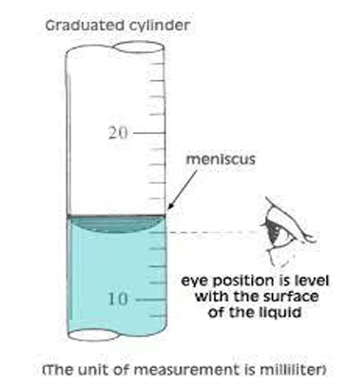
Technique of measuring liquid:
1- Pour the liquid from the bottle to the graduate cylinder.
2- The graduate cylinder is then raised to level of eyes to minimize the error in reading.
3- The liquid is poured into a graduate cylinder until the bottom of the meniscus exactly reaches the required mark.
4- We measure the amount of liquids by
volume although there are exceptions,
some liquids measured by weight as
(glycerin, acids, and oils)
so we convert
this weight to volume by specific gravity.

Slide 6
Domestic measure:
These are the measure usually used at home for administration of drugs. They are always extremely inaccurate and depend on the shape of the measure:
• Teaspoonful = 5 ml
• Dessertspoonful = 8 or 10 ml
• Tablespoonful = 15 ml
• Coffee cupful = 30 ml
• Tea cupful = 120 ml
• Glassful = 240 ml

Slide 7
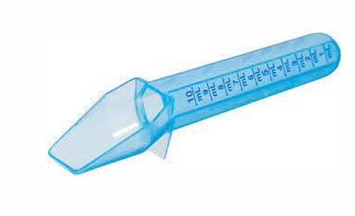
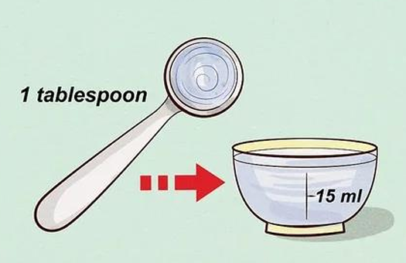
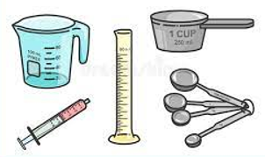
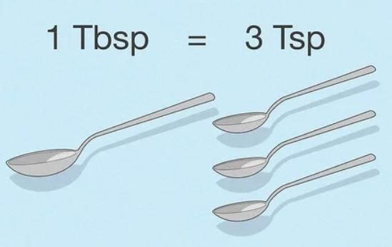

Slide 8
Specific gravity
Is the ratio expressed decimally of the weight of substance to the weight of an equal volume of substance chosen as standard, both substances are at the same temperature.
Water is used as standard of sp. gr. of liquids and solids.

Slide 9
Glycerin
Is a polyhydric alcohol
obtained by the
saponification of fats. It is miscible with both water and alcohol; it is an excellent solvent for
tannins, phenols, and
boric acid
Preparations in
which glycerin is
the solvent are
called Glycerides.
In its concentrated
form glycerin acts as a
preservative that
prevents the growth of
bacteria and mold.
It has a sweet
taste so it is used
in some of the
syrups especially
those made with
Dextrose. It’s
frequently used
in ear drops
because it
softens wax due
to its softening
property.

Slide 10
Example:
Weight of glycerin = 12 g and its specific gravity = 1.26
so the volume will be 9.5
• Experimental work:
• Measure teaspoonful and tablespoonful and write the
experimental volume. Then find the percentage of error.
• Teaspoonful = 5 mL
• Experimental value = 5.8 mL
• 5.8-5= 0.8 mL
Percentage of error = $\frac{0.8 ∗100\%}{5}$ = 16 %
• Percentage of error = 16 %

