Slide 1


Estimation of Hemoglobin
Physiology lab

Slide 2
Hemoglobin
found in the RBC.
responsible for carrying oxygen to all cells in the body.
also binds to carbon dioxide and carries it to the lungs from the cells to be released.
buffer against change in [h⁺]
hemoglobin detection can also gives the health care worker an idea about:-
patient’s oxygen carrying capacity
current blood loss and recovery from blood loss
treatment of rbc disorders, like anemia.

Slide 3
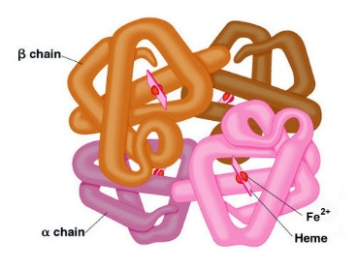
Hemoglobin
makes up 98% of the protein found in the rbc and gives blood its red color.
composed of two parts….
heme , 4 iron atoms in the ferrous state (fe2+) and porphyrin ring
globin , 4 protein chains
the most common globin forms are alpha and beta chains.

Slide 4
Variant forms of hemoglobin
Oxyhemoglobin: hemoglobin combined with oxygen.
Carbaminohemoglobin: hemoglobin combined with CO2.
Methemoglobin: Ferrous iron in converted into ferric iron.

Slide 5
Medical application
the body will respond for the decrease in haemoglobin level (for slightly lower than normal haemoglobin levels) as a compensatory mechanism:-
the heart will beat faster and more forcefully.
the lungs breath rate will increase.
when the level drops too low for us, we start to feel tired, breathless and may start to run into problems with too little oxygen getting to important organs like the heart and brain.
this can cause palpitations, angina (chest pains), headache or dizzy spells.

Slide 6
Medical conditions
anemia :- is a decrease of hemoglobin concentration.
polycythemia :- is an increase of hb concentration.

Slide 7
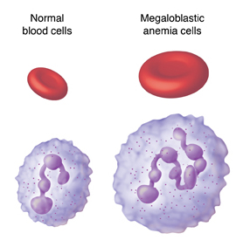
Types of anemia:
Iron deficiency anemia: commonest cause of anemia in most parts of the world cause either due to loss of iron due to bleeding or an inadequate diet or mal-absorption.
Megaloblastic anemia: caused by deficiency of vitamin B12 or folate deficiency or both of them.
Pernicious anemia :- an autoimmune destruction of gastric parietal cells leading to a lack of intrinsic factor which important for vitamin B₁₂ absorption in the gut.

Slide 8
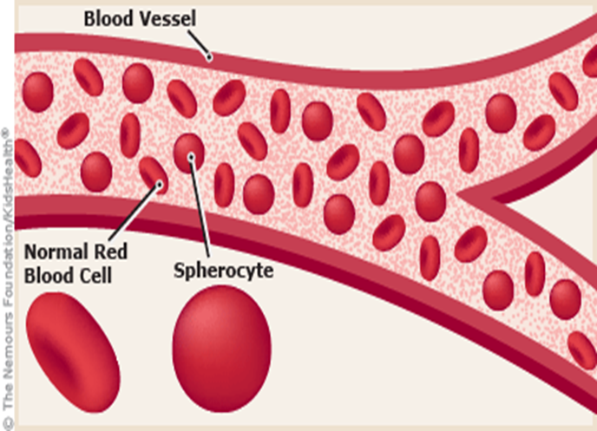
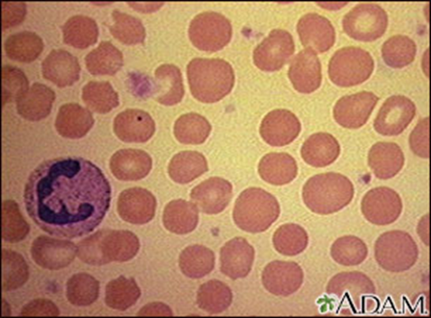
Hemolytic anemia includes
  1- Hereditary spherocytosis:-
  2- Glucose 6 Phosphate dehydrogenase deficiency
  Favism (hemolytic anemia from the ingestion of the broad beans)
  3- Hemoglobinopathies :
    Sickle cell anemia:
    Thalassaemia:
  4-Acquired hemolytic anemia
  Autoimmune hemolytic anemia
  Hemolytic disease of newborn
  ABO incompatibility
  Rhesus (Rh) incompatibility
  5-Anemia of chronic disease.

Slide 9
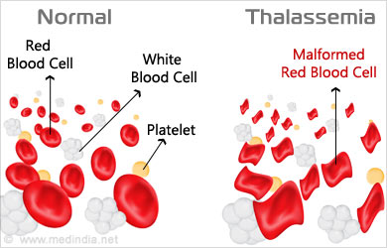

Slide 10
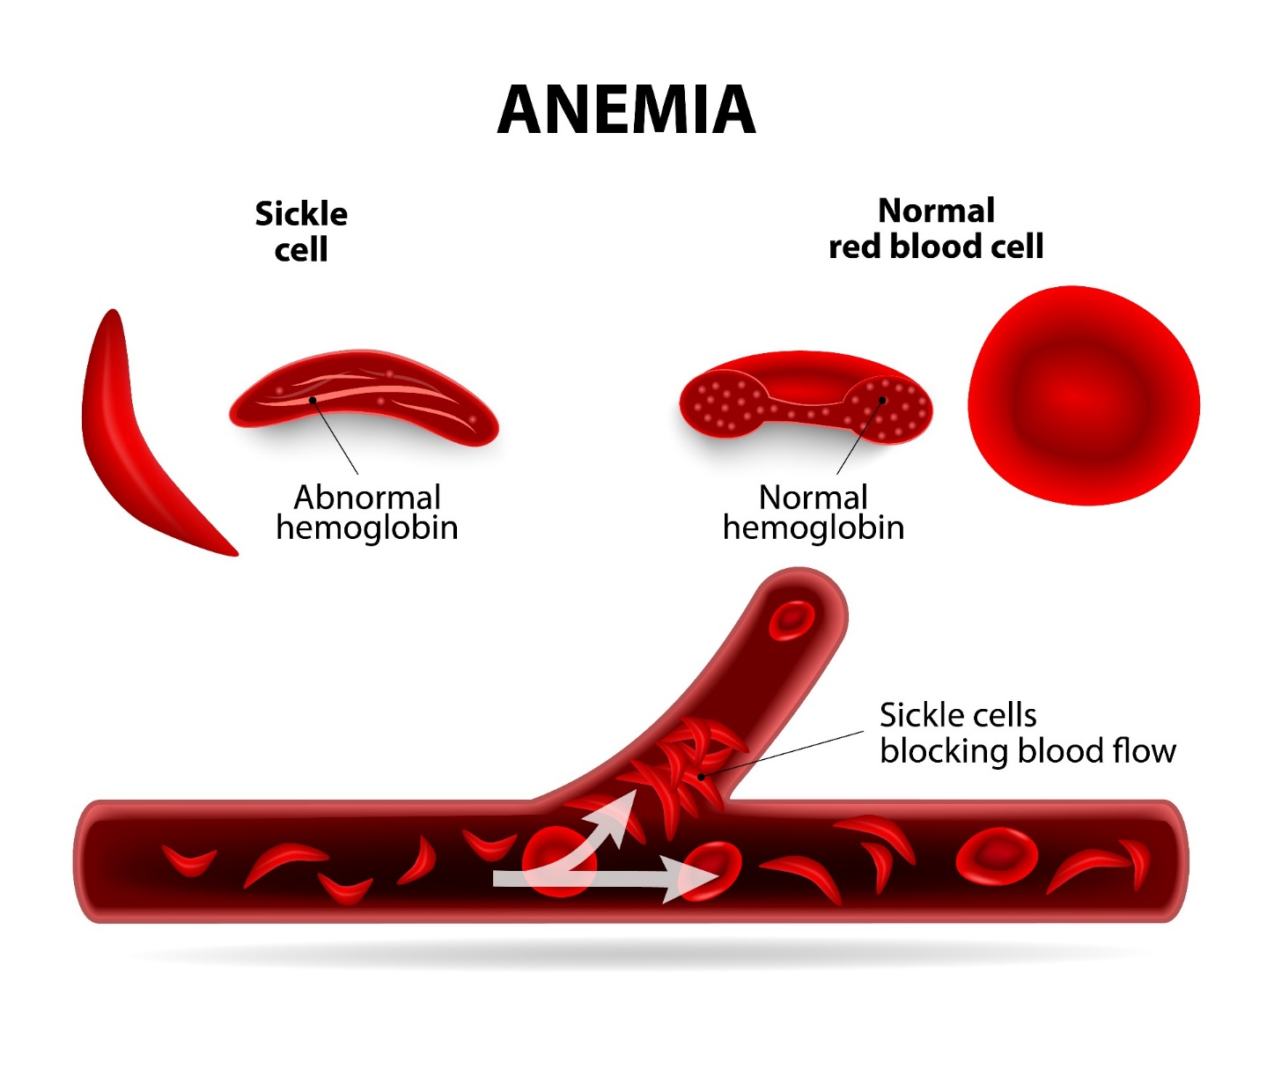

Slide 11
Materials and Instruments
SAHLI’S METHOD
All Hb is converted into acid hematine and the intensity of the color is measured by comparing it with the standered
Sahli Haemometer consists of
A color standard
Pipette marked to contain 20 microliter of blood.
Graduated tube
Distilled water (D.W.)
0.1 normal HCl
Anticoagulated whole blood or capillary blood can be used.

Slide 12
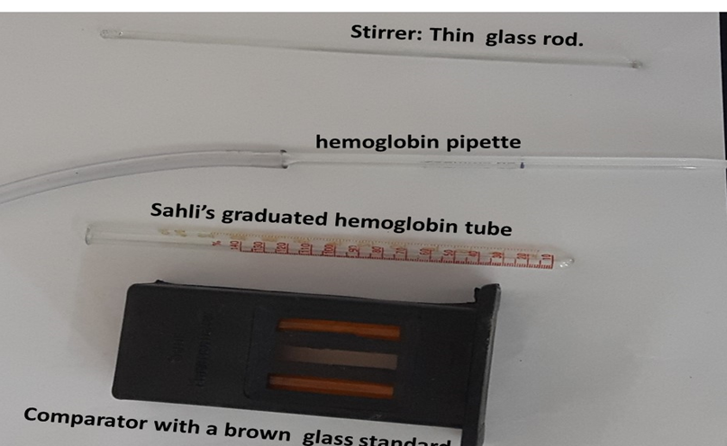

Slide 13
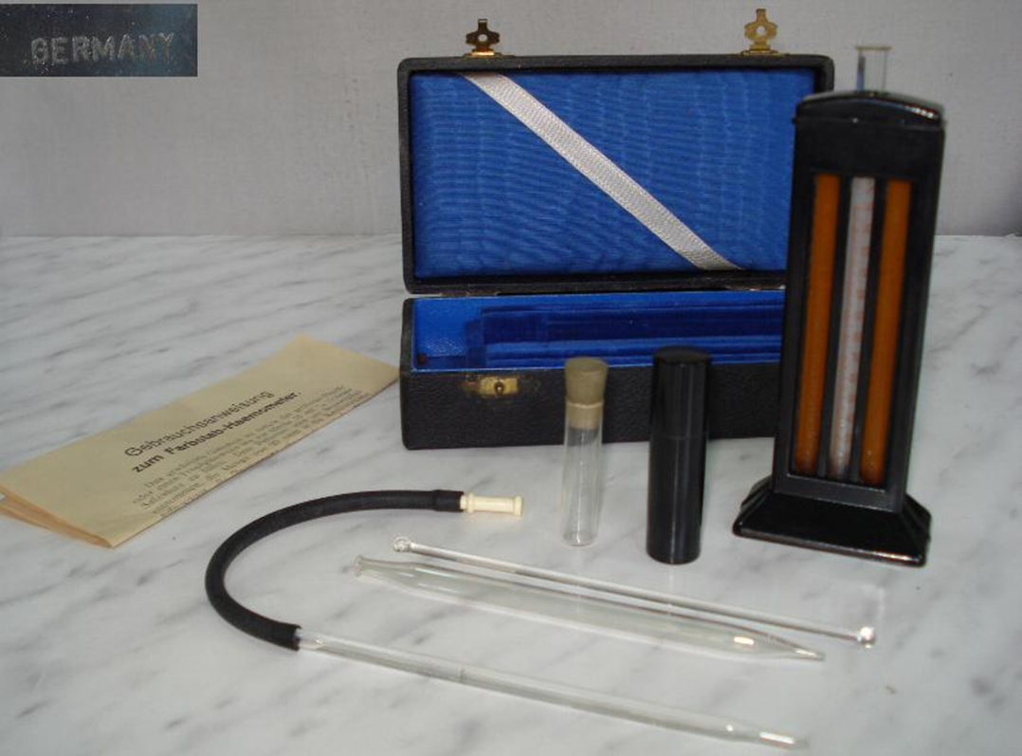
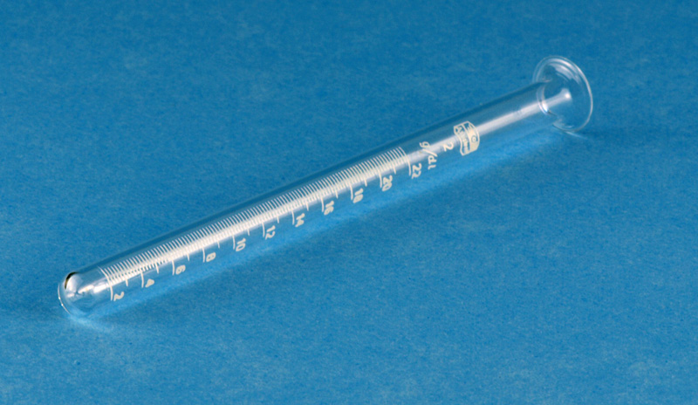

Slide 14
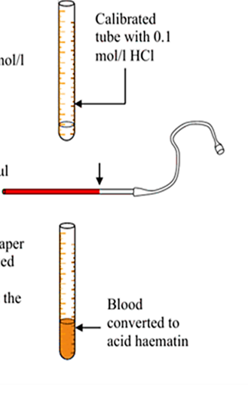
Procedure :
Place into the Hb tube the HCL (0.1 N) by pipette till 20 marks.
Add blood from EDTA tube to Hb tube till the 20 μl, and transfer the blood into the mixing tube.
Mix it well by glass stirrer.
Add distal water drop by drop, mixing well by a glass rod and compare the color of this tube with the standard tube.
After 5 minutes, read the hemoglobin content from the scale on the graduated mixing tube.

Slide 15
Normal value
male 13.5-17.5 gm/dl
female 11.5-15.5 gm/dl
newborn 21 gm/dl

