Slide 1

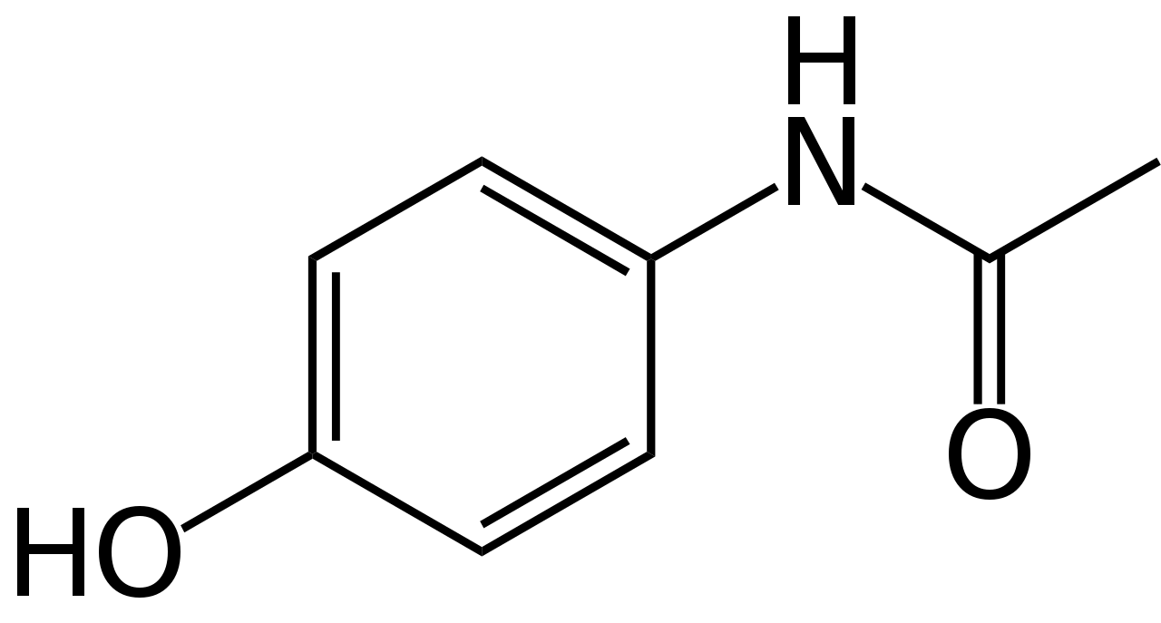
Paracetamol (acetaminophen or para-hydroxyacetanilide) is a non-opioid analgesic and antipyretic agent used to treat fever and mild to moderate pain.a widely used over the counter medication and common brand names include Tylenol and Panadol.
Paracetamol is widely used for various conditions, such as headaches, toothache, muscle pain, arthritis, colds, flu, and post-operative pain. Paracetamol is available in different forms, such as tablets, capsules, liquids, powders, suppositories.

Slide 2
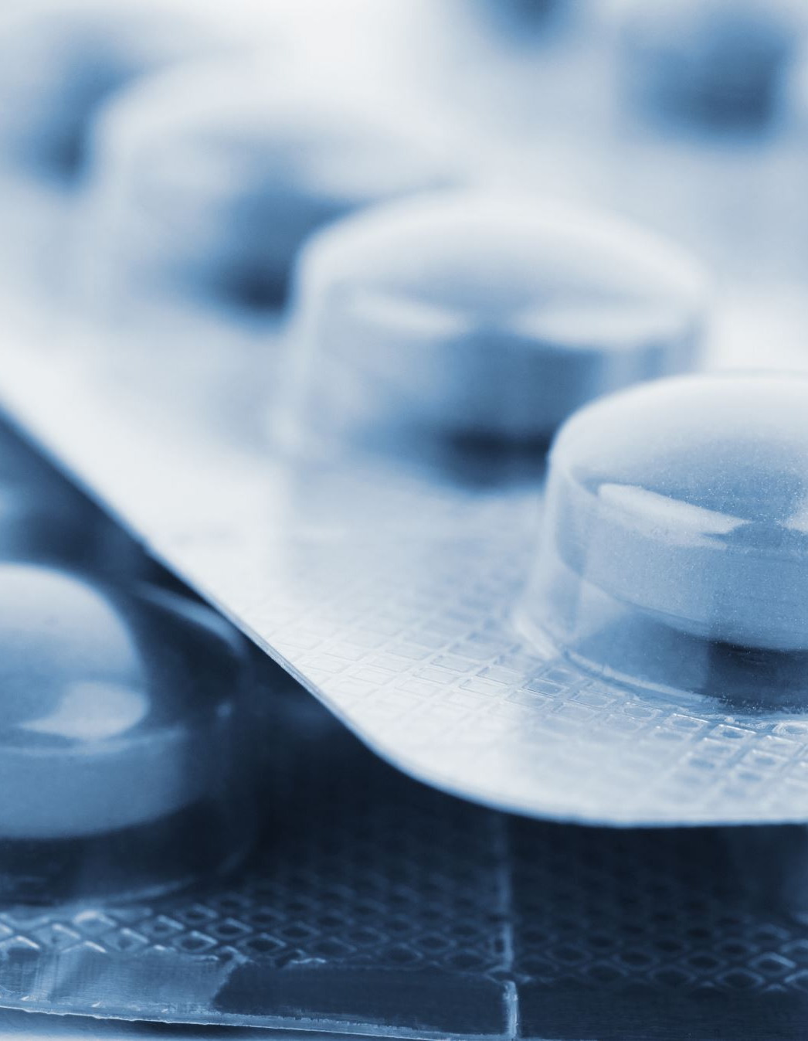
Paracetamol overdose
Paracetamol overdose is a serious and potentially fatal condition that occurs when someone takes more than the recommended dose of paracetamol, a common painkiller and fever reducer. Paracetamol overdose can cause severe liver damage and even liver failure if not treated promptly with an antidote. Here are some facts about paracetamol overdose:

Slide 3
Paracetamol overdose can happen after a single large dose or repeated doses that exceed the recommended limit. The recommended limit for adults is 4 grams (8 tablets of 500 mg each) per day, and for children it is 15 mg per kg of body weight per dose, up to 60 mg per kg per day
The symptoms of paracetamol overdose may not appear until 24 hours after ingestion. They include nausea, vomiting, abdominal pain, and feeling tired. After a few days, the symptoms may worsen and include jaundice, bleeding, confusion, and coma

Slide 4

paracetamol overdose effect on liver
Paracetamol overdose can lead to liver failure if not promptly treated with the antidote. Paracetamol is usually taken by mouth and is available in various ways, such as in tablet, caplet, soluble and liquid forms. About 20% of the medicine is processed in the intestinal wall and the remainder in the liver. As a result, a small amount of a toxic compound (n-acetyl-p-benzoquinone imine, or NAPQI) is formed in the liver but is quickly detoxified by a substance called glutathione. However, in overdose, the stores of glutathione can be depleted so that there isn’t enough to remove the increased amounts of NAPQI. The NAPQI can then build up and damage the liver. Paracetamol is the most common medicine taken in overdose. It can lead to liver failure in a number of days, despite using medication to protect the liver. Liver failure can be fatal

Slide 5
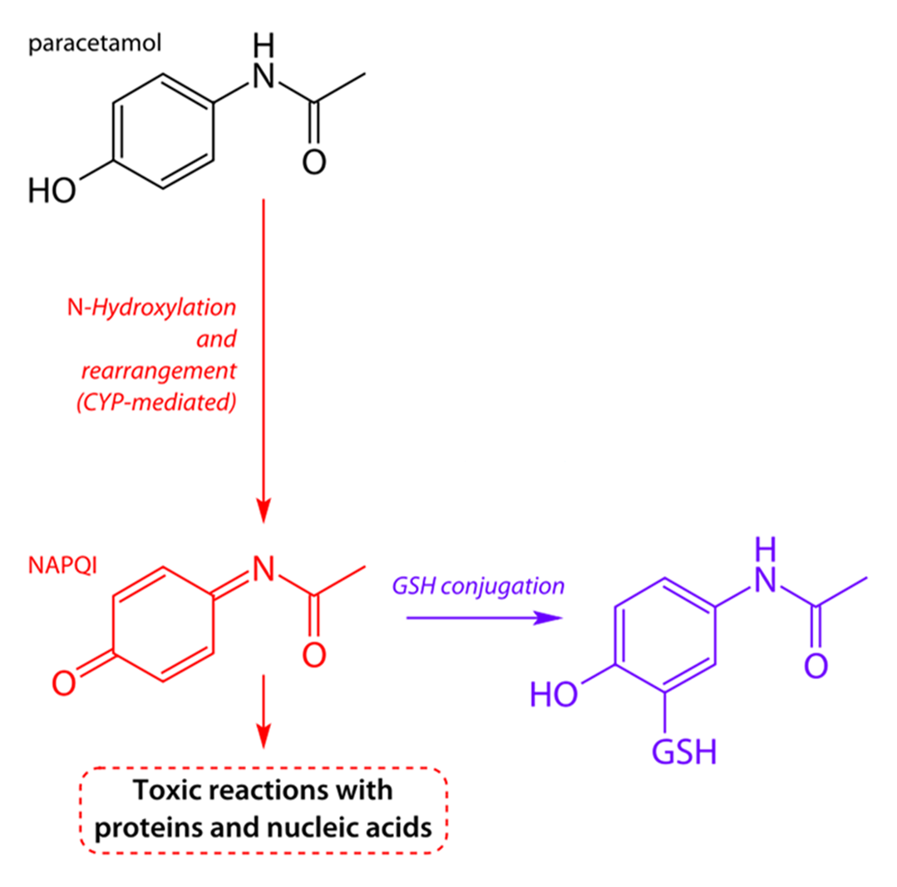
Illustration scheme showing the effect of paracetamol overdose on the liver

Slide 6
some Methods of preparation paracetamol
name of reaction: acetylationlation
Type of reaction :Nucleophilic substitution
CH3COONa
1

Slide 7
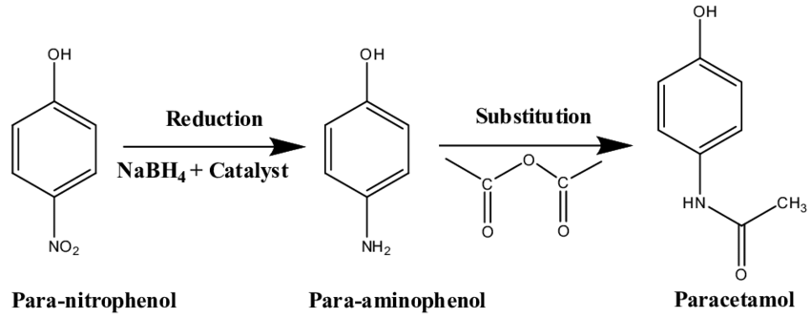
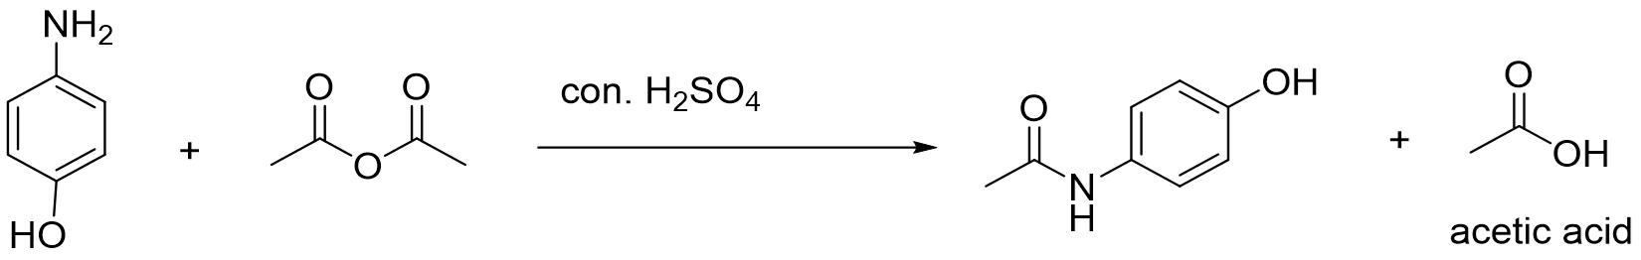
2
APAP
PAP
3

Slide 8
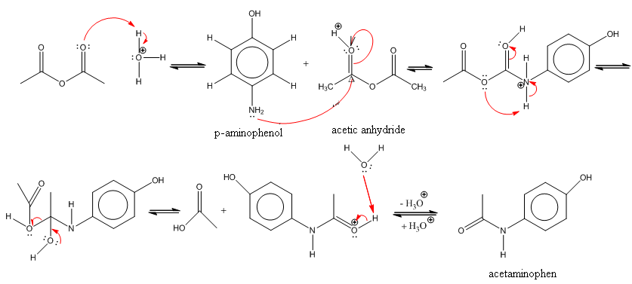
The reaction mechanism of acetaminophen synthesis

Slide 9
Procedure
Take 0.3gm from para-aminophenol and 0.12gm sodium acetate into Erlenmeyer flask .
Add 2.5ml of distilled water to the Erlenmeyer flask and shaking.
Add 0.5 ml from glacial acetic acid in mixture and shake to became color solution.
Place the Erlenmeyer flask in an ice bath with shaking , begin to form a precipitate white.
Filtration: used distill water cold or (1:1) ethanol and distill water. [take 2ml from mix ethanol , distill water]
Heat the mix on hotplate around (80-90)℃ for period (15 min.)
Add (2-3)drops from sulfuric acid (con.)to solution with shaking

Slide 10
Used acetic acid as solvent to para-aminophenol and give group acetyl to group amine
Used distill water a solvent to para-aminophenol
. Used a sodium acetate to convert salt para hydroxy aniline to para hydroxy aniline .

Slide 11

Calculations:
109.13
151.17
0.3
X
X( Theoretical yield)=$\frac{0.3 ∗151.17}{109.13}=$

Slide 12
