Slide 1
Infra-red spectroscopy
Introduction
4
2023-2024

Slide 2

Infrared spectroscopy (IR spectroscopy) is the spectroscopy that deals with the infrared region of the electromagnetic spectrum, that is light with a longer wavelength and lower frequency than visible light .
Near-infrared; 14000–4000 cm⁻¹ (0.8–2.5 μm wavelength) can excite overtone or harmonic vibrations.
Mid-infrared; 4000–400 cm⁻¹(2.5–25 μm) may be used to study the fundamental vibrations and associated rotational-vibrational structure.
Far-infrared, 400–10 cm⁻¹ (25–1000 μm), lying adjacent to the microwave region, has low energy and may be used for rotational spectroscopy.

Slide 3
What happens when a sample absorbs UV/Vis energy?
π*
UV/Vis
(∼200 nm)
Excitation of ground state electrons (typically π and n electrons) E_{electronic} increases momentarily
π → π*
transition
sample
π
What happens when a sample absorbs IR energy?
Stretching and bending of bonds (typically covalent bonds) E_{vibration} increases momentarily
IR
(∼3500 cm⁻¹)
-O-H
-O—H
(IR) measures the bond vibration frequencies in a molecule and is used to determine the functional group

Slide 4
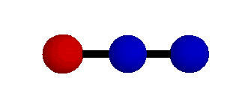
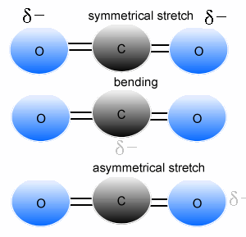
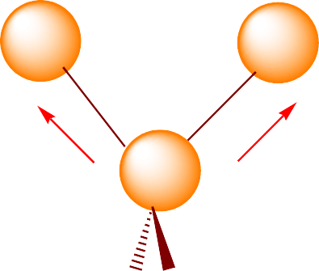
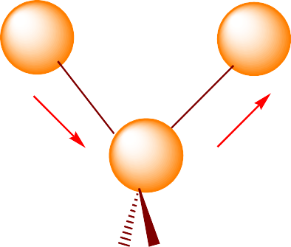
Molecular vibrations
What is a vibration in a molecule?
Any change in shape of the molecule- stretching of bonds, bending of bonds, or internal rotation around single bonds
There are two main vibrational modes :
1. Stretching - change in bond length (higher frequency) Occurs at higher energy: 4000-1250 cm⁻¹
Symmetric
Asymmetric

Slide 5
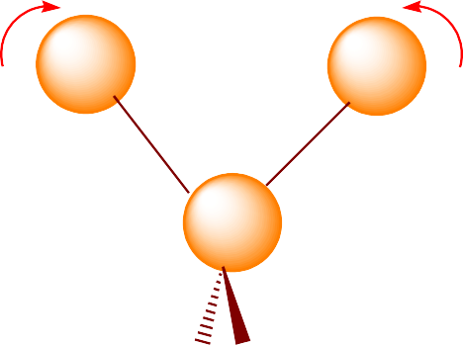
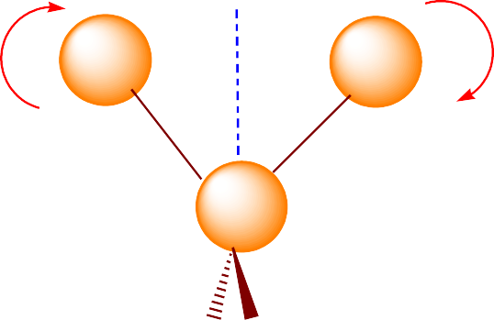
2. Bending - change in bond angle (lower frequency)
Occurs at lower energy: 1400-666 cm⁻¹.
In-plane (Scissoring)
Out-plane (Twisting)
More complex types of stretching and bending vibrations are possible

Slide 6
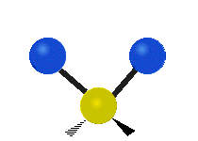

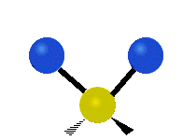


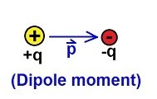
Symmetric stretching
Asymmetric stretching
Scissoring
Rocking
Wagging
Twisting
Dipole moments occur when there is a separation of charge. They can occur between two ions in an ionic bond or between atoms in a covalent bond; dipole moments arise from differences in electronegativity.
The larger the difference in electronegativity, the larger the dipole moment.

Slide 7
Can a vibration change the dipole moment of a molecule?
Infrared active vibrations (those that absorb IR radiation) must result in a change of dipole moment
Asymmetrical stretching/bending are IR active.
Symmetrical stretching/bending is not IR active
Question: Which of the following atoms or molecules will absorb IR radiation and WHY?:
I—Cl H₂ N₂ Cl₂

Slide 8
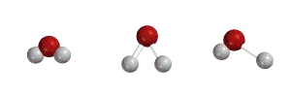
Number of vibrational modes
A molecule can vibrate in many ways, and each way is called a vibrational mode.
In order for a vibrational mode in a sample to be "IR active", it must be associated with changes in the dipole moment.
Example H₂O, will have (3 × 3 – 6 = 3) degrees of vibrational freedom, or modes.
For molecules with N number of atoms,
Linear molecules have 3N – 5 degrees of vibrational modes
Nonlinear molecules have 3N – 6 degrees of vibrational modes (also called vibrational degrees of freedom).
Symmetric Bending Asymmetric

Slide 9
Factors affect the NUMBER of IR bands
Degeneracy of bands from several absorptions of the same frequency
Lack of change in molecular dipole moment during vibration
Fall of frequencies outside the 4000-400 cm⁻¹ region
All of above factors decrease the number of bands
What are the reasons that affect (reduced or increase) the number of theoretical fundamental vibrations in IR spectroscopy?

Slide 10


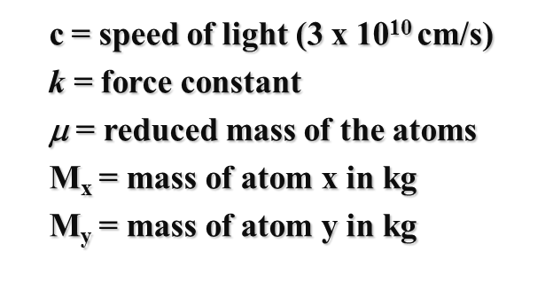

Hooke’s law
Bonds can be thought like a spring, and wavenumbers can be approximated by Hooke’s law
The electronegativity (force constant of the bond)
The relative masses of the atoms
Their geometry vibrate at different types

Slide 11
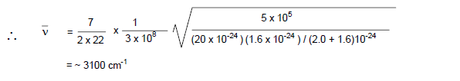
Hooke’s law-Example
Calculate the predicted vibrational frequency (in cm⁻¹) for C- H bond, knowing that: The force constant for single bond is 5x 10⁵ dyne/ cm, the velocity of light is 3 X 10⁸ cm/s, the mass of carbon atom is 20 x10⁻²⁴g, the mass of hydrogen is 1.6 x 10⁻²⁴ g.

Slide 12


The relationship between wave number (v), bond strength and mass
The vibrational frequency of a bond would increase with the increase in bond strength. Consequently, we can expect that
C=C and C=O > C-C and C-O, respectively
The vibrational frequency of a bond would increase with the decrease in reduced mass of the system.
Similarly,
C-H and O-H > C-C and C-O, respectively
O-H > O-D

Slide 13
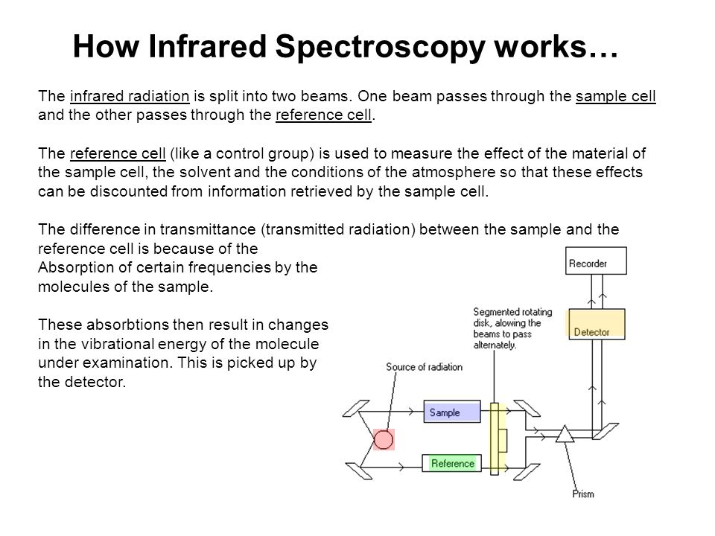
Instrumentation IR spectroscopy
source of energy
Sampling area
Photometer
Grating (monochromator )
Detector

Slide 14
Solvents in IR spectroscopy
Properties of solvents
Pure solvent is placed in the reference
The spectrum thus obtained is that of the solute except in the region in which the solvent absorbs strongly .
The solvent selected must be dry and transparent in interest .
Types of solvents
Solvent, like carbon tetrachloride (CCl₄) a is relatively free of absorption at frequencies above 1333 cm ⁻¹ ,
carbon disulfide (CS₂) shows little absorption below 1333cm⁻¹
Solvent and solute combinations that react must be avoided . For example :-
CS₂ cannot be use as a solvent for primary or secondary amine
Amino alcohol react slowly with CS₂ & CCl₄
Chloroform (CHCl₃) shows absorption at all wavelength but its absorption is so high ,so avoid it and used analyses dissolving solvent than neglected

Slide 15
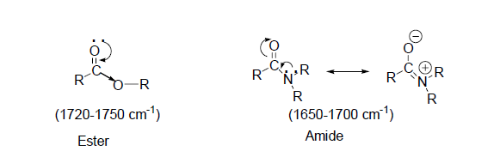
Factors affect IR frequencies
The replacement of an alkyl group of the saturated aliphatic ketone by a heteroatom (O, N) shifts the C=O stretching frequencies due to inductive and resonance effects.
In esters, the oxygen due to inductive effect withdraws the electrons from carbonyl group and increases the C=O bond strength and thus the frequency of absorption.
Inductive and Resonance Effects
Hydrogen bonding
Ring size effects
Conjugation Effects

Slide 16
Factors affect IR frequencies
In amides, due to the conjugation of lone pair of electrons on nitrogen atom, the resonance effect increases the C=O bond length and reduces the C=O absorption frequency. Therefore, C=O absorption frequencies due to resonance effects in amides are lowered but due to inductive effect in esters are increased than those observed in ketones.
Inductive and Resonance Effects
Hydrogen bonding
Ring size effects
Conjugation Effects
What is the effect of inductive and resonance effect at the at Vibration frequencies?

Slide 17
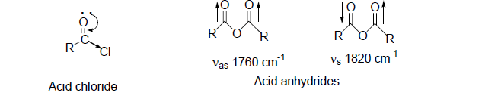
Factors affect IR frequencies
In acid chlorides, the halogen atom strengthens the C=O bond through inductive effect and shifts the C=O stretching frequencies even higher than are found in esters.
The acid anhydrides give two bands in C=O stretching frequency region due to symmetric (~1820 cm⁻¹) and asymmetric (~1760 cm⁻¹) stretching vibrations.
Inductive and Resonance Effects
Hydrogen bonding
Ring size effects
Conjugation Effects
What is the effect of inductive and resonance effect at the at Vibration frequencies?

Slide 18
Factors affect IR frequencies
The C=O stretching frequencies for C=C conjugated systems are generally lower by 25-45 cm⁻¹ than those of corresponding non-conjugated compounds.
The delocalization of π-electrons in the C=O and C=C bonds lead to partial double bond character in C=O and C=C bonds and lowers the force constant.
Greater is the ability of delocalization of electrons, the more is lowering in C=O stretching frequency.
Inductive and Resonance Effects
Hydrogen bonding
Ring size effects
Conjugation Effects

Slide 19
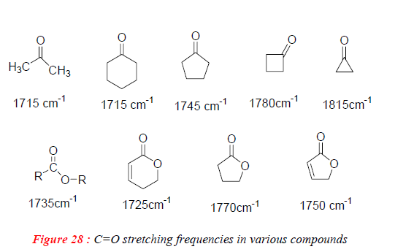
Factors affect IR frequencies
Decrease in ring size increases the C=O stretching frequency.
This gives more s character to the C=O sigma bond and thus results in strengthening of C=O double bond.
The comparison of C=O stretching frequencies of various compounds shows that in ketones and esters, ~ 30 cm⁻¹ increase in frequency occurs on moving to one carbon lower ring.
Inductive and Resonance Effects
Hydrogen bonding
Ring size effects
Conjugation Effects

Slide 20
Factors affect IR frequencies
The strength of Hydrogen bonding decreases as the distance between X & Y increase. Hydrogen bonding alters the force constant of both groups ,thus, the frequencies of both stretching and bending vibrations are altered
The X-H stretching band move to lower frequencies (longer wavelength )usually with increase intensity and band widening
The stretching frequency of the acceptor group ,for , C=O is also reduced but to a lesser degree than the proton donor group
Inductive and Resonance Effects
Hydrogen bonding
Ring size effects
Conjugation Effects

Slide 21
Factors affect hydrogen bonding
Temperature since when temp. increases, the H- bonding decreases
Concertation have different affect on both H-bonding result from intermolecular bonding disappear at low conc. While intramolecular bonding has internal effect & so it persist at very low conc.
The relative acidity and basicity of the proton donor and acceptor groups affect the strength of bonding.
Ring strain
Molecular geometry

Slide 22
Factors affect position of C=O stretching band
The physical state
Electronic and mass effect of neighbouring group
The relative acidity and basicity of the proton donor and acceptor groups affect the strength of bonding.
Ring strain
Conjugation effect
Hydrogen bonding effect
Inductive effect

Slide 23

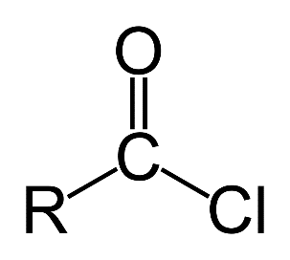
Example: The carbonyl stretching frequency in RCOCH₃ (~1720 cm⁻¹) is lower than acid chloride RCOCl (1750-1820 cm⁻¹).
This change in frequency of the C=O stretching may be arising due to:
Difference in mass between CH₃ and Cl
The inductive or mesomeric influence of Cl on the C=O bond
Coupling interactions between C=O and C -Cl bonds
Change in bond angles arising due to steric factors etc.

