Slide 1
General lab and safety Rules
gloves
long hair
Food
Smoking
Never smell chemicals directly
Never sit on the bench tops during lab.
Read all chemical labels carefully
Never return chemicals to the reagent bottle
Always add acid to water
Always wash your hands before leaving laboratory

Slide 2
The Analytical chemistry
Analytical chemistry is branch of chemistry science deal with identification and separation of compounds and mixture, then determination of the proportions of the constituents.
We have two types of analysis:
A- Qualitative analysis: تحليل نوعي
B- Quantitative analysis: تحليل كمي

Slide 3
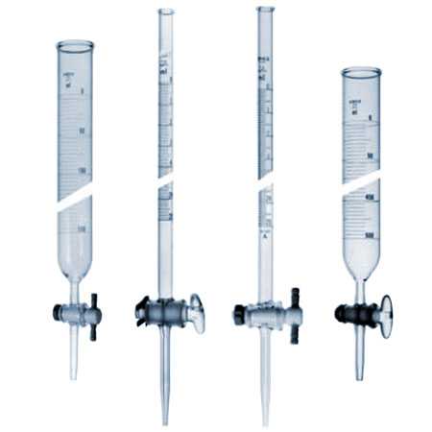
Experiment 1
Volumetric measurement glassware
1- Buret: A piece of glassware used for carefully measured volume of a liquid regent come in various sizes

Slide 4
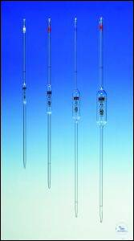
2- Pipet: A piece of glassware used for measuring the volume of Iiquid comes in various sizes

Slide 5
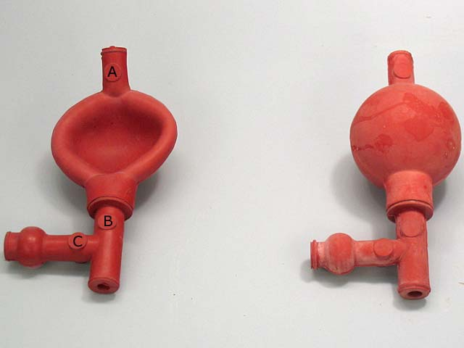
Note: We always use fill pipets

Slide 6
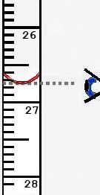
3-Graduated cylinder : A piece of glassware used for measuring the volume of Iiquid comes in various sizes

Slide 7
4-Volumetric flask: A piece of glassware manufactured with capacities ranging from 5 ml to 5 liters , it is used in:
a- preparation of standard solutions.
b- In dilution of the concentrated solution.

Slide 8
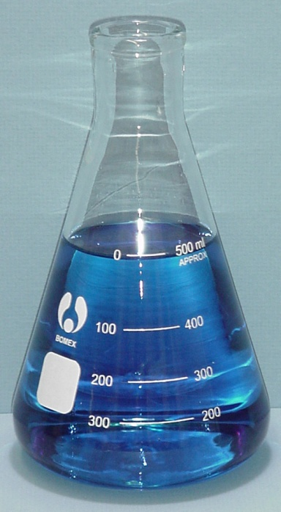
5-Conical flask : A piece of glassware come in various sizes used for:
a-titration
b-Filtration
c-Distillation
d-Heating and evaporation

Slide 9
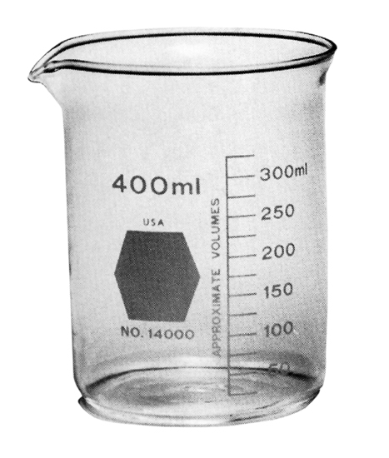
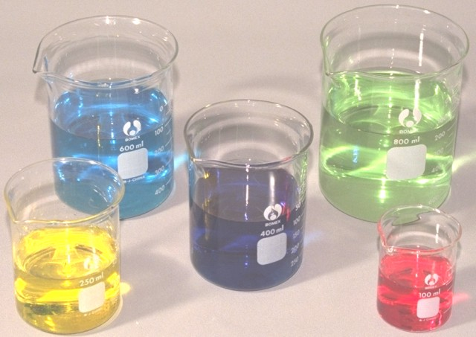
6-The beaker: A piece of glassware come in various sizes, used for:
a- Dissolving the samples
b- Transfer the solution
c- Container of solution

Slide 10
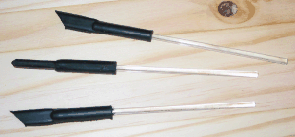
7. Stirring glass rod: A piece of glassware come in various sizes ,used forMixing solven and solute.

Slide 11
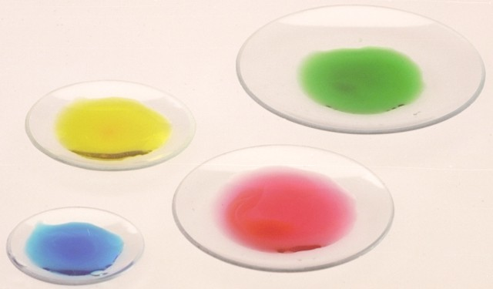
8- Watch glass: A piece of glassware come in various sizes, manufactured from glass,using in:
a- Weighing of non-hygroscopic material.
b- Covering the beakers that contain heat solution.
c- Covering the beakers during heat solution.

Slide 12
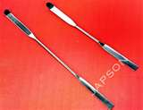
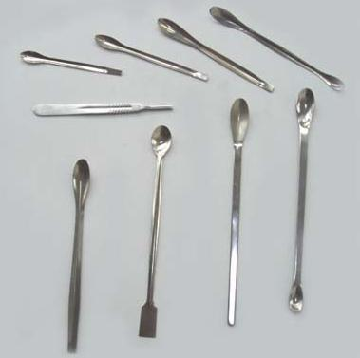
9- Spatula: A piece of laboratory tools used for transfer of solid material from a reagent bottle manufactured from steel and ceramic materials.

Slide 13
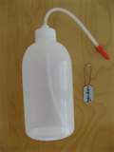
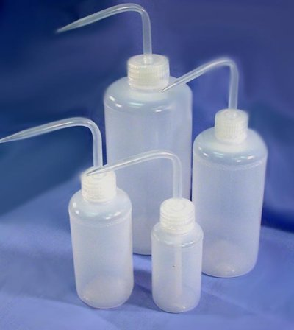
10-Polyethylene wash bottle: A piece of laboratory tool used for washing the glassware, manufactured from polyethylene

Slide 14
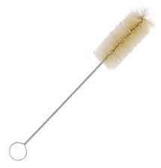
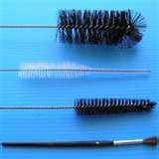
11- Brush: A piece of laboratory tool used for cleaning the glassware come in a various sizes.

Slide 15
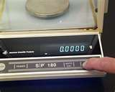
12-Sensitive Balance:

Slide 16
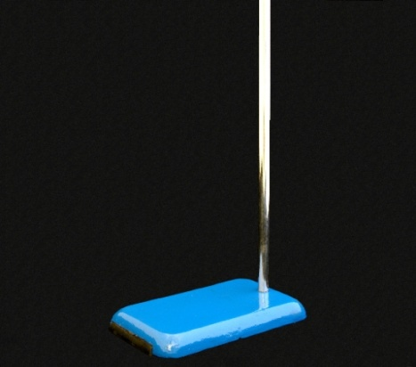
13- Stand

Slide 17
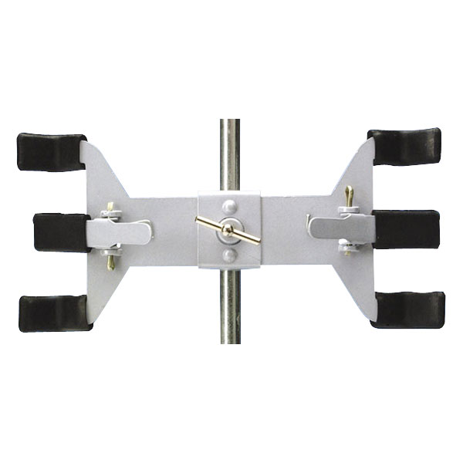
14-Clamp (Buret clamp)
(Double Buret clamp)

Slide 18
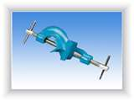
15-Holder (Clamp holder)

Slide 19
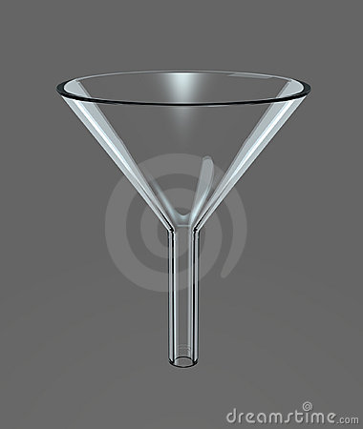
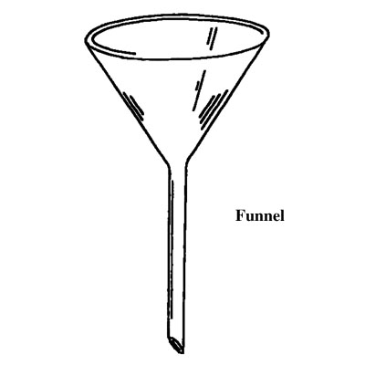
16-Funnel: A piece of glassware used for:
a- Transfer the Liquids.
b-In filtration

