Slide 1
General lab and safety Rules
gloves
long hair
Food
Smoking
Never sit on the bench tops during lab.
Read all chemical labels carefully
Never return chemicals to the reagent bottle
Always add acid to water
Always wash your hands before leaving laboratory

Slide 2
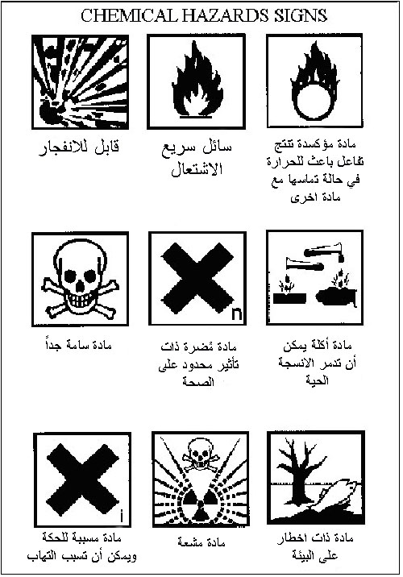

Slide 3
The Analytical chemistry
Analytical chemistry is branch of chemistry science deal with identification and separation of compounds and mixture, then determination of the proportions of the constituents.
We have two types of analysis:
A- Qualitative analysis: تحليل نوعي
B- Quantitative analysis: تحليل كمي

Slide 4
Qualitative Analysis
Classical methods Instrumental methods
1. Simple chemical test (inorganic & organic). 1. Gas chromatography (G.C).
2. Paper chromatography 2-Infrared (IR).
3. Thin layer chromatography 3.Nuclear magnetic resonance (NMR).
4. Analysis of ignition. 4. Mass Spectroscopy (MS).
Qualitative Analysis

Slide 5
Quantitative Analysis
Instrumental methods Classical methods
1. Electrochemical analysis 1- Gravimetric analysis
2-Spectrophotometer. 2- Volumetric analysis
a).Acid-base titration.
b).Redox titration.
c).Precipitation titration.
d).Complex formation titration.

Slide 6
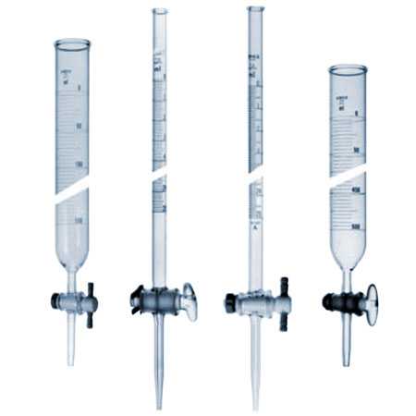
Experiment 1
Volumetric measurement glassware
1- Burette: A piece of glassware used for carefully measured volume of a liquid regent come in various sizes

Slide 7
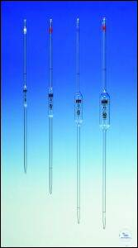
2- Pipette: A piece of glassware used for measuring the volume of Iiquid comes in various sizes

Slide 8
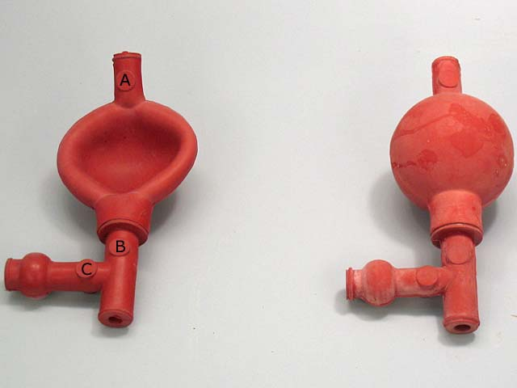
Note: We always use fill pipettes

Slide 9
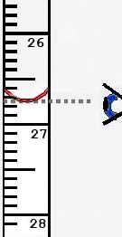
3-Graduated cylinder : A piece of glassware used for measuring the volume of Iiquid comes in various sizes

Slide 10
4-Volumetric flask: A piece of glassware manufactured with capacities ranging from 5 ml to 5 liters , it is used in:
a- preparation of standard solutions.
b- In dilution of the concentrated solution.

Slide 11
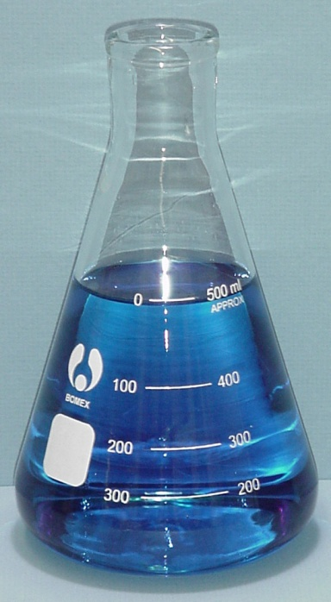
5-Conical flask : A piece of glassware come in various sizes used for:
a-titration
b-Filtration
c-Distillation
d-Heating and evaporation

Slide 12
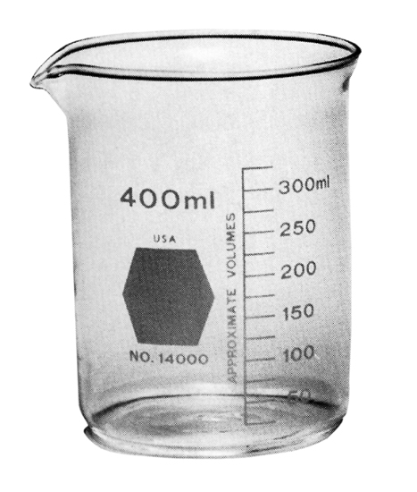
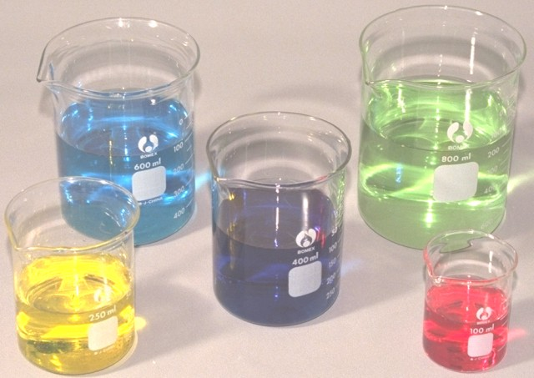
6-The beaker: A piece of glassware come in various sizes, used for:
a- Dissolving the samples
b- Transfer the solution
c- Container of solution

Slide 13
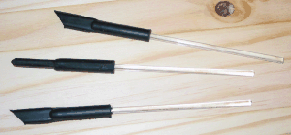
7. Stirring glass rod: A piece of glassware come in various sizes ,used forMixing solven and solute.

Slide 14
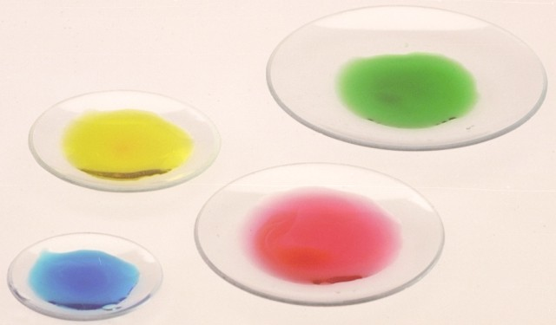
8- Watch glass: A piece of glassware come in various sizes, manufactured from glass,using in:
a- Weighing of non-hygroscopic material.
b- Covering the beakers that contain heat solution.
c- Covering the beakers during heat solution.

Slide 15
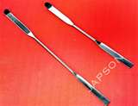
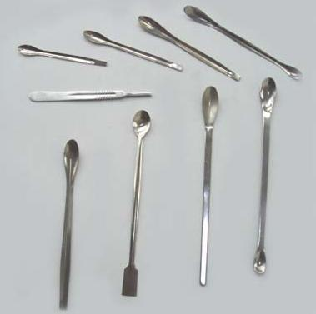
9- Spatula: A piece of laboratory tools used for transfer of solid material from a reagent bottle manufactured from steel and ceramic materials.

Slide 16
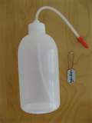
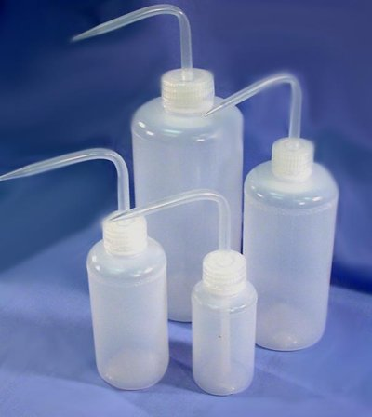
10-Polyethylene wash bottle: A piece of laboratory tool used for washing the glassware, manufactured from polyethylene

Slide 17
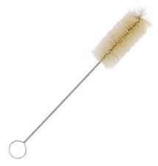
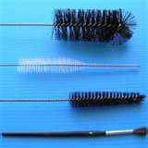
11- Brush: A piece of laboratory tool used for cleaning the glassware come in a various sizes.

Slide 18
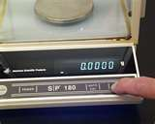
12-Sensitive Balance:

Slide 19
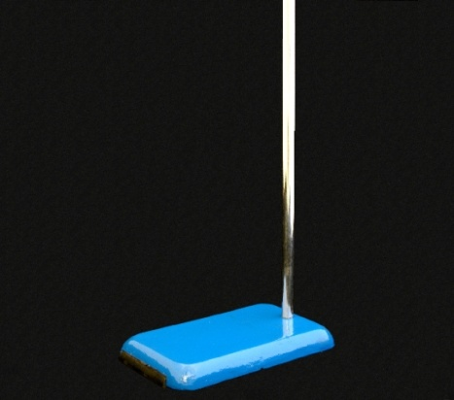
13- Stand

Slide 20
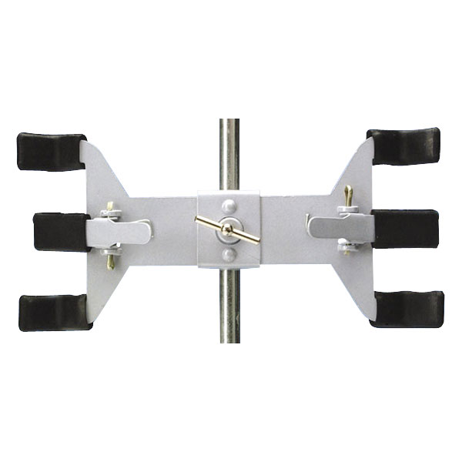
14-Clamp (Buret clamp)
(Double Buret clamp)

Slide 21
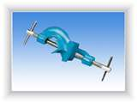
15-Holder (Clamp holder)

Slide 22
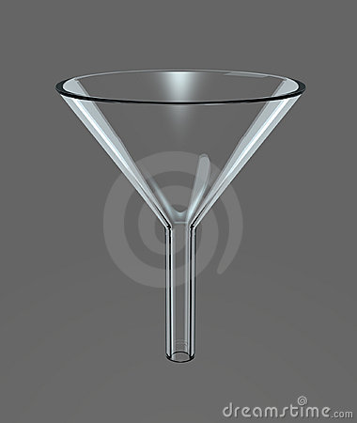
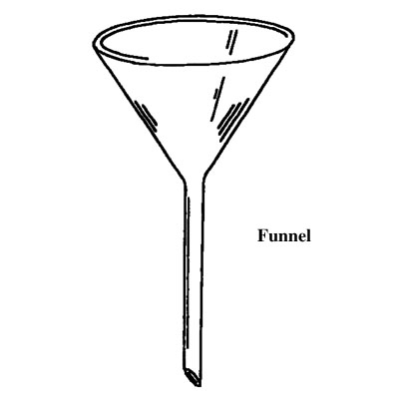
16-Funnel: A piece of glassware used for:
a- Transfer the Liquids.
b-In filtration

Slide 23
Method for the Expression of concentration
1- Formality
the number of gram- formula weights of solute in one liter of solution
$F=\frac{wt}{Fwt}×\frac{1000}{Vml}$

Slide 24
2- Morality the number of gram- molecular weights (or moles) in one liter of solution
$M=\frac{wt}{M.wt}×\frac{1000}{Vml}$
3-Normality:
the number of gram- equivalent weight in one liter of the solution
$N=\frac{wt}{eq.wt}×\frac{1000}{Vml}$

Slide 25
Equivalent weight of chemicals:-
The definition of the equivalent weight for a chemical compound always refers to a specific chemical reaction evaluation of this quantity is impossible without knowledge of the nature of this reaction, always:-
$Eq.Wt.=\frac{M.Wt. }{n}$ ; n = Equivalence
For:-
a). Acids equal a no. of H⁺ ions that react.
1. Inorganic acids n = no. of H in formula (HCl=1; HNO₃=1; H₃PO₄=3; H₂SO₄=2; H₂CO₃=2).
2. Organic acids n = no. of –COOH in formula (CH₃COOH=1; HOOC-CH₂-CH₂-COOH=2).
b). Bases equal a n =no. of OH⁻ ions that react (NaOH =1; NH₄OH=1; Al(OH)₃=3; Ba(OH)₂=2).
c). Salts equal a no. of metals ion multiplied by the number of its oxidants:-
{NaCl, KI, AgNO₃=1}; { Na₂CO₃, Ca(NO₃)₂ , BaSO₄, CaHPO₄ = 2};{Na₃PO₄, Al(NO₃)₃ , Na₃AsO₄ = 3}; Ca₃(PO₄)₂= 6 ; Al₂(SO₄)₃ =6; NaHCO₃ = 1
d). Redox reagents equal a no. of electron moles in reaction or the change in oxidation number of reagent: Fe ⁺³ + e⁻ ➔ Fe ⁺² n = 1
Sn ⁺² ➔ Sn ⁺⁴ + 2e⁻ n = 2
e). Ions equal a no. of ion charge: (Na⁺,NO₃⁻,HCO₃⁻,H₂PO₄⁻,K⁺=1),(Ca⁺²,Mg⁺²,SO₄⁻²,CO₃⁻²=2)
(PO₄ ⁻³, Al⁺³ = 3)

Slide 26
Percent Concentration
Weight percent= $\frac{weight of Solute}{weight of Solution}×100$
Volume percent = $\frac{Volume of Solute}{Volume of Solution}×100$
Weigh- Volume percent$=\frac{weight of Solute.g}{Volume of Solution ml} ×$100

Slide 27
Preparation & Standardization
1-Solids
Preparation (0.1N)of NaOH in250 ml
N = $\frac{WT}{EQ .WT}X\frac{1000}{Vml}$
V ml = 250
Eq. wt =
Wt = X

