Slide 2
Assay of aspirin by direct acid- base titration
Lecturer Luma Amer
2022-2023

Slide 3
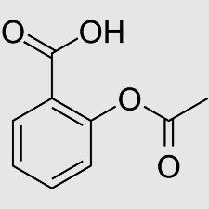
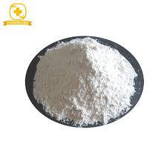
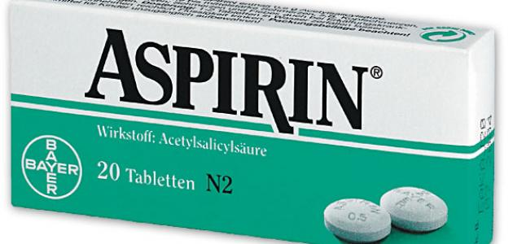
Introduction:
Aspirin is acetyl salicylic acid, occurs as white crystals, used as analgesic to relieve minor aches and pain, as antipyretic to reduce fever and as anti- inflammatory medication. Its molecular formula (C₉H₈O₄).

Slide 4
Properties:
Aspirin is an aromatic compound containing both a carboxylic acid functional group and an ester functional group.
Aspirin can be prepared by reacting salicylic acid and acetic anhydride in the presence of an acid catalyst.
It is slightly soluble in water (1:300) and soluble in alcohol (1:5), chloroform (1:17) and ether (l: 15), Also it dissolves easily in glycerin.
Its melting point (135°C), and Molecular weight = 180.2 g/mol

Slide 5
Acidity:
It is a monoprotic weak acid
Ka = 2.8 x 10-4 at 25 degree Celsius, so very little of the molecular aspirin dissociates to form acetylsalicylate ions.
Equilibrium dissociation reaction:

Slide 6
It slowly decomposed to acetic acid and salicylic acid in the presence of heat and moisture.
It readily absorbed from stomach and small intestine.
Their absorption depends strongly on the pH of the environment.

Slide 7
Aim of experiment:
Apply Alkalimetry assay to determine the percentage
purity of aspirin tablet.
Principle
In this experiment you will determine the percentage purity of aspirin by using (Titration method).
The aspirin will be titrated against a standard solution of base, 0.1 N NaOH. Base will be dispensed from a burette into a conical flask containing the dissolved acid (in ethanol) and phenolphthalein indicator, which show a faint pink color in basic solutions.

Slide 8
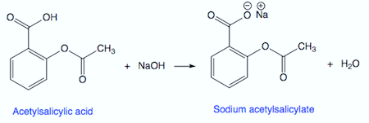

Slide 9
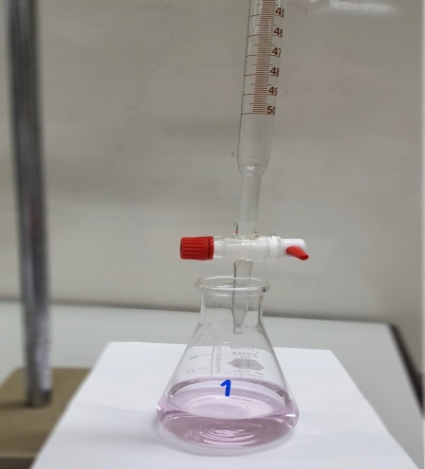
Procedure
Fill the burette with 0.1M NaOH solution using the funnel provided.
Ensure there are no bubbles by tapping the side of the burette.
Take action to do blank titration .
2. Grind up ONE aspirin tablet to a fine powder using the pestle and mortar.
3. Place a clean, dry conical flask on a top balance.
Zero the reading.
Add all the powder to the conical flask using a spatula and record the weight of the powder
Add 10ml of ethanol to the conical flask.
Add 3 drops of phenolphthalein indicator solution.
6. Swirl the conical flask carefully until the powder is fully dissolved.
Swirl for at least 2 minutes.
7. Titrate carefully with sodium hydroxide.
The end point is reached at the first instance of the pink colour persisting.
8. Record the volume of the sodium hydroxide

Slide 10
Calculation
Recovery % = practical content/ theoretical = $\frac{( V_{B}XN_{B}X Eq.Wt) }{theoretical}$ X 100
V(NaOH) = end point ml
N(NaOH) = 0.1N
Eq.Wt (aspirin) = 180.2 g/mol

