Slide 1

Assay of indomethacin
Lecturer Luma Amer
Department of Pharmaceutical Chemistry/Collage of pharmacy
3 ^{rd} stage: ^{2ed} lab.

Slide 2
Acidimetry and Alkalimetry Assays
Both methods are defined as the analytical methods that can be used for the determination of the content of the active compounds in pharmaceutical preparations and in pure forms.
In both methods the neutralized reaction is fundamental for the determination of weight of the content.
What is the difference between Acidimetry and Alkalimetry assays ? Or,
Define Acidimetry and Alkalimetry assays ?

Slide 3
Alkalimetry Assay of Indomethacin
Indomethacin is a nonsteroidal anti-inflammatory drug (NSAID) that reduces fever, pain and inflammation. It is similar to ibuprofen (Motrin) and naproxen (Naprosyn, Aleve). Indomethacin works by reducing the production of prostaglandins.
Its preparations are capsules and suppositories
What is the Its action and uses for Indomethacin?

Slide 4
Physical Properties
Indomethacin is a white or yellow, crystalline powder, practically insoluble in water sparingly soluble in ethanol and ether. Its chemical formula is (C₁₉H₁₆ClNO₄) , its melting point is(158°C to 162°C) and its pk_{a} (4.5) for the carboxylic acid group in aqueous media. It is soluble at higher pH although it is reported that indomethacin is not stable in alkaline solutions. Solution of indomethacin at pH 7.4 has been reported to be stable up to 24 hours, but shows rapid decomposition in highly alkaline solutions (The Merck Index, 1996).

Slide 5
Solubility for Indomethacin: poor solubility in water.
Soluble in acetone (40 mg/ml - clear, yellow solution), ethanol (20 mg/ml), ether.

Slide 6
Indomethacin M. wt. (357.8g /mol)
Indomethacin contains not less than 90% and not more than 110.0%of {1-(4-chlorobenzoyl)-5-methoxy-2-methylindol-3-yl} acetic acid, calculated with reference to the dried substance

Slide 7
The aim of this experiment
Apply Alkalimetry assay to determine the content of Indomethacin in a capsule of 25mg

Slide 8
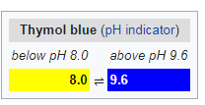
Principle:
Indomethacin contains an acidic group (COOH) so it considered as acid hence it can be determined by titration against 0.01N NaOH using thymol blue indicator. At the end point the color changes to blue .

Slide 9
Procedure:
Dissolve the content of one in a beaker by addition of 10 ml of acetone.

Slide 10
Shake then filter into a conical flask and wash twice with 5 ml of acetone.

Slide 11
Titrate the filtrate with 0.01N NaOH using thymol blue as an indicator.
Carry out a blank titration.

Slide 12
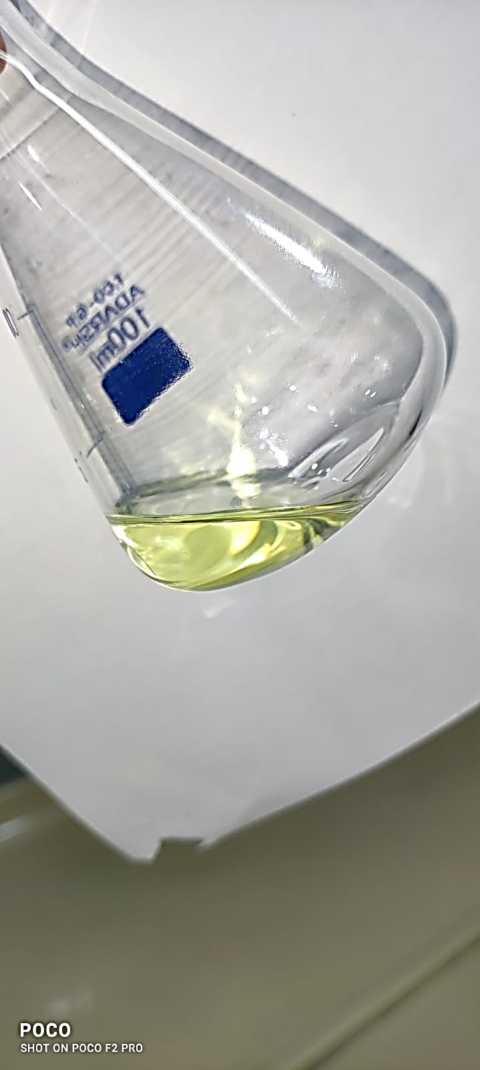
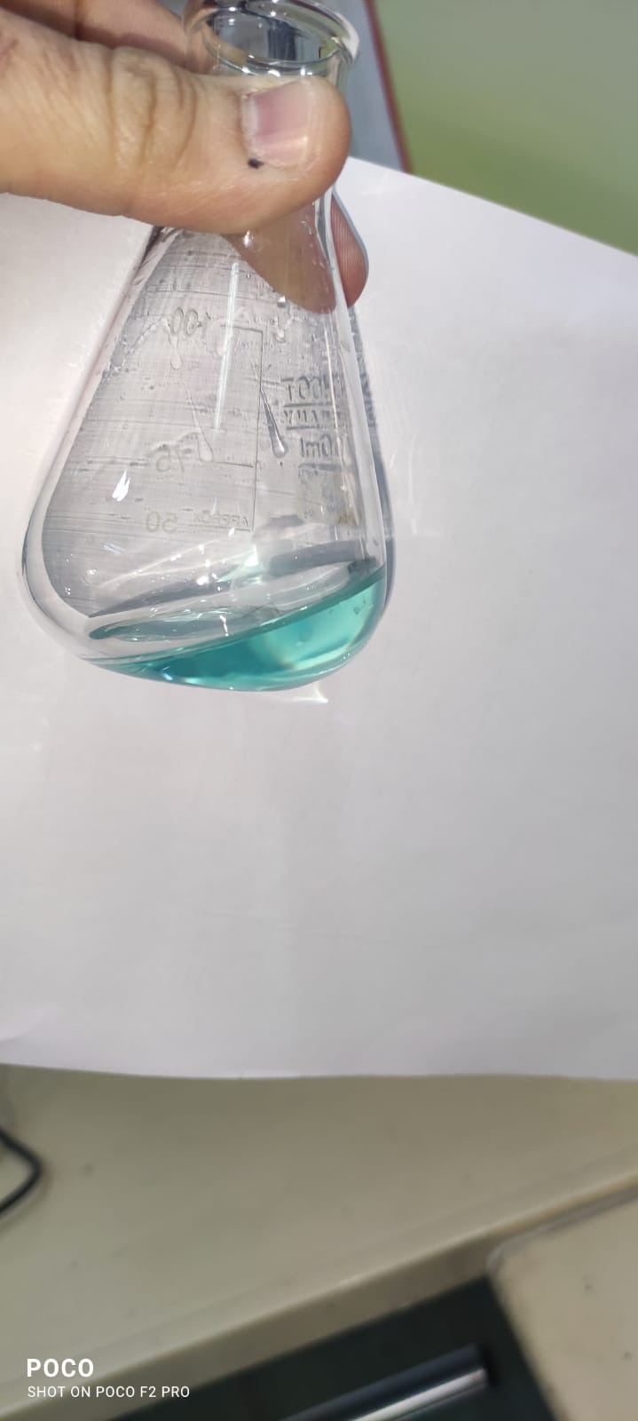
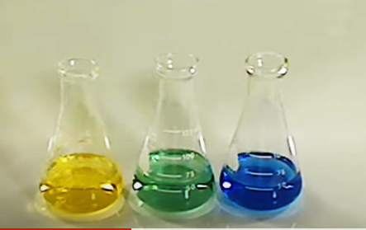

Slide 13
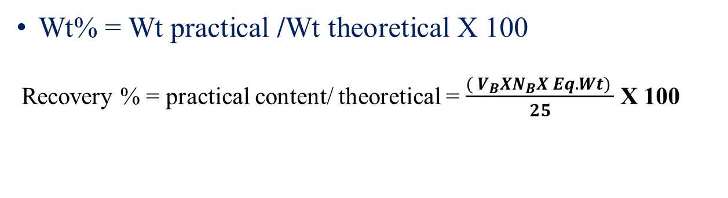
Calculations:
Wt% = Wt practical /Wt theoretical X 100
Recovery % = practical content/ theoretical = $\frac{( V_{B}XN_{B}X Eq.Wt) }{25}$ X 100

Slide 14


