Slide 1
Lecture No.1
Inorganic pharmaceutical chemistry
Introduction
Pharmaceutical Chemistry: is a branch of chemistry that deals with the chemical, biochemical and pharmacological aspects of drugs.
Inorganic chemistry: is the study of all the elements and their compounds except carbon and its compounds.
Classification of Inorganic Pharmaceuticals
can be classified in two ways
1. Based on their uses.
2. Based on their application in therapy.

Slide 2
Importance of Inorganic Pharmaceuticals
Inorganic pharmaceuticals are useful in any of the following ways.
Useful medicinally for their therapeutic purpose. Example: Astringents and antimicrobials etc.
Useful as pharmaceutical aids. Example: Bentonite, talc etc.
To change the reaction of body fluid. To acidify or alkalis. Example: Antacids, alkalis, mineral acids.
Replacing or replenishing the normal content of body fluids. Example: Sodium, potassium, calcium, chloride, phosphate ions … etc.
Useful as reagents to carry out the reactions. Example: Catalysts (platinum, nickel) oxidizing and reducing agents (lithium aluminum hydride).
Useful in Pharmaceutical analysis. Example: Titrants such as potassium permanganate ….. etc.

Slide 3
Classification based on their applications (therapeutic classification):
Acidosis: sodium chloride, potassium chloride and others.
Alkalosis: sodium chloride, potassium chloride.
Acne: sulphur and its compounds.
Allergic diseases: magnesium thiosulphate.
Anaemia: iron compounds.
Anoxia: Oxygen.
Arthritis: sodium aurothiomalate.
Asphyxia: Oxygen.
Athlete’s foot (Tinea pedis): sodium pyrophosphate.
Boils: magnesium sulphate.
Burns: silver nitrate, oxygen, zinc peroxide.
Carbuncles: magnesium sulphate.

Slide 4
Various uses of inorganic pharmaceuticals
Abrasives: Dibasic calcium phosphate.
Absorbents: Calcium carbonate.
Acidifiers: Dilute hydrochloric acid.
Adsorbents: Bismuth subcarbonate, Bismuth subnitrate.
Alkalizers: Sodium citrate.
Anesthetics: Nitrous oxide.
Antacids: Aluminum hydroxide gel, Calcium carbonate, Magnesium carbonate.
Anthelmintics: Ammoniated mercury, Sodium antimony tartrate.
Antibacterial: Yellow mercuric oxide (ophthalmic).
Anticonvulsants: Potassium bromide.
……….ets

Slide 5
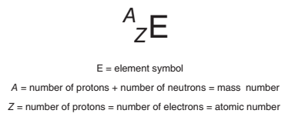
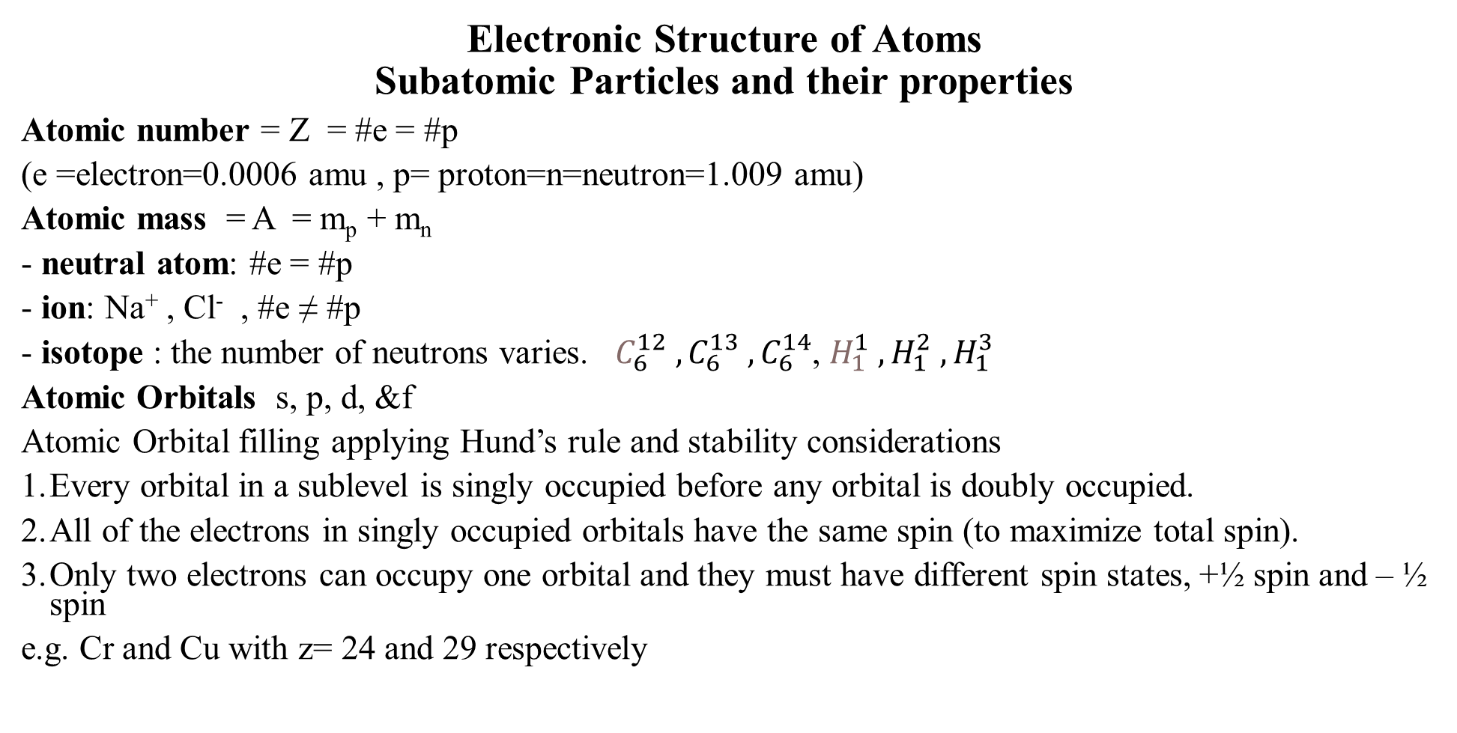
Electronic Structure of Atoms
Subatomic Particles and their properties
Atomic number = Z = #e = #p
(e =electron=0.0006 amu , p= proton=n=neutron=1.009 amu)
Atomic mass = A = m_{p} + m_{n}
- neutral atom: #e = #p
- ion: Na⁺ , Cl⁻ , #e ≠ #p
- isotope : the number of neutrons varies. $C_{6}^{12} , C_{6}^{13} ,C_{6}^{14}$, $H_{1}^{1} , H_{1}^{2} ,H_{1}^{3}$
Atomic Orbitals s, p, d, &f
Atomic Orbital filling applying Hund’s rule and stability considerations
Every orbital in a sublevel is singly occupied before any orbital is doubly occupied.
All of the electrons in singly occupied orbitals have the same spin (to maximize total spin).
Only two electrons can occupy one orbital and they must have different spin states, +½ spin and – ½ spin
e.g. Cr and Cu with z= 24 and 29 respectively

Slide 6
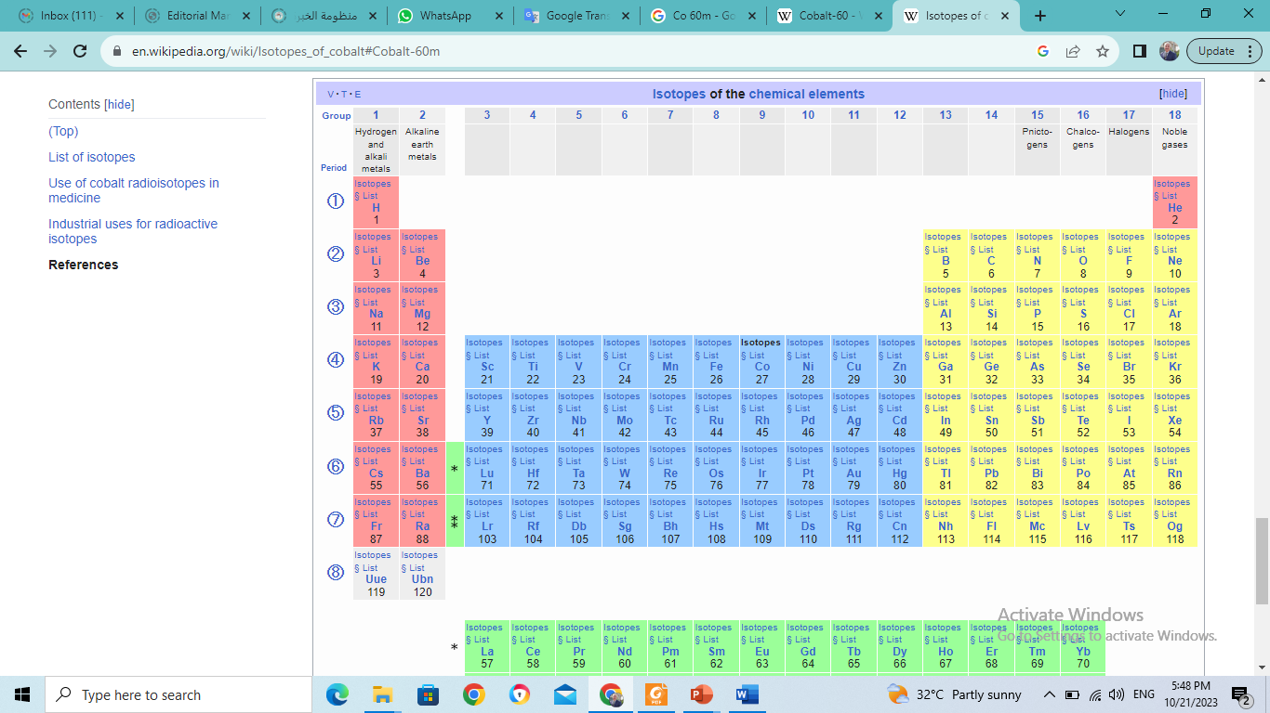
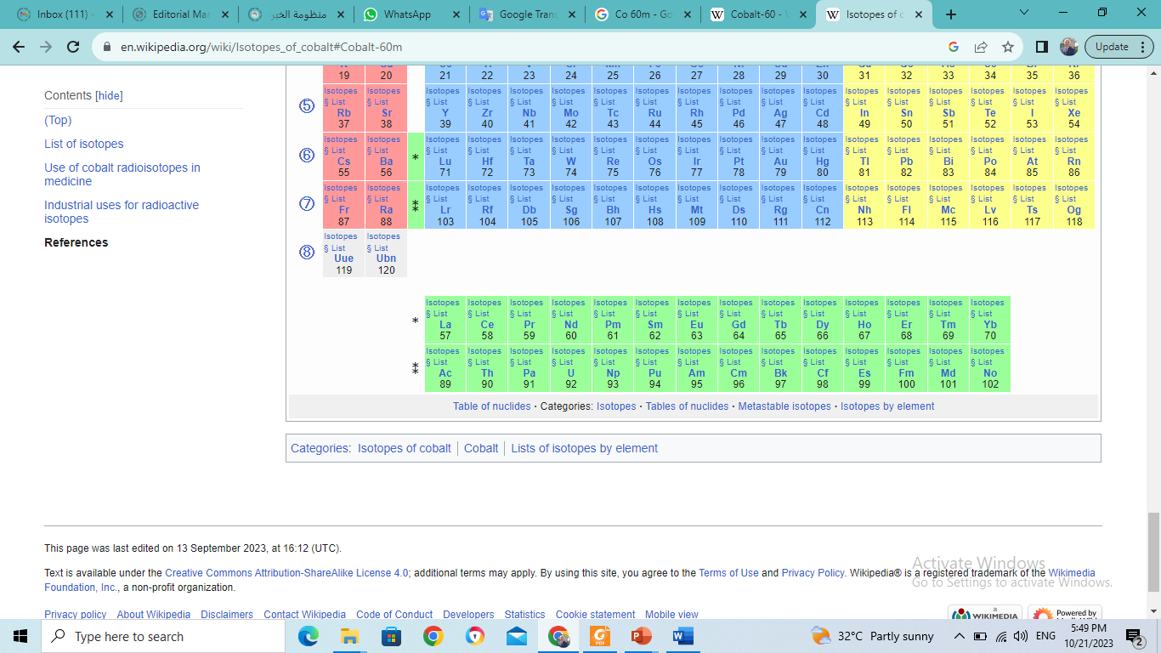

Slide 7
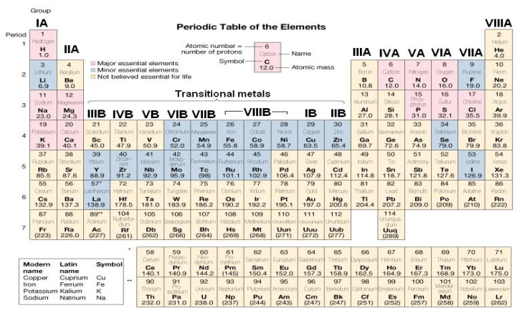
The Periodic Law
Electronegativity, definition and order.

Slide 8
Quantum Numbers :
Representation of Atomic Orbitals
The relation of a particular electron to the nucleus can be described through a series of four numbers, called the Quantum Numbers.
-The first (n) describe the energy(1,2,3,4) (Principle quantum number) shell =(K,L,M,N).
-The second (l) describe the shape (Angular momentum quantum number) (l =0,1,2,3,= s,p,d,f).
-The third (m_{l} ) orientation of the orbital (magnetic quantum number) (m_{l} =2l +1).
-The fourth (m_{s}) represents the "spin" of the electron (spin quantum number = ±1/2).

Slide 9
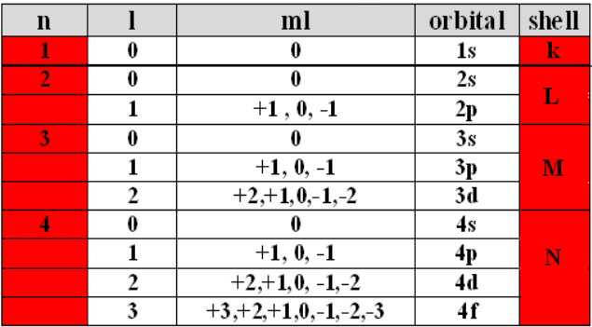

Slide 10
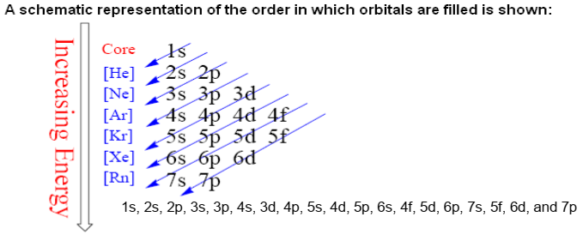

Slide 11
nS
nP
1
2
3
4
5
6
7
H |  |  |  |  |  |  |  |  |  |  |  |  |  |  |  |  | He
 |  |  |  |  |  |  |  |  |  |  |  |  |  |  |  |  | Ne
 |  |  |  |  |  |  |  |  |  |  |  |  |  |  |  |  | Ar
 |  |  |  |  |  |  |  |  |  |  |  |  |  |  |  |  | Kr
 |  |  |  |  |  |  |  |  |  |  |  |  |  |  |  |  | Xe
 |  |  |  |  |  |  |  |  |  |  |  |  |  |  |  |  | Rn
(n-1) d
(n-2) f
the quantum theory helps to explain the structure of the periodic table. n - 1 indicates that the d subshell in period 4 actually starts at 3 (4 - 1 = 3).

Slide 12
Writing electron configuration
Li 1s² 2s¹
C 1s² 2s² 2p²
O 1s² 2s² 2p⁴
Ne 1s² 2s² 2p⁶
S Ne¹⁰ 3s² 3p⁴
Every element is different.
- The number of protons determines the identity of the element.
- The number of electrons determines the charge.
- The number of neutrons determines the isotope.
- All chemistry is done at the electronic level (that is why electrons are very important).
- Electronic configuration is the arrangement of electrons in an atom; These electrons fill the atomic orbitals.

Slide 13
Properties within a group of elements r generally the same .
* the major differences include in quantitative.
Ionization energy: amount of energy to remove electron from gaseous atom .
In period( raw) ionization energy increase within move from left to right but it contrast in group. It decrease with descending in group.
Atomic radius:
* period decrease Atomic radius within going from left to right(increase A.#, n value constant) .b more p in the nucleus higher electrical force pulls e(s) closer to nucleuses
Group increase Atomic radius down the group or by increase n value( increase atomic #). valence e(s) radius at higher electron levels and not bonund as tightly to the nucleus protons they radius shield (pushed away) by other e(s) in inner levels
Electronegativity: the ability of an atom in a molecule to attract shared e(s) to itself.
* any period increase electronegativity from left to right.
In group decrease electronegativity from top to bottom. Except VIIIA(inert gas).
The most electronegative element is F and the least electronegative element is Francium (Fr) (IA).

Slide 14
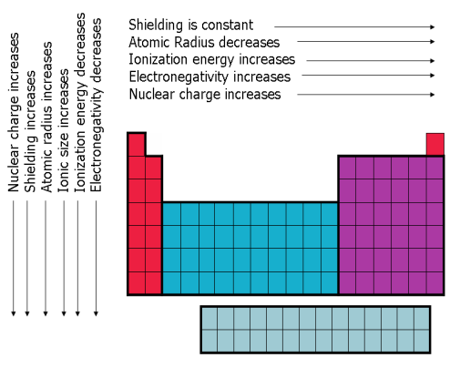

Slide 15
Electronic Structure of Molecules δ, л, n, л*, δ*
Columbic attraction, electron –electron Repulsion and nuclear repulsion Covalent; sharing of electron pairs Ionic; electrostatic interaction
Orbital Hybridization- It involves mixing of atomic orbitals to provide a new set of degenerate orbitals having different spatial orientations and directional properties than the original atomic orbitals.
Examples using Be, B and C including shapes and properties.
The effect of ligand strength and the magnetic properties of the complex in determining shape e.g. octahedral, tetrahedral or square planar.
Types of Bonding Interactions
Ionic, involves ionization. e.g. sodium and calcium chlorides
Covalent, involves sharing e. e.g. hydrogen, chlorine, carbon, hydrocarbons, phosphorus, carbon dioxide and hydrogen cyanide.
Coordinate Covalent Bonding, involves sharing pair (e)s e.g. in boron trifluoride etherate.
Q: What determines the nature of a bond?

Slide 16
Hydrogen Bonding
Hydrogen bonding is a weak secondary interaction usually intramolecular and also intermolecular. It explains some of the unusual properties of water such as its relatively high boiling point. It is also important in describing the structures of proteins and nucleic acids.
To form a H-bond, there must exist a hydrogen atom attached directly to one of the three atoms F, O or N. These atoms have high electronegativities.
Van der Waals Forces
Van der Waals forces are weak intermolecular forces to explain important phenomena including halogens and hydrocarbons as well as drug – receptor. These interactions depend on masses and distance between molecules.

Slide 17
Other types of Interactions
Polar interactions as well as induced dipole interactions are weak forces. However, they are important in explaining some properties of compounds as well as drug – receptor interactions and the relative stability of some isomers.
A Polar Molecule : The center of the overall negative charge on the molecule does not coincide with the center of overall positive charge on the molecule. The molecule can be oriented such that one end has a net negative charge and the other a net positive charge, i.e. the molecule is a dipole.
A nonpolar molecule : Has no charges on the opposite ends of the molecule Or, has charges of the same sign on the opposite ends of the molecule , Molecule is not a dipole
Polarisation
Apart of the extreme cases of pure covalent bonding of homonuclear diatomic molecules and pure ionic bonding between GI and GVII atoms, these is always varying degrees of ionic or covalent character described in terms of polarity.
The later depends on:
polarisabilty, highest for cations of high q/r.
polarising power, highest for anions of high q/r.
dipole moment, difference in electronegativities.

Slide 18
Coordination Compounds
Metallic cations, especially the transition metals are able to form stable compounds with additional anions or molecules with lone pair(s) of electrons (ligands), to form complexes. The maximum number of sites of the central metal-occupied is called the coordination number.
The metal ion and its associated ligands is called the complex ion. The later with its counter ions is called the coordination compound. The stability of a complex depends on the metal ion and the basicity of the ligand, Lewis’s concept. Ligands can be bi-dentate, tri-dentate, tetra-dentate, hexa-dentate or octa-dentate.
Bonding in Complexes
The valence bond theory is used to obtain a quantitative picture of bonding in complexes. The theory uses the idea of hybridization of the central metal atomic orbitals. The orientation of the five d orbitals of the metal in a complex is made of two sets. The d x2-y2 and dz2 orbitals are oriented along the axes of the Cartesian coordinate system. The other three; dxy, dyz and dxz are directed between the axes.

Slide 19
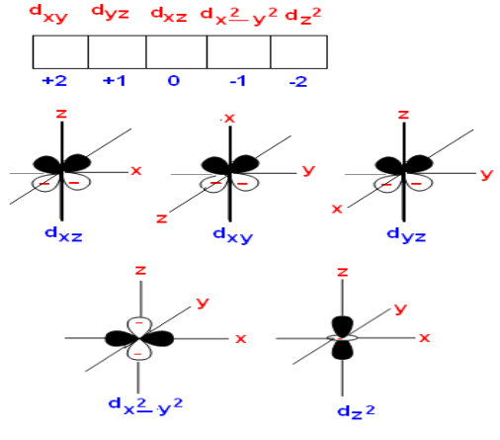

Slide 20
Octahedral Complexes, 1-3 electrons
For transition metals containing 1-3 electron in the d orbital e.g Cr⁺³ complexing with six cyano, CN⁻ ions to form [Cr(CN)₆]⁻³. Chromium (III) is a d³ ion; that is it contains 3 electrons in the in its 3d valance orbital.
These electrons are unpaired and occupy the three off-axis d orbitals, thus leaving two d, one s and 3p orbitals empty for bonding with six cyano groups. If these six orbitals hybridize six equivalent orbitals are formed and will be occupied by the six lone pairs of electrons donated by the six cyano ligands.
Cr²⁴ Ar¹⁸ 4S² 3d⁴ 4p
Cr⁺³ Ar¹⁸ 4S 3d³ 4p
6 ( N ≡≡ C ─)

Slide 21
Octahedral Complexes, 4-6 electrons
When four or more electrons in the outer d orbital, for example complexes formed with iron(III) which is a d5 ion, the normal ground state arrangement of electrons use different orbitals for bonding.
Fe²⁶ Ar¹⁸ 4S² 3d⁶
Fe⁺³ Ar¹⁸ 4S 3d⁵ 4p 4d
In hexa-aquo iron(III) which is a high spin complex, with similar magnetic moment as the free ion, hybridization of six orbitals (tow 4d, one 4s, and three 4p) called outer orbital hybridization, sp³d² instead of the usual sp³d² hybridization.
If the water molecules in hexa-aquo iron(III) complex ion are replaced with cyano groups, the hexacyanoferrate (III) ion results which has lower magnetic moment, a low spin complex.
This is a result of the high magnetic field of the cyano groups of sufficient strength to repel the electrons in the two d orbitals which directly oppose the approaching ligands.
The electrons become paired with those in the other d orbitals. Pairing with the six orbitals of the ligands will result in a low spin octahedral complex.
Fe⁺³ Ar¹⁸ 4S 3d⁵ 4p

Slide 22
Complexes with 7-9 d electrons
Transition metal ions with seven, eight, or nine d electrons generally have coordination number of 4 which leads to either a square planar or a tetrahedral arrangement of the ligands.
The strength of the ligand and the formation of high – and low spin complexes may be predicative of the type of hybridization and therefore the geometry of the complex.
For example a d⁸ ion complexing with a ligand having a relatively weak electrostatic field has no d orbitals available for bonding. However, the ligands can bond through the four sp³ hybrid orbitals formed on the metal to give a tetrahedral complex.
A strong ligand will force the metal into a low spin state and a square planar resulting from dsp³ hybridization will be formed. The complex has one vacant d orbital.

Slide 23
Complexes and Chelating Agents
Chelating agents are important aspects of pharmacy, drug therapy. They have much efficacy in the treatment of heavy metal poisoning for elements such as lead, arsenic, mercury and iron.
Chelating agents are important in treatment of metabolic disorders where metals such as iron and copper are accumulated in abnormal amounts in various tissues.
Examples of important chelating agents include EDTA, BAL, penicillamine and deferoxamine.
Calcium Disodium salt of EDTA
It is a mixture of the dihydrate salt. It is a white crystalline granules or powder. It is odorless, slightly hygroscopic and has a faint saline taste. It is stable in air, soluble in water with pH between 6.5 and 8.0. It is used in the treatment of heavy metal poisoning especially plumbism (lead) and Cu, Ni, Cd, Zn, Cr & Mn but not for mercury, arsenic or gold. An increase in the excretion of metal in the urine by (500ug/liter/24hr or greater for Pb) is an indication of poisoning (toxicity). It induces hypocalcaemia states (low serum Ca). Doses are (intravenous) I.V. or (intramuscular) I.M. of 75mg/kg of body weight. Preparation; a solution containing 200mg/ml for injection.

Slide 24
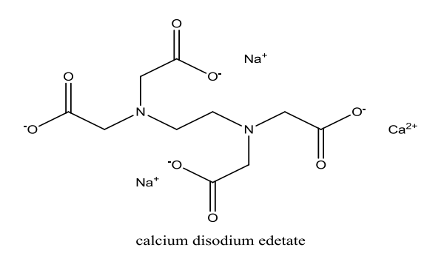
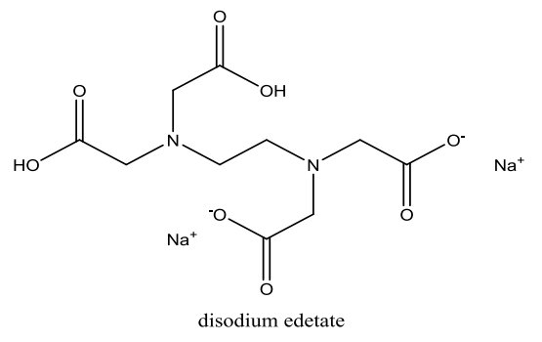
Disodium edetate is a white crystalline powder which is soluble in water and has pH of 4.0-6.0. It is used in treatment related to hypercalcemia including occlusive vascular disease and cardiac arrhythmias. It is not useful for dissolution of urinary calculi. Doses; IV injections of 50mg/kg of body weight. Preparation; 150mg/ml for injection.

Slide 25
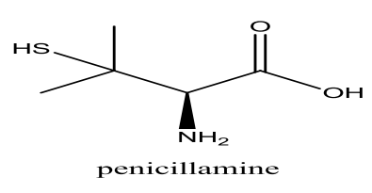
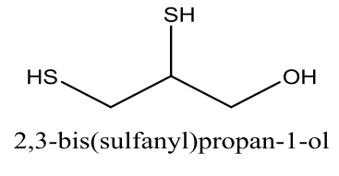
Dimercaprol (BAL) is a colorless of mercaptan-like odor. It competes with enzymes containing sulfhydryl groups (responsible for oxidation-reduction) for the metals causing poisoning. The mercaptides formed are excreted in the urine. BAL is of value in the treatment of arsenic or gold poisoning and early mercury poisoning, within a few hours.
Dose: in severe arsenic or gold poisoning, 3.0mg/kg is given six times a day for two days, four times a day on the third day, then twice daily on the next ten days. For early mercury poisoning, 5.0mg/kg followed by 2.5mg/kg twice daily for ten days.
Preparations: I.M. injection of 100mg/ml in peanut oil.

Slide 26
(CH₃)₂-C(SH)- CH(NH₂)-COOH
Penicillamine
It is a white crystalline powder having characteristic odor. It is freely soluble in water with pH of (4.5-5.5).
Penicillamine is used for treatment of poisoning of many metal including lead, iron, mercury and gold. Penicillamine is used for treatment of hepatolenticular degeneration (degeneration of the brain associated with increased levels of copper and Wilson’s disease) which is associated with elevated levels of copper in tissues including; eye, liver, brain and kidney. Penicillamine is used in the treatment of gold dermatitis. Penicillamine is used in the treatment of cystinurea, the presence of crystals of cystine in urea.
Dose: 250mg capsules given four times a day. Preparations: Cuprimine capsules containing 250mg of penicillamine for oral administration. The effectiveness of penicillamine as compared to is attributed:
1. its ability to resist metabolic inactivation by an oxidase since it doesn't have a
hydrogen on the beta carbon atom.
2. its sulfhydryl group ability to convert Cu⁺² to Cu⁺, with the formation of a tetrahedral rather than a square planar complex which has less affinity in competition with the tissue proteins containing –SH groups of oxidative value.

Slide 27
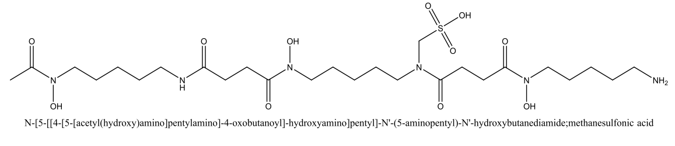
Deferoxamine is for acute iron deficiency. It forms an octahedral complex with Fe⁺³. It has no affinity to divalent ions including Fe⁺². Deferoxamine is not soluble in the gastrointestinal tract so oral administration is not effective. It is produced by streptomyces as a ferric Fe(III)complex.
After chemical removal of the iron, the chelating agent is purified as the methyl sulphonate salt.
Dose: IV or IM injections of 1.0g followed by 0.5g every 4-12 hours. Preparations: Desferal ampules containing 500mg of the lyophilized powder for injection.

Slide 28


