Slide 1
Fundamentals of Organic Groups and Reactions

Slide 2
1. Electron Donating Groups (EDGs)
Definition: Electron Donating Groups (EDGs) are groups or atoms that increase electron density around the atom they are attached to in an organic compound.
Simple Explanation: EDGs push or donate electrons towards the molecule. They help stabilize positive charges (or make the molecule more reactive towards accepting electrons).
How they work:
Through resonance: Some groups can share a pair of electrons through resonance. These electrons move within the molecule, increasing electron density in specific regions.
Through electronegativity: Groups with atoms that have low electronegativity (like carbon and hydrogen) tend to give or not pull electrons.

Slide 3
Clear and comprehensive examples
Hydroxyl group (-OH):
Example: In phenol (C₆H₅OH), the hydroxyl group donates electrons into the aromatic ring through resonance, making the ring more reactive.
2. Amino group (-NH₂):
Example: In aniline (C₆H₅NH₂), the amino group donates electrons into the aromatic ring via resonance, making the ring electron-rich and more reactive.
3. Alkyl groups (-CH₃, -C₂H₅):
Example: In toluene (C₆H₅CH₃), the methyl (CH₃) group pushes electrons into the aromatic ring, increasing its reactivity.
4. Ethers, -OR , The oxygen anion, -O-

Slide 4
2. Electron Withdrawing Groups (EWGs)
Definition : Are groups of atoms or molecules attached to a compound that pull electron density away from the rest of the molecule. This happens because these groups are more electronegative than the atoms they are attached to. EWGs make the attached atom or part of the molecule less electron-rich, which can influence the reactivity of the molecule.
Simple Explanation: Groups that decrease electron density around the attached atom, making the molecule more attractive to nucleophiles.
Examples:
Nitro Group (-NO₂): Decreases electron density, found in aromatic compounds.
Carbonyl Group (-C=O): Decreases electron density and attracts nucleophiles.

Slide 6
3. Nucleophiles
Definition: Nucleophiles are molecules or ions that are rich in electrons and are attracted to positive or electron-deficient areas of other molecules, where they donate their electrons to form bonds.
Examples:
• Hydroxide Ion (OH⁻): Attacks carbon centers in substitution reactions.
• Ammonia (NH₃): Acts as a nucleophile to form new bonds with carbon.

Slide 7
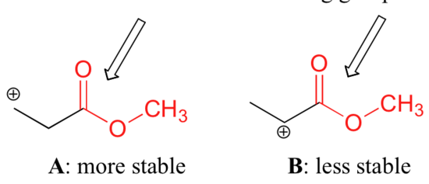
4. Electrophiles
Definition: Electron-deficient species that accept electrons to form a new bond.
Examples:
• Carbonyl Carbon (C=O): Acts as an electrophilic site in nucleophilic reactions.
• Proton (H⁺): Accepts electrons to form bonds in many reactions.

Slide 8
Types of Addition Reactions
For polar addition reactions there are two classifications, namely:
Electrophilic Addition reactions.
Nucleophilic Addition reactions.
For non-polar addition reactions, we have two classifications, namely:
Free radical addition reactions.
Cycloadditions reactions.

Slide 9
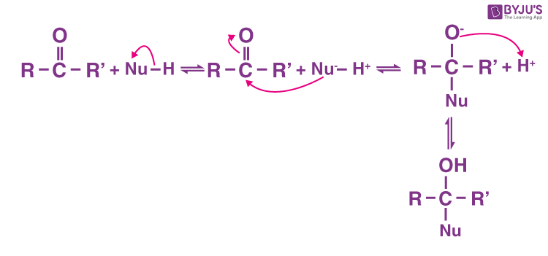
5. Nucleophilic Addition Reaction
Definition: A nucleophilic addition reaction is a type of reaction where a nucleophile donates its electron pair to an electron-deficient atom (usually a carbon atom in a double bond, like a carbonyl group) and forms a new bond. This reaction is common with electrophilic carbon centers found in compounds like aldehydes and ketones.
Examples:
• Aldehyde Addition: A nucleophile attacks the carbonyl carbon in aldehydes to form alcohols.
• Ketone Addition: Nucleophiles react with ketones to form secondary alcohols.

Slide 10
6. Electrophilic Addition Reaction
Definition: An electrophilic addition reaction can be described as an addition reaction in which a reactant with multiple bonds as in a double or triple bond undergoes its π bond broken and two new σ bonds are formed.
Examples:
• HBr Addition to Ethene: The electrophile breaks the double bond and adds to the molecule.
• Water Addition to Alkenes: Electrophile adds across a double bond in alkenes.

Slide 11
Difference Between Nucleophilic Addition and Electrophilic Addition
Property | Nucleophilic Addition | Electrophilic Addition
Reacting Species | Nucleophile attacks an electron-deficient or partially positive center | Electrophile attacks an electron-rich center (π bond)
Common Compounds | Typically polar compounds like carbonyls (C=O) in aldehydes/ketones | Alkenes and alkynes (double or triple bonds)
Examples | Cyanide addition to aldehydes and ketones | HBr addition to alkenes
Product | Forms alcohols or similar compounds | Converts unsaturated compounds to saturated ones

Slide 12
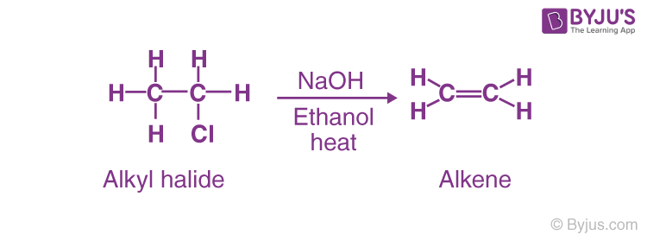
7. Elimination Reaction
Definition: Elimination reaction is a type of reaction that is mainly used to transform saturated compounds (organic compounds which contain single carbon-carbon bonds) to unsaturated compounds (compounds which feature double or triple carbon-carbon bonds).
• Dehydration of Alcohol: Forms alkenes by removing water.
• HX Elimination from Alkyl Halides: Forms a double bond in alkenes.

Slide 13
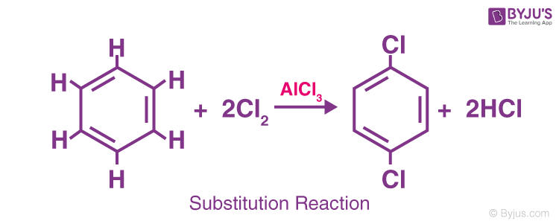
8. Substitution Reaction
Definition: A substitution reaction is a type of chemical reaction in which one functional group in a molecule is replaced (substituted) by another group. This reaction is common in organic chemistry, especially with alkanes, alkyl halides, and aromatic compounds.
. There are two main types of substitution reactions:
Nucleophilic Substitution (SN ).
Electrophilic Substitution.

Slide 14
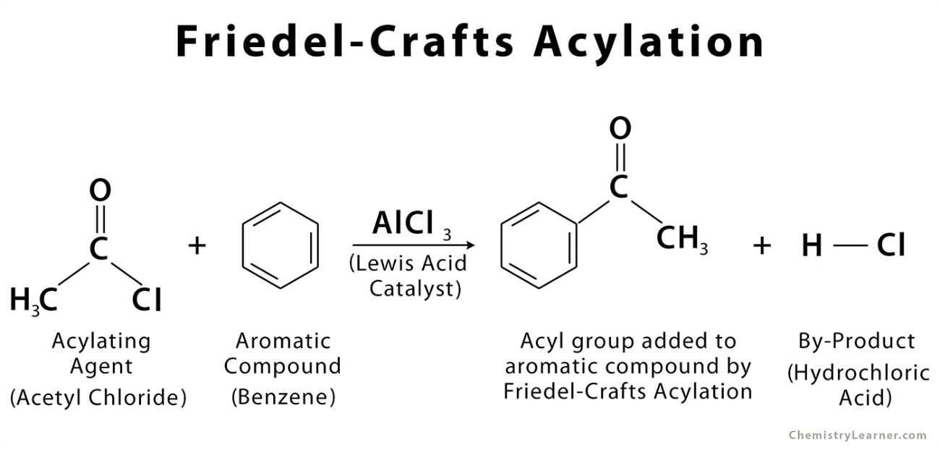
9. Acylation Reaction
Definition: Acylation is a chemical reaction where an acyl group (R-CO-) is introduced into a compound, typically replacing a hydrogen atom. The acyl group consists of a carbonyl group (C=O) attached to an alkyl group (R). Acylation is a crucial reaction in organic chemistry, especially in the synthesis of more complex molecules.
Examples:
• Friedel-Crafts Acylation: Acyl group added to an aromatic ring using acyl chloride and AlCl₃.
• Amine Acylation: Acyl group reacts with an amine to form amides.

Slide 15
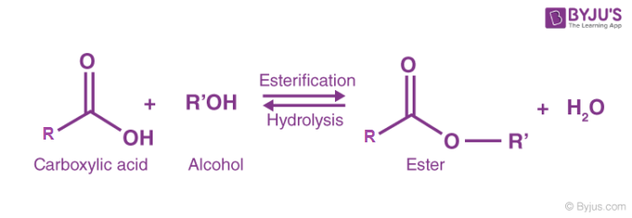
10. Esterification
Definition: Esterification is a chemical reaction in which an alcohol reacts with a carboxylic acid to form an ester and water. This process typically requires an acid catalyst, such as concentrated sulfuric acid, to enhance the reaction rate.
General Reaction:
Alcohol + Carboxylic Acid → Ester + Water
Examples:

Slide 16
11. Steric Hindrance
Definition : Steric Hindrance :This is a specific type of steric effect, which is generally negative. It occurs when large groups obstruct or prevent chemical reactions by physically blocking access to reactive sites on a molecule. In other words, steric hindrance is the particular case where spatial constraints hinder a molecule’s ability to interact with other reactants.
Examples:
In an SN2 (nucleophilic substitution bimolecular) reaction, if a molecule has large groups (like tertiary alkyl groups), the nucleophile will struggle to reach the reaction center, slowing down or even stopping the reaction.

Slide 17
