Slide 1
Medical Microbiology
Lab. 2
By
Assistant lecturer
Zainab farooq shafeeq
2022-2023

Slide 2
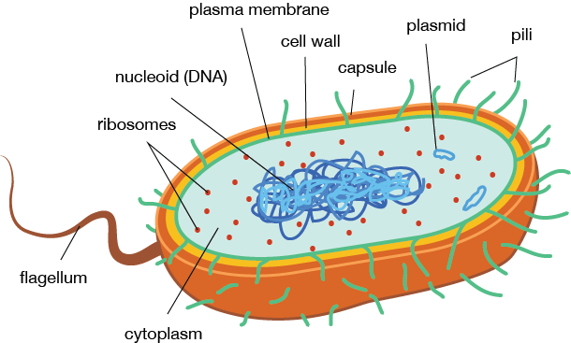
Bacterial Morphology
Bacteria: are unicellular free living organisms without chlorophil having doth DNAand RNA

Slide 3
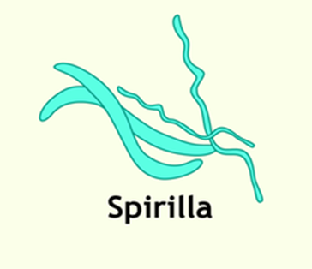
Bacterial morphology
Can be grouped into three types
1- Spherical (cocci)
2- Rod – shaped
(bacili)
3 – Helical
(spirilla)

Slide 4
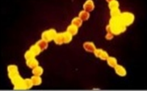
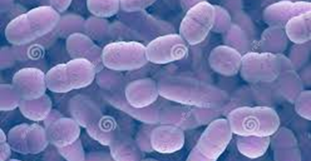
1- Spherical ( cocci) : bacteria may occur single , in pairs ,
in tetrads , in chain and in irregular masses.
Staphylococcus aureus
(in clusters)
Streptococcus pyogenes
(in chain)
Streptococcus pneumoniae
(in pairs)

Slide 5
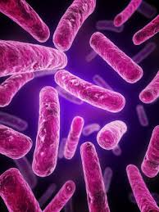
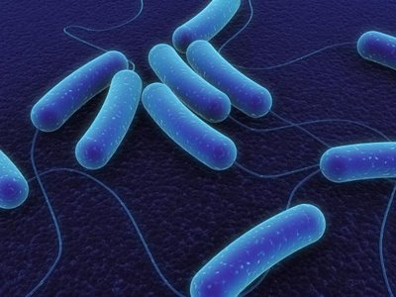
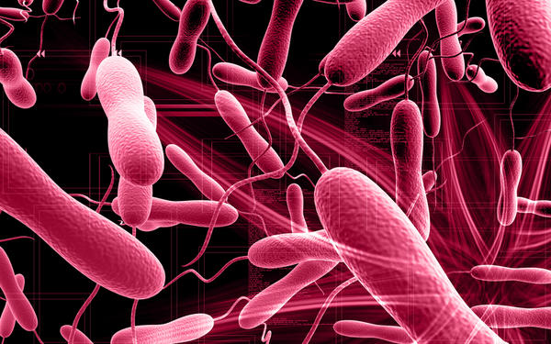
2- Rod – shaped(bacilli): bacteria may vary considerably in length may have square , round , or pointed end and may be motile or non-motile
Bacillus subtilis
Escherichia coli
3- Helical and curved bacteria : exite as slender spirochaetes , spirillum and bent rods (vibrios).

Slide 7
Smear preparation and simple stain
Smear preparation
Principles
A bacterial smear is a dried preparation of bacterial cells on a glass slide.
In bacterial smear that has been properly processed :
1- The bacteria are evenly spread out on the slide in such a concentration that they are adequately separated from on another.
2- The bacteria are not washed off the slide during staining.
3- Bacterial form is not distorted.

Slide 8
Procedure:
In making a smear the bacteria from either a broth culture or an agar slant or plate my be used . If a slant or plate is used , a small mount of bacterial growth is transferred to a drop of water on a glass slide and mixed , and the mixture is spread out evenly over a large area on the slide .
If the medium is liquid , place one or two loops of the medium directly on the slide and spread the bacteria over a large area.
Allow the slide to air dry at room temperature. The next step is to attach the bacteria to the slide by heat fixing . This is accomplished by gentle heating , passing the slide several time through the hot portion of flame of a Bunsen burner . Most bacteria can be fixed to the slide and killed in this way without serious distortion of cell structure.

Slide 11
Simple stain
Principles
Simple staining is carried out to visualize bacteria and to compare morphological shapes and arrangements of bacterial cells.
In simple stain , the bacterial smear is stained with single basic dye .
Bacterial cell surface is slightly negative so it tends to bind strongly to the cationic chromogen of basic dyes.
Commonly used dyes for simple staining are :
Crystal violet (20-30 sec. staining time).
Methylene blue (60 sec. staining time).
Carbolfuchsin (5-10 sec. staining time).

