Slide 2
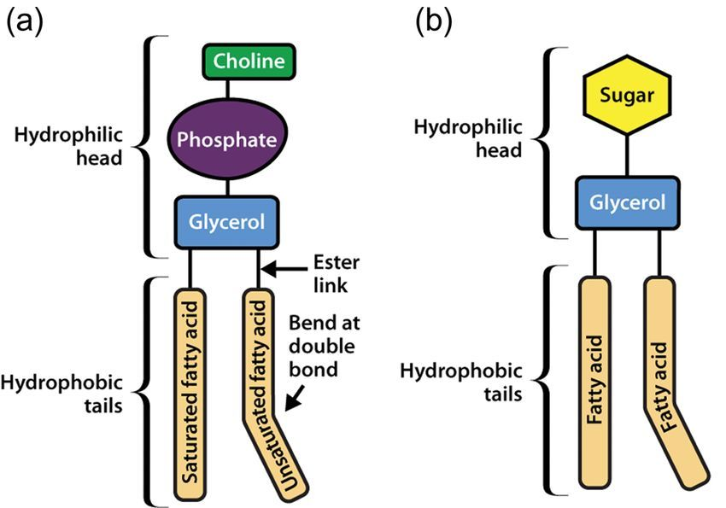
Lipids
Lipids are a heterogeneous group of compounds.
insoluble in water and soluble in organic solvent such as (alcohol, acetone).

Slide 3
Classification of lipid
Simple lipid
Compound lipid
Derived lipid
fatty acid and glycerol give ester of fatty acid
Exp. Fats, waxes
Ester of fatty acid containing another group
Exp. glycolipids
Produced when hydrolyzed simple or compound lipid
Exp. Cholesterol

Slide 4
fats are lipids that solid at room temperature.
oils are lipids that liquid at room temperature.
Function of lipid
Part of cell membrane
Source of energy
Regulate activities of cells and tissues

Slide 5
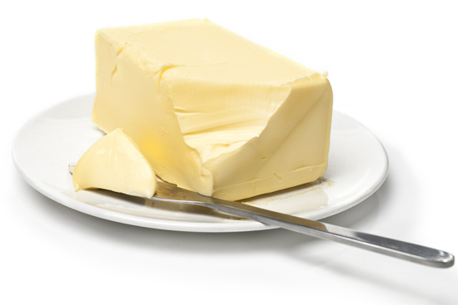
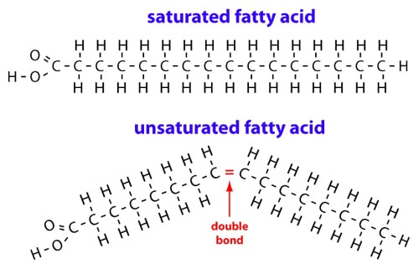
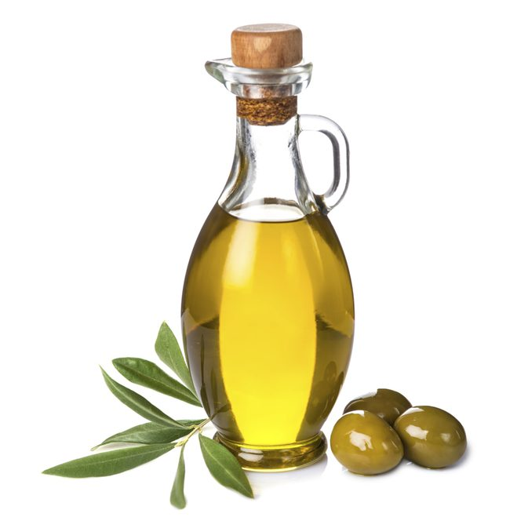
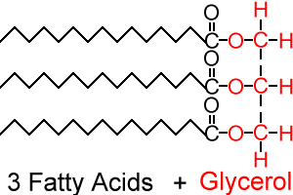
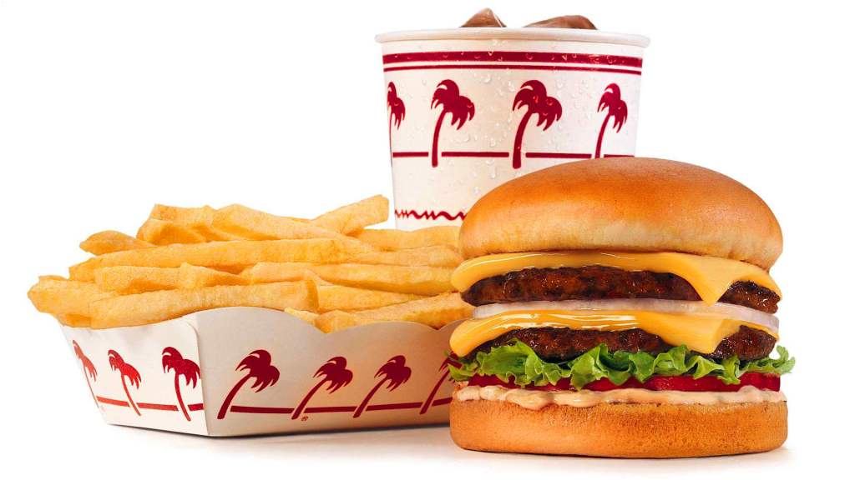
Types of fatty acids

Slide 6
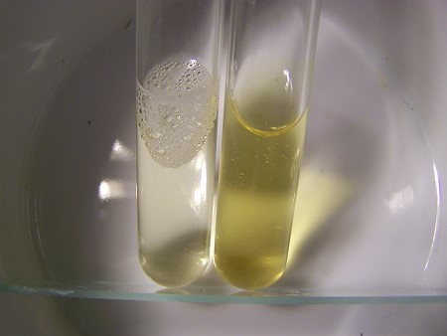
Iodine test
Specific test for (unsaturated fatty acid).
Depends on reaction of iodine reagent with double bond of fatty acid.
Produced colorless (+).
+ -

Slide 7
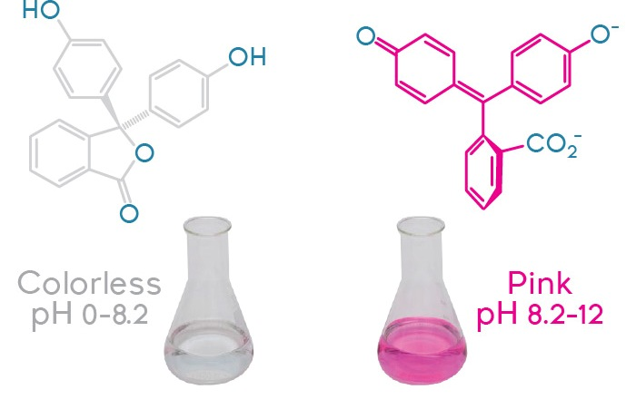
Reaction test
Specific test for fatty acid (saturated and unsaturated).
Depends on fatty acid decolorizes the red color of phenolphthalein reagent because it have free carboxyl group .
Produced colorless (+).

Slide 8
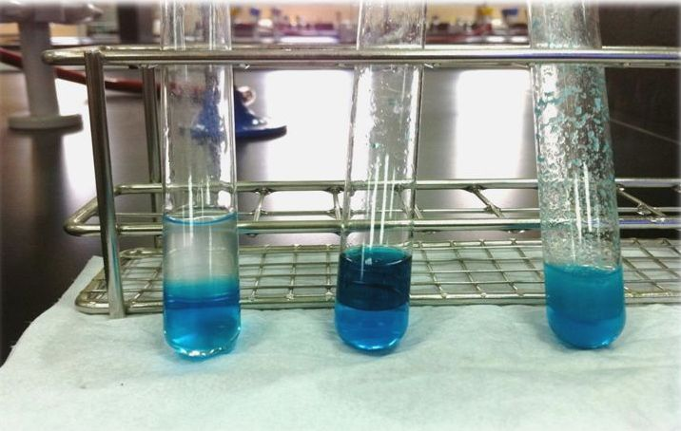
Copper acetate test
Specific test for distinguish between TG, unsaturated and saturated fatty acid.
Depends on reaction of (Cu⁺² ) with (COOH) of fatty acid.
Neutral unsaturated saturated

Slide 9
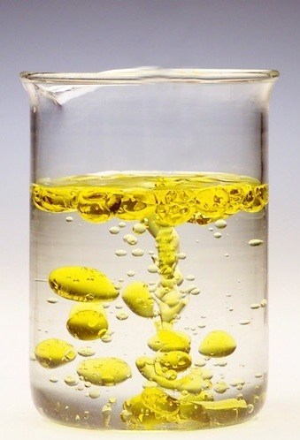
Emulsification of oils
Emulsion when lipid shake with water then broken down to give minute particles which is immiscible with water.
Because oil particles will get together and carried above the surface of water.
So add soap to this mixture, oil will be miscible in this solution (oil + water + soap) to give emulsion permanent.

Slide 10
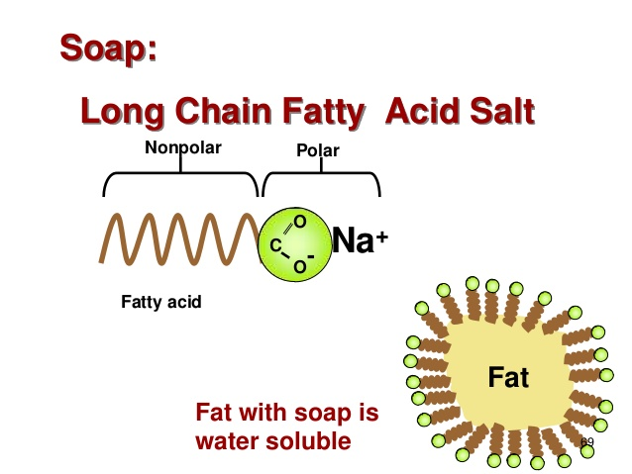
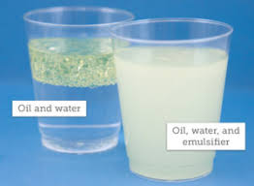
Chemical substances that make emulsion permanent are:
(soap, proteins, bile salts and phospholipid).

Slide 11
Lipid tests
1- iodine Test :
(test for unsaturated fatty acid)
2 - reaction Test :
(test for general fatty acid)
3- copper acetate Test :
(distinguish between lipids)
(1 ml) of lipid
(4 drops) OF reagent
(1 ml) of liquid
(4 drops) of reagent
(1 ml) of liquid
(1 ml) OF reagent, shake, let stand
oleic
(+)
Brown
(-)
Purple (palmitic)
(-)
TG
(+)
palmitic
TG
Saturated
unsaturated
4- emulsification of oils:
5- cholesterol test:
(1 ml) of lipid
(2 ml) of water
Salkowski test
(2 ml) of cholesterol in dry test tube
(2 ml) of H₂SO₄ (con.)
Mix, let stand
Few drop of soap and shake

Slide 12
Unknown
(palmatic , TG, Oleic)
Reaction Test :
(1ml ) of unknown
(6 drop) of reagent
Reaction test
Copper acetate test
Iodine Test :
(1 ml) of unknown
(4 drop) of reagent
(-)
neutral
(+)
Fatty acid
Iodine test
Copper acetate Test :
(1 ml) of unknown
(1 ml) of reagent, shake,
let stand
(+)
(-)

