Slide 1
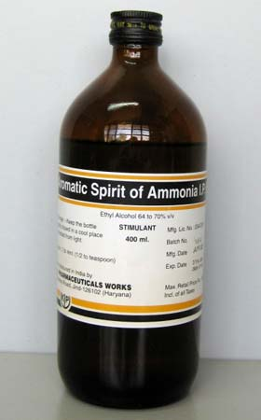
Spirits

Slide 2
Spirits
Are alcoholic or hydro alcoholic solutions of volatile principle (mostly volatile oil)
spirits could be classified according to their uses:
Therapeutic spirits: which contain therapeutic volatile substances.
Flavoring spirits : which contain flavoring volatile substances.

Slide 3
spirits also known as essences.
Spirits prepared by distillation, but nowadays there are prepared by dissolving the volatile substances in alcohol.
The amount of volatile substance in spirits varies greatly and no fixed percentage can be given ,but in all cases, volatile substances in the spirits is more than that of aromatic water.
Amount of alcohol differ from one spirit to another ,the lowest amount of alcohol found in internal spirits as(aromatic spirit of ammonia) which contain 62-68% alcohol while (camphor spirit) which is used externally contain 80-87%.
Spirits when taken orally , they are generally mixed with portion of water to reduce from pungency.
In preparation of spirits we must keep in mind that the oil dissolved in alcohol is precipitated causing turbidity when the solutions are mixed with water other than specified in the formula ,so all equipment should be dry and filter paper should be moisten with alcohol.
Spirits should be stored in light resistant containers and in cool place to prevent evaporation of alcohol and volatilization of volatile substance or active ingredients and to limit oxidative changes.

Slide 4
Methods of preparation of spirits
-Simple solution method
-Maceration
-Chemical reaction
-Distillation

Slide 5
Spirits of orange B.P
Rx
Oil of orange 200 ml
Oil of lemon 50 ml
Oil of coriander 20 ml
Oil of anise 5 ml
Alcohol Q.S 1000 ml
Method:
According to simple solution method, mix oils with sufficient alcohol to make the product measure 1000 ml.
Note :
Anise oil use as carminative and mild expectorant (as cough mixtures and lozenges)

Slide 6
Compound spirit of cardamom B.P
Rx
Oil of cardamom 20 ml
Oil of orange 20 ml
Of cinnamon 2 ml
Oil of clove 1 ml
Anethol 1 ml
Oil of carawya 0.2 ml
Alcohol Q.S 200 ml
Method:
Mix the oils and anethol with sufficient alcohol to make the product measure 200 ml.
Notes: -
Carawya oil used as antispasmodic agent ,mainly in children mixtures.
Cinnamon oil used as carminative and flavouring agent.
Cardamom used as carminative and flavouring agent.
Anethol used as mild expectorant in cough mixtures and lozenges, also as flavouring agent.
Aromatic spirit of ammonia
Rx
Ammonium carbonate 34 g
Dilute solution of ammonia 90 ml
Oil of lemon 10 ml
Oil lavender 1 ml
Oil of myristica 1 ml
Alcohol 700 ml
D.W Q.S 1000 ml

Slide 7
Method:
Dissolve the solid agent in dilute solution of ammonia with little amount of water , while the oil dissolved in alcohol also with little amount of water, and then add the aqueous solution into alcoholic one after filtering each one.
Note :
In preparation of aromatic spirit of ammonia we make filtration due to the presence of water with alcohol that lead to precipitation of volatile oil
uses of official spirits :
Carminative (aromatic spirit of ammonia)
Antacid (aromatic acid of ammonia)
Mild reflex circulatory stimulant (camphor spirit)
Flavouring agent (cinnamon spirit)

Slide 8
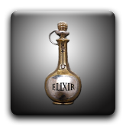
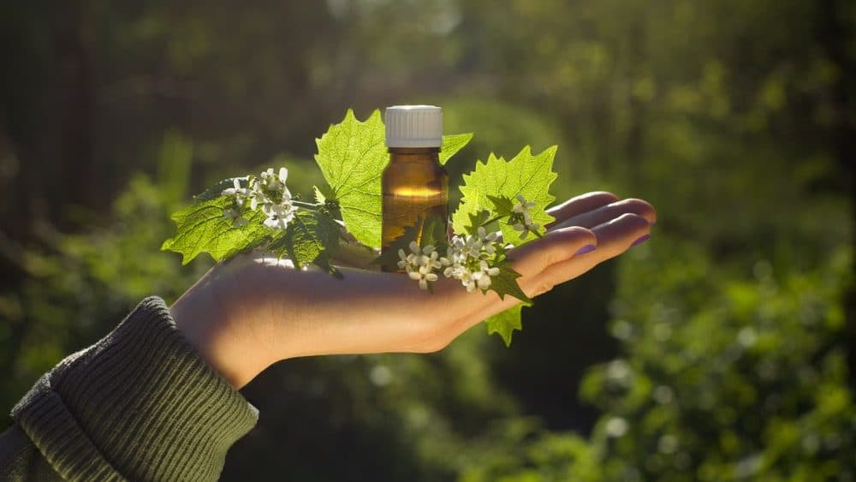
Elixir

Slide 9
Elixir is clear, sweetened hydro-alcoholic solution. Alcoholic content vary from 10% to 12% and up to 40% Intended for oral use usually flavoured to enhance palatability. Usually less sweet than syrups and less viscous.
They are classified into two classes,
Medicated /Non-Medicated
Medicated elixir is used for therapeutic effects. Examples of medicated elixirs are
1. Antihistamine Elixir: Diphenhydramine HCl
2. Analgesic Elixir: acetaminophen
3. Antispasmodic Elixir: hyoscyamine sulfate
4. Sedative Elixir: phenobarbital

Slide 10
Non medicated elixirs
Do not contain any therapeutic agent can be used for dilution of an existing medicated elixir. These only contain Water, alcohol, sweetening agent and coloring agent
Most common non medicated elixir is following:
• Aromatic elixir perfumes
• Compound benzaldehyde elixir
• Isoalcoholic elixir

Slide 11
Advantages of Elixirs
• Better able to maintain both water-soluble and alcohol-soluble components in solution.
• Has a stable characteristic.
• Easily prepared by simple solution.
Disadvantages
• Less effective than syrups in masking taste of medicated substances.
• Contains alcohol, accentuates saline taste of bromides

Slide 12
Elixirs
Components of an elixir
Purified water and alcohol are the main component of the elixir. This is employed as a co-solvent to ensure solubility of all ingredients.
the concentration of alcohol varies depending on the formulation. Generally, the concentration of alcohol is 8-10% v/v (Low alcoholic Elixir); however, in some preparations, the concentration of alcohol may be greater than 40% v/v.(High alcoholic Elixir)

Slide 13
Polyol co-solvents, e.g. propylene glycol, glycerol, may be employed to enhance the solubility of the therapeutic agent and associated excipients.
Sweetening agents as Sucrose , saccharine, and sorbitol . Less concentration is required as compared to syrups
Flavors and colors.
All pharmaceutical elixirs contain flavors and colors to increase the palatability and enhance the aesthetic qualities of the formulation.
Preservatives Elixirs containing more than 10 to 12% of alcohol are usually self-preserving and do not require the addition of an antimicrobial agent. Otherwise Parabens and Benzoates added.

Slide 14
Method of preparation:
Dissolve the water-soluble ingredients in part of the water,
Dissolve the sucrose in it.
Dissolve the other ingredients in the alcohol (5-40%)
The aqueous solution is then added to the alcoholic solution with constant stirring and make up the volume with the solvent or vehicle specified in the formulation.
Sucrose increases viscosity but decreases the solubility properties of water so in addition of viscosity-enhancing agents, e.g. hydrophilic polymers, may be required to optimize the rheological properties of elixirs.
Elixirs should be brilliantly clear and therefore strained or filtered, if necessary, subjected to clarifying action of purified talc.
Elixirs should be stored in tight ,light resistant containers and protected from excessive heat because of their usual content of volatile oil and alcohol.

Slide 15
Differences between elixirs and syrups
Elixirs are usually less sweet and less viscous than syrups because they contain a lower proportion of sugar and consequently are less effective than syrups in masking the taste of medicinal substances.
Elixirs are better able than aqueous syrups to maintain both water soluble and alcohol soluble components in solution because of their hydroalcoholic character.
From manufacturing stand point, elixirs are preferred over syrup due to their stability and ease of preparation (by simple solution).

Slide 16
Notes for Preparation of elixir
Elixirs are usually prepared by simple solution method with agitation and / or by the admixture of two or more liquid ingredients.
Alcohol soluble and water soluble components are generally dissolved separately in alcohol and purified water, respectively. Then the aqueous solution is added to alcoholic solution rather than the reverse, in order to maintain the highest possible alcoholic strength at all times so that minimal separation of alcohol- soluble components occurs.
When the two solutions are completely mixed the mixture is made to volume with specified solvent or vehicle.

Slide 17
Note :-
In preparation of elixirs frequently the final mixture will not be clear (cloud) due to separation of some flavouring oils by reduced alcoholic concentrations. If this occurs the elixir is usually permitted to stand for a prescribed number of hours , to ensure the saturation of hydro-alcoholic solvents and to permit the oil globules to coalesce so that they are more easily removed by filtration.
comparison between elixirs and spirits
Elixirs spirits
1.Contain sweetening agent 1. not contain
2.More viscous 2. less viscous
3.Need preservative if the 3. not need
alcohol content is less than 10-12%
4.Water and alcohol 4. alcohol is usually the primary
are usually the primary solvent
5.For internal use only 5. used internally and externally
6. Concentration of alcohol is 4-40% 6. concentration of alcohol is 62-87%

Slide 18
Phenobarbital elixir U.S.P
Rx
Phenobarbital 4 g
Tr. of orange peel 30 ml
Solution of amaranth 10 ml
Alcohol 125 ml
Glycerin 450 ml
Syrup 250 ml
D.W Q.S 1000 ml
Method:
Dissolve the phenobarbital in alcohol
Add the tincture of orange peel ,glycerin, syrup, amaranth solution and add sufficient water to produce 1000 ml ,mix well and filter.
Notes :
The phenobarbital elixir used as sedetive and hypnotic.
Glycerin used as thicknening agent ,also increase the solubility of phenobarb .
Tr.of orange peel used as flavouring agent.
Solution of ammaranth used as colouring agent.
Syrup used as sweetening agent.

Slide 19
Pediatric paracetamol elixir B.P
Rx
Paracetamol 120 mg
Alcohol 0.5 ml
Chloroform spirit 0.1 ml
Propylene glycol 0.5 ml
Conc. rose berry juice 0.125 ml
Amaranth solution 0.01 ml
Invert syrup 1.375
Glycerol Q.S 5ml
Method:
Dissolve paracetamol in alcohol.
Add chloroform spirit ,propylene glycol, juice, amaranth solution, invert syrup.
Complete the volume by addition of glycerol.

Slide 20
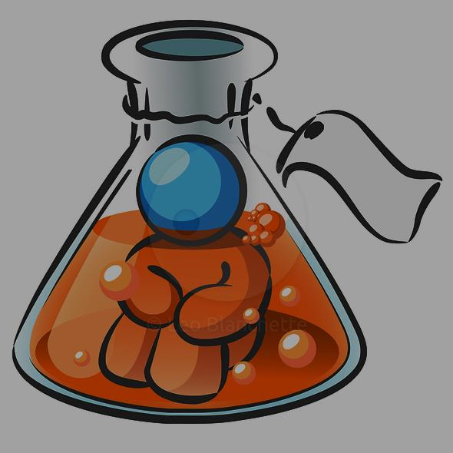
Thank you

