Slide 1
Lab 6 Weight variation, content uniformity &Disintegration test (official test) industrial pharmacy fifth stage 2024-2025 Lec. Zeina D. SALAMAN Lec. Ashti m.h. saeed ASSIST. LEC. MAYSAM HUSSEIN

Slide 2
Pharmacopeial or official tests:
A- Weight variation
The limited weight variation according to USP:
Take 20 tabs and weigh individually and calculate the average weight and compare the individual tab. weight with the average then no more than 2 tabs should be outside percentage limit.
Allowance | 10% | 7.5% | 5%
Average wt. (mg) | Less than 130 mg | 130-324mg | More than 324 mg

Slide 3
Factors affecting wt. variation:
1. Segregation of the powder
2. Poor flow
3. Poor mixing
4. Variation in the adjustment of the upper and lower punch
5. Use of insufficient quantity of lubricant
Note: Wt. Variation method used to determine drug content uniformity, if powder of tab. Contain 90-95% active ingredient, while wt. Variation test is not sufficient to assure uniformity of potency for moderate to low dose drugs in which excipients make up the bulk of the tab. Weight.

Slide 4
B. Content uniformity
The test for Content Uniformity of preparations presented in dosage units is based on the assay of the individual content of drug substance(s) in a number of dosage units to determine whether the individual content is within the limits set. In another meaning it is a measure of the consistent distribution of the active pharmaceutical ingredient (API) within a batch of tablets, ensuring each tablet delivers the correct dosage.
Small dose drug having problem of content uniformity and wt. variation so each calculate individually.
Content uniformity for low dose drugs (to assure uniform potency):
Test 30 tablets by randomly selected for the sample.
At least 10 tablets of them assayed individually (nine of them must contain not less than 85% or more than 115% of the labeled drug content. The tenth tab. Must not be less than 75% or more than 125% of the labeled content), if these conditions not met then the remaining 20 tablets is individually assayed and non of them falls outside the range of 85-115%

Slide 5
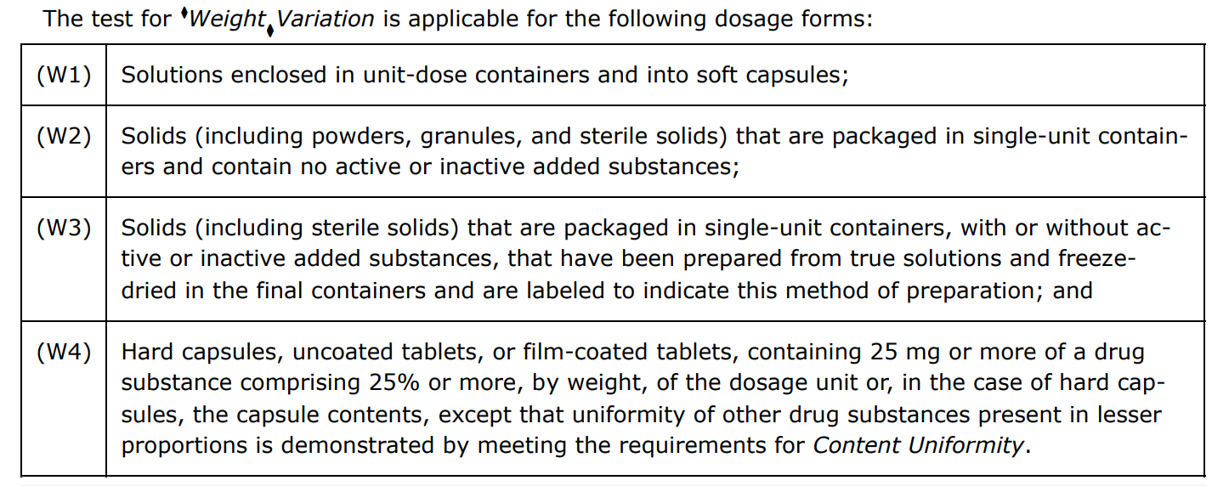
Factors contribute directly in content uniformity problems of tablet:
1- Non-uniform distribution of the drug substance throughout the powder mixture or granulation.
2- Segregation of the powder mixture or granulation during various manufacturing process.
3- Tablet wt. variation.
NOTE: The test for Content Uniformity is required for all dosage forms not meeting the below conditions for the Weight Variation test. (table is for viewing)

Slide 6
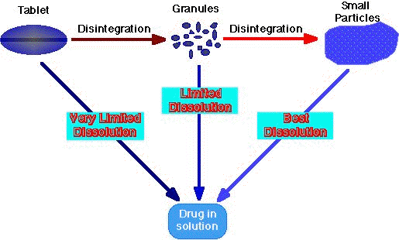
C. Disintegration test
It is performed to identify the disintegration of tablet in particular time period
For a drug to be readily available to the body , it must be in solution.
For most tablets, the first important step toward solution is break down of the tablet into smaller particles or granules, a process called disintegration.

Slide 7
Complete disintegration: is A state in which any residue remain is A soft mass having no palpable firm core except fragments of insoluble coating remaining on the screen of the apparatus.

Slide 8
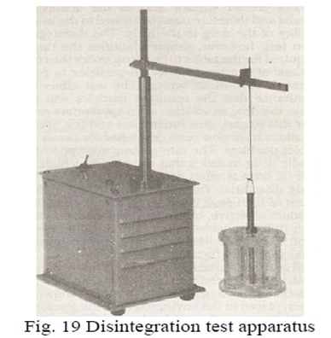
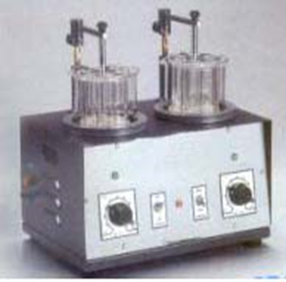
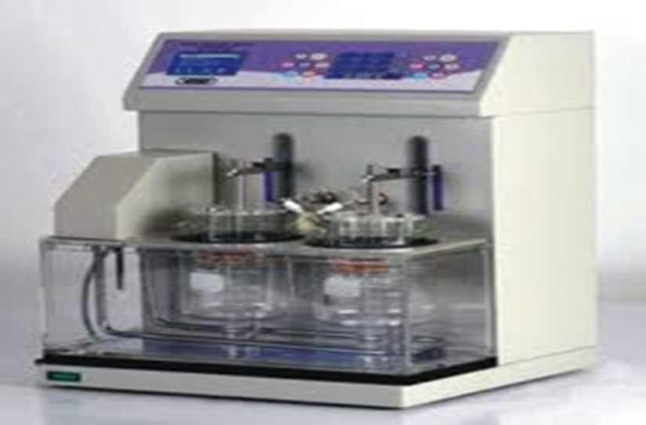
Disintegration test apparatus

Slide 9
To be in compliance with USP standards, the end time of the test at which all parts of the tablet must disintegrate and pass (eliminated) through the mesh screen (from the set of tubes) in which the tabs held during agitation (lowering and rising process).
The lowering and rising process (agitation) held at constant frequency (28-32 cycle)/min in such away that the highest position of the tubes ensure that the screen remain below the surface of water.
Note: enteric coated tablets are similarly tested. Except that the tablets are tested in simulated gastric fluid for one hour, after which no sign of disintegration, cracking or softening must be seen. They are immersed in simulated intestinal fluid for the time specified in the monograph, during which time the tablets disintegrate completely for A positive test.

Slide 10
Disintegration time: the U.S.P. Device (disintegrator) uses 6 glass tubes that are 3 inches long; open at the top and 10 mesh screen at the bottom end.
To test for disintegration time, one tablet is placed in each tube and the basket rack is positioned in a 1-l beaker of water, simulated gastric fluid or simulated intestinal fluid at 37 ± 2 ⁰ c such that the tablet remain 2.5 cm below the surface of liquid on their upward movement and not closer than 2.5 cm from the bottom of the beaker in their downward movement.
Move the basket containing the tablets up and down through A distance of 5-6 cm at A frequency of 28-32 cycles per minute. Floating of the tablets can be prevented by placing perforated plastic discs on each tablet.
Disintegration test: (triplicate is done) we start with 6 tablets (each tablet in each tube), if one or two tablets failed to disintegrate completely, test should be repeated for additional 12 tablets, the requirement met if not fewer than 16 of the total 18 are disintegrated.

Slide 11
Factors affecting the disintegration time
Content : especially the quantity and quality of the disintegrant and lubricant (mixing condition and time of addition of lubricant), the lubricant increase the disintegration time by decreasing the wettability of the tablets due to its hydrophobicity.
Hardness: amount of binder , compression force.
Design of granulation procedure which will affect the physical properties of the granules.

