Slide 1


Practical organic pharmaceutical chemistry III
Fourth class / 2st semester
2023-2024
Lab 5
Synthesis of Benzoyl Glycine
Done by:
Assistant Lecturer: Hawazin Aziz Hamim

Slide 2
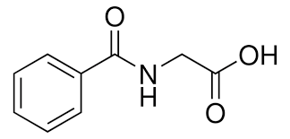
Benzoylglycine(C9H9NO3)
Benzoylglycine (hippuric acid, Benzoylaminoacetic acid) is an acyl glycine that is commonly monitored in biomarker assessment studies (e.g., diseases and disorders, occupational exposure of toluene). Hippuric acid is synthesized in the liver and its production is greatly increased following consumption of benzoic acid. In itself it does not have a direct biological function, however p-hydroxy-hippurica acid can be used as an inhibitor of Ca2+ ATPase.
Physical Properties
Molar mass(179.17 g/mol), Melting point(187 - 188 °C)

Slide 3
Physical Properties
1-As a white solid with have Molar mass(179.17 g/mol)
2-Melting point(187 - 188 °C)
3-Solubility in DMSO (Slightly) and Methanol (Slightly).
Chemical Properties
Benzoylation methods
The insertion of a benzoyl moiety instead of the active hydrogen atom present in hydroxyl (—OH), primary amino (—NH2) or secondary amine function (>NH) is usually termed as the ‘Benzoylation Reaction’. This particular reaction essentially bears a close resemblance to the phenomenon of ‘Acetylation’ except that .

Slide 4
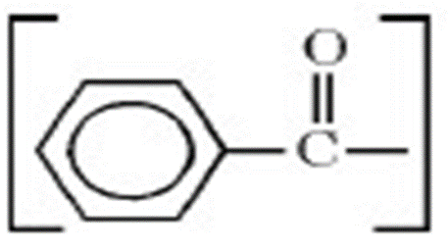
In this specific instance the reagent employed is ‘benzoyl chloride’ which reacts in the presence of Pyridine or Sodium hydroxide and not benzoic anhydride (as in the case of ‘acetylation’).

Slide 5
Schotten-Baumann reaction
In the Schotten-Baumann method of benzoylation, the hydroxyl or amino compound (or a salt of the latter) is either suspended or dissolved in an excess of freshly prepared 10% (w/v) aqueous sodium hydroxide solution, together with a small excess of benzoyl chloride
The resulting mixture is shaken vigorously. It has been observed that under these experimental parameters ‘benzoylation’ proceeds smoothly. Thus, the solid benzoylated product, which being insoluble in the aqueous medium, gets separated.

Slide 6
Advantages of Benzoylation over Acetylation:
There are, in fact, two major advantages of benzoylation over acetylation, namely :
First, generally the benzoyl derivatives are obtained as crystalline solids having comparatively higher melting points than the corresponding acetyl derivatives,besides, possessing lower solubilities in a wide range of solvents.
Secondly, the benzoyl derivatives may be prepared rapidly and conveniently in aqueous medium, as compared to the ‘acetylation’ carried out in acetic anhydride, acetyl chloride, and glacial acetic acid ; in addition to the fact that benzoyl chloride undergoes hydrolysis rather extremely slowly and sluggishly.

Slide 7
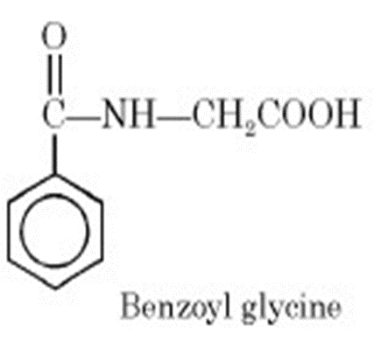
Synthesis of Benzoyl Glycine
Theory:
1- Glycine (i.e., α-aminoacetic acid) interacts with one mole of benzoyl chloride, in the presence of 10% (w/v) NaOH solution, to yield benzoyl glycine with the elimination of one mole of HCl. The excess of 10% NaOH solution serves two purposes, namely : first, to remove the un reacted benzoyl chloride
2-secondly, the HCl eliminated reacts with NaOH to yield NaCl. Both sodium benzoate and sodium chloride are water-soluble, whereas the desired product benzoyl glycine being insoluble may be separated easily.

Slide 8
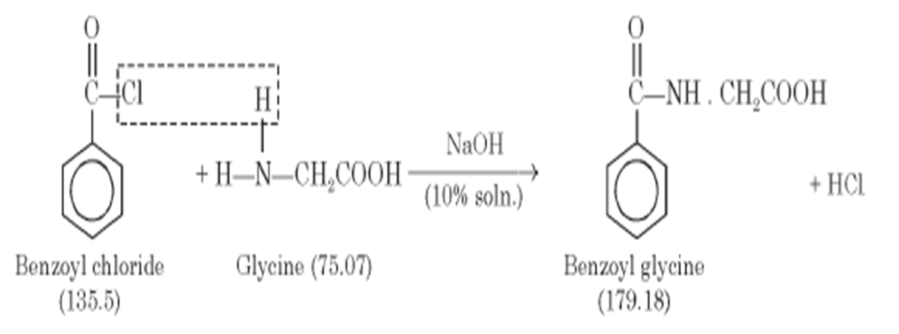
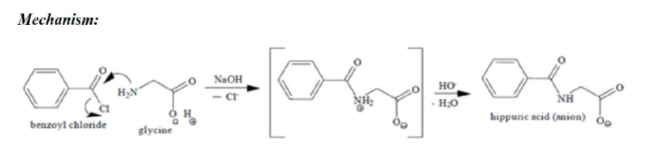
Equation:

Slide 9
Chemicals Required:
Glycine1g ; Sodium hydroxide solution 10% (w/v) : 10 ml ; Benzoyl chloride : (2 ml) ; Carbon tetrachloride : 4 ml ; Conc. Hydrochloric acid : 1-2ml
Procedure:
Dissolve 0.5 g (0.033 mol) of glycine in 5 ml of 10% NaOH solution contained in a conical flask.
2.Transfer (1 ml, 0.038 mol) of benzoyl chloride in approximately two equal lots to the above solution (1).
3.Stopper the flask securedly and shake the contents vigorously after each addition until all the benzoyl chloride has virtually reacted.
4. Pour the contents of the flask to a beaker and rinse the flask with a little water.

Slide 10
5. Add a few grams of crushed-ice into the solution and acidify the contents by adding concentrated hydrochloric acid (0.5-1 mL)drop wise and carefully with constant stirring until the mixture is acid to Congo red paper (pH 5.0 Red ; pH 3.0 Blue-Violet).
6. Collect the resulting crystalline precipitate of benzoyl glycine, which is contaminated with a small amount of benzoic acid, on a Büchner funnel, wash with cold water and drain well .
7. Transfer the solid into a beaker and add 2 ml of carbon tetrachloride, cover it with a clean water-glass, and boil it gently over an electric water-bath for 10 minutes (bp. CCl4 76.7°C). Thus, it will extract any benzoic acid which may have been produced during the course of reaction .

Slide 11
Precautions:
(1) The addition of benzoyl chloride to the alkaline mixture of glycine must be carried out slowly.
(2) Continuous shaking of the above mixture be done till the whole of benzoyl chloride has reacted.
(3) It is necessary to render the resulting mixture to acidic conditions with Congo Red paper.
Safety Precautions-
Wear a lab coat- Wear face mask as there might be toxic or irritating fumes around - Wear gloves chemicals might be corrosive as they cause harm to ourskin

Slide 12
Application
1-Hippuric Acid is an acyl glycine produced by the conjugation of benzoic acid and glycine, found as a normal component in urine as a metabolite of aromatic compounds from food. Increased urine hippuric acid content may have antibacterial effects.
2-Hippuric acid can be used to study cell biology, chemical biology, bioactivesmall molecules, amino acid derivatives, peptide synthesis, chemicalsynthesis and nutrition.
3-Hippuric acid has been used to inform the metabolism and urinary excretion of procyanidins
4-Uses in medicine, Para-amino-hippuric acid (PAH), a derivative of Hippuric Acid, is a compound useful in medical tests involving the kidney. Renal Clearance of PAH is thus useful in calculation of renal plasma flow (RPF), which empirically is (1-Hematocrit) times renal blood flow.

Slide 13
5-Conjugation with amino acids is an important route in the conjugation of drug and xenobiotic carboxylic acids for elimination. These amino acid conjugates are usually less toxic than their precursor acids and hence, are excreted readily into the urine and bile.

Slide 14
Questions
Q1/ What are the salts formed with benzoyleglycine and how we can getrid of it?
Q2/ Why we use sodium hydroxide in benzoyleglycine preparation?
Q3/ What are the salts formed with benzoyleglycine and how we can getrid of it?
Q4/ Why we use sodium hydroxide in benzoyleglycine preparation?

Slide 15
References
1- Wishart, David S.; Guo, An Chi; Oler, Eponine; Wang, Fel; Anjum, Afia; Peters, Harrison; Dizon, Raynard; Sayeeda, Zinat; Tian, Siyang; Lee, Brian L.; Berjanskii, Mark; Mah, Robert; Yamamoto, Mai; Jovel Castillo, Juan; Torres Calzada, Claudia; Hiebert Giesbrecht, Mickel; Lui, Vicki W.; Varshavi, Dorna; Varshavi, Dorsa; Allen, Dana; Arndt, David; Khetarpal, Nitya; Sivakumaran, Aadhavya; Harford, Karxena; Sanford, Selena; Yee, Kristen; Cao, Xuan; Budinsky, Zachary; Liigand, Jaanus; Zhang, Lun; Zheng, Jiamin; Mandal, Rupasri; Karu, Naama; Dambrova, Maija; Schiöth, Helgi B.; Gautam, Vasuk. "Showing metabocard for Hippuric acid (HMDB0000714)". Human Metabolome Database, HMDB. 5.0.
2-One or more of the preceding sentences incorporates text from a publication now in the public domain: Chisholm, Hugh, ed. (1911). "Hippuric Acid". Encyclopædia Britannica. Vol. 13 (11th ed.). Cambridge University Press. p. 523.
3-Pero, RW (2010). "Health consequences of catabolic synthesis of hippuric acid in humans". Current Clinical Pharmacology. 5 (1): 67–73. doi:10.2174/157488410790410588. PMID 19891605.
4- Ingersoll, A. W.; Babcock, S. H. (1932). "Hippuric acid". Organic Syntheses. 12: 40. doi:10.15227/orgsyn.012.0040; Collected Volumes, vol. 2, p. 328.
5- Wikoff WR, Anfora AT, Liu J, Schultz PG, Lesley SA, Peters EC, Siuzdak G (March 2009). "Metabolomics analysis reveals large effects of gut microflora on mammalian blood metabolites". Proc. Natl. Acad. Sci. U.S.A. 106 (10): 3698–3703. Bibcode:2009PNAS..106.3698W. doi:10.1073/pnas.0812874106. PMC 2656143. PMID 19234110.

Slide 16


