Slide 1

Chalcone

Slide 2
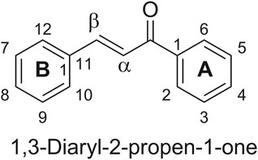
What is chalcone
Chalcone is an organic compound and the core structure for a class of natural compounds known as chalconoids. Chemically, chalcone is an α,β-unsaturated ketone, specifically a derivative of benzylideneacetophenone, and it has the formula 𝐶6𝐻5𝐶𝑂𝐶𝐻=𝐶𝐻𝐶6𝐻5​ . This structure consists of two aromatic rings connected by a three-carbon α,β-unsaturated carbonyl system. Chalcones can be synthesized through a base-catalyzed aldol condensation reaction between benzaldehyde and acetophenone.

Slide 3
Key Properties and Uses
Antioxidant and Anti-inflammatory: Chalcones are commonly found in various plants and are known for their antioxidant and anti-inflammatory properties. They are precursors in the biosynthesis of flavonoids and isoflavonoids, both of which are important compounds in plants for pigmentation, UV protection, and other functions.
Biological Activity: Many chalcone derivatives are researched for potential medicinal properties, including anti-cancer, anti-microbial, and anti-inflammatory effects. Their biological activities stem from the structure’s ability to interact with various biological targets.
Applications in Synthetic Chemistry: Chalcones are also important intermediates in synthetic organic chemistry, used to create various derivatives and complex structures for pharmaceutical and agricultural applications.

Slide 4
Methods preparation chalcone
Crossed Aldol Condensation.
Claisen-Schmidt Condensation.

Slide 5
Crossed Aldol Condensation
The condensation reaction between two different molecules of an aldehyde or ketone in a protic solvent such as water or alcohol constitutes the crossed aldol reaction. When condensation is between two different carbonyl compounds, it is called crossed aldol condensation. When both aldehydes have alpha hydrogens, both can form carbanions and can also act as carbanion acceptors. Hence a mixture of four products is formed which has little synthetic value.
If one of the aldehydes has no alpha hydrogen then it can act only as a carbanion acceptor. In such a case, only two products are formed. A common substrate for the crossed aldol reaction is an aromatic aldehyde, which has no alpha position. Furthermore, dehydration of the initial condensation product is rapid which leads to the formation of the α, β – unsaturated ketone and prevents the retro-aldol reaction from taking place.

Slide 6
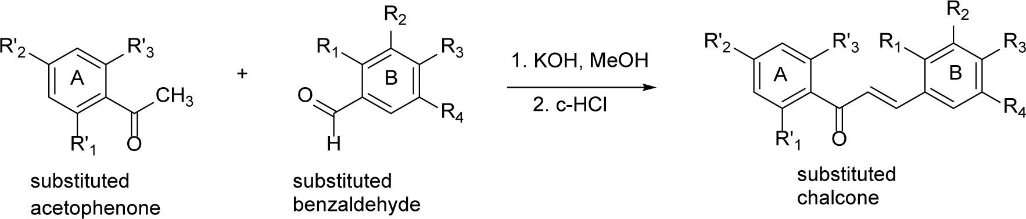

Slide 7
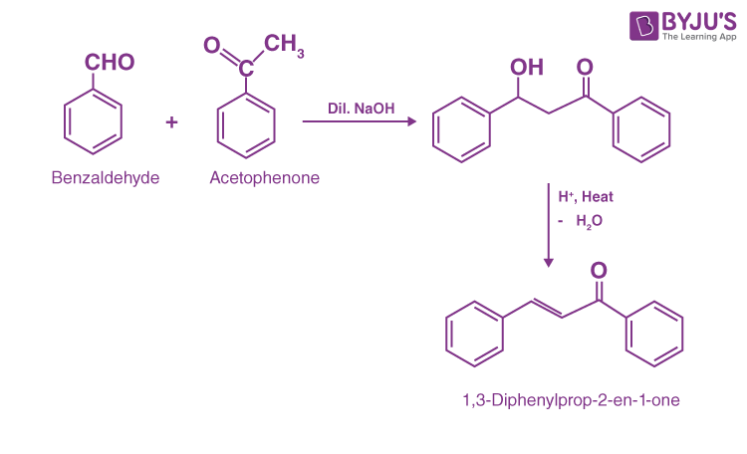
Example of Cross Aldol Condensation:
Reaction between Benzaldehyde and Acetophenone:
The reaction between benzaldehyde and acetophenone undergo cross aldol condensation in presence of dil. NaOH. In this reaction benzaldehyde have no alpha hydrogen but acetophenone have alpha hydrogen so its undergo aldol condensation form β-hydroxy ketone. Furthermore, dehydration leads to the formation of the α, β – unsaturated ketone. (benzalacetophenone)

Slide 8
Claisen-Schmidt Condensation
The Claisen-Schmidt condensation is a type of chemical reaction used to form α, β-unsaturated ketones or aldehydes. It’s often used to make compounds with a double bond, especially in pharmaceuticals. This reaction is a specific kind of Aldol reaction, where an aldehyde reacts with a ketone in the presence of a strong base.
Reaction Conditions
Substrates: Usually involves a non-enolizable aldehyde (like benzaldehyde) and an enolizable ketone (like acetone).
Base: Commonly uses a strong base like NaOH or KOH.
Temperature: Heating helps to remove water and complete the reaction

Slide 9
steps reaction claisen-schmidt condensation mechanism
Step 1: Base-Catalyzed Enolate Formation
Deprotonation of the Ketone
A base (e.g., hydroxide, 𝑂𝐻−) abstracts a proton (𝐻+) from the α-carbon of the ketone, forming a resonance-stabilized enolate ion.
2. Resonance Stabilization.
The negative charge on the α-carbon delocalizes to the carbonyl.
Step 2: Nucleophilic Attack.
Enolate Attacks the Aldehyde.
he nucleophilic enolate carbon attacks the electrophilic carbonyl carbon of the aldehyde, forming a β-hydroxyketone intermediate (aldol product).
Step 3: Protonation.
Stabilization of the Intermediate.
The alkoxide ion formed in the previous step is protonated by water, resulting in the β-hydroxyketone.
Step 4: Dehydration.
Base-Catalyzed Elimination of Water.
The β-hydroxyketone undergoes elimination of water under base-catalyzed conditions, leading to the formation of the α,β-unsaturated carbonyl compound (chalcone or related structure).
This step involves the abstraction of a proton from the β-carbon by the base and the loss of OH − from the α-carbon.

Slide 10
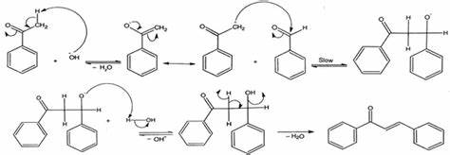

Slide 11
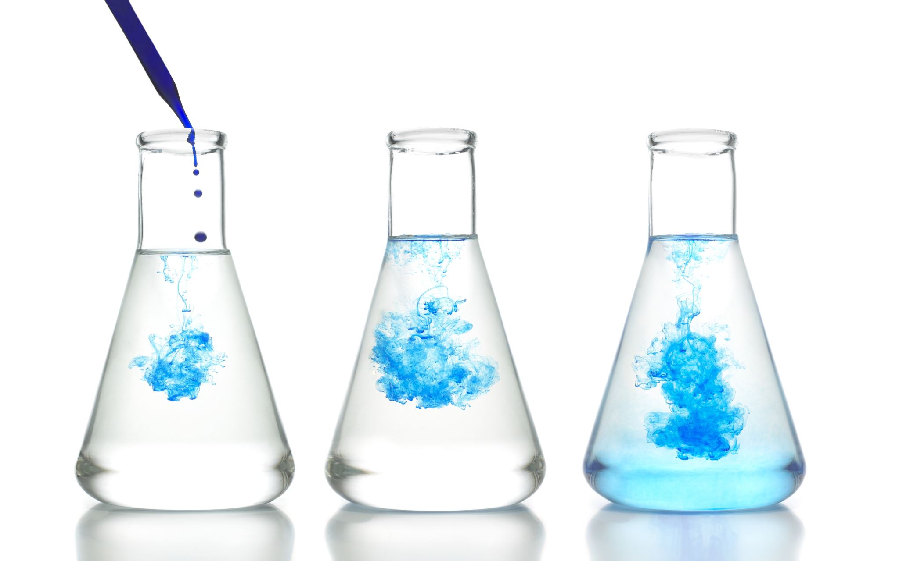
proceduer
Add 1mL of acetophenone and 1 mL of benzaldehyde into a 50 mL round-bottom flask.
Add 3 mL of ethanol to the flask as the reaction solvent. Mix the contents by swirling gently.
Add 1 ml sodium hydroxide solution(20%) dropwise to the reaction mixture while stirring continuously using a magnetic stirrer or glass rod.
Observe the formation of a yellow emulsion, which serves as a visual indication of enolate formation and the start of the reaction.
Allow the reaction mixture to stand at room temperature (25°C) for 60–90 minutes without heating.
Place the reaction flask in an ice bath for 15–20 minutes to promote complete precipitation of the product.
Filter the precipitate and wash it with a small amount of cold water to remove residual sodium hydroxide and any formed salts.
The recrystallization process is performed using ethanol heated to its boiling point to dissolve the impurities and obtain pure crystals upon cooling.

Slide 12
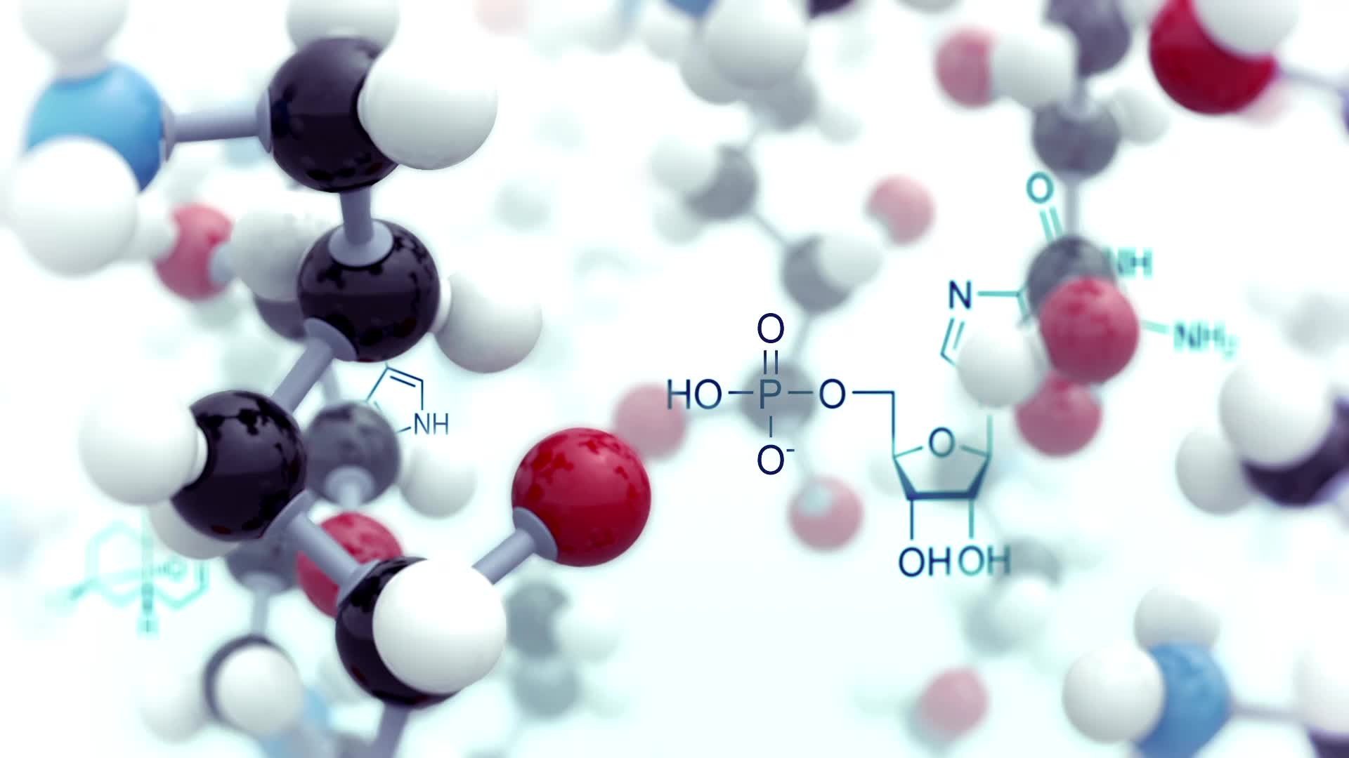
Physical Properties of Benzalacetophenone (Chalcone)
Molecular Formula: C 15​ H 12​ O .
Molecular Weight: 208.26 g/mol .
Appearance: Yellow crystalline solid.
Melting Point: 55–57°C for pure benzalacetophenone (may vary slightly depending on purity).
Solubility:
Soluble in Organic solvents like ethanol, acetone, chloroform, and benzene.
Insoluble in water.
UV-Vis Absorption:
Conjugated system allows for strong absorption in the UV range.

Slide 13
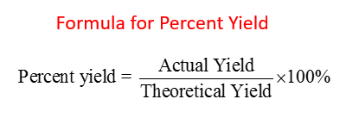
calculations

