Slide 1
Physicochemical properties
4. Mechanism of Drug Action
M.Sc. Students
Assist . Prof . karima F. Ali
Mustansiriyah University
College of Pharmacy
2023-2024

Slide 2
The three phases of drug action
There are three phases involved in drug action.
The first of these is the pharmaceutical phase .
For an orally administered drug, this includes the disintegration of a pill or capsule in the gastrointestinal tract (GIT), the release of the drug, and its dissolution.
The pharmaceutical phase is followed by the pharmacokinetic phase , which includes absorption from the GIT into the blood
supply, and the various factors that affect a drug’s survival
and progress as it travels to its molecular target.
The final pharmacodynamic phase involves the mechanism by
which a drug interacts with its molecular target and the resulting pharmacological effect.

Slide 3
Drug absorption
In order to be absorbed efficiently from the GIT, a drug
must have the correct balance of water versus fat solubility.
If the drug is too polar (hydrophilic), it will fail to pass through the fatty cell membranes of the gut wall .
If the drug is too fatty (hydrophobic), it will be poorly soluble in the gut and will dissolve in fat globules. This means that there will be poor surface contact with the gut wall, resulting in poor absorption.
It is noticeable how many drugs contain an amine functional group. Amines are weak bases and it is found that many of the most effective drugs contain amine groups having a pKa value in the range 6–8, they are partially ionized at the slightly acidic and alkaline pHs

Slide 4

present in the intestine and blood, respectively, and can easily equilibrate between their ionized and non-ionized forms
This allows them to cross cell membranes in the non-ionized form, while the presence of the ionized form gives the drug good water solubility and permits good binding interactions with its target binding site. The extent of ionization at a particular pH can be determined by the Henderson– Hasselbalch equation :
where [RNH2 ] is the concentration of the free base and [RNH3 + ] is the concentration of the ionized amine. Ka is the equilibrium constant for the equilibrium

Slide 5
when the amine is 50% ionized, pH = pKa . Therefore, drugs with a pKa of 6–8 are approximately 50% ionized at blood pH (7.4) or the slightly acidic pH of the intestines.
The hydrophilic/hydrophobic character of the drug is the crucial factor affecting absorption through the gut wall. Orally absorbed drugs tend to obey what is known as Lipinski’s rule of five .

Slide 6
Lipinski’s rule of five
• A molecular weight less than 500
• No more than 5 hydrogen bond donor (HBD) groups
• No more than 10 hydrogen bond acceptor groups
• A calculated log P value less than +5 (log P is a measure of a drug’s hydrophobicity.
The rule of five has been an extremely useful rule of thumb for many years, but it is neither quantitative nor foolproof.
For example, orally active drugs, such as atorvastatin
, rosuvastatin , ciclosporin , and vinorelbine , do not obey the rule of five. A high molecular weight does not in itself cause poor oral bioavailability.
One of the reasons that the molecular weight appears to be important is that larger molecules invariably have too many functional groups capable of forming hydrogen bonds.

Slide 7
Work carried out by Veber et al . (2002) demonstrated the
rather surprising finding that molecular flexibility plays an important role in oral bioavailability; the more flexible the molecule, the less likely it is to be orally active.
In order to measure flexibility, one can count the number of freely rotatable bonds that result in significantly different conformations. Bonds to simple substituents, such as methyl or alcohol groups, are not included in this analysis as their rotation does not result in significantly different conformations.
Veber’s studies also demonstrated that the polar surface area of the molecule could be used as a factor instead of the number of hydrogen bonding groups.
Structures that have a molecular weight of larger than 500 are quite likely to have more than 10 rotatable bonds.
The new rules suggest that rigidifying the structures to reduce the number of rotatable bonds would be beneficial.

Slide 8
Polar drugs with high molecular weight can cross the cells of the gut wall without actually passing through the membrane. This involves a process known as pinocytosis , where the drug is engulfed by the cell membrane and a membrane-bound vesicle is pinched off to carry the drug across the cell.
Some highly polar drugs are absorbed from the digestive system as they are able to ‘hijack’ transport proteins present in the membranes of cells lining the gut wall
Other highly polar drugs can be absorbed into the blood supply if they have a low molecular weight (less than 200), as they can then pass through small pores between the cells lining the gut wall.

Slide 9
Sometimes, drugs are deliberately designed to be highly polar so that they are not absorbed from the GIT.
These are usually antibacterial agents targeted against gut
infections. Making them highly polar ensures that the drug reaches the site of infection in higher concentration.
Polar drugs that break the above rules are usually poorly absorbed and have to be administered by injection.
It should be noted that the absorption of some drugs can be affected adversely by interactions with food or other drugs in the gut .
Other drug administration routes may involve an absorption process.
Lipophilicity and dissociation / ionization are responsible for transport and distribution of drugs in biological systems.
The geometric fit and the complementarity of the surface 3D properties of a ligand are responsible for its affinity to a binding site.
.

Slide 10
Key points:
Orally taken drugs have to be chemically stable to survive the acidic conditions of the stomach, and metabolically stable to survive digestive and metabolic enzymes.
Orally taken drugs must be sufficiently polar to dissolve
in the GIT and blood supply, but sufficiently fatty to pass
through cell membranes.
Most orally taken drugs obey Lipinski’s rule of five and have no more than seven rotatable bonds.
Highly polar drugs can be orally active if they are small
enough to pass between the cells of the gut wall, are recognized by carrier proteins, or are taken across the gut wall by pinocytosis.

Slide 11
Quantitative Structure Activity Relationships
Various strategies that can be used in the design of drugs. Several of these strategies involved a change in shape such that the new drug had a better ‘fit’ for its target binding site.
Other strategies involved a change in functional groups or substituents such that the drug’s pharmacokinetics or binding
site interactions were improved.
These latter strategies often involved the synthesis of analogues containing a range of substituents on aromatic or heteroaromatic rings or accessible functional groups.
The number of possible analogues that could be made is infinite if we were to try and synthesize analogues with every substituent and combination of substituents possible.

Slide 12
Therefore, it is clearly advantageous if a rational approach can be followed in deciding which substituents to use.
The quantitative structure–activity relationship (QSAR) approach has proved extremely useful in tackling this problem.
The QSAR approach attempts to identify and quantify
the physicochemical properties of a drug and to see whether any of these properties has an effect on the drug's biological activity. If such a relationship holds true, an equation can be drawn up which quantifies the relationship and allows the medicinal chemist to say with some confidence that the property (or properties) has an important role in the pharmacokinetics or mechanism of action of the drug. It also allows the medicinal chemist some level of prediction.

Slide 13
By quantifying physicochemical properties, it should be possible to calculate in advance what the biological activity of a novel analogue might be.
There are two advantages to this.
Firstly, it allows the medicinal chemist to target efforts on analogues which should have improved activity and, thus, cut down the number of analogues that have to be made.
Secondly, if an analogue is discovered which does not fit the equation, it implies that some other feature is important and provides a lead for further development.

Slide 14
QSAR approach attempts to identify and quantify the physicochemical properties of a drug and to see whether any of these properties has an effect on the drug’s biological activity by using a mathematical equation
Graphs and equations:
In the simplest situation, a range of compounds is synthesized
in order to vary one physicochemical property (e.g. log P ) and to test how this affects the biological activity (log 1/ C ) (we will come to the meaning of log 1/ C and log P in due course).
A graph is then drawn to plot the biological activity on the y axis versus the physicochemical feature on the x axis.
It is necessary to draw the best possible line through the data points on the graph. This done by procedure known as linear regression analysis by the least square method. If we draw a line through a set of data points will be scattered on either side of the line. The best line will be the one closest to the data points.
To measure how close the data points are , vertical lines are drawn from each point.

Slide 15
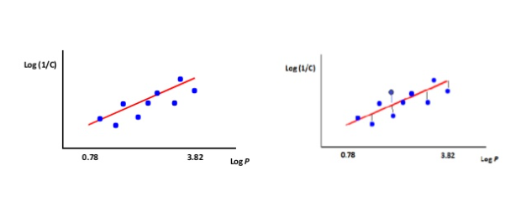
Biological activity versus log P .

Slide 16
Physicochemical properties
• Hydrophobicity of the molecule
• Hydrophobicity of substituents
• Electronic properties of substituents
• Steric properties of substituents
Hydrophobicity
The hydrophobic character of a drug is crucial to how easily it crosses cell membranes and may also be important in receptor interactions. Changing substituents on a drug may well have significant effects on its hydrophobic character and, hence, its biological activity. Therefore, it is important to have a means of predicting this quantitatively.

Slide 17

The partition coefficient ( p )
The hydrophobic character of a drug can be measured
experimentally by testing the drug’s relative distribution in an n -octanol/water mixture. Hydrophobic molecules will prefer to dissolve in the n -octanol layer of this two phase system, whereas hydrophilic molecules will prefer the aqueous layer. The relative distribution is known as the partition coefficient ( P ) and is obtained from the following equation:

Slide 18
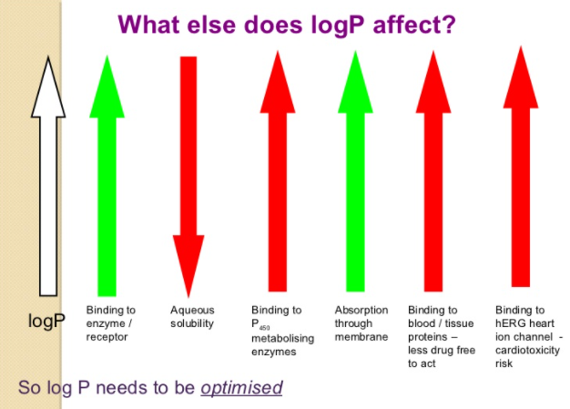

Slide 19
Hydrophobic compounds have a high P value, whereas
hydrophilic compounds have a low P value.
Varying substituents on the lead compound will produce a series of analogues having different hydrophobicities and, therefore, different P values.
By plotting these P values against the biological activity of these drugs, it is possible to see if there is any relationship between the two properties.
The biological activity is normally expressed as 1/ C , where C is the concentration of drug required to achieve a defined level of biological activity. The reciprocal of the concentration (1/ C ) is used, as more active drugs will achieve a defined biological activity at lower concentration

Slide 20
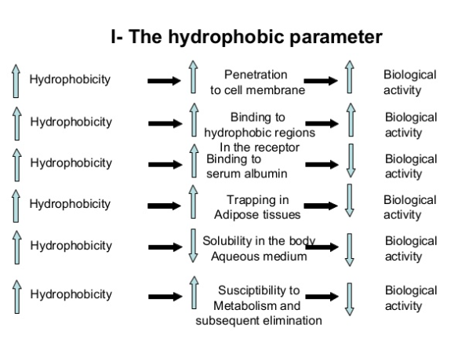

Slide 21
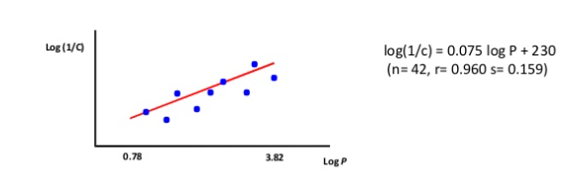
Linear relationship between Log p and Log 1/C
Activity of drugs is often related to P
Biological activity log(1/c) = -K1 log P + K2
Eg: binding of a drug to serum albumin determined by hydrophobicity and study of 42 compounds.
(straight line - limited range of log P)

Slide 22
Knowing how strongly a drug binds to serum albumin can be important in estimating effective dose levels for that drug.
When bound to serum albumin, the drug cannot bind to its receptor and so the dose levels for the drug should be based on the amount of unbound drug present in the circulation.
The equation above allows us to calculate how strongly drugs of similar structure will bind to serum albumin and gives an indication of how ‘available’ they will be for receptor interactions.
It is generally found that increasing the hydrophobicity of a lead compound results in an increase in biological activity.
This reflects the fact that drugs have to cross hydrophobic barriers, such as cell membranes, in order to reach their target. If these studies were to be extended to include compounds with very high log P values, then we would see a different picture. The graph would be parabolic, Here, the biological activity increases as log P increases until a maximum value is obtained. The value of log P at the maximum (log P 0 ) represents the optimum partition coeffi cient for biological activity

Slide 23

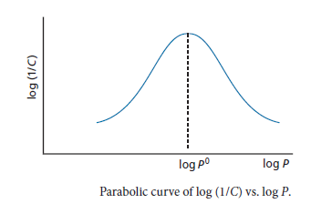
Non –linear relationship between Log P and Log 1/C
If the partition coefficient is the only factor influencing biological activity, the parabolic curve can expressed by the equation:
Optimum value of log P for anaesthetic activity = log Po
Few drugs where activity is related to log P factor alone. QSAR equations are only applicable to compounds in the same structural class (e.g. ethers). However, log Po is similar for anaesthetics of different structural classes

Slide 24
There are relatively few drugs where activity is related to the log P factor alone. Such drugs tend to operate in cell membranes where hydrophobicity is the dominant feature controlling their action. The best example of drugs which operate in cell membranes are the general anaesthetics. Although they also bind to GABA A receptors, general anaesthetics are thought to function by entering the central nervous system (CNS) and ‘dissolving’ into cell membranes where they affect membrane
structure and nerve function, there are no specific drug–receptor interactions and the mechanism of the drug is controlled purely by its ability to enter cell membranes (i.e. its hydrophobic character).
The general anaesthetic activity of a range of ethers was
found to fit the following parabolic equation:

Slide 25
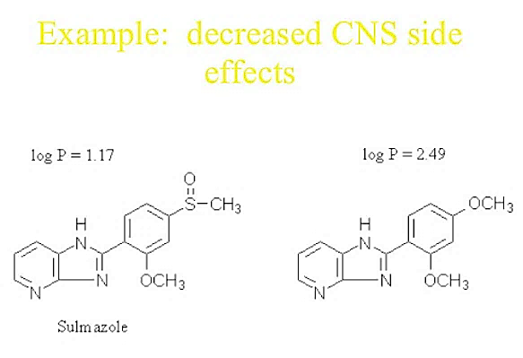
An increase in log P results in a decrease in biological activity.
As a rule of thumb, drugs which are to be targeted for the CNS should have a log P value of approximately 2.
Conversely, drugs which are designed to act elsewhere in
the body should have log P values significantly different from 2 in order to avoid possible CNS side effects (e.g. drowsiness)

Slide 26

The substituent hydrophobicity constant (π)
Partition coefficients can be calculated by knowing the contribution that various substituents make to hydrophobicity.
This contribution is known as the substituent hydrophobicity constant (π) and is a measure of how hydrophobic a substituent is relative to hydrogen.
The value can be obtained as follows. Partition coefficients are measured experimentally for a standard compound, such as benzene, with and without a substituent (X). The hydrophobicity constant (π X ) for the substituent (X) is
then obtained using the following equation:

Slide 27
where PH is the partition coefficient for the standard compound and P X is the partition coefficient for the standard compound with the substituent.
A positive value of π indicates that the substituent is more hydrophobic than hydrogen
A negative value indicates that the substituent is less hydrophobic.
As an example, consider the log P values for benzene (log P = 2.13), chlorobenzene (log P = 2.84), and benzamide (log P = 0.64) .
Benzene is the parent compound, and the substituent constants for Cl and CONH2 are 0.71 and −1.49 respectively.
Having obtained these values, it is now possible to calculate the theoretical log P value for meta -chlorobenzamide

Slide 28

A QSAR equation may include both P and π.
• P measures the importance of a molecule’s overall hydrophobicity (relevant to absorption, binding etc)
• π identifies specific regions of the molecule which might interact with hydrophobic regions in the binding site

Slide 29
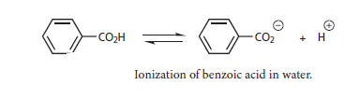
Electronic effects
The electronic effects of various substituents will clearly have an effect on a drug's ionization or polarity. This, in turn, may have an effect on how easily a drug can pass through cell membranes or how strongly it can interact with a binding site.
It is, therefore, useful to measure the electronic effect of a substituent. As far as substituents on an aromatic ring are concerned, the measure used is known as the Hammett substituent constant (σ).

Slide 30

This is a measure of the electron withdrawing or electron-donating ability of a substituent, and has been determined by measuring the dissociation of a series of substituted benzoic acids compared with the dissociation of benzoic acid itself.
Benzoic acid is a weak acid and only partially ionizes in water. An equilibrium is set up between the ionized and non-ionized forms, where the relative proportion of these species is known as the equilibrium or dissociation constant KH (the subscript H signifies that there are no substituents on the aromatic ring).

Slide 31
Benzoic acids containing electron-withdrawing substituents will have larger K X values than benzoic acid itself (KH ) and, therefore, the value of σX for an electron withdrawing substituent will be positive.
Substituents such as Cl, CN, or CF3 have positive σ values.
Benzoic acids containing electron-donating substituents
will have smaller KX values than benzoic acid itself and, hence, the value of σX for an electron-donating substituent will be negative.
Substituents such as Me, Et, and t -Bu have negative values of σ.
The Hammett substituent constant for H is zero.

Slide 32
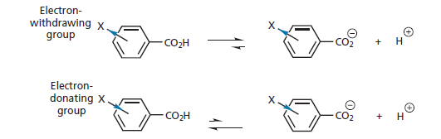
Position of equilibrium dependent on substituent group X.
The Hammett substituent constant takes into account both resonance and inductive effects. Therefore, the value of σ for a particular substituent will depend on whether the substituent is meta or para . This is indicated by the subscript m or p after the σ symbol.

Slide 33
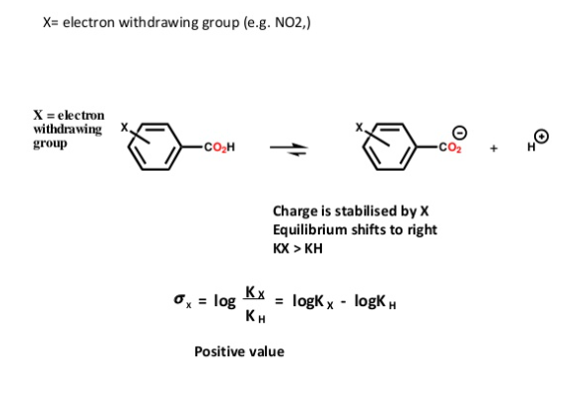

Slide 34
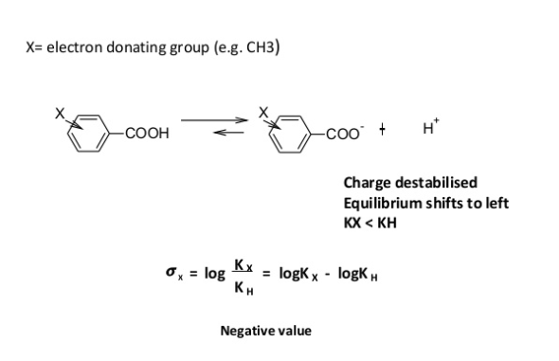

Slide 35
For example, the nitro substituent has σ p = 0.78 and σ m = 0.71.
In the meta position, the electron-withdrawing power is due to the inductive influence of the substituent, whereas at the para position inductive and resonance both play a part and so the σ p value is greater
Hammett substituent constants cannot be measured for ortho substituents as such substituents have an important steric, as well as electronic, effect. Tables of constants are available which quantify a substituent's inductive effect ( F ) and its resonance effect ( R ). The constants σ, R , and F can only be used for aromatic substituents and are, therefore, only suitable for drugs containing aromatic rings.

Slide 36
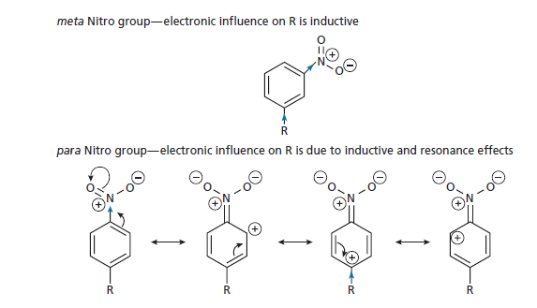
Substituent effects of a nitro group at the meta and para positions

Slide 37
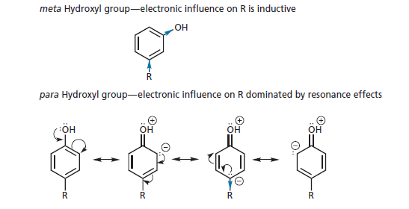
Substituent effects of a phenol at the meta and para positions.

Slide 38
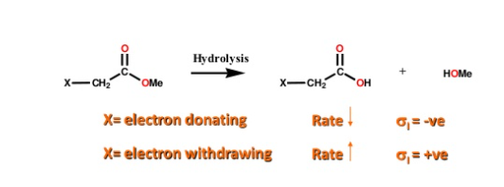
Aliphatic electronic substituents:
•Defined by σ1.
• Obtained experimentally by measuring the rates of hydrolyses of aliphatic esters
• Purely inductive effects
• Hydrolysis rates measured under basic and acidic conditions
Basic conditions: Rate affected by steric + electronic factors
Gives σ1 after correction for steric effect
Acidic conditions: Rate affected by steric factors only

Slide 39
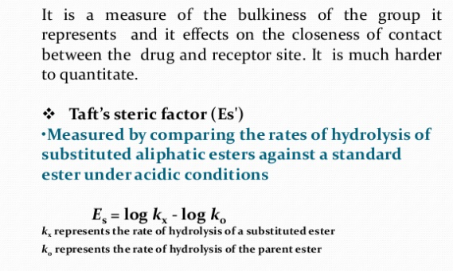
Steric factors

Slide 40
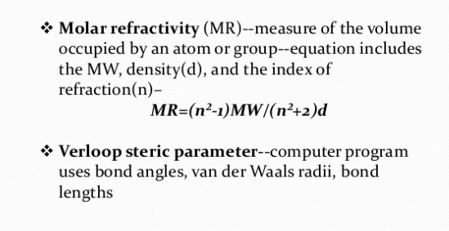

Slide 41
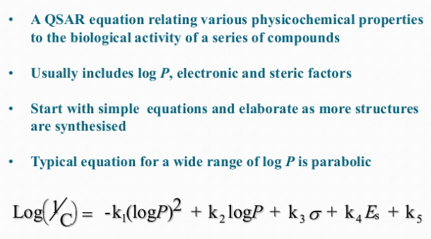
Hansch equation

Slide 42
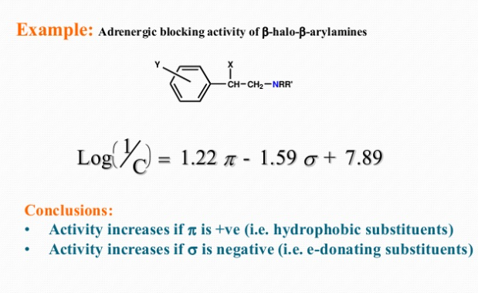

Slide 43
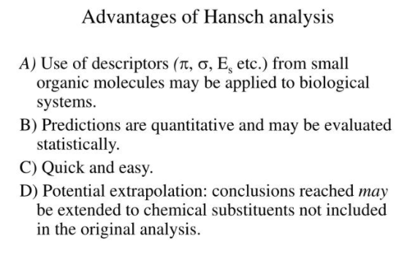

Slide 44
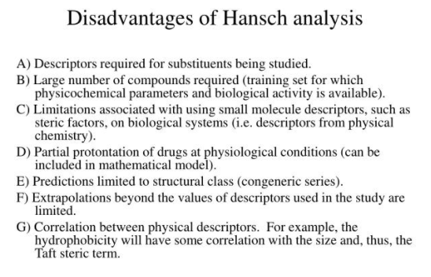

Slide 45


