Slide 1
Schiff Base
MSC. MOHAMMED AL-DAHLAKI

Slide 2
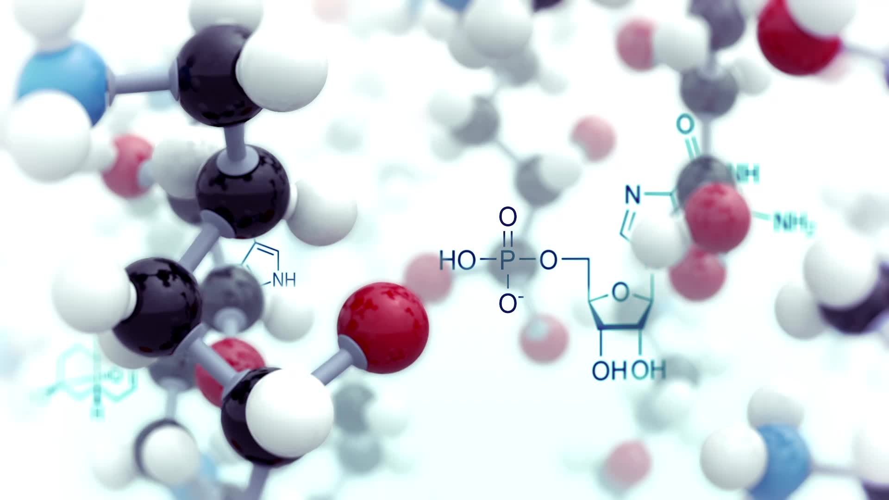
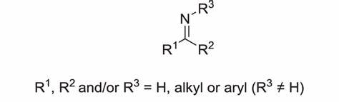
Introduction to Schiff Base
Schiff Bases, also known as azomethine compounds, are organic compounds containing a carbon-nitrogen double bond (-C=N-) known as the imine group. They are formed through a condensation reaction between a primary amine (R-NH2) and either an aldehyde or a ketone, with the elimination of water as a byproduct. Depending on the starting materials, Schiff Bases can be classified into two main types:
Aldimine: Formed when an aldehyde reacts with a primary amine, resulting in a structure where the imine (-C=N-) group is bonded to a hydrogen atom.
Ketoimine: Formed when a ketone reacts with a primary amine, resulting in a structure where the imine group is bonded to two alkyl or aryl groups.
The -C=N- bond, also called the azomethine functional group, is the defining feature of Schiff Bases.

Slide 3
Applications of Schiff Bases in Pharmacy and Other Fields.
Industrial Applications.
Dye and Pigment Synthesis: Used in creating vibrant and stable dyes.
Corrosion Inhibitors: Protect metals in industrial environments.
Polymer Development: Enhance thermal and mechanical properties of materials.
Catalysis and Chemical Synthesis.
Catalysts in Organic Reactions: Facilitate reactions like oxidation and reduction.
Ligands in Metal Complexes: Stabilize metal ions for use in chemical processes.

Slide 4

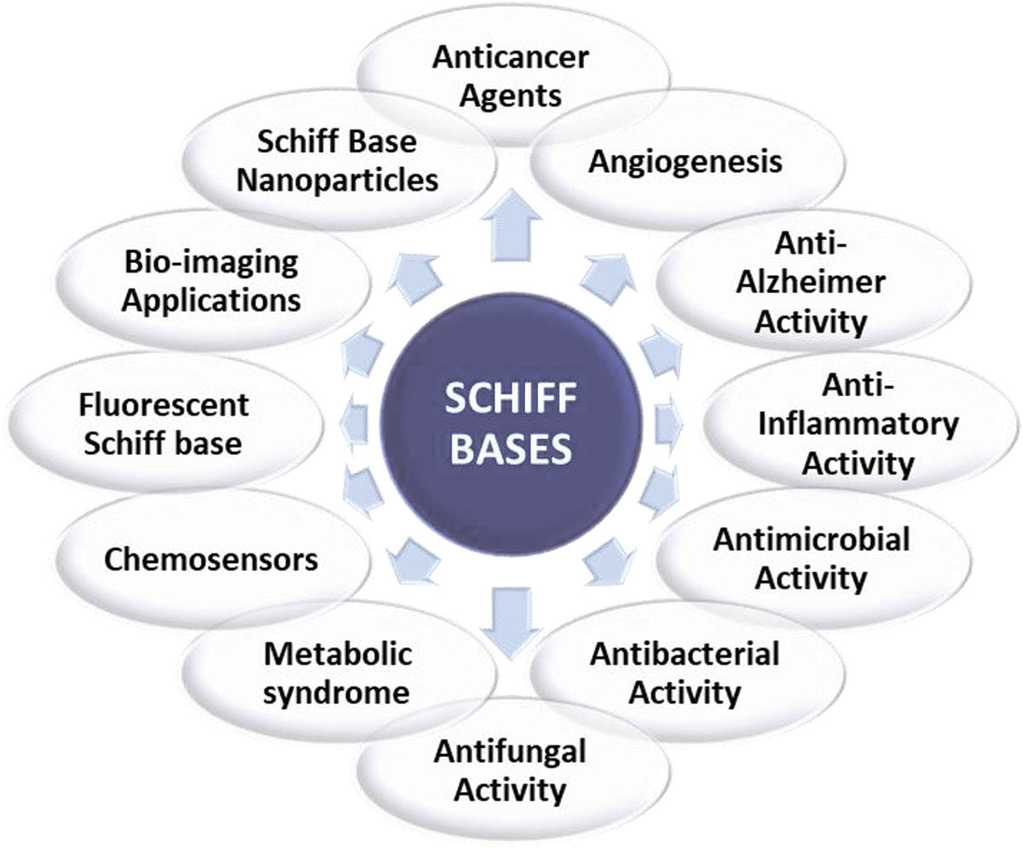
Pharmaceutical and Biological Applications

Slide 5

Reasons for Limited Use of Ketones in Schiff Base Preparation.
Lower Reactivity: Ketones are less reactive with amines compared to aldehydes.
Steric Hindrance: Alkyl or aryl groups around ketones hinder the reaction.
Reduced Product Stability: Schiff Bases from ketones are less stable.
Preference for Aldehydes: Aldehydes are more reactive and yield stable, clear products.
Limited Applications: Schiff Bases from ketones are less commonly used in pharmaceutical and industrial fields.

Slide 6
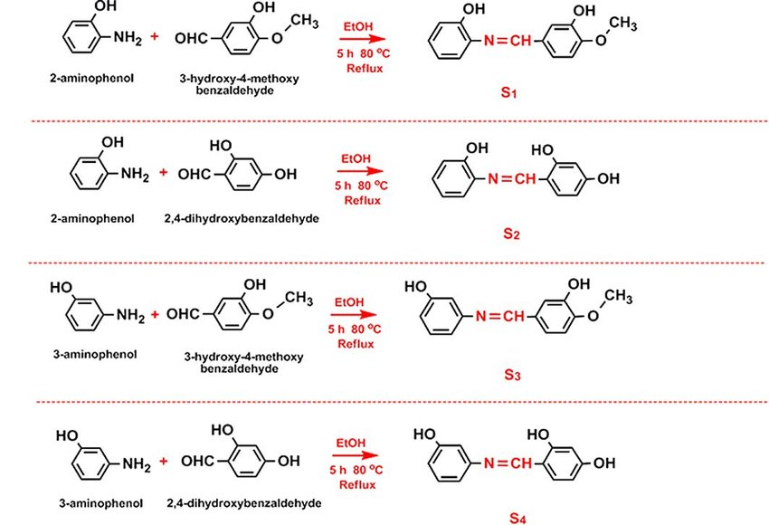
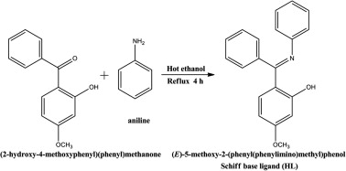
Some examples of preparation schiff base

Slide 7
Steps of the Reaction Mechanism.
Protonation of the Carbonyl Group:
The carbonyl oxygen (C=O) is protonated by an acid, increasing the electrophilicity of the carbonyl carbon.
2. Nucleophilic Attack by Amine:
The nucleophilic nitrogen atom of the amine (R-NH2) attacks the electrophilic carbon of the protonated carbonyl group, forming a tetrahedral intermediate.
3. Proton Transfer:
A proton transfer occurs, leading to the formation of a hydroxyl group (-OH) on the carbon and an NH2 group attached to the same carbon.
4. Elimination of Water:
The hydroxyl group (-OH) is protonated, making it a good leaving group, which is then eliminated as water (H2O).
5. Formation of the Imine (Schiff Base):
The intermediate undergoes deprotonation to form a stable imine (C=N), completing the formation of the Schiff base.

Slide 8
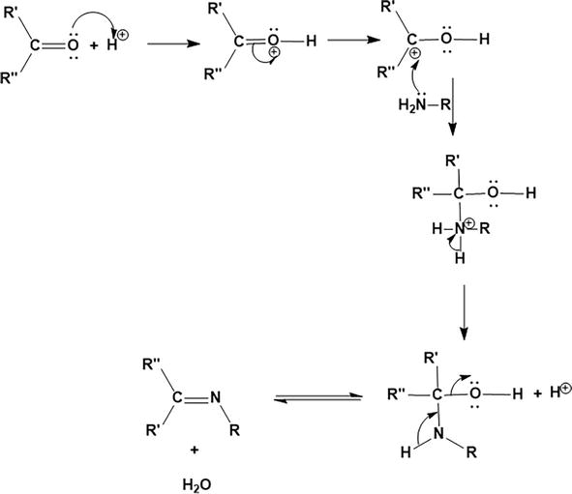

Slide 9
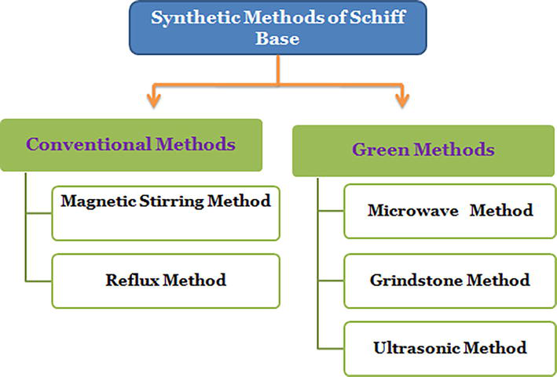

Slide 10
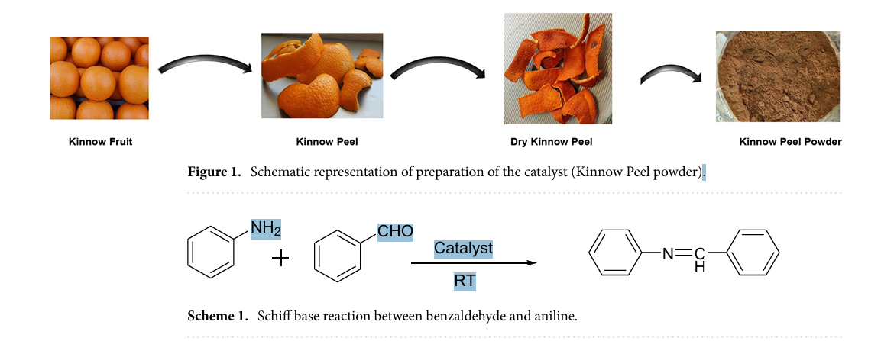
Schiff base reaction using Kinnow peel powder as Green catalyst.
Preparation of the catalyst. Kinnow peel wastes are washed with di-ionized water to remove dirt particles and cleaned well. The peel is dried in an oven for 24 h at 70 ºC to remove moisture content. The dried peel waste is converted into powder form and then the powder is stored for further experiment (Fig. 1).
Preparation of Schiff base and their derivatives. 10 mg of Kinnow peel powder is added in reaction mixture of 1 mmol of Benzaldehyde and 1 mmol of Aniline in a test tube and allowed to stir it for 3 min on the magnetic stirrer at room temperature. The performance of the reaction is checked by the TLC plates with mobile phase [9:1 ratio of hexane and ethyl acetate] and after the completion of catalytic reaction the desired product is recrystallized by ethanol. Similar method is used for Schiff base reaction between derivatives of aniline and
benzaldehyde.

Slide 11
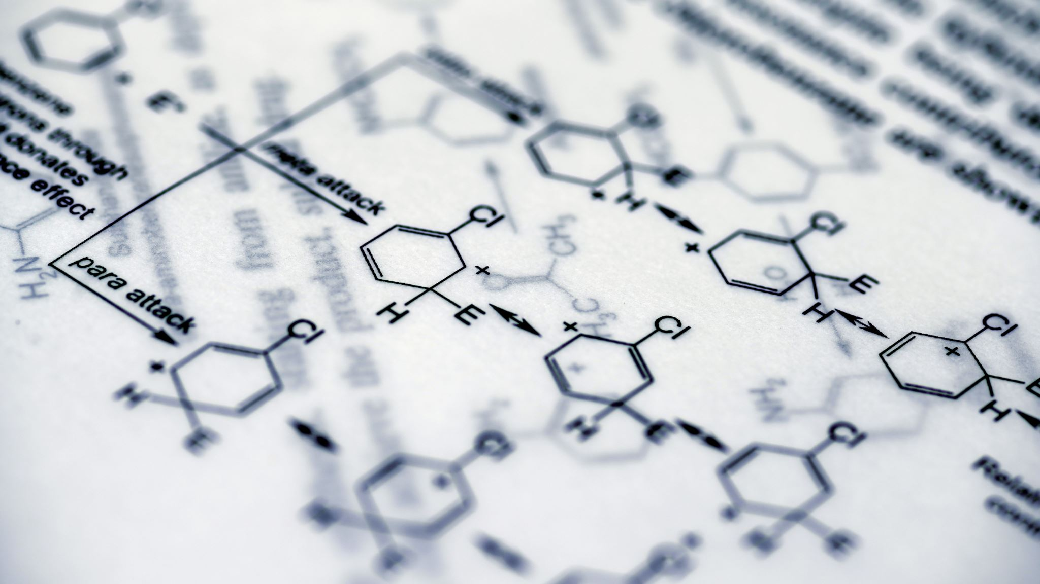
procedure
Add 1 mL (1.044 g, density = 1.044 g/mL) of benzaldehyde to a round-bottom flask, and then add 3-5 drops of glacial acetic acid.
Add 2.37 g of ethanol (3 mL, density = 0.79 g/mL) to the reaction flask containing the mixture, followed by 1.03 g of aniline (1 mL, density = 1.03 g/mL).
The mixture is heated for 30 minutes at a temperature of 40-50°C.
The solution is placed in an ice bath for 10-15 minutes until a light white precipitate forms.
The formed precipitate is filtered and washed with cold absolute ethanol to remove impurities, then recrystallized using absolute ethanol.
The melting point ranges between (51.2-52)°C.

Slide 12
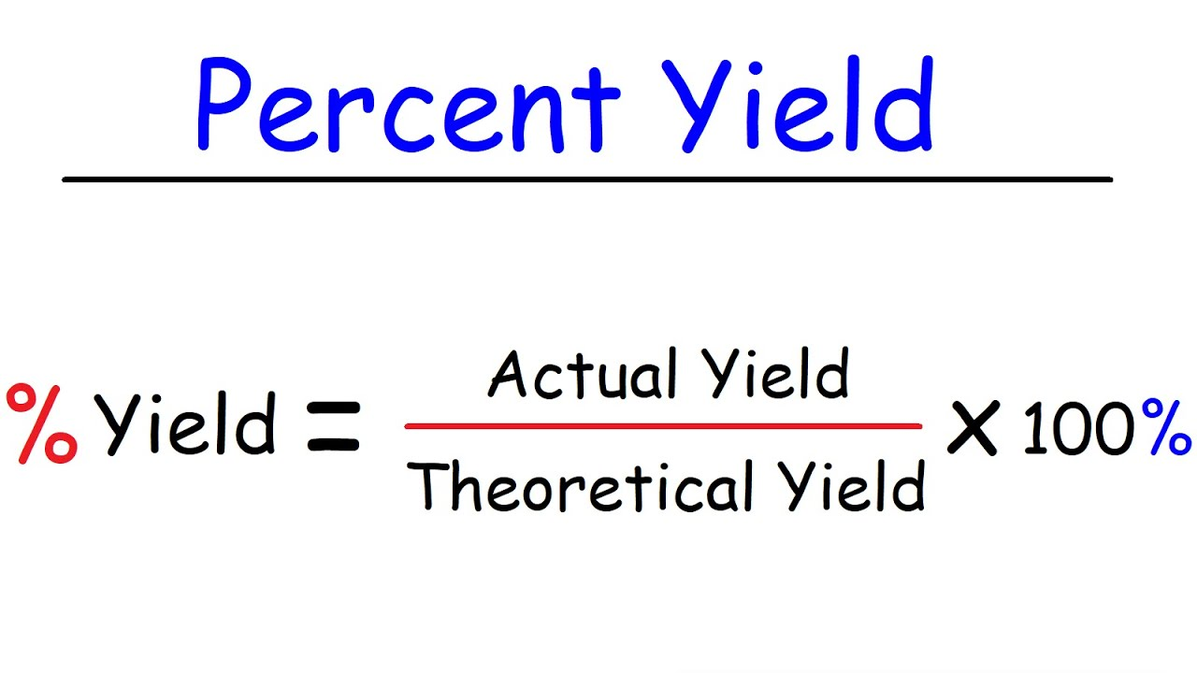
calculations
Molecular Weight: 181.24

