Slide 1
Principles of pharmacy practice
Lec 1
Lecturer Dr Athmar Dhahir Habeeb Al-Shohani
PhD in industrial pharmacy and pharmaceutical formulations
athmar1978@uomustansiriyah.edu.iq
athmar1978@yahoo.com
athmar.habeeb.12@ucl.ac.uk

Slide 2
Reducing and enlarging formulas
Pharmacists may have to reduce or enlarge formulas for pharmaceutical preparations in the course of their professional practice or manufacturing activities.
Official (United States Pharmacopeia—National Formulary) formulas generally are based on the preparation of 1000 mL or 1000 g.
Other formulas, as those found in the literature, may be based on the preparation of a dosage unit (e.g., 5 mL, 1 capsule) or another quantity (e.g., 100 mL).

Slide 3
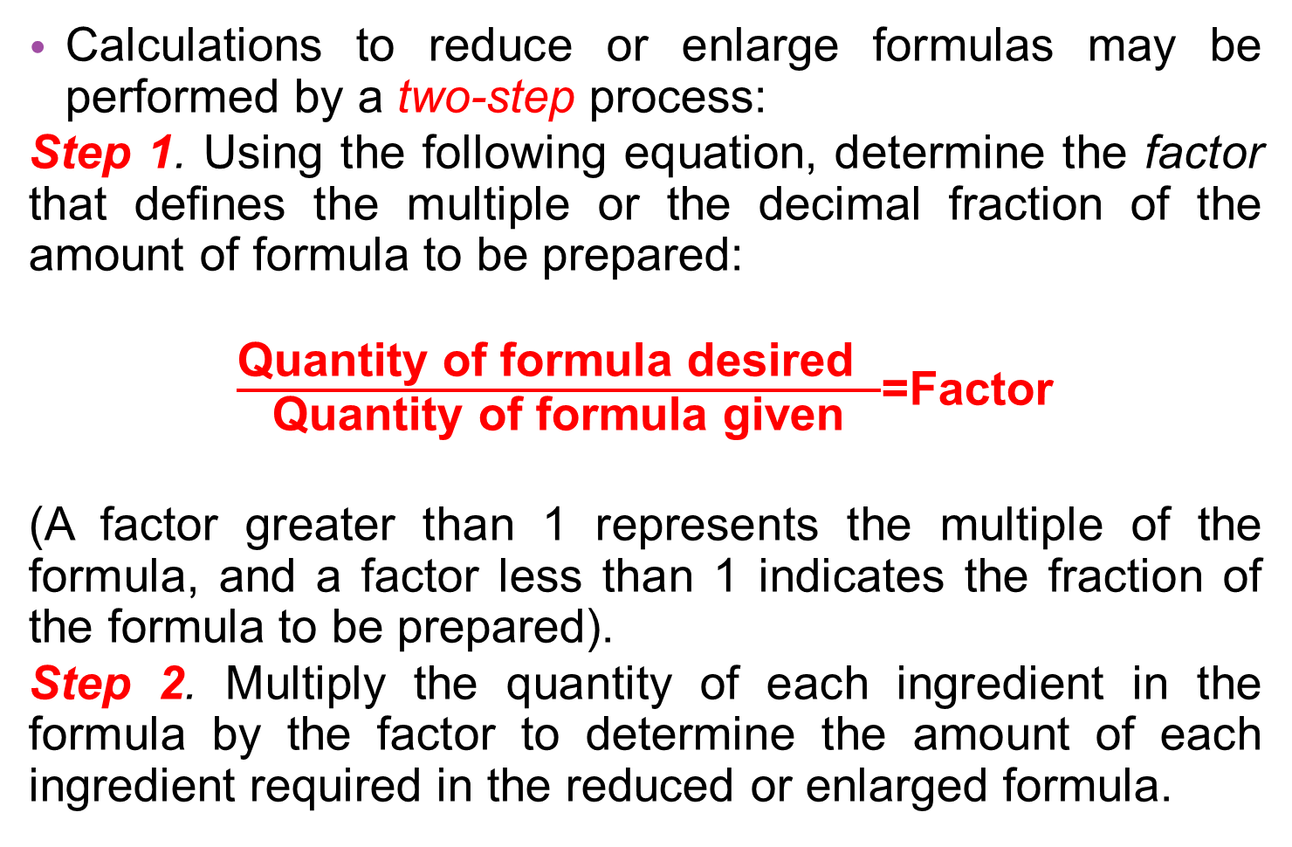
Calculations to reduce or enlarge formulas may be performed by a two-step process:
Step 1. Using the following equation, determine the factor that defines the multiple or the decimal fraction of the amount of formula to be prepared:
$\frac{\text{Quantity} \text{of} \text{formula} \text{desired} }{\text{Quantity} \text{of} \text{formula} \text{given}}$=Factor
(A factor greater than 1 represents the multiple of the formula, and a factor less than 1 indicates the fraction of the formula to be prepared).
Step 2. Multiply the quantity of each ingredient in the formula by the factor to determine the amount of each ingredient required in the reduced or enlarged formula.

Slide 4
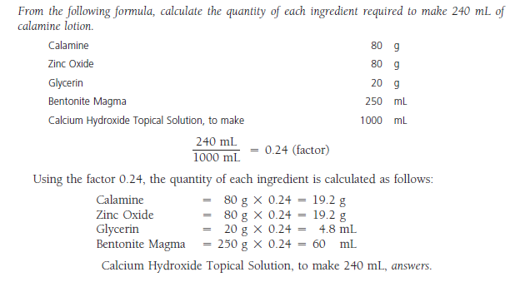

Slide 5
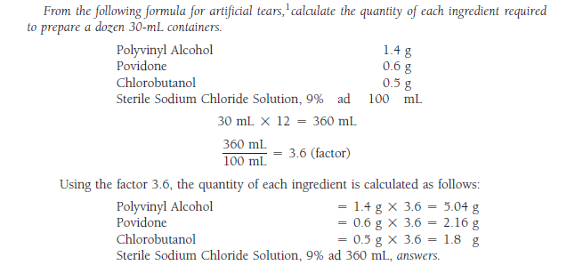

Slide 6
Formulas that specify proportional parts
On occasion, a pharmacist may encounter an old formula that indicates the ingredients in ‘‘parts’’ rather than in measures of weight or volume.
The parts indicate the relative proportion of each of the ingredients in the formula by either weight or volume, but not both.
A formula for solid or semisolid ingredients, therefore, may be considered in terms of grams, whereas a formula of liquids may be considered in terms of millilitres.

Slide 7
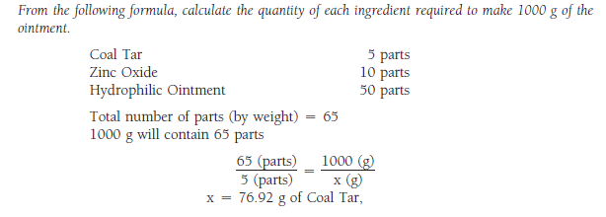
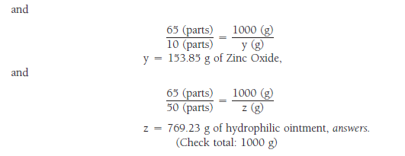

Slide 8
