Slide 1
Residual Titration Method
Lecturer Luma Amer
Department of Pharmaceutical Chemistry/Collage of pharmacy
3rdstage: ^{2nd}lab.

Slide 2
Inorganic Pharmaceutical Chemistry
Practical
Experiment 2
Residual Titration Method
Assay of Zinc Oxide

Slide 3
Residual Titration
A process in which the excess of standard solution used to react with an analyte is determined by titration with second standard solution .

Slide 4
Aim of the Experiment
Aim: The aim of the experiment is to determine the amount of zinc oxide in a pharmaceutical preparation.
Introduction
Zinc oxide, ZnO, is a white powder that is insoluble in water. It is an additive in many industrial uses including food as a source of zinc.
Zinc oxide is a topical agent. A mixture of zinc oxide with 0.5% iron(III) oxide is called calamine. The latter is used as lotion. Zinc oxide can be used in ointments and creams to protect against sunburn and other damage to the skin caused by UV.

Slide 5
Principle
Equation:
ZnO + H₂SO₄ → ZnSO₄ + H₂O
H₂SO₄ + 2 NaOH → Na2SO4 +2 H₂O
When zinc oxide is dissolved with an excess sulphuric acid, a neutralization reaction takes place. The amount of acid remaining is titrated with a standard solution of sodium hydroxide.

Slide 6
Materials Required
Zinc oxide: unknown g
Sulphuric acid: 1N
Sodium hydroxide: 1N
Ammonium chloride: 2.5g
Methyl orange

Slide 7
Procedure:
1- Using sensitive balance NO.1, Weigh accurately about --- g of Zno in a suitable beaker.
2- Using sensitive balance NO.1, Weigh 2.5g of NH₄Cl, in the same baker.
3- Dissolve with 30ml of 1N H₂SO₄ solution in fume hood NO.1 and stir the mixture.
Notice the formation of a turbid solution.
4- Gently heat the resulting mixture using heater NO. 1until a clear solution is obtained.
5-Add two drop of methyl orange solution as indicator. (Fume hood NO.1)
6- Fill the burette with 1 N NaOH, (Fume hood NO.1) and start the titration procedure.
8- complete your calculations.

Slide 8
Procedure (unk.):
1- Dissolve the smple with 50ml of 1N H2SO4 solution and stir the mixture.
Notice the formation of a turbid solution.
2- Gently heat the resulting mixture using hot plate magnetic stirrer until a clear solution is obtained.
3- Transfer 10 ml from previous solution to a conical flask.
4-Add two drop of methyl orange solution as indicator.
5- Fill the burette with 1 N NaOH, and start the titration
procedure.
6- Repeat the previous titration process.
7-calculate the Wt. practical for the sample ZnO if you know that:
The molar mass of ZnO is 81.408 g/mol

Slide 9
1N NaOH
g ZnO +2.5 g NH4Cl
+50 ml 1N H2SO4
heating + 2 drop m.o.

Slide 10
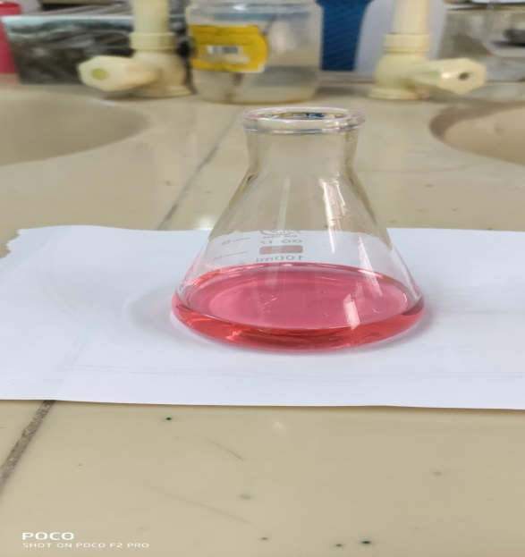
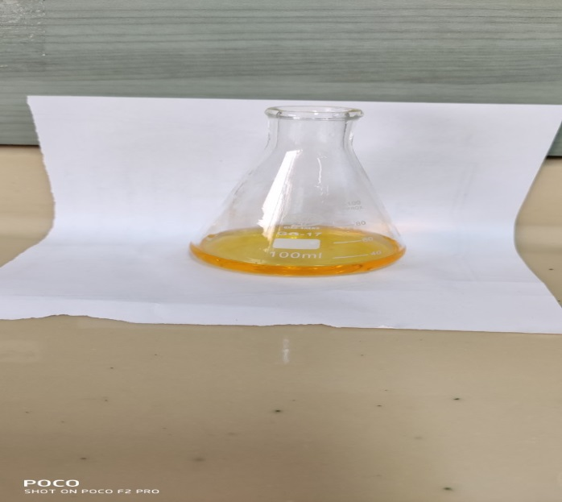
Pink yellow pH=3.2 pH= 4.4
m.o.

Slide 11
calculations
ZnO + H₂SO₄ → ZnSO₄ + H₂O
H₂SO₄ (excess)+ 2 NaOH → Na2SO4 +2 H₂O
mEq. of NaOH = mEq. of H₂SO₄ + mEq. of ZnO
mEq. of ZnO = mEq. of H₂SO₄ - mEq. of NaOH
mEq. of ZnO = N H₂SO₄ * V H₂SO₄ - N _{NaOH} *( V _{NaOH} * 50/10)
= mEq. Of ZnO
Wt. of ZnO mg = mEq. of ZnO * Eq.Wt. of ZnO
Wt. of ZnO mg = mg / 1000 = g
Wt.% = wt. practical / wt. Theoretical *100
Assume wt. Theoretical = 0.5 g ZnO
= 500 mg

Slide 12
Calculations (2)
% ZnO = ( V_{tot}–V_{rem}) x meq.wt x100 / wt of sampl
Where V tot = Total volume of H₂SO₄
V rem = volume of H₂SO₄ react with NaOH

Slide 13
Safety of zinc oxide
Potential Acute Health Effects:
Hazardous in case of inhalation. Slightly hazardous in case of skin contact (irritant), of eye contact (irritant), of ingestion

Slide 14
Safety of ammonium chloride
chemical dangers decomposes on heating. This produces toxic and irritating fumes (nitrogen oxides, ammonia and hydrogen chloride).
Hazardous in case of eye contact (irritant). Slightly hazardous in case of skin contact (irritant, sensitizer), of ingestion, of
inhalation

Slide 15
Safety of sodium hydroxide
Very hazardous in case of skin contact (corrosive, irritant, permeator), of eye contact (irritant, corrosive), of ingestion,of inhalation.
The amount of tissue damage depends on length of contact.
Eye contact can result in corneal damage orblindness.
Skin contact can produce inflammation and blistering.
Inhalation of dust will produce irritation to gastro-intestinal or
respiratory tract, characterized by burning, sneezing and coughing.

