Slide 1
Argentometric methods
Lecturer Luma Amer
Department of Pharmaceutical Chemistry/Collage of pharmacy
3rdstage: ^{5th}lab.

Slide 2

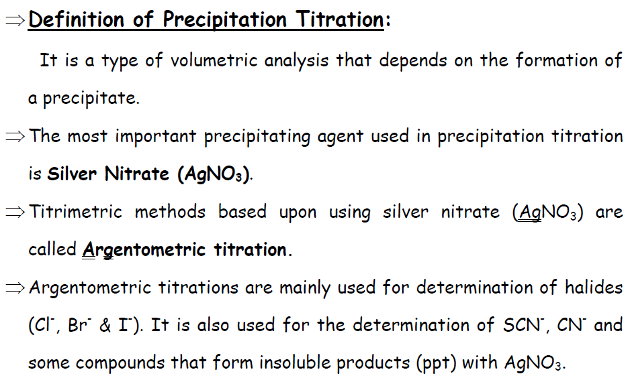
INTRODUCTION

Slide 3
It is, however, interesting to observe here that such reactions do offer limited usage because of the following facts:
(i) Co-precipitation effects do not give a real composition of the precipitate.
(ii) Choice of appropriate indicator is very much limited
(iii) the solubility product that plays a major role in such titration.
The solubility product constant, Ksp​, is the equilibrium constant for a solid substance dissolving in an aqueous solution. It represents the level at which a solute dissolves in solution. The more soluble a substance is, the higher the Ksp value it has.

Slide 4
Parameters that may be considered for a feasible argentometric analysis are:
1-Precipitate formed must be insoluble.
2- Precipitation process should be fast and rapid.
3-Co- precipitation effects must be minimal.
4- Detection f equivalence point must be apparently visible.
Assay methods :
Argentometric titrations may be divided into two class:
(i) Direct titration with silver-nitrate(M0hr's method).
(ii) Ammonium thiocyanate-silver nitrate titrations (Volhard’s Method).

Slide 5
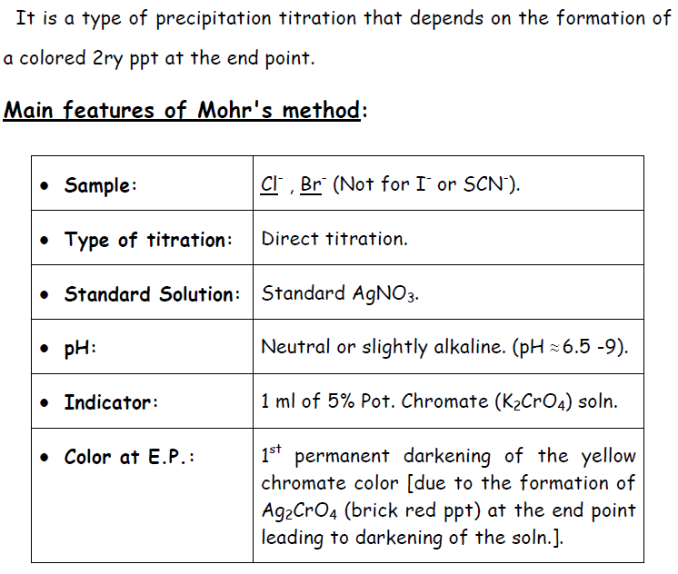
M0hr's method

Slide 6
Silver Nitrate
AgNO3 , M.Wt. 169.87 ,occurs as colorless or white crystals which omebec gray or grayish black on exposure to light , it is very soluble in water , sparingly soluble in alcohol and freely soluble boiling alcohol.
Solution of silver nitrate in concentrations between 0.5N and 1N are used as antibacterial agents.
Q: why silver nitrate is not a primary standard?
Q: After prepare silver nitrate solution, who should you store it?
Caution : silver nitrate is very corrosive , it never to be weighed on an analytical balance .it may damage the balance , it can also burn the skin and it is also expensive so do not waste it

Slide 7
Sodium chloride
A chemical compound with the formula NaCl .sodium chloride is the salt mot responsible for the salinity of the extracellular fluid of many multicellular organisms, it is commonly used as a condiment and food preservative
Q: Can you consider NaCl as a primary standard compound or not ?
sodium chloride white crystals, Odorless.
Very slightly toxic by ingestion. Dust may cause minor irritation to mucous membranes upon inhalation.
potassium chromate: Yellow crystals. Odorless.
Known human carcinogen (IARC-1).
Highly toxic by ingestion. Irritating to body tissues. Sensitizer. Avoid all body contact.

Slide 8
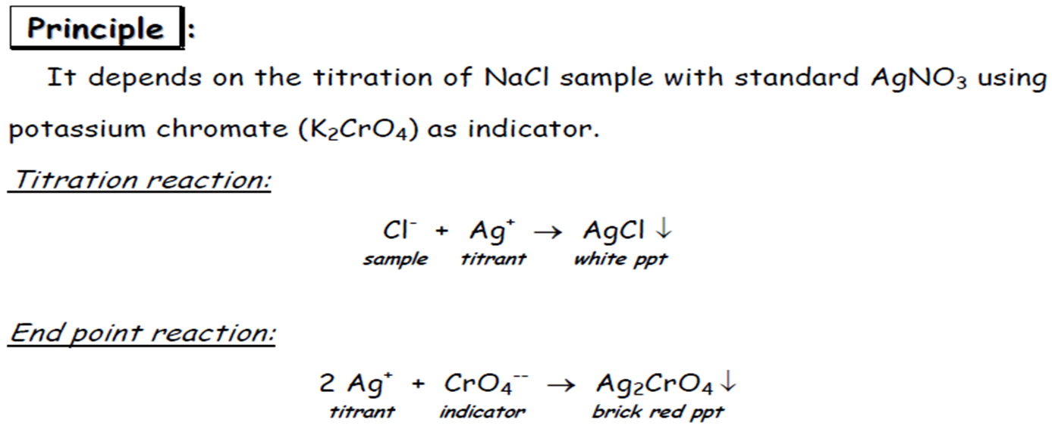
Standardization of silver Nitrate solution

Slide 9
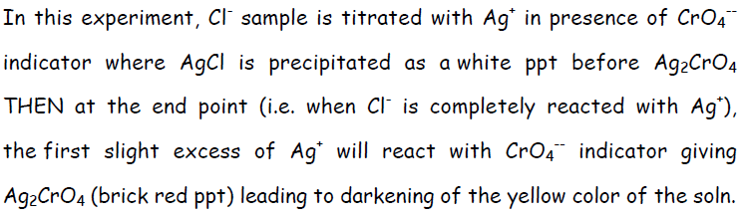
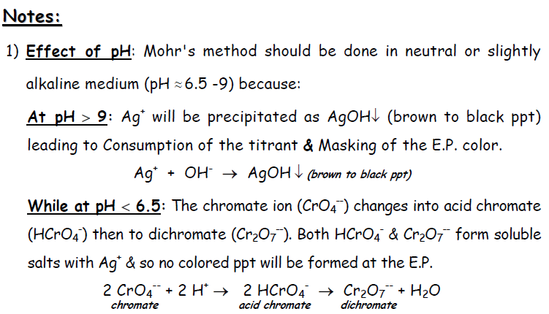

Slide 10
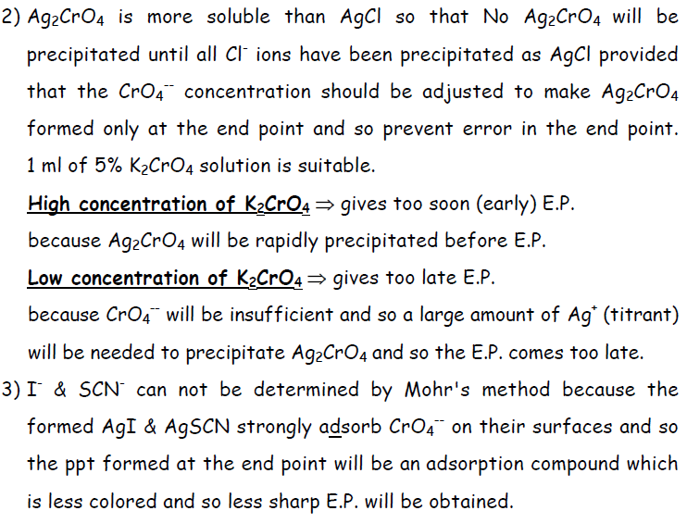

Slide 11
Procedure :
1- From hood NO.1 and using your measuring cylinder transfer 5ml of 0.1 N NaCl solutions to your conical flask.
2- From hood NO.1, add 1ml of 5% potassium chromate (K2CrO4) indicator.
3- Fill the burette about 10 ml of AgNO3 solution from hood NO.1
4- Titrate against AgNO3 solution.
Note: your end point is reached when a brick red precipitate is reached.
4- Complete your calculations.

Slide 12
AgNO3 solution
5 ml of 0.1 NaCl
+ 1 ml 5%K2CrO4

Slide 13
Calculations:
1- Calculate the Normality for AgNO3 .
NV NaCl = NV AgNO3
2- calculate the Wt% for NaCl in your solution
no.Eq. of NaCl = no.Eq. of AgNO3
1eq wt. NaCl ≡ 1eq wt. AgNO3
58.45 g/eq.NaCl ≡ (1000 ml) 1N AgNO3 / 1000
0.05845 g/eq. NaCl ≡ 1 ml 1N AgNO3 / 10 or *0.1N
0.005845 g/eq. NaCl ≡ 1 ml 0.1N AgNO3
W/ V %= wt. Practical / v Theoretical*100
wt. Practical= 0.005845 g/eq .* v (e.p.)

