Slide 1
Introductory Lecture
Lecturer Luma Amer
Department of Pharmaceutical Chemistry/Collage of pharmacy 1 ^{st} and 3 ^{rd} stage: ^{1st}lab.

Slide 2
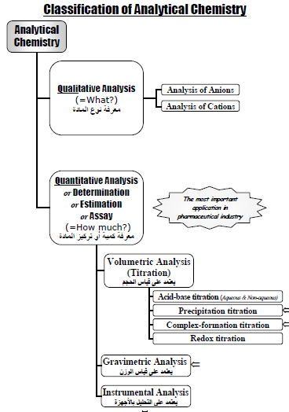

Slide 3
Titration _ What is the benefits of the titration procedure? _ How could you detected the end of the reaction ,the end point? - types of indicator? _ What is the requirements or conditions for primary standard solution?

Slide 4
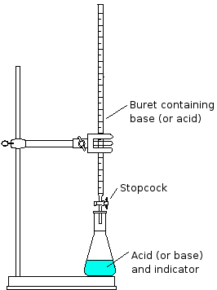

Slide 5
Primary standard like: _ Base :Anhydrous sodium carbonate, Na2CO3 _ Acid : Hydrated oxalic acid, ( COOH)2 .2H2O _ Oxidizing agent : Potassium dichromate, K2CrO7 _ Reducing agent :Sodium oxalate, Na2C2O4 _ Precipitating agent: Sodium chloride, NaCl Non standard solutions like ?

Slide 6
Method for expression of concentration : _ Formality _ Molarity _ Normality _ Percent concetration:1- ,2- ,3- Equivalent weight for chemicals _ Acids _ Bases _ salts _ Redox reagent

Slide 7
Q : How can you describe the eq. wt. for: 1. Acid 2.Base 3.Salt , with example?

Slide 8
Q: Discuss briefly the properties of primary standard solution?

