Slide 1
Assay of Citric Acid
Lecturer Luma Amer
Department of Pharmaceutical Chemistry/Collage of pharmacy 3 ^{rd} stage
Lecturer Luma Amer
2023-2024

Slide 2
Introduction
Citric acid (C6H8O7, m. wt. = 192.09) is a white crystalline powder .
It is very soluble in water and freely soluble in alcohol.
its solutions are strongly acidic ?
Citric acid is a weak organic acid found naturally in citrus fruits such as lemons and oranges.
Citric acid also finds applications in pharmaceuticals, cosmetics, and various industrial processes.

Slide 3
Citric acid is commonly used in effervescent salts because it releases carbonates. It is also used to dissolve kidney stones.
Citric It has a sour taste.
It is available as the anhydrous form or monohydrate form.
Assay of citric acid is based on the anhydrous form.
it is a naturally occurring component of metabolism in almost all living things.(Krebs cycle).

Slide 4
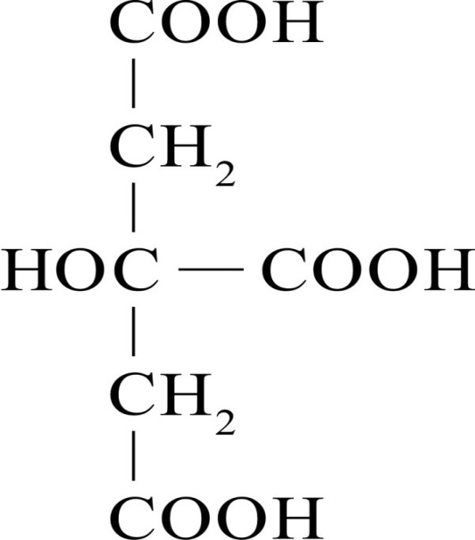
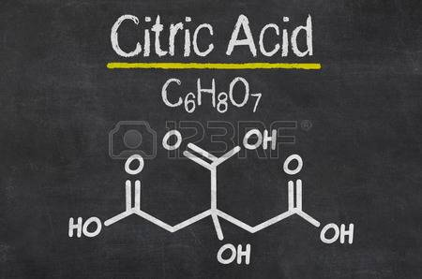
Chemical formula
C6 H8 O7 (anhydrous)
C6 H8 O7 · H2O (monohydrate)
Structural formula
192.1 g / mol

Slide 5
Chemical principle
Titration Method help to determine the concentration or purity of citric acid in a given sample.
Since citric acid has strong acid properties, it is titrated against a standard basic solution like 0.5N NaOH solution in an acid- base reaction using phenolphthalein solution as the indicator

Slide 6
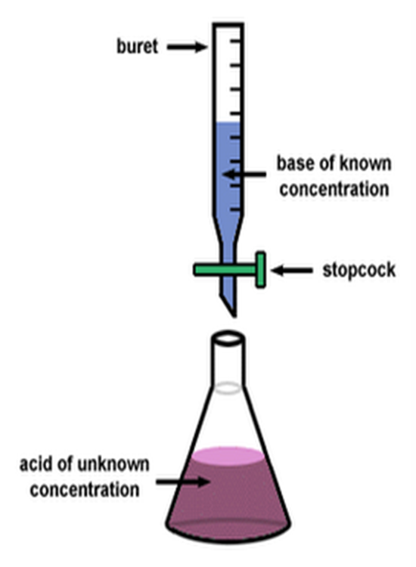
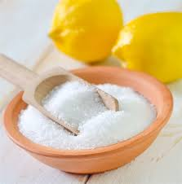
procedure
1- Transfer 10 ml of un known (citric acid solution ) to conical flask .
2- Add 1-2 drop of ph.ph. Indicator.
3- start titration with (0.5) NaOH solution, until you get a faint pink color.
titration apparutus

Slide 7
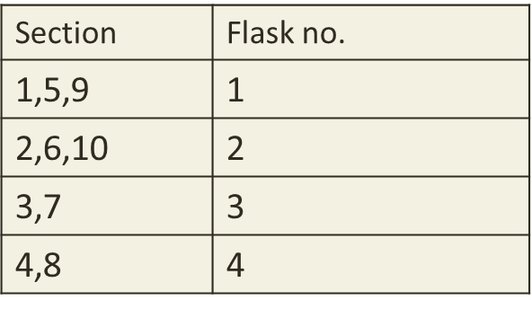
Calculations
Calculate the Wt. practical of citric acid in your sample.
Calculate the normality and the molarity in your sample If you know that:
(C₆H₈O₇, m. wt. = 192.09 g / mol)

