Slide 1
Assay of furosemide
Lecturer Luma Amer
Department of Pharmaceutical Chemistry/Collage of pharmacy 3 ^{rd} stage
Lecturer Luma Amer
2020-2021

Slide 2
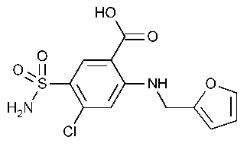
Furosemide (FUR), structurally a sulfonamide
4-chloro-2-[(2-furanylmethyl) amino]-5-Sulphamoyl benzoic acid
Furosemide M. Wt. (330 74g / mol)

Slide 3
Medical uses:
an antibacterial agent.
diuretic ,used to reduce extra fluid in the body caused by conditions such as heart failure, liver disease, and kidney disease.
used to treat hypertension( high blood pressure).
Chemical and Physical Properties:
odorless white to slightly yellow crystalline powder.
melting point 210 C with decomposition.
Practically insoluble in water, methylene chloride.
soluble in acetone, sparingly soluble in ethanol; it dissolves in dilute solutions of alkali hydroxides.
weak acid with an acidic pKa value of 3.8 (carboxylic acid).
Light sensitive, air sensitive.
molecular weight (330.74) g/ mol.
The official methods for the determination of FUR in dosage forms are based on titrimetric spectrophotometry and HPLC

Slide 4
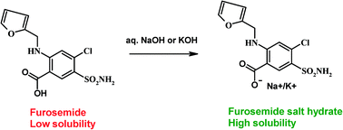
Principle:
furosemide contain acidic group (COOH) so it considered as acid which can be determined by titration against 0.01N NaOH using phenol red as indicator. At the end point the color changes to pink
C12H11ClN2O5S + NaOH (C12H10ClN2O5S) Na + H2O

Slide 5
Procedure:
1.Take one tablet and dissolve this amount in 10 ml of hot alcohol then filter it.
2.Titrate the filtrate with 0.01N NaOH using phenol red as indicator.
phenol red (pH indicator)
below pH 6.8 |  | above pH 8.2
6.8 | ⇌ | 8.2
Calculation:
Furosemide%= practical content/ theoretical

